Slide 1
CS 404/504 Special Topics: Adversarial Machine Learning
Dr. Alex Vakanski

Slide 2
Lecture 12
Privacy Attacks against Machine Learning Models

Slide 3
Lecture Outline
Privacy attacks in AML
Categories of privacy attacks
Membership inference attack
Feature inference attack
Model extraction attack
Causes of privacy leaks
Attacks against distributed learning
Carlini (2020) – Training data extraction attack against GPT-2
Yu (2023) – Training data extraction attack against GPT-Neo

Slide 4
Privacy Attacks in AML
Privacy Attacks in AML
Privacy attacks are also referred to as inference attacks or confidentiality attacks
They can broadly be developed against:
Training data
E.g., reveal the identity of patients whose data was used for training a model
ML model
E.g., reveal the architecture and parameters of a model that is used by an insurance company for predicting insurance rates
E.g., reveal the model used by a financial institution for credit card approval
Privacy attacks are commonly divided into the following main categories
Membership inference attack
Feature inference attack
Model extraction attack

Slide 5
Membership Inference Attack
Categories of Privacy Attacks
Membership inference attack
Adversarial goal: determine whether or not an individual data instance $x^{∗}$ is part of the training dataset $𝒟$ for a model
The attack typically assumes black-box query access to the model
Attacks on both supervised classification models and generative models (GANs, VAEs) have been demonstrated
A common approach is to first train several shadow models that imitate the behavior of the target model, and use the prediction vectors of the shadow models for training a binary classifier (that infers the membership)
Figure form: Liu et al. (2020) When Machine Learning Meets Privacy: A Survey and Outlook

Slide 6
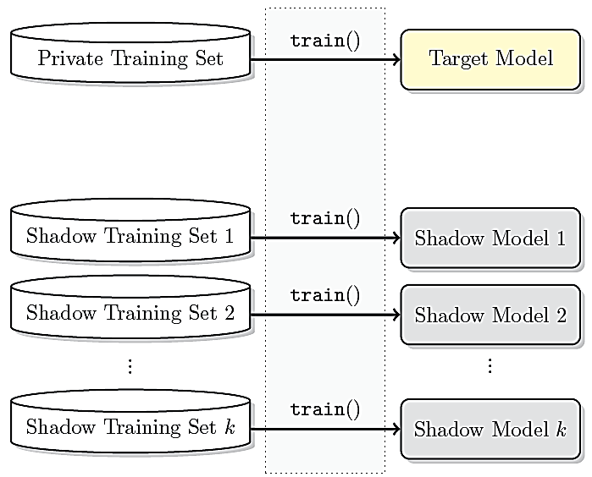
Shadow Training Attack
Membership Inference Attack
Shokri (2016) Membership Inference Attacks Against Machine Learning Models
Threat model:
The adversary has back-box query access to the target model
The goal is to infer whether input samples were part of its private training set
Shadow training approach:
Create several shadow models to substitute the target model
Each shadow model is trained on a dataset that has a similar distribution as the private training dataset of the target model
E.g., if the target model performs celebrity face recognition, the attacker can collect images of celebrities from the Internet
Then, query the target model with images of Brad Pitt, and if the confidence of the target model is high, then probably the private training set contains images of Brad Pitt: use those images for the shadow training sets
Same input instances are used to create shadow training sets for training multiple shadow models

Slide 7
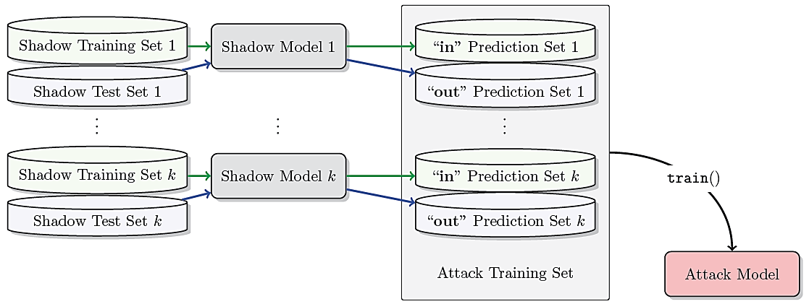
Shadow Training Attack
Membership Inference Attack
The output probability vectors from the shadow models are next used as inputs for training attack models (as binary classifiers) for each class
E.g., the probability vectors for all input images of Brad Pitt from all shadow training sets are labeled with 1 (meaning ‘in’ the training set)
The probability vectors for all input images of Brad Pitt from all shadow test sets are labeled with 0 (meaning ‘out’ or not in the training set)
An attack model is trained on these inputs to perform binary classification (in or out)
A separate attack model is trained for each celebrity person in the shadow training sets

Slide 8
Shadow Training Attack
Membership Inference Attack
The attack models for each class are afterward used to predict whether individual inputs instances were members of the private training set of the target model
The assumption in this attack is that the output probability vectors of the shadow models are different for samples that are members of the shadow training sets, in comparison to samples that are members of the shadow test sets
Experiments showed that increasing the number of shadow models improves the accuracy of membership inference, but it also increases the computational recourses

Slide 9
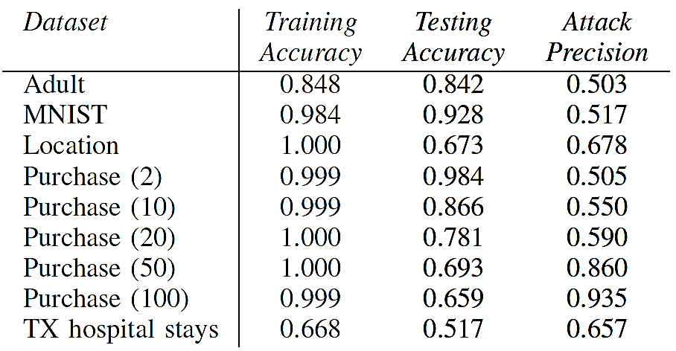
Shadow Training Attack
Membership Inference Attack
The table shows the accuracy of a target model on training and testing sets, and the success of the attack for several models
One can note that the larger the overfitting (difference between the training and testing accuracy), the more successful the membership inference attack is
Conclusively, overfitting not only reduces the generalization of a model, but also makes the model more likely to leak sensitive information about the training data
In addition, the attack was more successful for training datasets that are more diverse and have larger number of classes (e.g., compare Purchase model with 100 classes to Purchase with 2 classes)

Slide 10
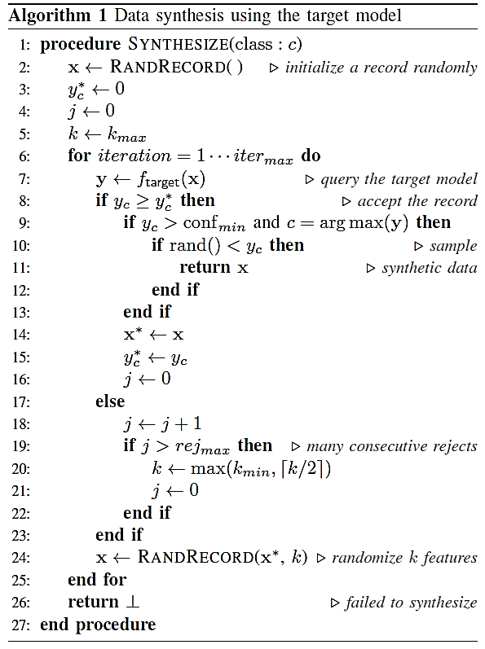
Shadow Training Attack
Membership Inference Attack
If the adversary cannot get access to input samples for creating shadow training sets or to any other statistics about the target data distribution, the authors developed an algorithm for creating synthetic samples by querying the target model
First, for each class, start with a random sample, query the target model and change each input feature until the modified samples are classified with high confidence
Next, randomly change a set of input features, and repeat the procedure to create new samples

Slide 11
Feature Inference Attack
Categories of Privacy Attacks
Feature inference attack
Adversarial goal: recreate certain features of a data instance $x^{∗}$ or statistical properties (such as average value for a class) from the training dataset $𝒟$ for a model
A.k.a. attribute inference attack, reconstruction attack, or data extraction attack
Various attacks were developed to either recover partial information about the training data (such as sensitive features of the dataset, or typical representatives of specific classes in the dataset) or full data samples
An example of a training data extraction attack is described later in this lecture
Similarly, recreating dataset properties that were not encoded in the dataset is also referred to as property inference attack
E.g., extract information about the ratio of men and women in a patient dataset, despite that gender information was not provided in the training records
Figure form: Liu et al. (2020) When Machine Learning Meets Privacy: A Survey and Outlook

Slide 12
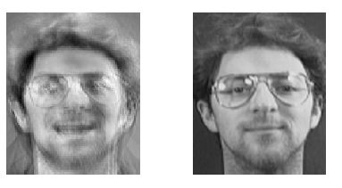
Model Inversion Attack
Feature Inference Attack
Fredrickson (2015) Model Inversion Attacks that Exploit Confidence Information and Basic Countermeasures
Model inversion attack creates prototype examples for the classes in the dataset
The authors demonstrated an attack against a DNN model for face recognition
Given a person’s name and white-box access to the model, the attack reverse-engineered the model and produced an averaged image of that person
The obtained averaged image (left image below) makes the person recognizable
This attack is limited to classification models where the classes pertain to one type of object (such as faces of the same person)
Recovered image using the model inversion attack
Image of the person used for training the model

Slide 13
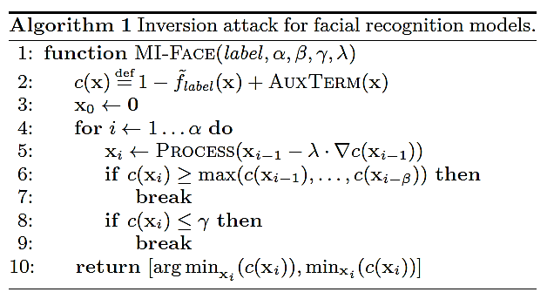
Model Inversion Attack
Feature Inference Attack
The model inversion attack applies gradient descent to start from a given label, and follow the gradient in a trained network to recreate an image for that label
In the algorithm, c denotes the cost function, whereas the PROCESS function applies image denoising and sharpening operations to improve the reconstructed image
Model inversion attack can be used for potential breaches where the adversary, given some access to the model, can infer features that characterize each class

Slide 14
Model Extraction Attack
Categories of Privacy Attacks
Model extraction attack
Adversarial goal: reconstruct an approximated model $f′(x)$ of the target model $f(x)$
A.k.a. model inference attack
The approximated function $f^{′}\left(x\right)$ will act as a substitute model and produce similar predicted outputs as the target model
The adversary has black-box query access to the model
The goal is to “steal” the model and use the substitute model for lunching other attacks, such as synthesis of adversarial examples, or membership inference attacks
Besides creating a substitute model, several works focused on recovering the hyperparameters of the model, such as the number of layers, optimization algorithm, activation types used, etc.
Figure form: Liu et al. (2020) When Machine Learning Meets Privacy: A Survey and Outlook

Slide 15
Causes of Privacy Leaks
Causes of Privacy Leaks
Overfitting is among the main causes of privacy leakage
It leads to poor generalization and memorization of the training data
Although adversarial training is often applied for increasing to model robustness, it reduces the accuracy on clean data, due to the trade-off between the model accuracy and robustness
The reduced accuracy can lead to increased sensitivity to data leakage
Datasets that are more diverse and with larger number of class labels are more susceptible to attacks
I.e., binary classifiers are safer than multiclass models
Input samples that are out-of-distribution (i.e., are considered outliers with respect to the distribution of the training data) are more susceptible to privacy leakage
Model complexity can also impact the vulnerability
Complex models with large number of parameters memorize more sensitive information about the training data

Slide 16
Attacks against Distributed Learning
Attacks against Distributed Learning
Privacy attacks against federated learning and related distributed learning models have also been demonstrated
The attacks can be passive (the adversary collects the updates) and active (the adversary shares information to impact the training procedure)
A malicious attacker who participates in federated learning can perform membership inference attack to reveal if other participants used a data record for training
Nasr (2018) Machine Learning with Membership Privacy Using Adversarial Regularization
Property inference attacks were developed to reveal whether training data with certain properties were used by the other participants
Melis (2019) Exploiting Unintended Feature Leakage in Collaborative Learning
Training data reconstruction attack was accomplished by using an additional GAN model for reconstructing class representative samples from the local dataset used by the other participants
Hitaj (2017) Deep Models Under the GAN: Information Leakage from Collaborative Deep Learning

Slide 17
Training Data Extraction from GPT-2
Training Data Extraction Attack against GPT-2
Training data extraction attack
Carlini (2020) Extracting training data from large language models
Attack on GPT-2 language model (LM)
GPT-2 has 1.5 billion parameters, it is trained on public data collected from the Internet
The goal of the attack is to analyze output text sequences from GPT-2 and identify text that has been memorized by the model
The authors had black-box query access to the GPT-2 model
Successfully extracted data examples include:
Personally identifiable information (PII): names, phone numbers, e-mail addresses
News headlines, log files, Internet forum conversations, code
The extracted information was present in just one document in the training data

Slide 18
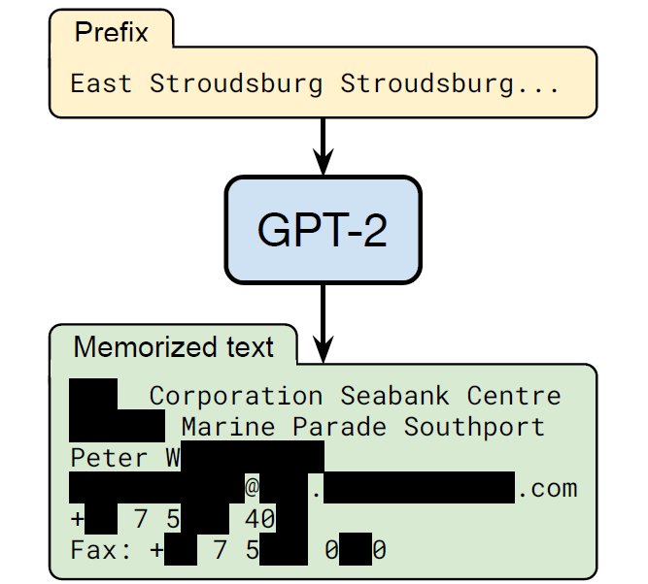
Training Data Extraction from GPT-2
Training Data Extraction Attack against GPT-2
Example of training data extraction
The authors query GPT-2 by entering the prefix: “East Stroudsburg Stroudsburg...”
The model outputted a block of text, which included the full name, phone number, email address, and physical address of the person
This information was included in the training data for GPT-2, it was memorized by the model, and extracted by using the training data extraction attack

Slide 19
Training Data Extraction from GPT-2
Training Data Extraction Attack against GPT-2
The main findings of the study are:
Most of the memorized samples were found in only 1 document in the dataset
However, the samples were repeated multiple times in the document
Out of 1,800 candidate sequences that were manually analyzed by the authors, GPT-2 memorized 600 from the public training data
Larger language models are more vulnerable to data extraction than smaller models
Although LMs are trained on large datasets and therefore they exhibit little overfitting, they can still memorize the training data
Implications:
Training data extraction attacks have previously been limited to small LMs trained on small datasets
It was also believed that LMs do not memorize the data, because they exhibit little overfitting
Recent LMs are increasingly larger, thus, such vulnerabilities can become more significant

Slide 20
Language Models Training
Training Data Extraction Attack against GPT-2
Language models are trained on large training datasets containing raw text scraped from the Internet
LM generate text sequences as fluent natural language
Therefore, are generative ML models
A common approach to train LMs is the “next-step prediction” objective
Given a sequence of tokens (word embeddings) $x_{1},x_{2},…,x_{i−1}$ from a vocabulary $𝒱$, the objective is to estimate the probability of the next token $x_{i}$ in the sequence given the previous tokens, i.e., $𝒫\left(x_{i}|x_{1},x_{2},…,x_{i−1}\right)$
E.g., given the sequence “Marry had a little,” the word “lamb” is the most likely next word in the sequence

Slide 21
GPT-2
Training Data Extraction Attack against GPT-2
GPT-2 (Generative Pre-training Transformer) was released by OpenAI in 2019
It is a family of several models with varying number of parameters, trained using the same dataset
GPT-2 XL: 1.5 billion parameters
GPT-2 Medium: 334 million parameters
GPT-2 Small: 124 million parameters
The training dataset consists of 40 GB of de-duplicated text data
The data is scraped from publicly available sources from the Internet
For the training data extraction attack the authors used GPT-2 XL
It was found that GPT-2 XL memorized 10 times more information than GPT-2 Small

Slide 22
Attack Threat Model
Training Data Extraction Attack against GPT-2
The authors had black-box query access to GPT-2
Objective: extract memorized training data
The strength of the attack is measured based on the number of documents in which the text appeared
Memorizing one word that occurred in many training examples (documents) is not severe
Stronger attack extract text that occurred in one single document
This is referred to as “unintended” memorization
The training data for GPT-2 was collected by OpenAI from public sources
OpenAI didn’t release the training dataset
But they released a document on the data collection process
The authors downloaded the public data by following the documentation
They didn’t have access to the actual dataset used by OpenAI

Slide 23
Attack Approach
Training Data Extraction Attack against GPT-2
Attack approach
Generate many text samples by using prefix prompts to GPT-2
Build 3 datasets of 200,000 generated samples, each sample if 256 tokens long
Sort the generated output text using 6 metrics (see next page)
LM has high confidence when the text is taken directly from the training data
Remove duplicate outputs
For the top 100 outputs, perform an Internet search to confirm whether the generated text is an exact match to a web document
Check with OpenAI to confirm if the extracted text occurred in their training dataset

Slide 24
Attack Approach
Training Data Extraction Attack against GPT-2
Metrics for sorting the predicted text
Perplexity, quantifies the level of “surprise” by the GPT-2 model
Defined as $P=exp\left(−\left(1/n\right){\sum_{i=1}^{n}{{logf}_{θ}\left(x_{i}|x_{1},x_{2},…,x_{i−1}\right)}}\right)$
Comparison to the predictions by GPT-Small and GPT-Medium models
It is less likely that the different models will memorize the same data
Text entropy when the output is compressed using zlib compression
Perplexity when the text is switched from uppercase to lowercase letters
Averaged perplexity using a sliding window of 50 tokens
Other strategies to improve the attack:
Use prompts based on Internet text
The authors used 3 datasets of 200,000 generated samples
For the 6 metrics above, this resulted in 3$×$6 configurations, or 1,800 top samples

Slide 25
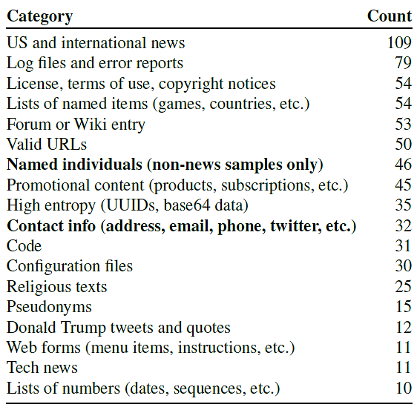
Results
Training Data Extraction Attack against GPT-2
The authors manually inspected 1,800 generated samples from GPT-2
They identified 604 memorized training examples (about 33% of the samples)
The categories of memorized training examples are shown in the table

Slide 26
Results
Training Data Extraction Attack against GPT-2
Examples of memorized content
Personally identifiable information (PII)
Found 78 examples of peoples’ names, phone numbers, addresses, and social media accounts
E.g., extracted the usernames of participants in an Internet forum conversation that appeared in one training document
URLs
50 examples of memorized URLs
Code
Identified 31 samples that contain snippets of memorized source code
Unnatural text
E.g., UUID: 1e4bd2a8-e8c8-4a62-adcd-40a936480059
GPT-2 memorized removed content
The authors extracted content that has been removed from the Internet, but it had been memorized by GPT-2

Slide 27
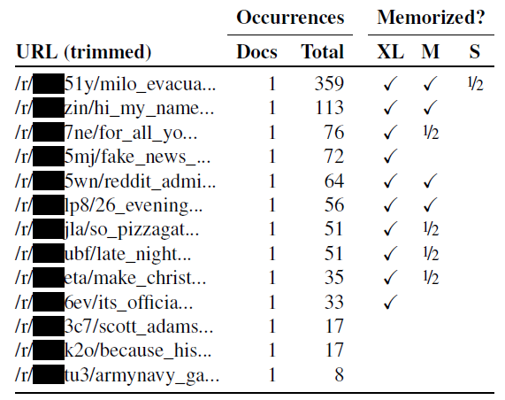
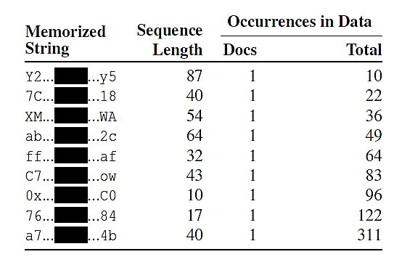
Results
Training Data Extraction Attack against GPT-2
Examples of memorized strings of unnatural text and URLs that occurred in only 1 document in the training data
E.g., in the left table the first extracted string listed has 87 characters, and occurred 10 times in 1 document
In the right table, we can see that GPT-XL model memorized more content than GPT-S and GPT-M models

Slide 28
Mitigation Strategies for Data Leakage
Training Data Extraction Attack against GPT-2
Selecting the training data for LMs
Avoid text from websites that are known to host sensitive data
Apply methods that limit the amount of sensitive content
E.g., filter personal information
De-duplicate content in the training data
Training with differential privacy
DP can reduce, but cannot prevent, memorization of content that occurs often in the dataset
Limitation: reduced accuracy, longer training times
Auditing LMs for memorization
Determine the level of memorization in LMs
E.g., the training data extraction attack can be used to evaluate the level of memorization of an LM

Slide 29
Ethical Considerations and Lessons
Training Data Extraction Attack against GPT-2
The authors contacted the individuals whose PII was extracted and obtained permissions to include it in the paper
All PII in the paper is masked with a black rectangle box
Among the 600,000 generated samples, 604 (or 0.1%) contain memorized text
The authors manually inspected only 1,800 samples
For complete memorization, it was estimated that the content should occur 33 times in one single document
It is important to further study and understand memorization in LMs, and develop prevention strategies

Slide 30
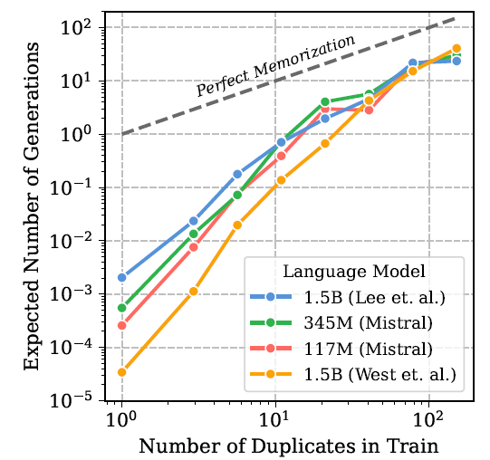
Data Deduplication as Mitigation Strategy
Data Deduplication as Mitigation Strategy
Defense against training data extraction using data deduplication
Kandpal (2022) Deduplicating Training Data Mitigates Privacy Risks in Language Models
This work showed the success of training data extraction attack against GPT-2 was due to the duplication of data in the training set
Deduplicating data samples can significantly reduce the attack success
The figure shows the expected number a text sequence can occur in generated text versus the number of occurrence of that text sequence in the training dataset
There is a linear relationship between these quantities
Perfect Memorization refers to generating a sequence at the same frequency as it appears in the training data

Slide 31
Training Data Extraction from GPT-Neo
Training Data Extraction Attack against GPT-Neo
Training data extraction attack against GPT-Neo
Yu (2023) Bag of Tricks for Training Data Extraction from Language Models
The paper introduced several new techniques for extracting training data from language models
Attacked is GPT-Neo, a language model with 1.2 B parameters
The authors had black-box query-based access to the model
The attack is based on a benchmark for training data extraction
The benchmark defines text prompts and the expected answer
This is called targeted data extraction
As opposed to non-targeted data extraction, where the attacker can select their own text prompts for the attack
Focus is on data that occurs in only one document in the training dataset (1-eidetic memorized data)

Slide 32
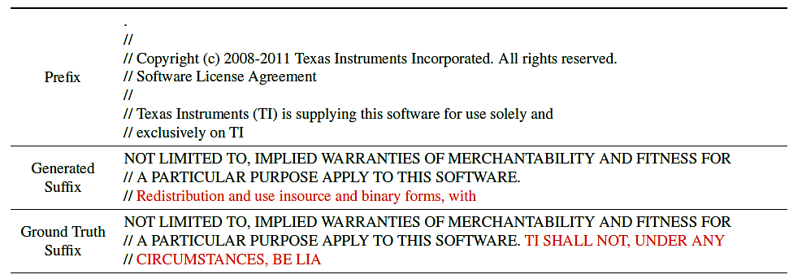
Training Data Extraction from GPT-Neo
Training Data Extraction Attack against GPT-Neo
Attack results
Prefix – prompt to the model
Generated suffix – the answer generated by the proposed attack approach
Ground truth suffix – the actual answer in the training dataset
Red color indicates mismatched text between the generated suffix and the ground truth

Slide 33
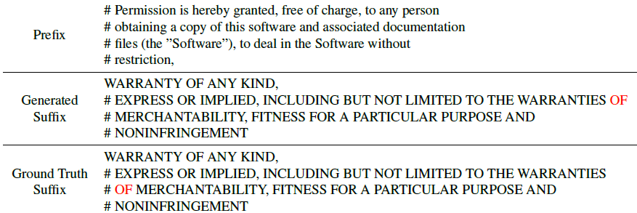
Training Data Extraction from GPT-Neo
Training Data Extraction Attack against GPT-Neo
Additional results from the attack

Slide 34
Approach
Training Data Extraction Attack against GPT-Neo
To generate an answer, language models apply a two-step approach:
Suffix generation - generate a set of candidate answers for a given prefix
A sequence of tokens is generated by sampling from the probability distribution of the tokens in the vocabulary
Suffix ranking - rank the candidate answers based on specific criteria and retain the best answer
Eliminate less likely suffixes based on the perplexity metric
The authors introduced several techniques for data extraction that are applied to either the suffix generation or ranking steps

Slide 35
Evaluation Metrics
Training Data Extraction Attack against GPT-Neo
Metrics that were used to evaluate the attack success
Precision $ℳ_{P}$ - proportion of correctly generated suffixes versus the total number of text prompts (prefixes)
Where a correctly generated suffix is considered identical to the ground truth suffix
Recall $ℳ_{R}$ - proportion of correctly generated suffixes versus the total number of generated suffixes
Hamming distance $ℳ_{H}$ - for two sentences of equal length, the number of positions where the letters differ
It is used to quantify the similarity between the generated and ground truth answers

Slide 36
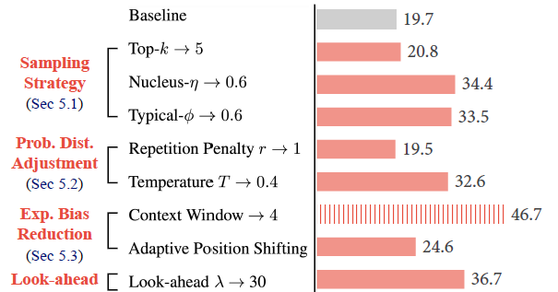
Suffix Generation Step
Training Data Extraction Attack against GPT-Neo
Proposed approaches for improved suffix generation
Sampling strategy (apply constraints to the sampling procedure from the probability distribution for the tokens)
Top-k: limit the number of sampled suffixes to the top-k suffixes, where the top-5 suffixes achieved the best results
Nucleus-η: limit the sampled tokens to a set of tokens with the total probabilities greater than η = 0.6
Typical-ϕ: limit the information content of the sampled tokens based on entropy rate of ϕ = 0.6

Slide 37
Suffix Generation Step
Training Data Extraction Attack against GPT-Neo
Probability distribution adjustment (adjust directly the sampling probability distribution)
Repetition penalty – apply penalty if the next token is a repetition of the previous token
Temperature – decrease the temperature by scaling the logits during suffix generation to reduce the diversity and improve the precision (similarly to the Defensive Distillation method)
Exposure bias reduction
Dynamic context window – adjust the window size (number of previously generated tokens) for generating the next token
Dynamic position shifting – adjust the positional encodings of the tokens, by selecting the positions with the lowest perplexity values
Look-ahead
Use the probability values of the next predicted tokens to inform the generation of the current token

Slide 38
Suffix Ranking Step
Training Data Extraction Attack against GPT-Neo
Introduced new criteria for ranking the generated suffixes to a prefix
Sentence-level criteria
Zlib – use the ratio of perplexity and zlib (entropy of a generated suffix, determined by the Zlib compression algorithm)
Cumprod – use cumulative product of the probabilities of a generated suffix
Token-level criteria
Surprised patterns – encourage tokens with high perplexity (high surprise)
High confidence – encourage generating tokens with a confidence greater than a threshold

Slide 39
Evaluation Results
Training Data Extraction Attack against GPT-Neo
Results from combining different techniques
Combining all techniques does not produce the most accurate suffixes
The best results were obtained by context window + high confidence

Slide 40
References
Liu et al. (2020) When Machine Learning Meets Privacy: A Survey and Outlook (link)
Rigaki and Carcia (2021) A Survey of Privacy Attacks in Machine Learning (link)
Cristofaro (2020) An Overview of Privacy in Machine Learning (link)

