Slide 1
CS 404/504 Special Topics: Adversarial Machine Learning
Dr. Alex Vakanski

Slide 2
Lecture 13
Defenses against Privacy Attacks

Slide 3
Lecture Outline
Defenses against Privacy Attacks
Anonymization techniques
Encryption techniques
Differential privacy
Distributed learning
ML-specific techniques
Jason Starace presentation
Introduction to differential privacy
Lu Cai presentation
Differentially private SGD
Johnny Stuto presentation
Scalable private learning with PATE
Sohag Sharidur
Introduction to federated learning

Slide 4
Defenses against Privacy Attacks
Defenses against Privacy Attacks
Data privacy techniques have the goal of allowing analysts to learn about trends in data, without revealing information specific to individual data instances
Therefore, privacy techniques involve an intentional release of information, and attempt to control what can be learned from the released information
Related to data privacy is the Fundamental Law of Information Recovery, which states that “overly accurate estimates of too many statistics can completely destroy privacy”
I.e., extracting useful information from a dataset (e.g., for training an ML model) poses a privacy risk to the data
There is an inevitable trade-off between privacy and accuracy (i.e., utility)
Preferred privacy techniques should provide an estimate of how much privacy is lost by interacting with data

Slide 5
Defenses against Privacy Attacks
Defenses against Privacy Attacks
Defense strategies against privacy attacks in ML can be broadly classified into:
Anonymization techniques
Encryption techniques
Differential privacy
Distributed learning
ML-specific techniques

Slide 6
Anonymization Techniques
Anonymization Techniques
Anonymization techniques provide privacy protection by removing identifying information in the data
E.g., remove personal identifiable information (PII)
In the example below, the Name and Address columns are removed
User ID | Name | Address | Account Type | Subscription Date
001 | Alice | 123 A St | Pro | 01/02/20
002 | Bob | 234 B St | Free | 02/03/21
003 | Charlie | 456 C St | Pro | 03/04/18

Slide 7
Anonymization Techniques
Anonymization Techniques
Anonymization is not an efficient defense method, since the remaining information in the data can be used for identifying the individual data instances
For example, based on health records (including diagnoses and prescriptions) with removed personal information released by an insurance group in 1997, a researcher extracted the information for the Governor of Massachusetts
This is referred to as de-anonymization
The same researcher later showed that 87% of all Americans can be uniquely identified using 3 bits of information: ZIP code, birth date, and gender
Dataset 1: Users medical database
Dataset 2: Users medical database with name and address removed
User ID | Name | Address | Zip Code | Birth date | Gender | Probable disease ID
001 | Alice | 123 A St | 83401 | 01/02/1997 | F | 120
002 | Bob | 234 B St | 83402 | 02/03/1995 | M | 35
003 | Charlie | 456 C St | 83403 | 03/04/1999 | M | 240
User ID | Zip Code | Birth date | Gender | Probable disease ID
001 | 83401 | 01/02/1997 | F | 120
002 | 83402 | 02/03/1995 | M | 35
003 | 83403 | 03/04/1999 | M | 240

Slide 8
Linkage Attack
Anonymization Techniques
De-anonymization of data by using connections to external sources of information is referred to as linkage attack
For example:
In 2006, Netflix published anonymized 10 million movie rankings by 500,000 customers
Two researchers showed later that by using movie recommendations on IMDb (Internet Movie Database) they could identify the customers in the Netflix data
Dataset 1: Annonymized dataset with removed personal information
Dataset 2: External public dataset that reveals the users in Dataset 1
User ID | Name | Address | Account Type | Subscription Date
001 | Alice | 123 A St | Pro | 01/15/20
002 | Bob | 234 B St | Pro | 02/03/21
003 | Charlie | 456 C St | Free | 03/04/18
User ID | Product Name | Product Price | Purchase Date
001 | TV | 400 | 01/02/20
002 | Iphone | 1,199 | 02/02/21
003 | Watch | 130 | 02/22/18

Slide 9
k-anonymity
Anonymization Techniques
k-anonymity is an approach for protecting data privacy by suppressing certain identifying data features
This approach removes fields of data for individuals who have unique characteristics
E.g., students at UI who are from Latvia and are enrolled in Architecture
A dataset is k-anonymous if for any person’s record, there are at least $k−1$ other records that are indistinguishable
Limitation: this approach is mostly applicable to large datasets with low-dimensional input features
The more input features there are for each record, the higher the possibility of unique records

Slide 10
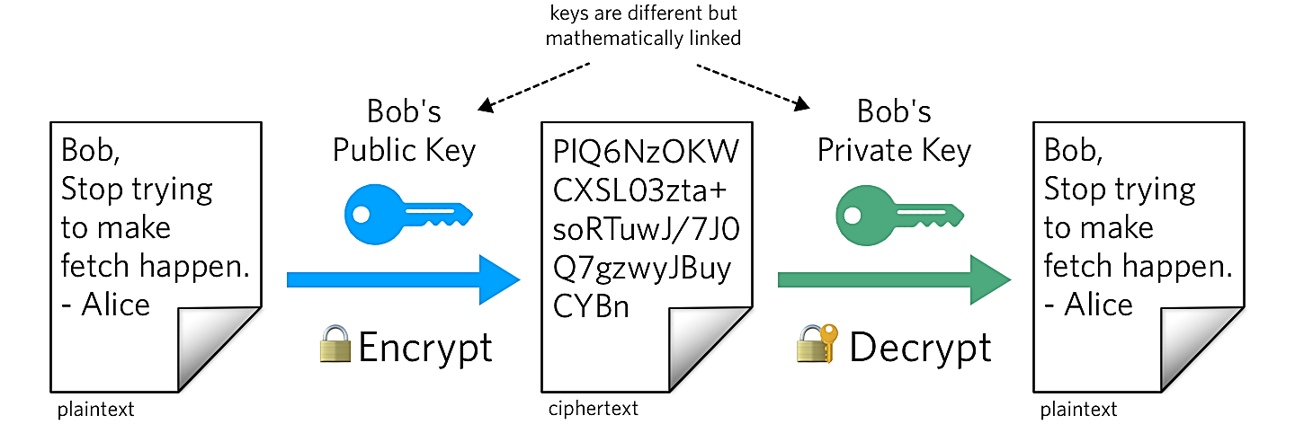
Encryption Techniques
Encryption Techniques
Encryption is a cryptography approach, which converts the original representation of information into an alternative form
The sender of encrypted information shares the decoding technique only with the intended recipients of the information
Encrypting the training data has been applied in ML
Common techniques for data encryption include:
Homomorphic encryption (HE)
Secure multi-party computation (SMPC)
Encrypting ML models is less common approach
Homomorphic encryption has been applied to the model gradients in collaborative DL setting to protect the model privacy
Figure form: What is Public Key Cryptography?

Slide 11
Homomorphic Encryption
Encryption Techniques
Homomorphic encryption (HE) allows users to perform computations on encrypted data (without decrypting it)
Encrypted data can be analyzed and manipulated without revealing the original data
HE uses a public key to encrypt the data, and applies an algebraic system (e.g., additions and multiplications) to allow computations while the data is still encrypted
Only the person who has a matching private key can access the decrypted results

Slide 12
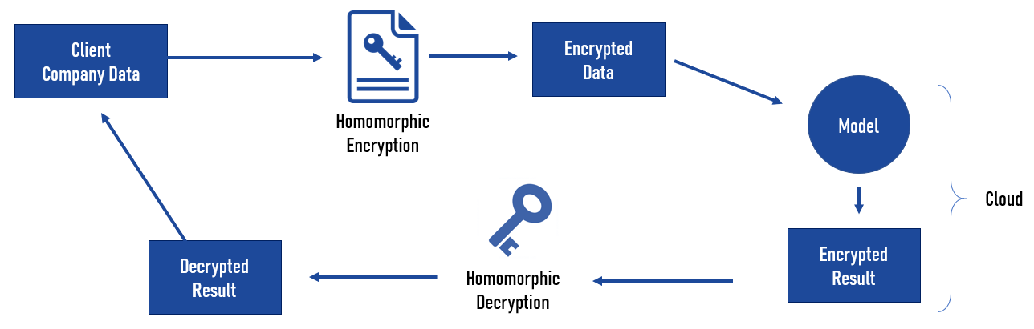
Homomorphic Encryption
Encryption Techniques
In ML, training data can be encrypted and send to a server for model training
Even if the server is untrusted or it is compromised, confidentiality of the data will remain preserved
One main limitation of HE is the slowing down of the training process
HE has been applied to traditional ML approaches, such as Naïve Bayes, Decision Trees
Training DNNs over encrypted data is still challenging, due to the increased computational complexity
Figure form: Homomorphic Encryption & Machine Learning: New Business Models

Slide 13
Privacy versus Confidentiality
Encryption Techniques
Encryption techniques in ML are mainly applied to protect the confidentiality of the data or model
Confidentiality refers to keeping the information (training data, model parameters) hidden from the clients and the public
It is ensuring that only authorized parties have access to the information
E.g., a server has an ML model trained on private data and provides the model to a client for inference
It is preferred to preserve the confidentiality of the model parameters from the client
Privacy refers to intentional release of information in a controlled manner to prevent unintended information leakage
It is ensuring that released data cannot uniquely identify individual inputs
E.g., a server applies Differential Privacy to a trained ML model to prevent memorization of information about individual inputs
Protecting privacy is more challenging than protecting confidentiality

Slide 14
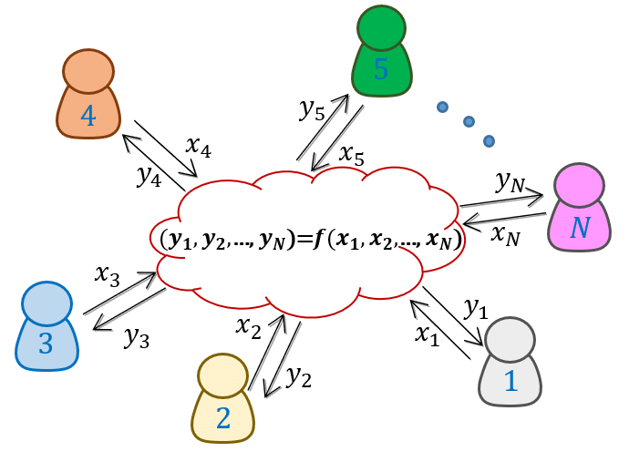
Secure Multi-Party Computation
Encryption Techniques
Secure Multi-Party Computation (SMPC) is an extension of encryption in multi-party setting
SMPC allows two or more parties to jointly perform computation over their private data, without sharing the data
E.g., two banks want to know if they have both flagged the same individuals and learn about the activities by those individuals
The banks can share encrypted tables of flagged individuals, and they can decrypt only the matched records, but not the information for individuals that are not in both tables
Figure form: Generation and Distribution of Quantum Oblivious Keys for Secure Multiparty Computation

Slide 15
Secure Multi-Party Computation
Encryption Techniques
SMPC versus HE
SMPC protects the privacy of the data in collaborative learning
E.g., participants in collaborative learning do not trust the other participants or the central server
HE protects the confidentiality of the data from external adversaries
E.g., a data owner wants to use a MLaaS (Machine Learning as a Service), but does not trust the service provider: (1) the owner sends encrypted data, (2) the provider processes encrypted data and sends back encrypted results, (3) the owner decrypts the results
Or, a bank can store encrypted banking information in the cloud, and use HE to ensure that only the employees of the bank can access the data

Slide 16
Secure Multi-Party Computation
Encryption Techniques
In ML, SMPC can be used to compute updates of the model parameters by multiple parties that have access to their private data
For examples, SMPC has been applied to federated learning, where participants encrypt their updates, and the central server can recover only the sum of the updates from all participants
Beside the data privacy, SMPC also offers protection against adversarial participants
Either all parties are honest and can jointly compute the correct output, or if a malicious party is dishonest the joint output will be incorrect
SMPC has been applied to traditional ML models, such as decision trees, linear regression, logistic regression, Naïve Bayes, k-means clustering
Application of SMPC to deep NNs is challenging, due to increased computational costs

Slide 17
Differential Privacy
Differential Privacy
Differential privacy is based on employing obfuscation mechanisms for privacy protection
A randomization mechanism $ℳ\left(D\right)$ applies noise $ξ$to the outputs of a function $f\left(D\right)$ to protect the privacy of individual data instances, i.e., $ℳ\left(D\right)=f\left(D\right)+ξ$
Commonly used randomization mechanisms include Laplacian, Gaussian, and Exponential mechanism
DP is often implemented in practical applications
Examples include:
2015: Google, for sharing historical traffic statistics
2016: Apple, for improving its Intelligent Personal Assistant technology
2017: Microsoft, for telemetry in Windows
2020: LinkedIn, for advertiser queries
2020: U.S. Census Bureau, for demographic data

Slide 18
DP Example
Differentially Private SGD
$D_{1}$ (includes Bob)
Consider two databases $D_{1}$ and $D_{2}$ that show if a person has diabetes or not
The only difference between the two databases is that $D_{2}$ does not include the last record in $D_{1}$ (for Bob)
Let’s assume that the databases are publicly available for making queries
To protect patient identities, it is not allowed to query the patient names
However, an adversary can query the sum of the persons with diabetes in the first database (e.g., $f\left(D_{1}\right)=64$), and the sum in the second database (e.g., $f\left(D_{2}\right)=63)$
Based on the difference $f\left(D_{1}\right)−f\left(D_{2}\right)=64−63=1$, the adversary can infer that Bob has diabetes
Alternatively, if $f\left(D_{1}\right)=63$ and $f\left(D_{2}\right)=63$, the adversary can infer that Bob does not have diabetes
Name | Has Diabetes
Don | 1
Monica | 0
…
…
Chris | 1
Bob | 1
$D_{2}$ (without Bob)
Name | Has Diabetes
Don | 1
Monica | 0
…
…
Chris | 1

Slide 19
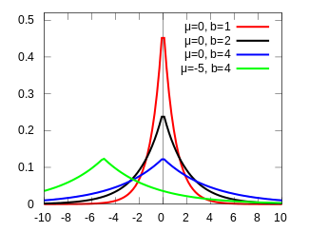
DP Example (cont’d)
Differentially Private SGD
An algorithm that is differentially private adds noise to the answers for $f\left(D_{1}\right)$ and $f\left(D_{2}\right)$ to make it difficult to infer the information about Bob
I.e., a randomization mechanism $ℳ\left(D\right)$is selected to add noise $ξ$to the output answers to queries $f\left(D\right)$, that is, $ℳ\left(D\right)=f\left(D\right)+ξ$
Additive noise $ξ$ from a Laplacian distribution (shown) is commonly applied
E.g., let’s assume a privacy budget $ε=0.5$and let’s sample noise from a Laplacian distribution with $μ=0$ and scale $b=1/ε=1/{0.5}=2$
6 random noise samples are: $ξ∈\left\{−0.13, 2.06, −1.67, −2.49, −0.52, 0.37\right\}$
Consider 3 queries by the adversary having the outputs $f\left(D_{1}\right)=64$and $f\left(D_{2}\right)=63$with added Laplacian noise $ξ$:
$ℳ\left(D_{1}\right)−ℳ\left(D_{2}\right)=63.87−65.06=−1.19$
$ℳ\left(D_{1}\right)−ℳ\left(D_{2}\right)=62.33−60.51=1.82$
$ℳ\left(D_{1}\right)−ℳ\left(D_{2}\right)=63.48−63.37=0.11$
Based on the differences between the randomized outputs from the queries for $D_{1}$ and $D_{2}$, now it is impossible for the adversary to tell if Bob has diabetes
$$Pr\left(ξ\right)$$
$$ξ$$

Slide 20
DP Mechanism
Differentially Private SGD
The important question in DP is: how much noise to add?
The amount of noise $ξ$depends on the data, and it needs to be adjusted
E.g., a function $f_{1}\left(D\right)$that provides the yearly income of people in thousands of dollars would require different level of noise than a function $f_{2}\left(D\right)$that provides the height in feet
The sensitivity of the function $f$determines how much the output $f\left(D\right)$changes by adding a single data instance
Sensitivity is defined as $∆f=max{\left\|f\left(D_{1}\right)−f\left(D_{2}\right)\right\|}_{1}$ for all possible datasets $D_{1}$ and $D_{2}$ differing in one data instance, where ${\left\|∙\right\|}_{1}$ denotes $ℓ_{1}$-norm
E.g., for the example with medical diabetes records, the sensitivity is $∆f=1$, since the sum of the people with diabetes can change only by 1 when a single input is added
A Laplacian mechanism that is $ε$-differentially private adds a Laplacian noise with scale $b={∆f}/ε$
Note that if the privacy budget $ε$ has smaller values, this will result in larger amount of Laplacian noise $ξ$ added to $f\left(D\right)$
Thus, the noisy outputs $ℳ\left(D\right)$ will reveal less private information about the inputs (i.e., provide better privacy protection), but also the noisy answers to the queries $ℳ\left(D\right)$will be less accurate

Slide 21
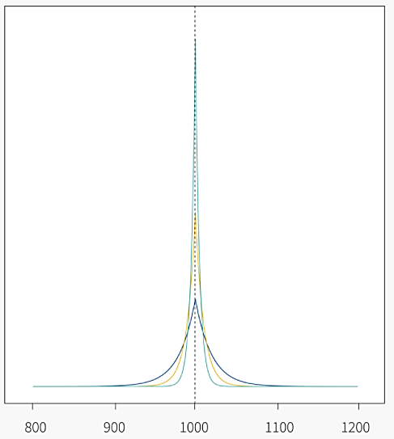
DP with Laplacian Randomization
Differentially Private SGD
The figure shows the probability distributions of the outputs $ℳ\left(D\right)$ for three different levels of Laplacian noise with $ε∈\left\{0.05, 0.1, 0.2\right\}$
The true output value is $f\left(D\right)=1,000$
Larger values of $ε$ have distributions that are tighter around the true value of $f\left(D\right)=1,000$ in the figure, and hence are more accurate, but leak more privacy
A mechanism $ℳ\left(D\right)$ is $ε$-differentially private if for all databases $D_{1}$ and $D_{2}$ that differ by at most one instance, and for any subset of outputs S:
$Pr\left(ℳ\left(D_{1}\right)∈S\right)≤e^{ε}$ $Pr\left(ℳ\left(D_{2}\right)∈S\right)$
In other words, $ε$-differential privacy ensures that the probabilities of any two outputs $ℳ\left(D_{1}\right)$ and $ℳ\left(D_{2}\right)$ differ by at most $e^{ε}$
E.g., for $ε=0.05$, ${Pr\left(ℳ\left(D_{1}\right)\right)}/{Pr\left(ℳ\left(D_{2}\right)\right)}$is at most $e^{0.05}=$ 1.05
Smaller $ε$ ensures more similar outputs $ℳ\left(D_{1}\right)$ and $ℳ\left(D_{2}\right)$, and provides higher levels of privacy
$$Pr\left(ℳ\left(D\right)\right)$$
$$ℳ\left(D\right)$$

Slide 22
DP with Gaussian Randomization
Differentially Private SGD
There are other DP mechanisms besides the Laplacian mechanism, that are more suitable for some applications
The Gaussian mechanism adds Gaussian noise instead of Laplacian noise, and the level of noise is based on the $ℓ_{2}$-norm sensitivity, instead of $ℓ_{1}$-norm
A Gaussian mechanism is $\left(ε,δ\right)$-differentially private if for all databases $D_{1}$ and $D_{2}$ that differ by at most one instance, and for any subset of outputs S:
$Pr\left(ℳ\left(D_{1}\right)∈S\right)≤e^{ε}$ $Pr\left(ℳ\left(D_{2}\right)∈S\right)+δ$
The $\left(ε,δ\right)$-differential privacy that is provided by the Gaussian mechanism introduces the probability parameter $δ$
Informally, $\left(ε,δ\right)$-differential privacy is guaranteed with probability $1−δ$
E.g., for $δ=0.05$, the method is 𝜀-differentially private with 95% probability
The Gaussian mechanism is therefore weaker than the Laplacian mechanism, since it allows scenarios when the privacy cannot be guaranteed

Slide 23
DP in Machine Learning
Differentially Private SGD
Training ML models can be considered an extension of the previous example on querying databases
I.e., ML models use data to learn a function, which is afterward used for prediction
The datasets for training ML models often contain sensitive information (e.g., medical records, personal information), so it is important to provide privacy guarantees
On the other hand, we know that ML models can memorize the training data, which can be exploited by adversaries to recover information about the data from a trained model
The challenge is: how to extract enough information from data to train accurate ML models without revealing the data

Slide 24
DP in Machine Learning
Differential Privacy
In ML, DP is achieved by adding noise to:
Model parameters
Several works applied DP to conventional ML methods
Differentially private SGD (Abadi, 2016) clips and adds noise to the gradients of deep NNs during training
This reduces the memorization of individual input instances by the model
The approaches that apply obfuscation to the model parameters via DP are also referred to as differentially private ML
Model outputs
PATE (Private Aggregation of Teacher Ensembles) approach (Papernot, 2018) employs an ensemble of models trained on disjoint subsets of the training data, called teacher models
Noise is added to the outputs of the teacher models, and the aggregated outputs are used to train another model, called student model
Training data
Obfuscation of training data in ML has been also investigated in several works

Slide 25
DP in Machine Learning
Differential Privacy
DP is typically applied in a centralized learning setting, where the data and model are at the same location
In this scenario, all data is gathered in one central location for model training
E.g., MLaaS typically requires that the users upload their data to a cloud-based server for training a model
Recently, DP has also been applied in a distributed learning setting, where the data are kept at separate locations from the model
DP-FedAvg (McMahan, 2018) is applied to federated learning
It introduced the Federated Averaging algorithm to limits the contributions by the data from individual users to the learning model

Slide 26
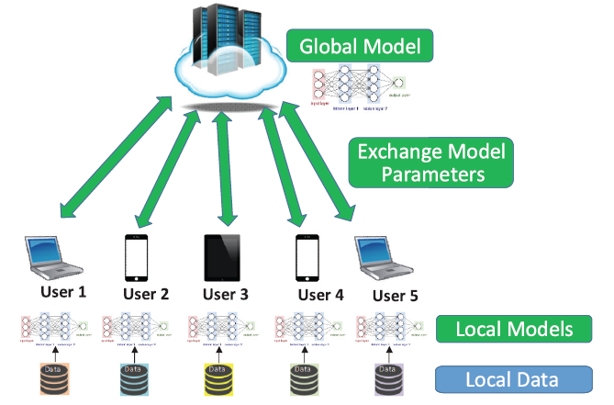
Distributed Learning
Distributed Learning
Distributed learning allows multiple parties to train a global model without releasing their private data
Some form of aggregation is applied to the local updates of the model parameters by the users in distributed learning to create a global model
E.g., averaging is one common form of aggregation
Federated learning is the most popular distributed learning scheme
Figure form: Liu et al. (2020) When Machine Learning Meets Privacy: A Survey and Outlook

Slide 27
Distributed Learning
Distributed Learning
Federated learning or collaborative learning – learn one global model using data stored at multiple locations (e.g., remote devices)
The data are processed locally, and used to update the model
The data do not leave the remote devices, remains private
The central server aggregates the updates and creates the global model
Decentralized Peer-to-Peer (P2P) learning – the remote devices communicate and exchange the updates directly, without a central server
Removes the need to send updates to a potentially untrusted central server
Split learning – each remote device is used to train several layers of the global model, and send the outputs to a central server
The remote devices can train the initial layers of a DNN, and the central server can train the final layers
The gradient is back-propagated from the central server to each user to sequentially complete the back-propagation through all layers of the model
The devices send the intermediate layers outputs, rather than model parameters
Split learning is more common for IoT devices with limited computational resources

Slide 28
ML-Specific Techniques
ML-Specific Techniques
In the lecture on privacy attacks in ML, we mentioned that overfitting is one of the reasons for information leakage
Regularization techniques in ML can therefore be used to reduce overfitting, as well as a defense strategy
Different regularization techniques in NNs include:
Explicit regularization: dropout, early stopping, weight decay
Implicit regularization: batch normalization
Other ML-specific techniques include:
Dimensionality reduction – removing inputs with features that occur rarely in the training set
Weight-normalization – rescaling the weights of the model during training
Selective gradient sharing – in federated learning, the users share a fraction of the gradient at each update

Slide 29
References
Liu et al. (2020) When Machine Learning Meets Privacy: A Survey and Outlook (link)
Rigaki and Carcia (2021) A Survey of Privacy Attacks in Machine Learning (link)
Cristofaro (2020) An Overview of Privacy in Machine Learning (link)
Borealis AI Tutorial #13: Differential Privacy II: Machine Learning and Data Generation (link)
Davide Testuggine and Ilya Mironov blog: Differential Privacy Series Part 1-DP-SGD Algorithm Explained (link)
Joseph P. Near and Chiké Abuah, Programming Differential Privacy – Chapter III: Differential Privacy (link)

Slide 30
Differential privacy
Jason starace

Slide 31
Differential Privacy
Topics
What is Differential Privacy
History of
In English
Formally
Fundamentals
Laplace Randomization
Approximate Differential Privacy
Privacy Loss as a random variable
Gaussian/Binomial noise
A real use case
Deep Learning with Differential Privacy

Slide 32
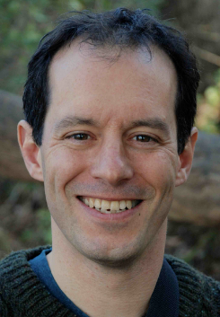
What is differential privacy
History
The definition of differential privacy came from a long line of work applying algorithmic ideas to the study of privacy [1], culminating with the work of:
Cynthia Dwork
Frank McSherry
Kobbi Nissim
Adam Smith
Source: Harvard Radcliffe Institute
Source: github.com/frankmcsherry
Source: CRCS
Source: Boston University
With their 2006 paper titled “Calibrating Noise to Sensitivity in Private Data Analysis”. The paper has since been revised and updated over the years with responses and additional information
Notes:
The need for privacy and
In this presentation I will be focusing more on the recent works of Dwork, McSherry, Nissim & Smith.
2 Types of privacy to consider ->
An individual's privacy when examining data for trends and/or statistical research (ML distinguish images of cancerous from non-cancerous cells)
Exploring data looking for a ’bad actor’ and protecting the privacy of the non-bad actors
Differential privacy covers the first.

Slide 33
What is differential privacy
So What is it?
English language definition:
“The outcome of any analysis is essentially equally likely, independent of whether any individual joins, or refrains from joining, the dataset” [4]
Notes:
We’ll learn essentially the same things about the dataset, if someone joins or doesn’t join the survey.
Which really goes to the core of statistical analysis, if the outcome of a query is changed by the addition or removal of 1 datapoint was the data really an accurate representation of the population

Slide 34
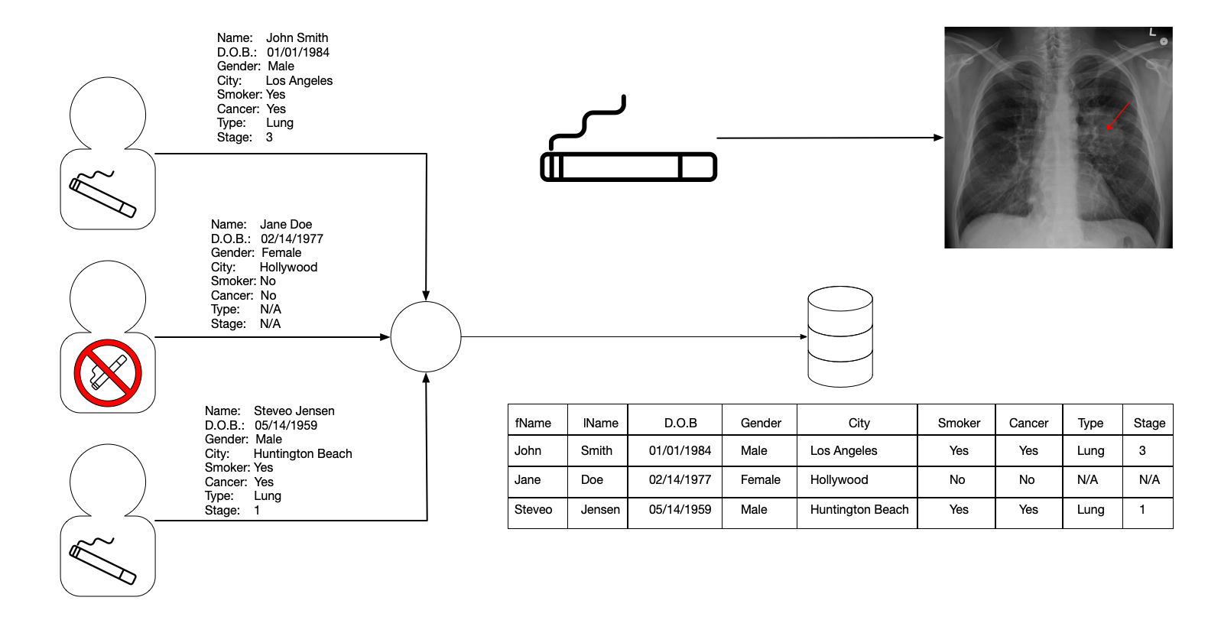
What is differential privacy
So What is it?

Slide 35
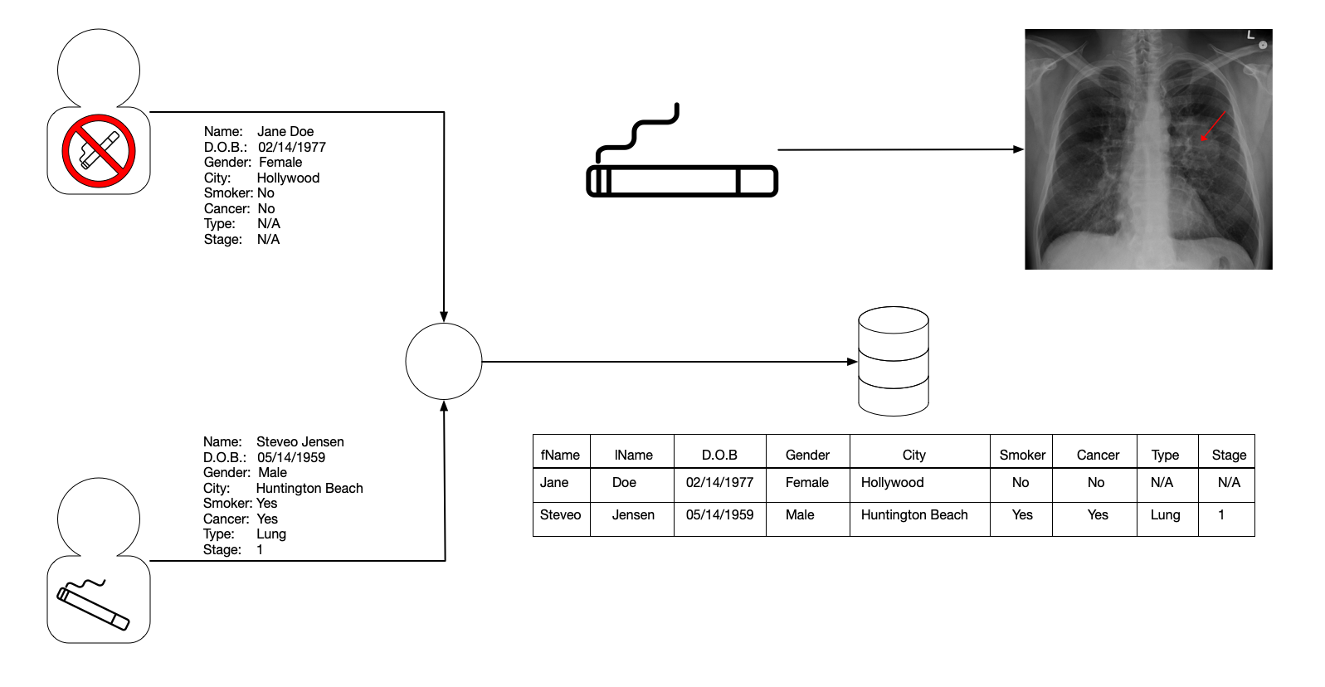
What is differential privacy
So What is it?
Notes:
With differential privacy we make a guarantee that even if an analyst knows all the data contained in both datasets
With John and 1 without John
The analyst cannot tell which database is being called to answer their queries. If the analyst can’t tell when they know all this, then clearly nothing is being leaked when they don’t know this information and is private

Slide 36
What is differential privacy
Key Terms [5]
$x, x^{′}, y, y′$ - (Adjacent) Datasets that are nearly identical. The first dataset is slightly larger by 1 record.
$ε$ - Privacy loss - Some value that is $≥0$
$ℳ$ - Algorithm (mechanism) operating on the dataset
Notes:
Differential privacy is not binary. Meaning it is not something that is or isn’t.
Epsilon (privacy loss) – governs the total amount of privacy loss

Slide 37
What is differential privacy
Formal definition [4][5]
$ℳ$ gives $ε$-differential privacy if for all pairs of data sets $x, y$ differing in the data of one person, and all events $𝒮$
$$Pr\left[ℳ\left(x\right)∈𝒮\right]≤ e^{ε}Pr⁡[ℳ\left(y\right)∈𝒮]$$
Randomness is introduced by $ℳ$
Notes:
This is a really strong definition of privacy.
The probability of seeing S when the algorithm (mechanism) operates on x is at most equal to e^epsilon of the probability of seeing S when the mechanism operates on the adjacent dataset
When epsilon is small, e to the epsilon is about 1 + epsilon -> This says that the probabilities are pretty close. → the definition is symmetric in x & y so we get the same if we swap
When the dataset is small, privacy is still preserved by increasing the amount of noise.
The statement is about the behavior of the mechanism, which is controlled by the ‘good guys’

Slide 38
Fundamentals
Properties of all differentially private algorithms
[Dwork et al.]
Immunity to Auxiliary Information. Differential privacy makes no reference to an input distribution.
Postprocessing. Anything derived from the output of a differentially private algorithm is itself differentially private and therefore suffers no additional privacy loss.
Composition. Differentially private algorithms compose, in the sense that when several differentially private algorithms are run “independently”, then the joint output of all the algorithms is still differentially private.
Group Privacy. Differential privacy with respect to changes of an individual’s data implies differential privacy with respect to changes in the data of small sets of individuals
if $ε$ for an individual, then $kε$ for groups of size $k$
Notes:
This one is tied to the next one.
The privacy comes from the process in which the outputs are generated. The ratio of privacy doesn’t change if someone who sees the data goes off and learns more about the individuals
In the worst-case scenario, the epsilons add up (we can do better as seen later)
If the algorithm has epsilon privacy for an individual and an individual's family has 5 members that participate in the ‘survey’ then the family would have 5 * epsilon

Slide 39
Randomization methods
Laplace mechanism
[Dwork et. Al][5]
$$Δ_{1}=\max_{adj x,y}\left|f\left(x\right)−f(y)\right|$$
$M\left(x\right)=f\left(x\right)+Y, where Y \sim Lap(Δ_{1}/ε$)
Laplace Probability Distribution Function
Source: Wikipedia
Notes:
The sensitivity is a property of the function and is the worst-case over-all pairs of adjacent datasets.
- This tells you how big of a gap -> or how much noise you will have to have to obscure the fact that it is one database rather than another
When the function is very sensitive Delta will be large and we will have to add a lot of noise, which makes sense, if we’re adding and removing and changing ‘f’. Which makes sense as we have to do a lot of work to hide the presence of an individual.
When we want really good privacy epsilon will be small, which again, would result in a lot of noise that needs to be added and makes sense as well.

Slide 40
Approximate differential privacy
[5]
$ℳ$ gives $(ε,δ)$-differential privacy if for all pairs of data sets $x, y$ differing in the data of one person, and all events $𝒮$
$$Pr\left[ℳ\left(x\right)∈𝒮\right]≤e^{ε}\operatorname{Pr}\left[ℳ\left(y\right)∈𝒮\right]+δ$$
Allows for use of Gaussian/Binomial noise
Reason | A/D | Details | Impact
Depends on L2 Sensitivity | Advantage | $${\left|\left|f\left(x\right)−f(y)\right|\right|}_{2}$$ | Improve by a factor of $≈\sqrt{k}$
Advanced Composition | Advantage | $privacy loss≤ \sqrt{k\log\left(\frac{1}{δ}\right)}ε$ with a probability $≥1 − δ$ | Privacy loss as mentioned rather than $kε$
Concentrated DP (CDP) & others | Advantage |  | Privacy loss rv is subgaussian
Notes:
Along the way people have looked at different ways to ‘relax’ differential privacy. One of the ways they’ve relaxed differential privacy is known as:
- Approximate DP or epsilon – delta differential privacy
The delta (generally very very small) represents what can go wrong. So why relax?...
Relaxing allows for the use of Gaussian/Binomial noise (as well as others)
1. In an example of ‘k’ counting queries, we would improve things by a factor of root k
Now that we see a reason to ‘relax’ Differential privacy, Let’s take a deeper dive into the Privacy loss

Slide 41
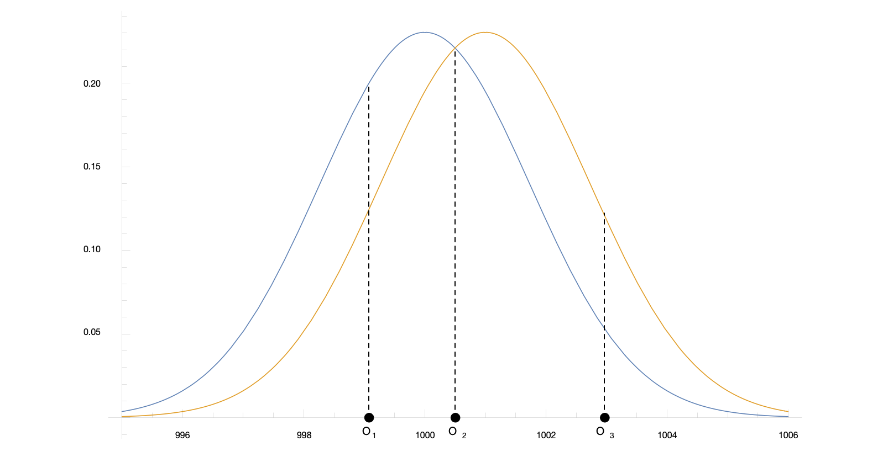
Privacy loss random variable
$$privacyLoss \left(c\right)= \ln\left[\frac{Pr\left[ℳ\left(x\right)=c\right]}{Pr\left[ℳ\left(y\right)=c\right]}\right]$$
[5]&[6]
Gaussian noise
Variance $σ^{2}=2$
$O_{1}$ - Attacker suspects real is $D_{1}$
$O_{2}$ - Attacker is confused
$O_{3}$ - Attacker is tricked thinking $D_{2}$ is the real database
Notes:
With a relaxed definition of Differential privacy we can take a deeper look into using Gaussian noise.
Using Gaussian noise with a variance of 2. Let’s take a scenario where we have a database containing information about our users (blue line) and then an adjacent db (yellow line) that is the same but off by 1 record.
The distributions above represent all the probabilities of responses we may receive when making queries from the dbs
Let’s say an adversary is making calls to the database to determine the number of people with blue eyes
The 2 datasets return 1,000 & 1,001 (real answer is 1,000 but the attacker doesn’t know)
If we return O1 the attacker is starting to suspect the real database is D1, it is 3 times larger that the response would come from D1, so you could say the attacker’s knowledge has tripled
If we return O2 the attacker’s knowledge is not changed
If we return O3 the attacker’s knowledge is divided by 3

Slide 42
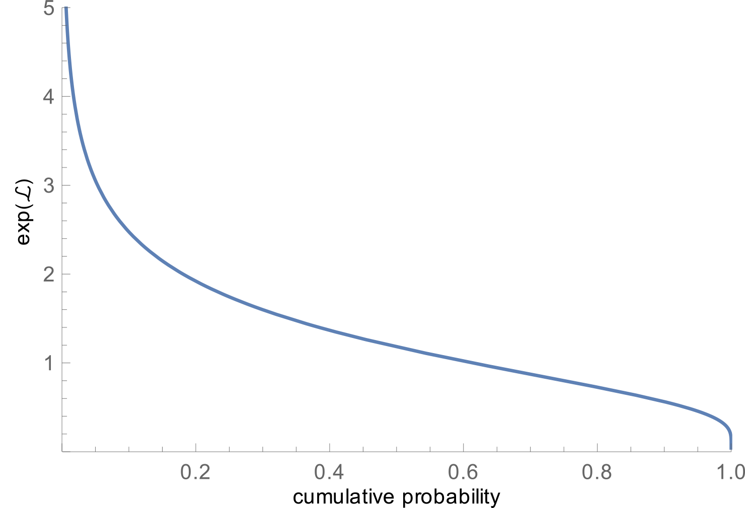
Privacy loss random variable
$$privacyLoss \left(c\right)= \ln\left[\frac{Pr\left[ℳ\left(x\right)=c\right]}{Pr\left[ℳ\left(y\right)=c\right]}\right]$$
A formal definition [5]&[6]
All possible events $𝒪=ℳ\left(D_{1}\right)$ in order of what benefits the attacker first
$ℒ→ℒ_{D_{1},D_{2}}\left(𝒪\right)$
Since we’re more interested in $e^{ε}$we will graph against $exp⁡(ℒ)$
Notes:
As we dive deeper into Privacy Loss, let’s change the graph to more accurately represent the probability of all events

Slide 43
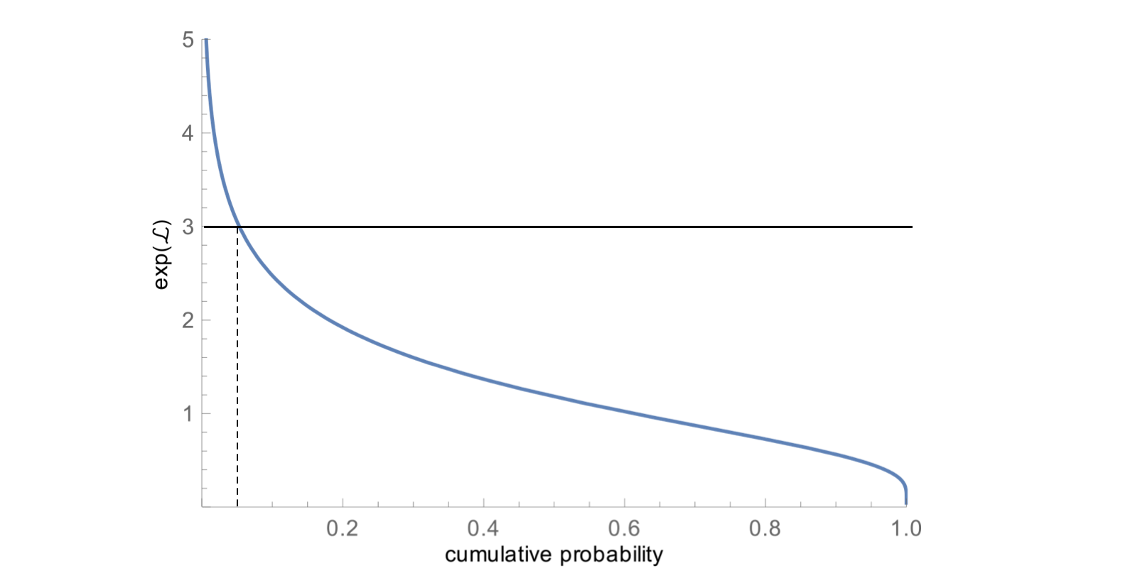
Privacy loss random variable
$$privacyLoss \left(c\right)= \ln\left[\frac{Pr\left[ℳ\left(x\right)=c\right]}{Pr\left[ℳ\left(y\right)=c\right]}\right]$$
A formal definition [5]&[6]
All possible events $𝒪=ℳ\left(D_{1}\right)$ in order of what benefits the attacker first
$ℒ→ℒ_{D_{1},D_{2}}\left(𝒪\right)$
Since we’re more interested in $e^{ε}$we will graph against $\exp\left(ℒ\right)$
Pick an arbitrary $ε=\ln{(3)}$
$δ$ Represents something terrible happening
How likely is it for $e^{ℒ}$ to be above $e^{ε}=3$
Measure the width -> $\left(\ln\left(3\right), δ_{1}\right)−DP, δ_{1}≈.054$
$$δ_{1}$$
Notes:
Though the simple intuition is correct it misses a little something, so let’s zoom in on where something goes wrong.

Slide 44
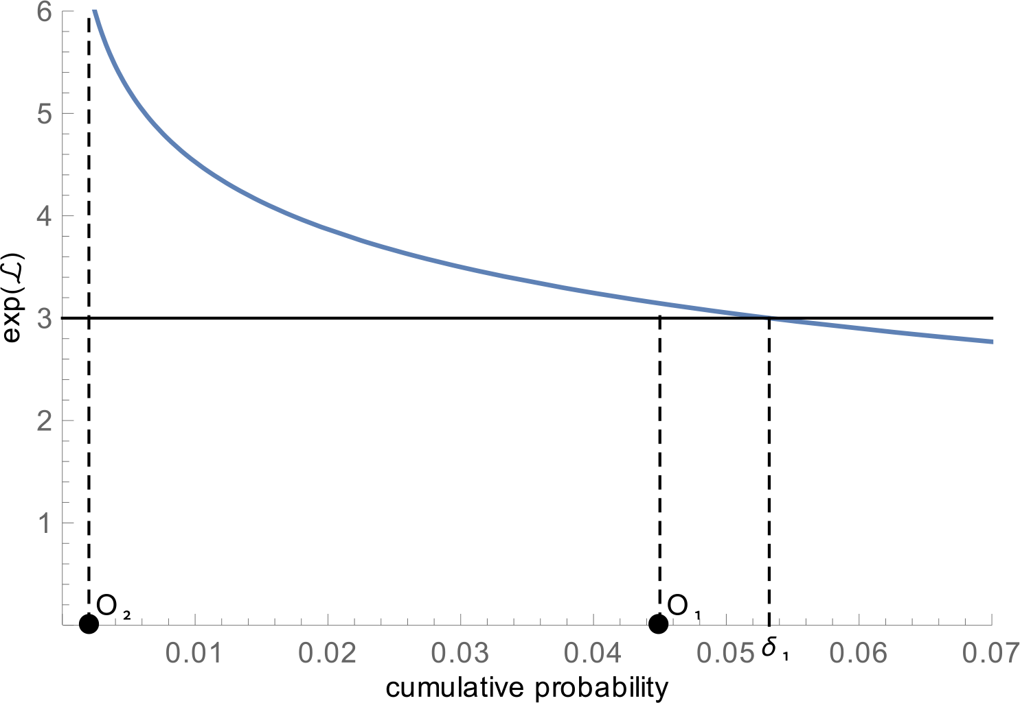
Privacy loss random variable
$$privacyLoss \left(c\right)= \ln\left[\frac{Pr\left[ℳ\left(x\right)=c\right]}{Pr\left[ℳ\left(y\right)=c\right]}\right]$$
A formal definition [5]&[6]
Returning $O_{1}$ is not great but not terrible $e^{ℒ}>e^{ε}$
Returning $O_{2}$ is a lot worse, it’s obvious it leaks more
$δ$ doesn’t account for this leakage
Resolve this by adding weights
$≈1$ to the very bad events
$≈0$ to the ‘not so’ bad events
But how?
Notes:
Though the simple intuition is correct it misses a little something, so let’s zoom in on where something goes wrong.

Slide 45
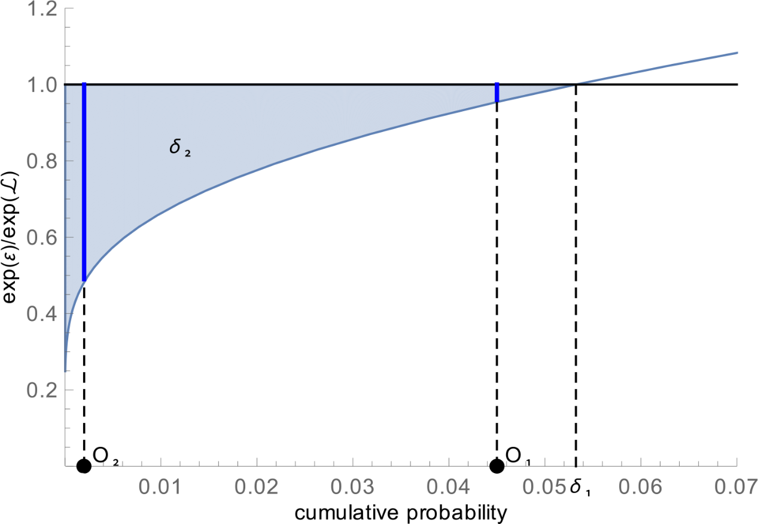
Privacy loss random variable
$$privacyLoss \left(c\right)= \ln\left[\frac{Pr\left[ℳ\left(x\right)=c\right]}{Pr\left[ℳ\left(y\right)=c\right]}\right]$$
A formal definition [5]&[6]
Take the inverse of the curve
Bad events approach 0
Normalize the curve using ratio $\frac{e^{ε}}{e^{ℒ}}$
Events not too bad close 1
This is the mass of all possible bad events, weighted by how likely they are and how bad they are.
$\left(\ln\left(3\right),δ_{2}\right)−DP with δ_{2}≈0.011$
This is a tighter characterization of $δ$ and not used in the typical definition of $(ε, δ)$
Notes:
The delta is the area highlighted in the graph above.
When L is very large, the inverse is close to 0
When L is close to epsilon the ratio is 1 and the distance is almost 0
Very bad events count more than kind of bad events
As opposed to 0.054

Slide 46
Gaussian mechanism
A formal definition [5]
$$\left|Privacy Loss\right|≤ε ⟹\left|\ln{\frac{e^{{{−z}^{2}}/{2σ^{2}}}}{e^{{−{\left(z+Δf\right)}^{2}}/{2σ^{2}}}}}\right|≤ ε$$
$$To achieve \left(ε,δ\right)−DP, set σ=Δf\sqrt{2 \ln{1/{δ/ε}}}$$
When outside range -> $\left|z\right|<σ\left(1−\frac{ε}{2}\right)⟶\left|Privacy Loss\right| at most 2ε$
$$PR\left[\left|Privacy Loss\right|≥tε\right]≤PR\left[\left|z\right|>σ\left(t−\frac{ε}{2}\right)\right]≈\frac{1}{t}e^{{{−t}^{2}}/2}$$
Notes:
Privacy loss is less than or equal to epsilon. When the log of ratio of the top over the shifted value is less than epsilon

Slide 47
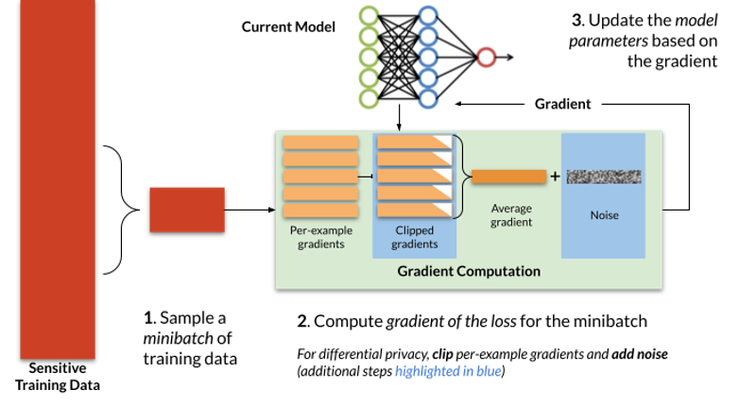
Dp and Deep Learning
DP-SGD [7]
Gradients computed per-example as opposed to computed on the average
Gradients are clipped to control sensitivity
Spherical Gaussian noise $b_{t}$ is added to their sum
Update step can be rewritten as:
$θ_{t+1}←θ_{t}−η ∙\left(∇_{t}+b_{t}\right)$
Adding noise during training can hurt accuracy
Notes:
For a fixed DP guarantee, the magnitude of the Gaussian noise that gets added to the gradient updates in each step in DP-SGD is proportional to the number of steps the model is trained for. As a result, it is import to tune the number of training steps for best privacy/utility trade-offs

Slide 48
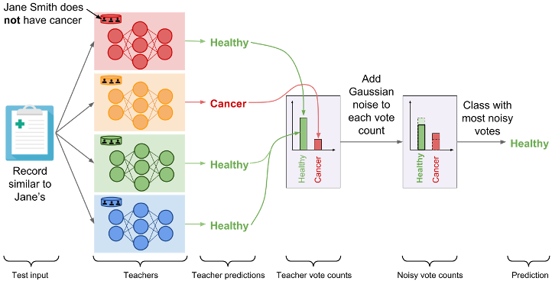
Dp and Deep Learning
Model Agnostic Private Learning [7]
Consider a multi-class classification problem.
Split training data into k disjoint subsets of equal size
Train independent models $\left(θ_{1}(x)…θ_{k}(x)\right)$
Compute a private histogram over the set of k predictions.
Add noise
Select histogram with highest count
Notes:
The private aggregation of teacher ensembles (PATE) proposes to have an ensemble of models trained withoutprivacy predict with differential privacy by having these models predict in aggregate rather than revealing their individual predictions. The ensemble of models is obtained by partitioning a private dataset into (non-overlapping) smaller subsets of data. Their predictions are then aggregated using the private histogram approach described above: the label predicted is the one whose noisy count of votes is the largest. The random noise added to vote counts prevents the outcome of aggregation from reflecting the votes of any individual teachers to protect privacy. When consensus is sufficiently strong among the ensemble of models, the noise does not alter the output of the aggregation.

Slide 49
Q & A

Slide 50
References
[1] Differential privacy. [Online]. Available: https://privacytools.seas.harvard.edu/differential-privacy (visited on 04/12/2023)
[2] Dwork, C., McSherry, F., Nissim, K., Smith, A. (2006). Calibrating Noise to Sensitivity in Private Data Analysis. In: Halevi, S., Rabin, T. (eds) Theory of Cryptography. TCC 2006. Lecture Notes in Computer Science, vol 3876. Springer, Berlin, Heidelberg. https://doi.org/10.1007/11681878_14
[3] [Dwork et al.] Dwork, C., McSherry, F., Nissim, K., & Smith, A. (2017). Calibrating Noise to Sensitivity in Private Data Analysis. Journal of Privacy and Confidentiality, 7(3), 17–51. https://doi.org/10.29012/jpc.v7i3.405
[4] Institute for Advanced Study. (2016, November 14). The Definition of Differential Privacy - Cynthia Dwork [Video]. YouTube. https://www.youtube.com/watch?v=lg-VhHlztqo
[5] Mathematical Picture Language. (2021, October 5). Cynthia Dwork | Oct 5,2021 | Differential Privacy:The Mathematical Bulwark [Video]. YouTube. https://www.youtube.com/watch?v=W--U-O3h_is
[6] Desfontaines, D. (2020, March 6). The privacy loss random variable - Ted is writing things. https://desfontain.es/privacy/privacy-loss-random-variable.html
[7] Papernot, N. (2022). How to deploy machine learning with differential privacy | NIST. NIST. https://www.nist.gov/blogs/cybersecurity-insights/how-deploy-machine-learning-differential-privacy

Slide 51
Deep Learning with differential privacy
Lu Cai

Slide 52
Outline
Background
Approach
Results – MNIST
Conclusion

Slide 53
Background
Differential privacy and deep learning
Differential privacy is a privacy framework that aims to protect sensitive information while still allowing for useful data analysis.
In practice, differential privacy involves adding noise to data before it is analyzed, so that the true values of individual data points are obscured. One of the key challenges in implementing differential privacy is balancing privacy with the usefulness of the data.
Deep neural networks are highly expressive models that can potentially memorize individual training examples. Deep learning with differential privacy is an emerging field that combines the power of deep neural networks with the privacy guarantees of differential privacy. The goal is to develop machine learning algorithms that can analyze sensitive data while preserving the privacy of individuals in the data.

Slide 54
Background
Differential privacy
The formal definition of (ε, δ)-differential privacy:
A randomized mechanism M: D → R satisfies ε-differential privacy if for any two adjacent inputs d, d' ∈ D and for any subset of outputs S ⊆ R, it holds that:
ε is a parameter that determines the strength of the privacy guarantee provided by a differentially private mechanism. A smaller value of ε corresponds to a stronger privacy guarantee.
δ is the probability that allows for plain ε-differential privacy broken.

Slide 55
Approach
Differential private training of neutral network
https://arxiv.org/abs/1607.00133
A differentially private stochastic gradient descent (SGD) algorithm
The moments accountant
Hyperparameter tuning

Slide 56
Approach
A differentially private stochastic gradient descent (SGD) algorithm
Compute the gradient for a random subset of examples (batch)
Clips the l₂ norm
Compute the average
Add noise
Take a step in the opposite direction of this average noisy gradient
Note: The authors perform the computation in batches, then group several batches into a lot for adding noise

Slide 57
Approach
Privacy accounting and hyperparameter tuning
For differentially private SGD, to compute the overall privacy cost of the training, an “accountant" procedure is implemented, which computes the privacy cost at each access to the training data, and accumulates this cost as the training progresses.
Hyperparameters can be tuned to balance privacy, accuracy, and performance. The model accuracy is more sensitive to training parameters such as batch size and noise level than to the structure of a neural network.

Slide 58
RESULTS - MNIST
Experiments on standard MNIST dataset for handwritten digit recognition consisting of 60,000 training examples and 10,000 testing examples
Baseline Model accuracy: 98.3%

Slide 59
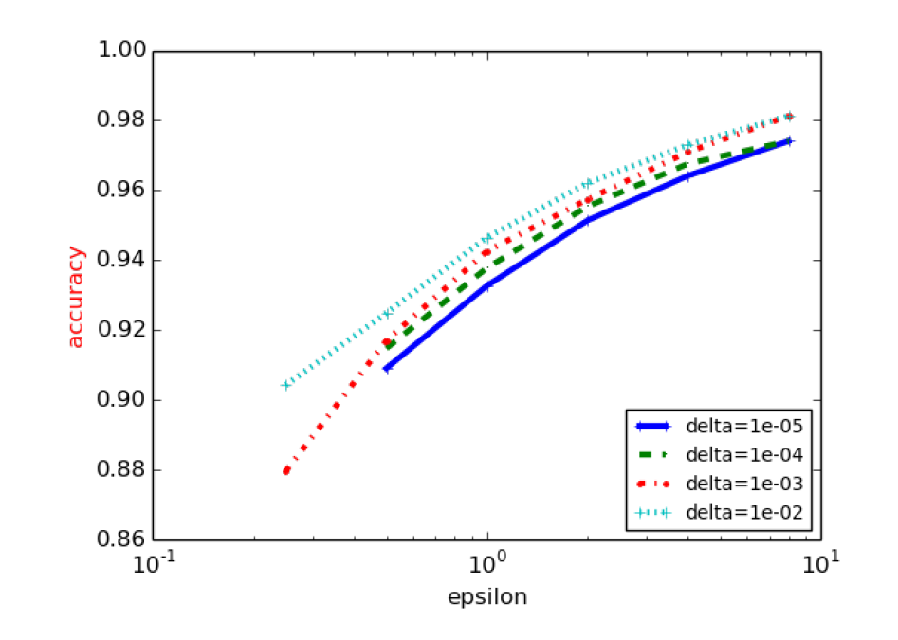
RESULTS - MNIST

Slide 60
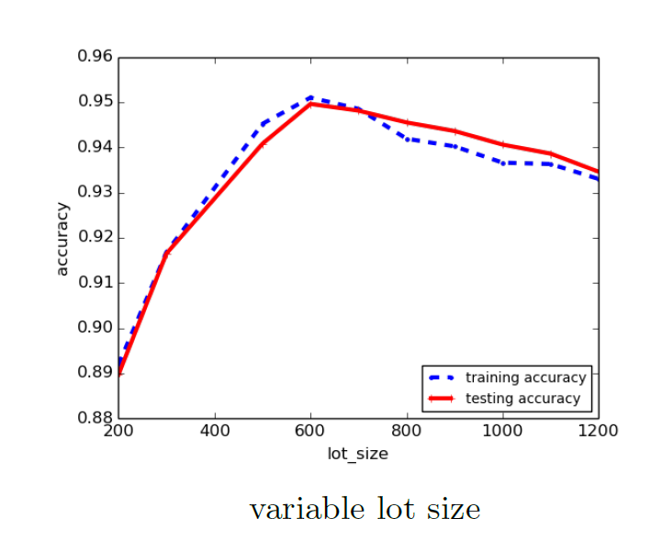
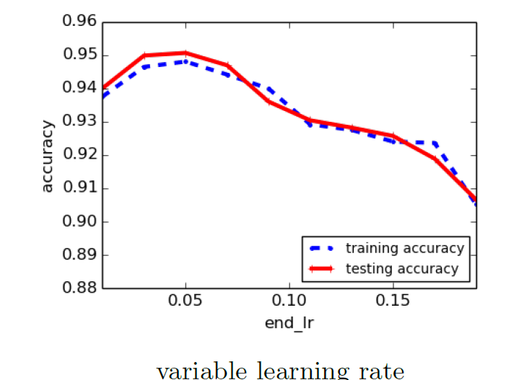
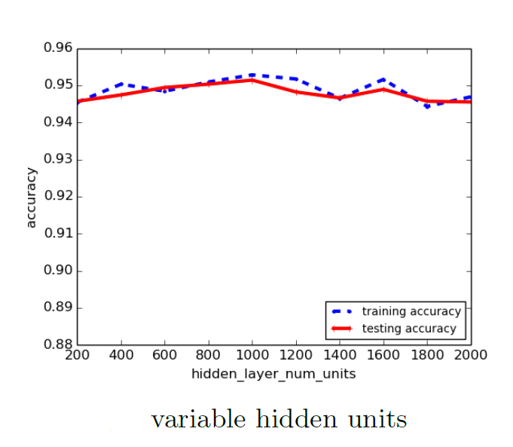
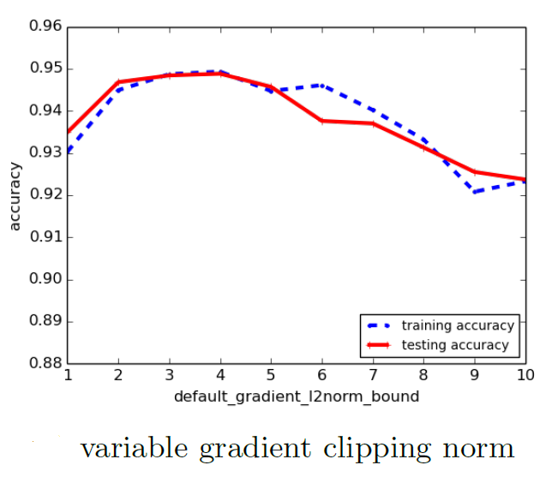
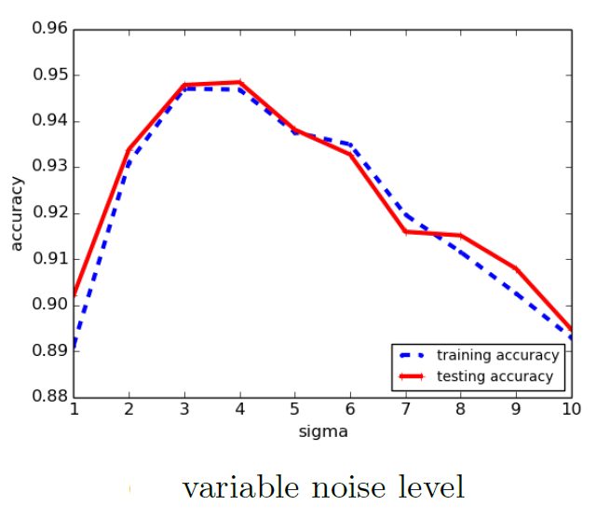
RESULTS - MNIST
The model accuracy is more sensitive to training parameters such as learning rate and noise level than to the structure of a neural network.

Slide 61
Conclusion
Deep learning with differential privacy is an approach to machine learning that aims to protect the privacy of sensitive data while still allowing for effective learning.
The algorithms of the paper are based on a differentially private version of stochastic gradient descent (SGD) and reach 97% training accuracy with (8; 10⁻⁵)-differential privacy.

Slide 62
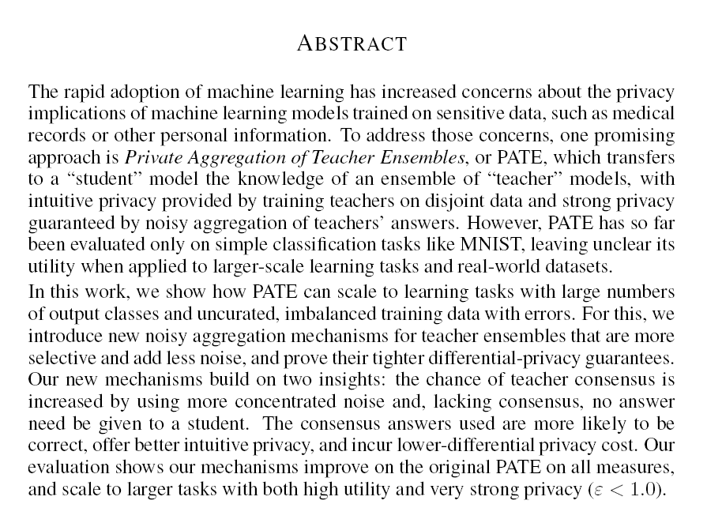
Scalable Private Learning with PATE
Private Aggregation of Teacher Ensembles
Written by: Nicolas Papernot, Shuang Song, Ilya Mironov, Ananth Raghunathan, Kuna Talwar, and Úlfar Erlingsson
by Johnny Stuto

Slide 63
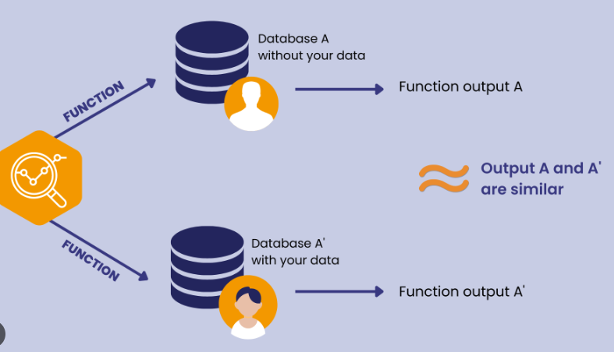
Outline:
Defenses against Privacy Attacks
Specific Mitigation Techniques
Differential Privacy
Rényi Differential Privacy (RDP)
PATE Framework Components
Teachers/Student Model/Aggregator
Results
Conclusion
Questions

Slide 64
Defenses against Privacy Attacks
Data privacy techniques have the goal of allowing analysts to learn about trends in data, without revealing information specific to individual data instances
Therefore, privacy techniques involve an intentional release of information, and attempt to control what can be learned from the released information
Data privacy is rooted in the Fundamental Law of Information Recovery, which that, in order to extract accurate and useful information from a dataset, some degree of privacy must be sacrificed.
Conversely, to achieve strong privacy protection, some loss of utility or accuracy is inevitable
This principle highlights the inherent trade-off between the privacy of individual data points and the utility or accuracy of the information derived from the dataset. As stronger privacy guarantees are required, more noise or obfuscation needs to be introduced into the data analysis process, which can result in a decrease in the utility or accuracy of the analysis. There is an inevitable trade-off between privacy and accuracy (i.e., utility)
In the context of differential privacy, this trade-off is represented by the privacy parameter (ε). Lower values of ε correspond to stronger privacy guarantees, but at the cost of decreased utility or accuracy in the output. Choosing an appropriate value for ε requires balancing the need for privacy protection with the desired level of utility or accuracy in the analysis.

Slide 65
Mitigation techniques
Anonymization techniques: Remove personally identifiable information (PII) from the dataset.
Data synthesis: Generate synthetic datasets that preserve the statistical properties of the original data while ensuring privacy.
Federated learning: Use distributed learning approaches, such as federated learning, to train machine learning models on multiple devices or nodes without sharing raw data
Secure multi-party computation (SMPC): Employ cryptographic techniques like SMPC to perform computations on encrypted data without revealing the underlying sensitive information
Privacy-aware data collection: Collect data with privacy considerations in mind from the outset. This includes obtaining proper consent from users, collecting only necessary data, and ensuring proper access controls and data storage practices.
Differential privacy: Implement differentially private algorithms for data analysis and machine learning. This approach introduces controlled noise to the output of an algorithm, providing a mathematically provable privacy guarantee. Balancing the privacy parameter (ε) with the desired utility or accuracy is crucial to ensure a reasonable trade-off between privacy and utility.

Slide 66
Differential privacy:
The PATE (Private Aggregation of Teacher Ensembles) method falls under the category of differential privacy.
PATE is a privacy-preserving machine learning framework that enables model-agnostic training while providing differential privacy guarantees for the training dataset.
By using the PATE method, you can train machine learning models that preserve privacy without significantly compromising performance, making it a valuable approach for various applications where data privacy is a primary concern.
Injecting noise into the dataset to create plausible deniability.
The noise shouldn’t change the outcome of the computation.
An observer should not be able to determine any PII from the output or identify whose data was trained on.
ε = Upper bound for the loss of privacy
δ = probability that privacy will not be held
M = Model training algorithm

Slide 67
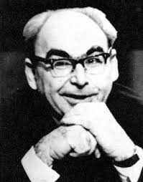
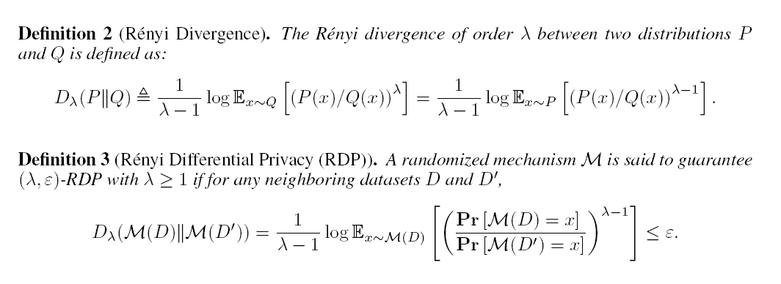
Rényi Differential Privacy
Rényi divergence, also known as Rényi's α-divergence, is a measure of dissimilarity between two probability distributions. It was introduced by Alfréd Rényi, a Hungarian mathematician, in 1961. Rényi divergence generalizes the concept of the Kullback-Leibler (KL) divergence, a widely used measure of divergence between probability distributions.
Rényi Differential Privacy (RDP) is a generalization of the classical differential privacy framework. It was introduced by Ilya Mironov in 2017 to address some limitations of traditional differential privacy, particularly in the context of composition, which occurs when multiple privacy-preserving operations or queries are applied. RDP introduces an additional parameter, called the order (α), alongside the classical privacy parameter (ε).

Slide 68
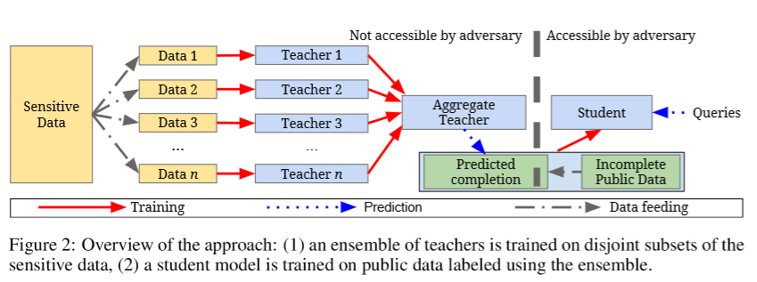
PATE Framework Components
Current approaches show potential but are untested at scale and have issues with scalability, robustness and utility.
In the PATE framework, multiple teacher models are trained on disjoint subsets of the sensitive training dataset
A student model then learns from these teacher models by querying them through an aggregator, which enforces differential privacy by introducing controlled noise.
The student model is trained on insensitive data, allowing it to generalize the knowledge acquired from the teacher models without directly accessing sensitive data.

Slide 69
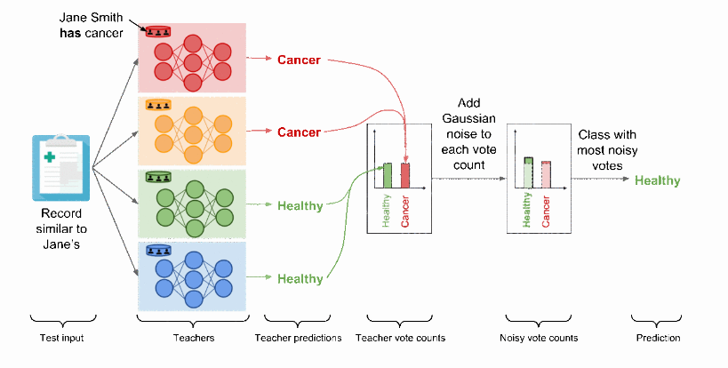
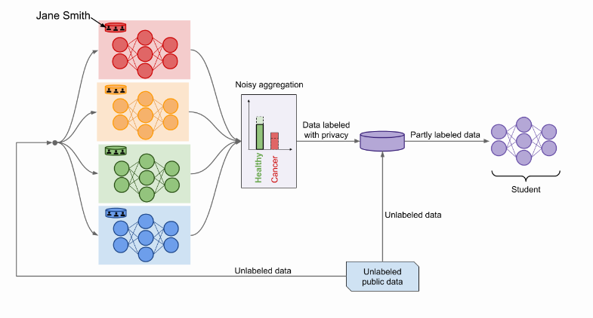
PATE Framework
The PATE approach is based on a simple intuition: if two different classifiers, trained on two different datasets with no training examples in common, agree on how to classify a new input example, then that decision does not reveal information about any single training example.
The decision could have been made with or without any single training example, because both the model trained with that example and the model trained without that example reached the same conclusion.

Slide 70
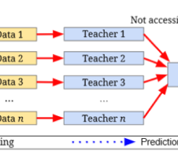
tEACHERS
The teacher models are trained on disjoint subsets of the sensitive training dataset, each with its own portion of the data.
These models provide expertise on the data they were trained on while maintaining privacy.
By using multiple teachers, the PATE framework leverages the wisdom of the ensemble, which helps increase the overall accuracy and generalization capabilities of the student model.

Slide 71
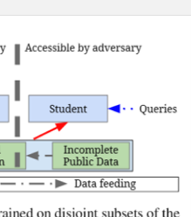
Student models
The student model learns from the teacher models without direct access to the sensitive data. It is trained on an insensitive or public unlabeled dataset, which is labeled by interacting with the ensemble of teachers via the aggregator.
The student model aims to replicate the performance of the teachers while ensuring privacy protection for the sensitive training data

Slide 72
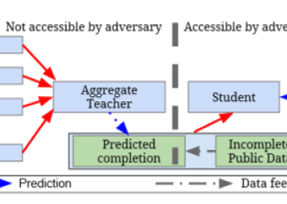
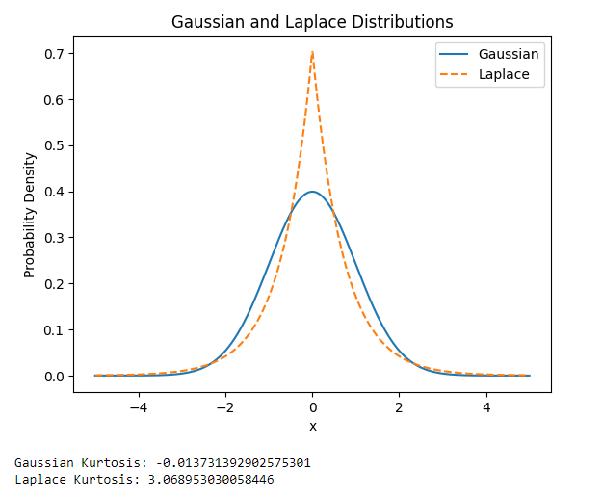
aggregators
Build off the PATE method
New methods for aggregating teacher/student answers
Confidence Aggregator
Teacher consensus module where Min of T teachers guarantee a correct classification and throw out queries where teachers don’t know
Interactive Aggregator
Student confidence scoring. Don’t ask teachers for an answer if confidence is high that the student knows
Expensive Queries are high cost to privacy
Gaussian noise instead of Laplacian
Less computationally expensive
Causes less noise overall.

Slide 73
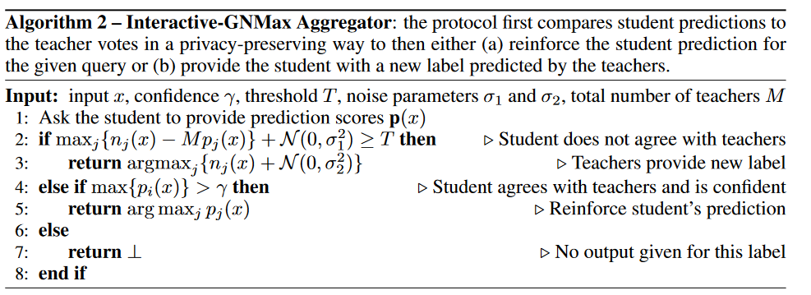
Aggregator Algorithms
Confident Aggregator:
Interactive Aggregator:

Slide 74
Experimental Setup
Datasets (private personal attributes)
MNIST
Street View House Numbers (SVHN)
US Census Income Adult (UCI Adult
Glyph: Synthetically generated computer font symbols with at most 150 different classes
Teacher Ensembles: 100,500,1000,5000 (number of teachers & partitions of data)
Queries: 500-12000 depending on dataset
Privacy parameters: δ = 10⁻⁸ probability that privacy will not be held

Slide 75
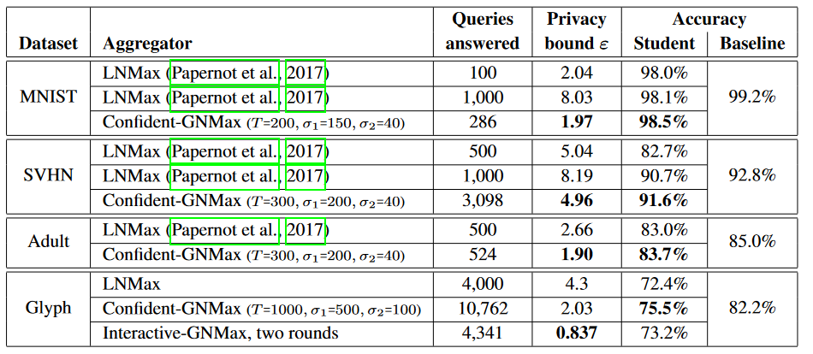
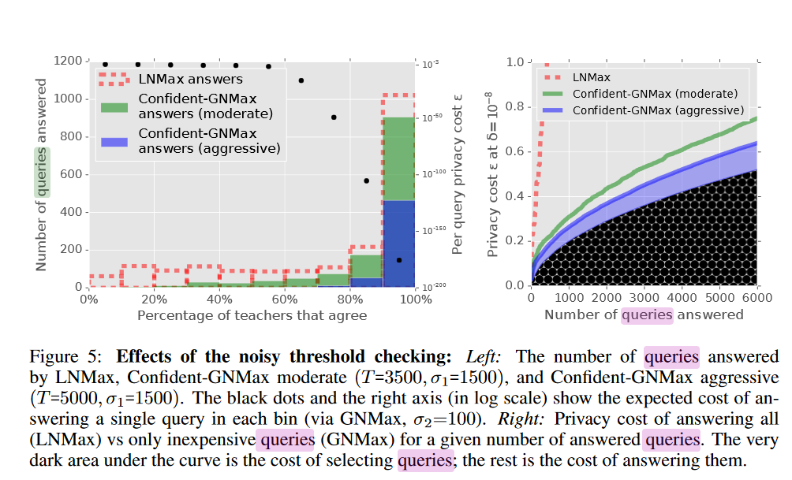
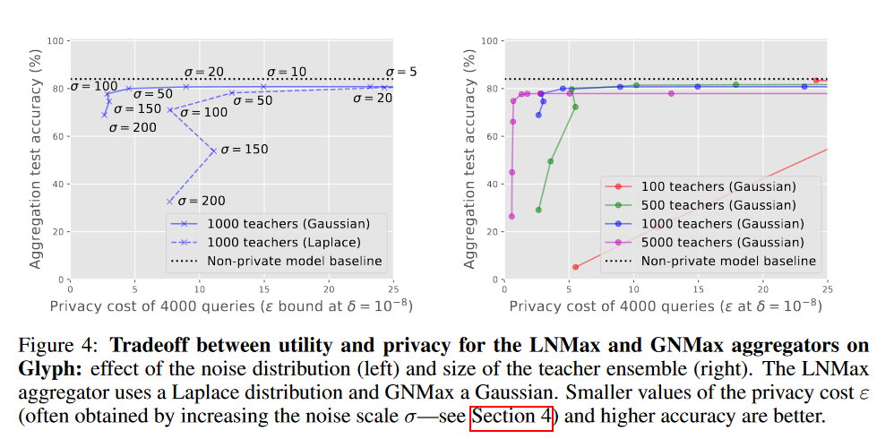
Results

Slide 76
Conclusion
Privacy can be thought of as an ally rather than a foe in the context of machine learning.
As the techniques improve, differential privacy is likely to serve as an effective regularizer that produces better-behaved models.
Within the framework of PATE, machine learning researchers can also make significant contributions towards improving differential privacy guarantees without being an expert in the formal analyses behind these guarantees.
New methods for aggregating teacher/student answers provide a privacy preserving technique that reduces leakage
Caps queries at a confidence interval
Stops overfitting student’s queries by checking confidence of student's answers
Improvements across the board in Privacy ε loss(lower is better)
Confirms that PATE has the potential to be used at scale
Generalization improved by changing perturbation method

Slide 77
References
Papernot, N., Song, S., Mironov, I., Raghunathan, A., Talwar, K., and Erlingsson, Ú., Scalable Private Learning with PATE, arXiv e-prints, 2018.
Nicolas Papernot, Martín Abadi, Úlfar Erlingsson, Ian Goodfellow, and Kunal Talwar. Semi supervised knowledge transfer for deep learning from private training data. In Proceedings ofthe 5th International Conference on Learning Representations (ICLR), 2017.
Liu et al. (2020) When Machine Learning Meets Privacy: A Survey and Outlook
Rigaki and Carcia (2021) A Survey of Privacy Attacks in Machine Learning Cristofaro (2020) An Overview of Privacy in Machine Learning
https://www.nist.gov/blogs/cybersecurity-insights/threat-models-differential-privacy
http://www.cleverhans.io/privacy/2018/04/29/privacy-and-machine-learning.html

Slide 78
Introduction to Federated Learning
Presenter: Shahidur Rahoman Sohag
Reporting To:
Dr. Alex Vakanski
1

Slide 79
Table of Contents
Introduction
Concept & Motivation (What & Why)
Mechanism
How it works, popular optimization algorithms
Research Findings
Different research methods, pros, cons
Conclusion
Future research, expectations, my thoughts
2

Slide 80
DID YOU KNOW?
According to the U.S. Department of Health and Human Services, the 337 healthcare incidents in 2022 reported affected 19,992,810 individuals.
3

Slide 81
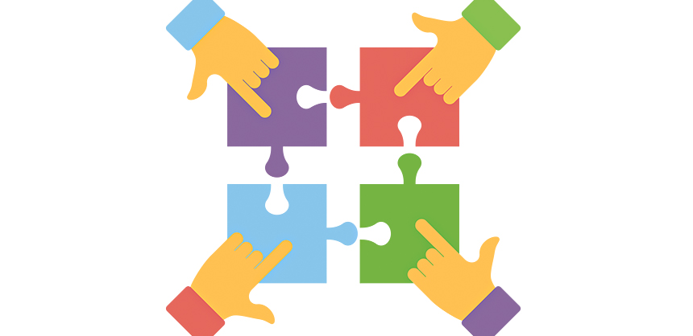
Introduction
What is federated learning?
Federated learning (also known as collaborative learning) is a machine learning technique that trains an algorithm via multiple independent sessions, each using its own dataset
Motivation?
The motivation for federated learning is the preservation of the privacy of the data owned by the clients.
4

Slide 82
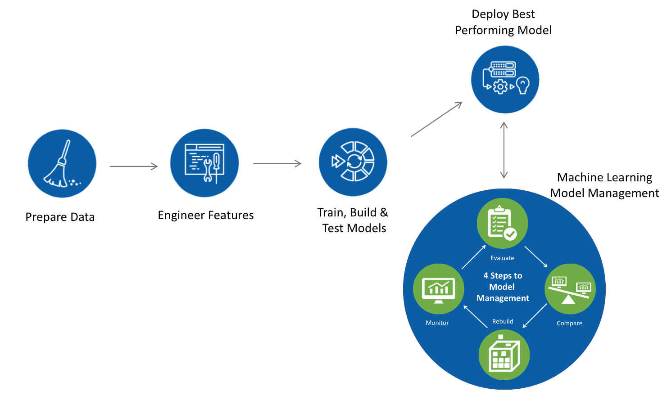
General ML Approach
5

Slide 83
Cloud ML Approach
6

Slide 84
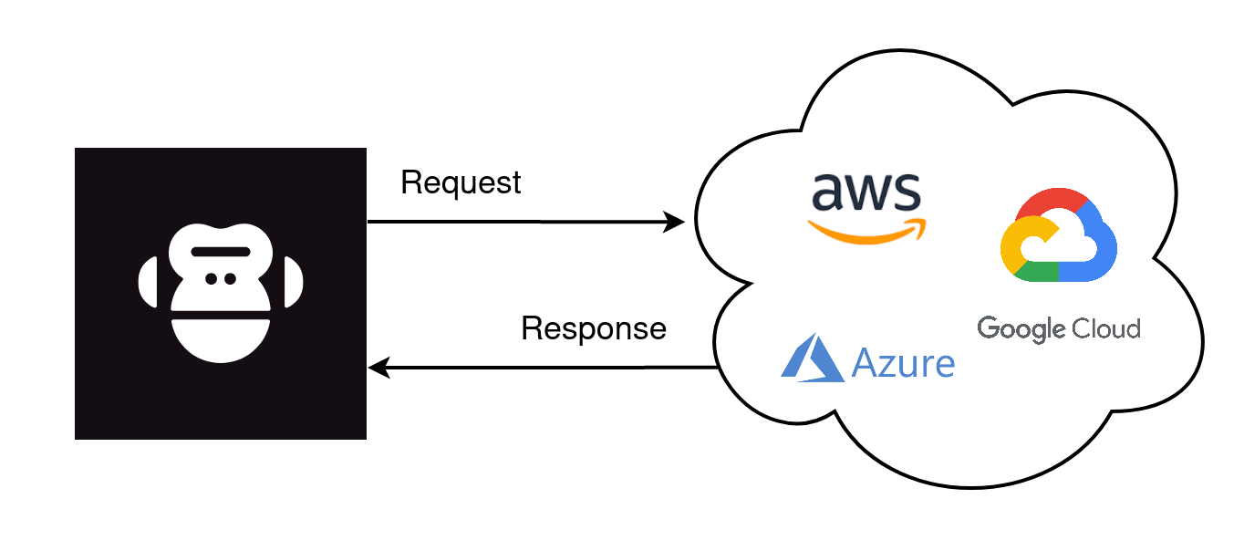
Centralized ML Approach
7

Slide 85
WHAT’S WRONG WITH THIS?
8

Slide 86
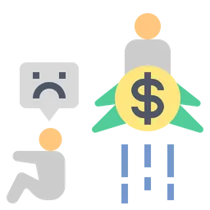
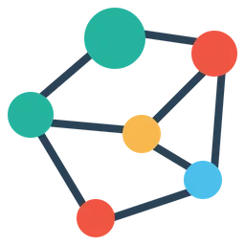
Drawbacks of Centralized ML
Privacy Concerns
Scalability Issues
CML involves transmitting all the data to a central location.
Difficult to scale as the number of users and data sets increase
Cost & Bias
Network Latency
Big issue when the data being transmitted is large to central server for processing
Requires significant computing resources. Can be prone to bias if the training data is not representative of the population,
9

Slide 87
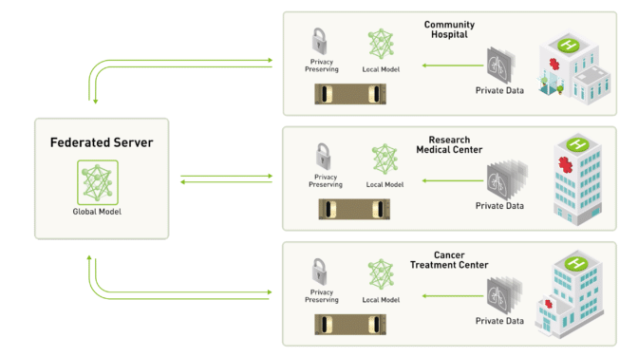
Federated Learning
10

Slide 88
Federated Learning (Heterogenous)
11

Slide 89
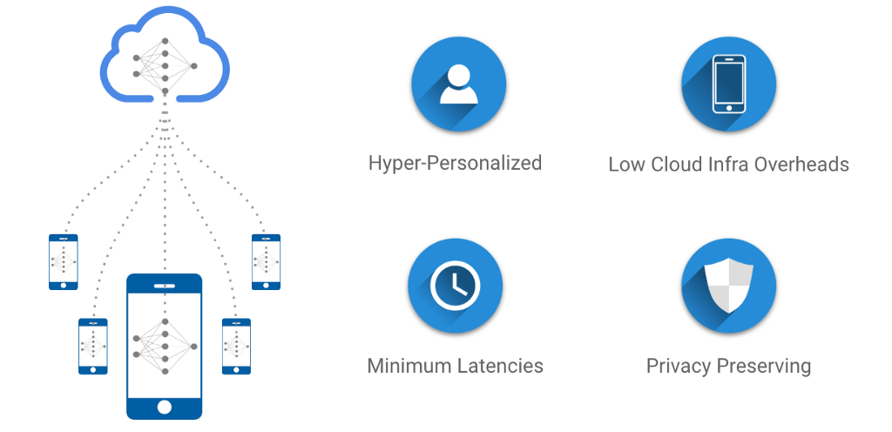
Key Factors of Federated Learning
12

Slide 90
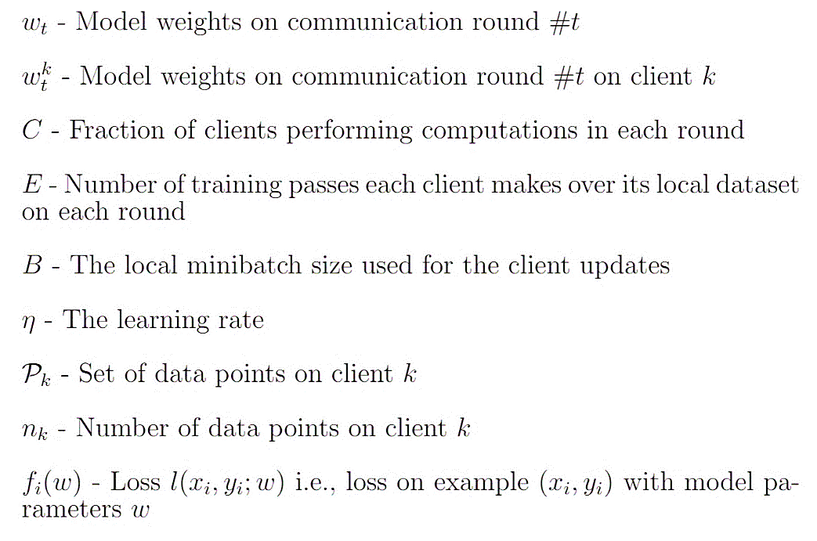
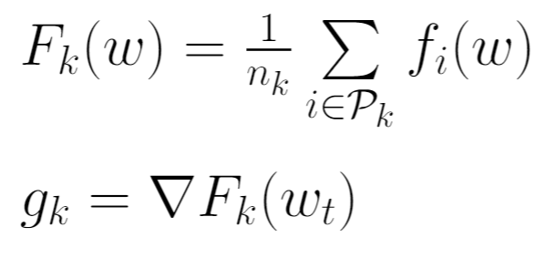
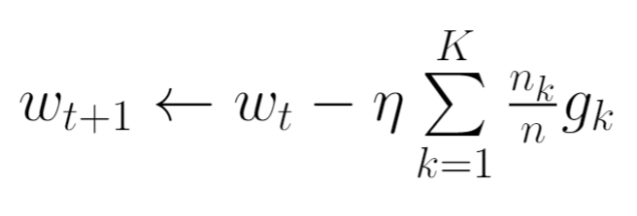
Optimization Algorithm
FedSGD
This corresponds to a full-batch (non-stochastic) gradient descent. For the current global model w^{t}, the average gradient on its global model is calculated for each client k.
13

Slide 91
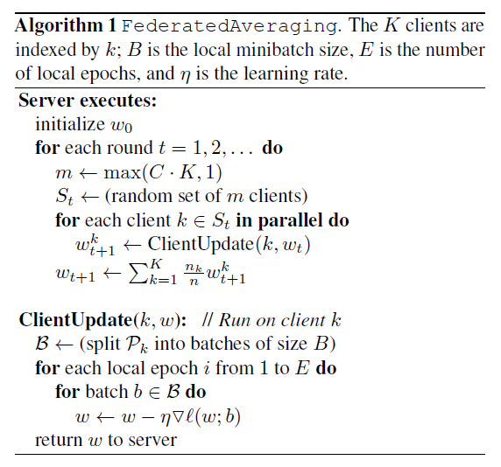
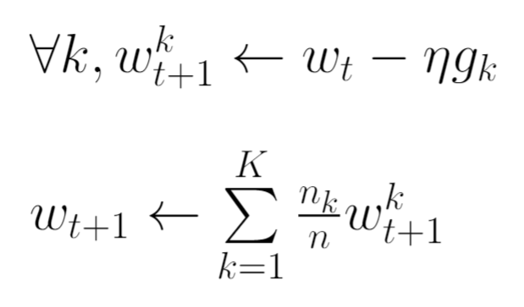
Optimization Algorithm
FedAVG
Each client locally takes one step of gradient descent on the current model using its local data, and the server then takes a weighted average of the resulting models.
14

Slide 92
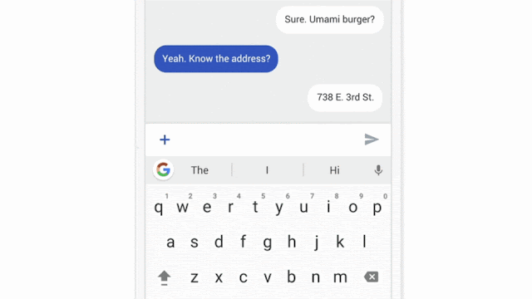
A Regular Application of FL
15

Slide 93
Behind The Scene
Personalizes model locally based on users usage
Sends the updated result, and repeats
Many users updates are aggregated to form a concensus change
16

Slide 94
When FL Updates?
17

Slide 95
Current Research
Privacy-preserving federated learning
One of the main challenges in federated learning is to ensure the privacy of the local data on the devices. Researchers are exploring new methods to improve the privacy of federated learning algorithms, such as using differential privacy or homomorphic encryption
Communication-efficient federated learning
Federated learning involves communication between the devices and the central server, which can be a bottleneck in terms of time and resources. Researchers are exploring new methods to reduce the communication overhead of federated learning algorithms, such as using compression techniques or designing more efficient communication protocols.
18

Slide 96
Current Research
Federated learning in non-i.i.d. settings
Federated learning assumes that the data on the devices are identically and independently distributed (i.i.d.). However, in real-world scenarios, this assumption may not hold. Researchers are exploring new methods to extend federated learning to non-i.i.d. settings, such as using transfer learning or meta-learning.
Federated learning for healthcare
Federated learning has the potential to improve healthcare by enabling the development of predictive models without compromising patient privacy. Researchers are exploring new methods to apply federated learning to healthcare applications, such as developing models for disease diagnosis or personalized treatment recommendations.
19

Slide 97
Potential Future of FL
Blockchain Integration
Smart City
We can expect to see FL being integrated with blockchain technology to further enhance the security and privacy of data used in machine learning.
Can be used to analyze data from various sources such as traffic sensors, public transport systems, and energy usage.
Manufacturing
Education
Can be used in industry to improve quality control and predict equipment failures and trained on data from multiple factories without sharing proprietary information
Can provide more personalized education, collaborated research
20

Slide 98
JUST TO LET YOU KNOW
According to the Health Insurance Portability and Accountability Act, healthcare data breaches in the U.S. have decreased by 48%.
21

Slide 99
Conclusion
To conclude, I would like to say that federated learning in the field of machine learning has a great potential. I truly believe day by day people will be more aware of their data. Therefore, decentralized machine learning will be applied almost everywhere vastly in healthcare, education, finance and robotics.
22

Slide 100
Reference
 | Links / Paper Title
1 | https://en.wikipedia.org/wiki/Federated_learning
2 | https://ai.googleblog.com/2017/04/federated-learning-collaborative.html
3 | https://www.getastra.com/blog/security-audit/healthcare-data-breach-statistics/
4 | A Performance Evaluation of Federated Learning Algorithms
5 | FEDERATED LEARNING: STRATEGIES FOR IMPROVING COMMUNICATION EFFICIENCY
23

Slide 101
THANK YOU
24

