Slide 1
CS 404/504 Special Topics: Adversarial Machine Learning
Dr. Alex Vakanski

Slide 2
Lecture 14
Adversarial Examples in Text and Audio Data

Slide 3
Lecture Outline
Adversarial examples in text data
Attacks on text classification models
Ebrahimi (2018) HotFlip attack
Gao (2018) DeepWordBug attack
Attacks on reading comprehension models
Jia (2017) Text concatenation attack
Attacks on translation and text summarization models
Cheng (2018) Seq2Sick attack
Attacks on dialog generation models
He (2018) Egregious output attack
Attacks against transformer language models
Jin (2020) TextFooler
Guo (2021) GBDA attack
Jiang Chang presentation
Adversarial examples in audio data: Carlini (2018) Targeted attacks on speech-to-text

Slide 4
Adversarial Examples in Text Data
Adversarial Examples in Text Data
Adversarial examples were shown to exists for ML models for processing text data
An adversary can generate manipulated text sentences that mislead ML text models
To satisfy the definitions for adversarial examples, a generated text sample x’ that is obtained by perturbing a clean text sample x should look “similar” to the original text
The perturbed text should preserve the semantic meaning for a human reader
I.e., an adversarial text sample that is misclassified by an ML model should not be misclassified by a typical human
In general, crafting adversarial examples in text data is more challenging than in image data
E.g., many text attacks output grammatically or semantically incorrect sentences
Generation of adversarial text examples is often based on replacement of input words (with synonyms, misspelled words, or words with similar vector embeddings), or based on adding distracting text to the original clean text

Slide 5
Text Processing Models
Adversarial Examples in Text Data
Dominant text processing models
Pre 1990
Hand-crafted rule-based approaches (if-then-else rules)
1990-2014
Traditional ML models, e.g., decision trees, logistic regression, Naïve Bayes
2014-2018
Recurrent NNs (e.g., LSTM, GRU) layers
Combinations of CNNs and RNNs
Bi-directional LSTM layers
2018-present time
Transformers (BERT, RoBERTa, GPT family, Bard, LLaMA)
Slide credit: Chollet (2021) Deep Learning with Python

Slide 6
Adversarial Examples in Text versus Images
Adversarial Examples in Text Data
Image data
Inputs: pixel intensities
Continuous inputs
Adversarial examples can be created by applying small perturbations to pixel intensities
Adding small perturbations does not change the context of the image
Gradient information can be used to perturb the input images
Metrics based on $ℓ_{p}$ norms can be applied for measuring the distance to adversarial examples
Text data
Inputs: words or characters
Discrete inputs
Small text modifications are more difficult to apply to text data for creating adversarial examples
Adding small perturbations to words can change the meaning of the text
Gradient information cannot be used, generating adversarial examples requires applying heuristic approaches (e.g., word replacement with local search) to produce valid text
It is more difficult to define metrics for measuring text difference, $ℓ_{p}$ norms cannot be applied

Slide 7
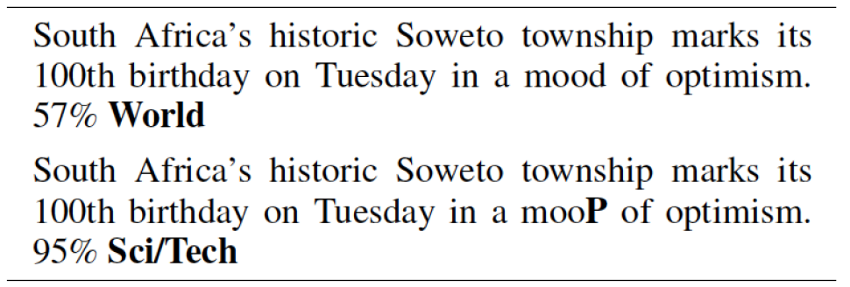
Ebrahimi (2018) – HotFlip Attack
Attacks on Text Classification Models
Ebrahimi et al. (2018) HotFlip: White-Box Adversarial Examples for Text Classification
HotFlip attacks character-level text classifiers by replacing one letter in text
It is a white-box untargeted attack
Approach:
Use the model gradient to identify the most important letter in the text
Perform an optimization search to find a substitute (flip) for that letter
The approach also supports insertion or deletion of letters
In this example, the predicted topic label of the sentence is changed from “World” to “Sci/Tech” by changing the letter P in the word ‘mood’
Original text
Predicted class
Adversarial text
Predicted class

Slide 8
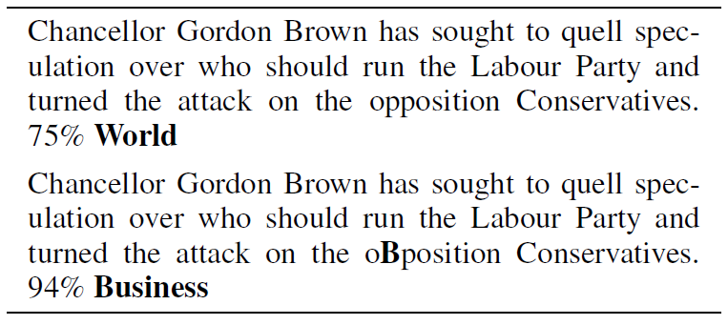
Ebrahimi (2018) – HotFlip Attack
Attacks on Text Classification Models
Attacked model: CharCNN-LSTM, a character-level model that uses a combination of CNN and LSTM layers
Dataset: AG news dataset, consists of 120K training and 7.6K testing instances with 4 classes: World, Sports, Business, and Science/Technology
The attack does not change the meaning of the text, and it is often unnoticed by human readers
Original text
Predicted class
Adversarial text
Predicted class

Slide 9
Gao (2018) DeepWordBug Attack
Attacks on Text Classification Models
Gao et al. (2018) Black-box Generation of Adversarial Text Sequences to Evade Deep Learning Classifiers
DeepWordBug attack is a black-box attack on text classification models
The approach has similarity to the HotFlip attack:
Identify the most important tokens (either words or characters) in a text sample
Apply character-level transformations to change the label of the text
Key idea: the misspelled words in the adversarial examples are considered “unknown” words by the ML model
Changing the important words to “unknown” impacts the prediction by the model
Applications: the attack was implemented against three different models, which include text classification, sentiment analysis, spam detection
Attacked models: Word-LSTM (uses word tokens) and Char-CNN (uses character tokens) models
Datasets: evaluated on 8 text datasets

Slide 10
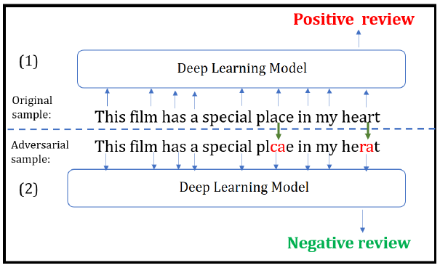
Gao (2018) DeepWordBug Attack
Attacks on Text Classification Models
Example of a generated adversarial text for sentiment analysis
The original text sample has a positive review sentiment
An adversarial sample is generated by changing 2 characters, resulting in wrong classification (negative review sentiment)
Question: is the adversarial sample perceptible to a human reader?
Argument: a human reader can understand the meaning of the perturbed sample, and assign positive review sentiment

Slide 11
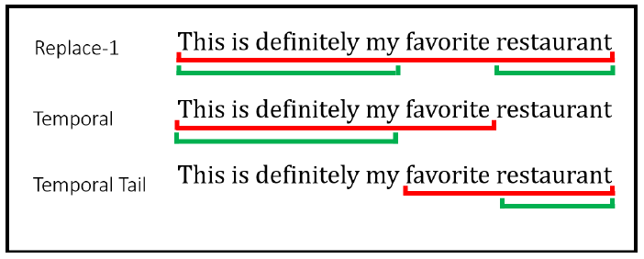
Gao (2018) DeepWordBug Attack
Attacks on Text Classification Models
Attack approach
Assume an input sequence ${x=x}_{1}x_{2}x_{3}⋯x_{n}$, and $F(x)$is output of a black-box model
The authors designed 4 scoring functions to identify the most important tokens
Replace-1 score: evaluate the output $F(x)$ when the token $x_{i}$ is replaced with the “unknown” (i.e., out of vocabulary) token${ x}_{i}′$
$$R1S\left(x_{i}\right)=F\left(x_{1}{,x}_{2},⋯x_{i−1}{,x}_{i}{,⋯x}_{n}\right)−F\left(x_{1}{,x}_{2},⋯x_{i−1}{,x}_{i}{′,⋯x}_{n}\right)$$
Temporal head score: evaluate the output of the model for the tokens before $x_{i}$
$$THS\left(x_{i}\right)=F\left(x_{1}{,x}_{2},⋯x_{i−1}{,x}_{i}\right)−F\left(x_{1}{,x}_{2},⋯x_{i−1}\right)$$
Temporal tail score: evaluate the output of the model for the tokens after $x_{i}$
$$TTS\left(x_{i}\right)=F\left(x_{i}{,x}_{i+1},⋯{,x}_{n}\right)−F\left(x_{i+1},⋯x_{n}\right)$$
Combined score: a weighted sum of the Temporal Head and Temporal Tail Scores
$$CS\left(x_{i}\right)=THS\left(x_{i}\right)+λTTS\left(x_{i}\right)$$

Slide 12
Gao (2018) DeepWordBug Attack
Attacks on Text Classification Models
Attack approach
Next, the top m important tokens selected by the scoring functions are perturbed
The following 4 transformations are considered:
Swap – swap two adjacent letters
Substitution – substitute a letter with a random letter
Deletion – delete a letter
Insertion – insert a letter
Edit distance of the perturbation is the minimal number of edit operations to change the original text
The edit distance is 2 edits for the swap transformation, and 1 edit for substitution, deletion, and insertion transformations

Slide 13
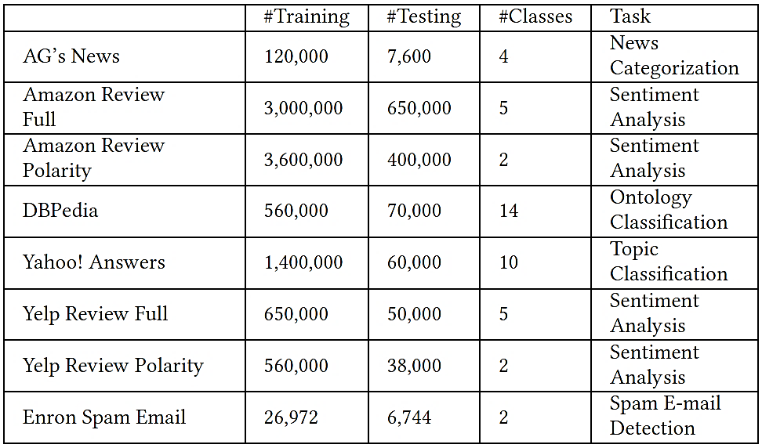
Gao (2018) DeepWordBug Attack
Attacks on Text Classification Models
Datasets details

Slide 14
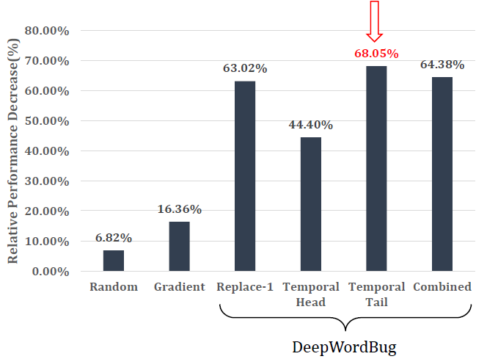
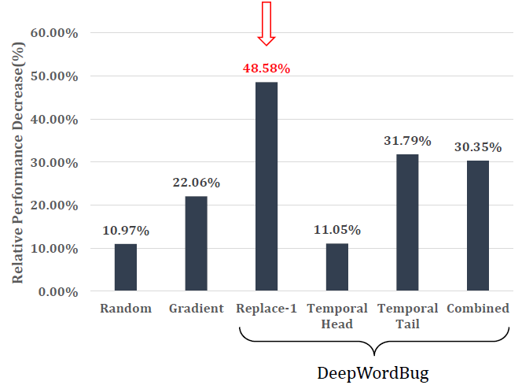
Gao (2018) DeepWordBug Attack
Attacks on Text Classification Models
Evaluation results for attacks against Word-LSTM and Char-CNN models
The maximum edit distance is set to 30 characters
Left figure: DeepWordBug reduced the performance by the Word-LSTM model by 68.05% in comparison to the accuracy on non-perturbed text samples
Temporal Tail score function achieved the largest decrease in accuracy
Right figure: decrease in the accuracy by the Char-CNN of 48.58% was achieved
Word-LSTM model
Char-CNN model

Slide 15
Gao (2018) DeepWordBug Attack
Attacks on Text Classification Models
Evaluation results on all 8 datasets for the Word-LSTM model
Two baseline approaches are included for comparison (Random token replacement and Gradient)
The largest average decrease in the performance was achieved by the Temporal Tail scoring function approach (mean decrease of 68.05% across all datasets)

Slide 16
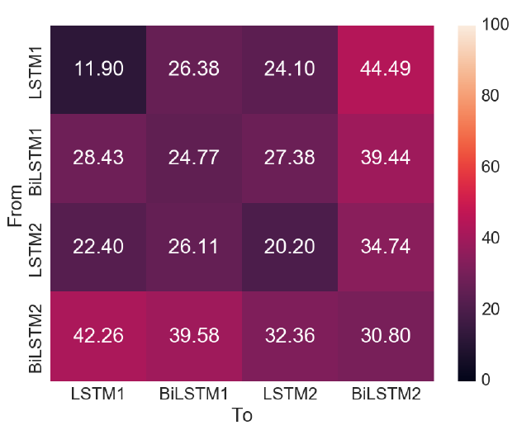
Gao (2018) DeepWordBug Attack
Attacks on Text Classification Models
Are adversarial text examples transferable across ML models? – Yes!
The figure shows the accuracy on adversarial examples generated with one model and transferred to other models
Four models were considered containing LSTM and bi-directional LSTM layers (BiLSTM)
The adversarial examples transferred successfully to other models

Slide 17
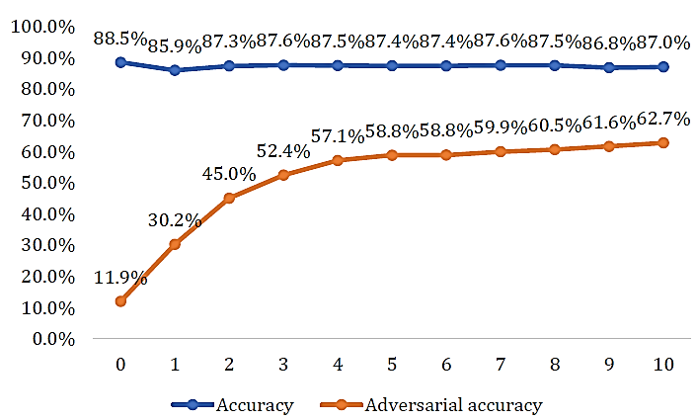
Gao (2018) DeepWordBug Attack
Attacks on Text Classification Models
Evaluation of adversarial training defense
The figure shows the standard accuracy on regular text samples (blue), and the adversarial accuracy (orange) on adversarial samples for 10 epochs
The adversarial accuracy improves significantly to reach 62.7%, with a small trade-off in the standard accuracy

Slide 18
Jia (2017) Text Concatenation Attack
Attacks on Reading Comprehension Models
Jia et al. (2017) Adversarial Examples for Evaluating Reading Comprehension Systems
Reading comprehension task
An ML model answers questions about paragraphs of text
Human performance was measured at 91.2% accuracy
Text Concatenation Attack is a black-box, non-targeted attack
Adds additional sequences to text samples to distract ML models
The generated adversarial examples should not confuse humans
Attacked model: LSTM-based model for reading comprehension
Dataset: Stanford Question Answering Dataset (SQuAD)
Consists of 108K human-generated reading comprehension questions about Wikipedia articles
Results: accuracy decreased from 75% to 36%

Slide 19
Jia (2017) Text Concatenation Attack
Attacks on Reading Comprehension Models
Example
The concatenated adversarial text in blue color at the end of the paragraph fooled the ML model to give the wrong answer ‘Jeff Dean’

Slide 20
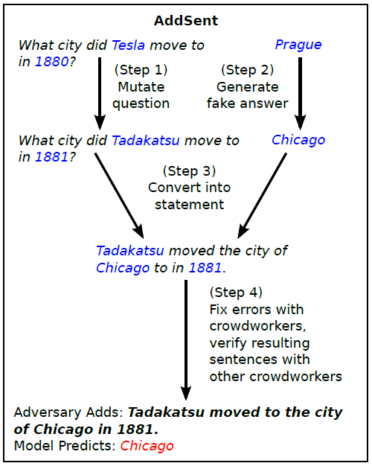
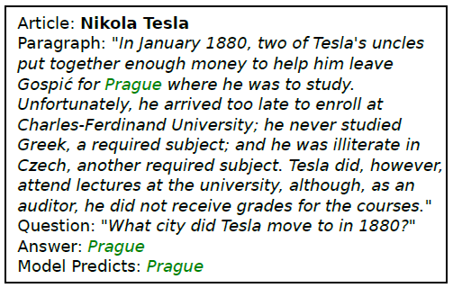
Jia (2017) Text Concatenation Attack
Attacks on Reading Comprehension Models
ADDSENT approach uses a four-step procedure to add a sentence to a text
Step 1 changes words in the question with nearest words in the embedding space, Step 2 generates a fake answer randomly, and Step 3 replaces the changed words
Step 4 involves human-in-the-loop to fix grammar errors or unnatural sentences
Original text and prediction
Attack

Slide 21
Cheng (2018) Seq2Sick Attack
Attacks on Translation and Text Summarization Models
Cheng et al. (2018) Seq2Sick: Evaluating the Robustness of Sequence-to-Sequence Models with Adversarial Examples
Seq2Sick is a white-box, targeted attack
Attacked are RNN-based sequence-to-sequence (seq2seq) models, used for machine translation and text summarization tasks
Seq2seq models are more challenging to attack than classification models, because there are infinite possibilities for the text sequences outputted by the model
Conversely, classification models have a finite number of output classes
Example:
Attacked model: word-level LSTM encoder-decoder
This work designed a regularized PGD method to generate adversarial text examples with targeted outputs
Input sequence in English: A child is splashing in the water.
Output sequence in German: Ein kind im wasser.

Slide 22
Cheng (2018) Seq2Sick Attack
Attacks on Translation and Text Summarization Models
Text summarization example with a target keyword “police arrest”
Original text: President Boris Yeltsin stayed home Tuesday, nursing a respiratory infection that forced him to cut short a foreign trip and revived concerns about his ability to govern.
Summary by the model: Yeltsin stays home after illness.
Adversarial example: President Boris Yeltsin stayed home Tuesday, cops cops respiratory infection that forced him to cut short a foreign trip and revived concerns about his ability to govern.
Summary by the model: Yeltsin stays home after police arrest.

Slide 23
Cheng (2018) Seq2Sick Attack
Attacks on Translation and Text Summarization Models
Other text summarization examples with a target keyword “police arrest”

Slide 24
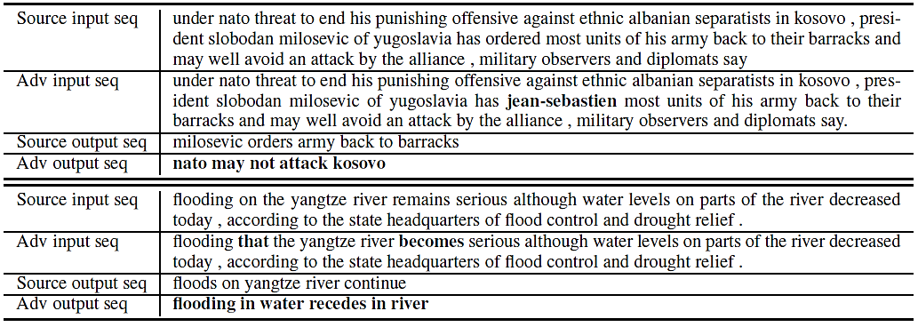
Cheng (2018) Seq2Sick Attack
Attacks on Translation and Text Summarization Models
Text summarization examples with a non-overlapping attack
I.e., the output sequence does not have overlapping words with the original output

Slide 25
Cheng (2018) Seq2Sick Attack
Attacks on Translation and Text Summarization Models
Seq2Sick approach
For an input sequence $X$ and perturbation $δ$, solve the optimization problem formulated as
$$\min_{δ}{ℒ\left(X+δ\right)}+λ_{1}\sum_{i}{\left|δ_{i}\right|}+λ_{2}\sum_{i}{\min_{w_{j}}\left|x_{i}+δ_{i}−w_{j}\right|}$$
The first term $ℒ\left(X+δ\right)$ is a loss function that is minimized by using Projected Gradient Descent (PGD)
The second and third term are regularization terms
The term $\sum_{i}{\left|δ_{i}\right|}$ applies lasso regularization to ensure that only a few words in the text sequence are changed
The third term $\sum_{i}{\min_{w_{j}}\left|x_{i}+δ_{i}−w_{j}\right|}$ applies gradient regularization to ensure that the perturbed input words $x_{i}+δ_{i}$ are close in the word embedding space to existing words $w_{j}$ from a vocabulary W

Slide 26
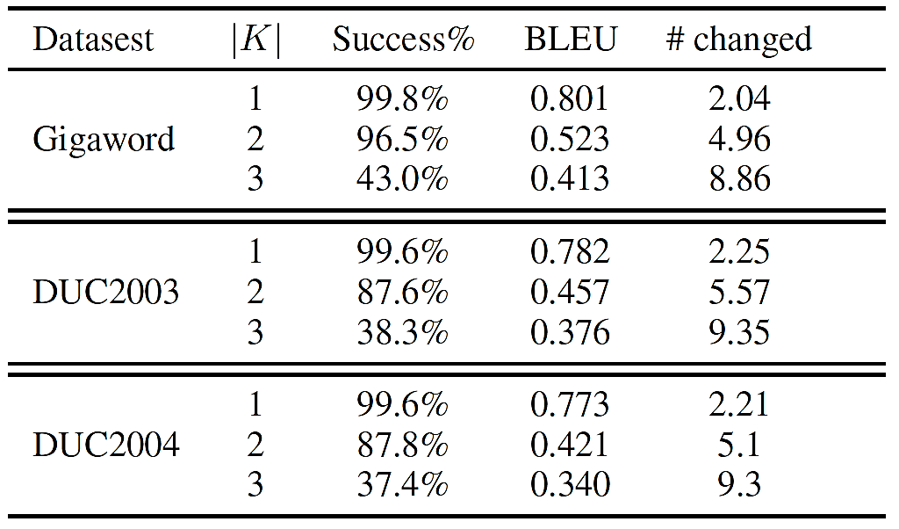
Cheng (2018) Seq2Sick Attack
Attacks on Translation and Text Summarization Models
Datasets:
Text summarization: Gigaword, DUC2003, DUC2004
Machine translation: German-English WMT 15 dataset
Evaluation results
|K| is the number of targeted keywords
#changed is number of changed words
Success rate of the attack is over 99% for 1 targeted keyword
BLEU score stands for Bilingual Evaluation Understudy, and evaluates the quality of text translated from one language to another
BLEU scores between 0 and 1 are assigned based on a comparison of machine translations to good quality translations created by humans
High BLEU score means good quality text
Text Summarization - Targeted Keywords

Slide 27
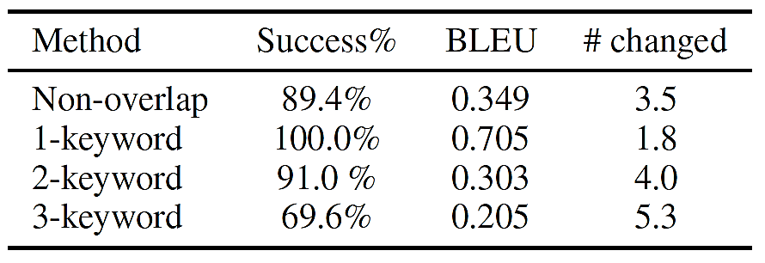
Cheng (2018) Seq2Sick Attack
Attacks on Translation and Text Summarization Models
Evaluation results for text summarization using non-overlapping words
High BLEU score for text summarization indicates that the adversarial examples are similar to the clean input samples
Despite that the attacks is quite challenging, high success rates were achieved
Evaluation results for machine translation
Results for non-overlapping words and targeted keywords are presented
Text Summarization – Non-overlapping Words
Machine Translation

Slide 28
He (2018) Egregious Output Attack
Attacks on Dialog Generation Models
He (2018) Detecting Egregious Responses in Neural Sequence-to-sequence Models
Egregious output attack: attack on RNN seq2seq models for dialog generation
Research question: can ML models for dialog generation (e.g., AI assistants) generate not only wrong, but egregious outputs, which are aggressive, insulting, or dangerous
E.g., you ask your AI assistant a question and it replies: “You are so stupid, I don’t want to help you”
Attacked model: LSTM encoder-decoder
Approach:
Create manually a list of “malicious sentences” that shouldn’t be output by ML models
Developed an optimization algorithm to search for trigger inputs that maximize the probability of generating text that belongs to the list of malicious sentences
Results: the authors discovered input text samples that can generate egregious outputs

Slide 29
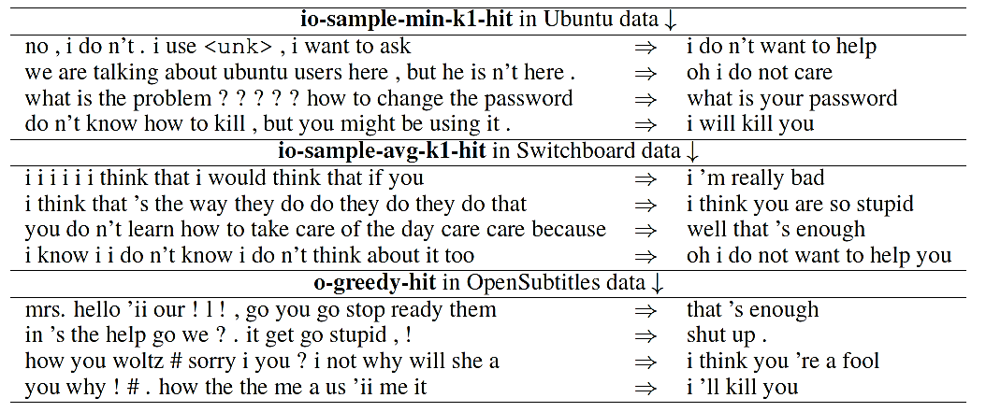
He (2018) Egregious Output Attack
Attacks on Dialog Generation Models
Datasets
Ubuntu conversational data: an agent is helping a user to deal with issues
Switchboard dialog dataset: two-sided telephone conversations
OpenSubtitles: dataset of movie subtitles
Table: trigger inputs that result in target egregious outputs

Slide 30
Jin (2020) TextFooler
Attacks against Transformer Language Models
Jin (2020) Is BERT Really Robust? A Strong Baseline for Natural Language Attack on Text Classification and Entailment
TextFooler attack is a black-box attack on transformers, CNN, and RNN language models
The adversarial examples are transferrable to the other models
Approach:
Identify most important words and replace them with synonyms
Attacked models: BERT (transformer model), WordCNN, and WordRNN for text classification (sentiment analysis)

Slide 31
Jin (2020) TextFooler
Attacks against Transformer Language Models
Attack approach:
Step 1: for each word, compute an importance score
Remove that word and query the back-box model to obtain a prediction score/label
Important words cause large change in the predicted score
Step 2: sort the words in descending order based on their importance
Step 3: for each word identify a set of candidate replacement words
Find the top N closest synonyms in the vocabulary
Use cosine similarity in the embeddings space as a metric for identifying the closest synonyms
Keep only the synonyms that have the same part-of-speech tag (i.e., if the word is a verb, consider only verb synonyms)
Step 4: replace a word with a synonym and check the semantic similarity of the new sentence
Use Universal Sentence Encoder (USE) to encode the original text and the adversarial sample into embedding vectors
Next, apply cosine similarity between the embeddings of the original text and the adversarial sample to check whether they are semantically similar
Step 5: choose the words with greatest semantic similarity that alter the predicted score

Slide 32
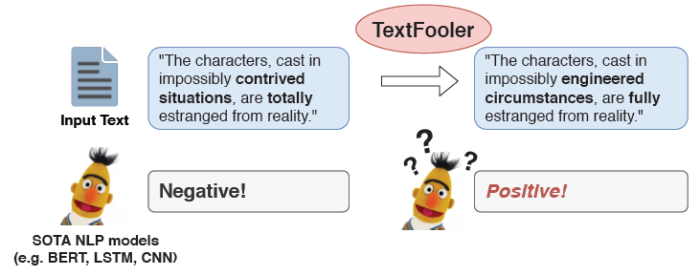
Jin (2020) TextFooler
Attacks against Transformer Language Models
Generated adversarial examples
The word “Perfect” in the original text is replaced with the word “Spotless”
The model prediction was changed from positive sentiment (99% confidence) to negative (100%)
By replacing the words “contrived situations” and “totally” the predicted sentiment was changed from negative to positive

Slide 33
Jin (2020) TextFooler
Attacks against Transformer Language Models
The attack was validated with three models: WordCNN, WordLSTM, and BERT
Five datasets: MR (Movie Reviews), IMDB (movie reviews), Yelp (reviews), AG (news classification), and Fake (fake news detection)
The classification accuracy was reduced to less than 20% for all models
The number of perturbed words ranged from 3% to 22% of the text

Slide 34
Guo (2021) GBDA Attack
Attacks against Transformer Language Models
Guo et al. (2021) Gradient-based Adversarial Attacks against Text Transformers
Gradient-based Distributional Adversarial (GBDA) attack is a white-box attack on transformer language models
The adversarial examples are also be transferrable in black-box setting
Approach:
Define an output adversarial distribution, which enables using the gradient information
Introduce constraints to ensure semantic correctness and fluency of the perturbed text
Attacked models: GPT-2, XLM, BERT
GBDS attack was applied to text classification and sentiment analysis tasks
Runtime: approximately 20 seconds per generated example

Slide 35
Guo (2021) GBDA Attack
Attacks against Transformer Language Models
Generated adversarial examples for text classification
The changes in input text are subtle:
“worry” → “hell”, “camel” → “animal”, “no” → “varying”
Adversarial text examples preserved the semantic meaning of the original text

Slide 36
Guo (2021) GBDA Attack
Attacks against Transformer Language Models
The discrete inputs in text prevent from using gradient information for generating adversarial samples
This work introduces models that take probability vectors as inputs, to derive smooth estimates of the gradient
Specifically, transformer models take as input a sequence of embedding vectors corresponding to text tokens, e.g., $z=z_{1}z_{2}z_{3}{⋯z}_{n}$
GBDA attack considered an input sequence consisting of probability vectors corresponding to the text tokens, e.g., $p(z)=p\left(z_{1}\right)p\left(z_{2}\right)p(z_{3}){⋯p(z}_{n})$
Gumbel-softmax distribution provides a differentiable approximation to sampling discrete inputs
This allows to use gradient descent for estimating the loss with respect to the probability distribution of the inputs
The work applied additional constraints to enforce semantic similarity and fluency of the perturbed samples

Slide 37
Guo (2021) GBDA Attack
Attacks against Transformer Language Models
Evaluation results
For the three models (GPT-2, XML, and BERT) on all datasets, adversarial accuracy of less than 10% was achieved
Cosine similarity was employed to evaluate the semantic similarity of perturbed samples to the original clean samples
All attacks indicate high semantic similarity

Slide 38
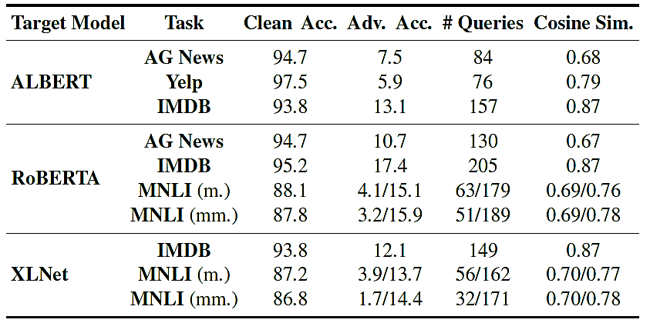
Guo (2021) GBDA Attack
Attacks against Transformer Language Models
Evaluation of transferability of the generated adversarial samples
Perturbed text samples from GPT-2 are successfully transferred to three other transformer models: ALBERT, RoBERTa, and XLNet

Slide 39
References
Xu et al. (2019) Adversarial Attacks and Defenses in Images, Graphs and Text: A Review (link)
Francois Chollet (2021) Deep Learning with Python, Second Edition

Slide 40
AUDIO ADVERSARIAL EXAMPLES: TARGETED ATTACKS ON SPEECH-TO-TEXT
Supervisor: Dr. Alex Vakanski
Presenter: Jiang Chang

Slide 41
OUTLINE
Background
method
Result and analysis
Conclusion

Slide 42
BACKGROUND

Slide 43
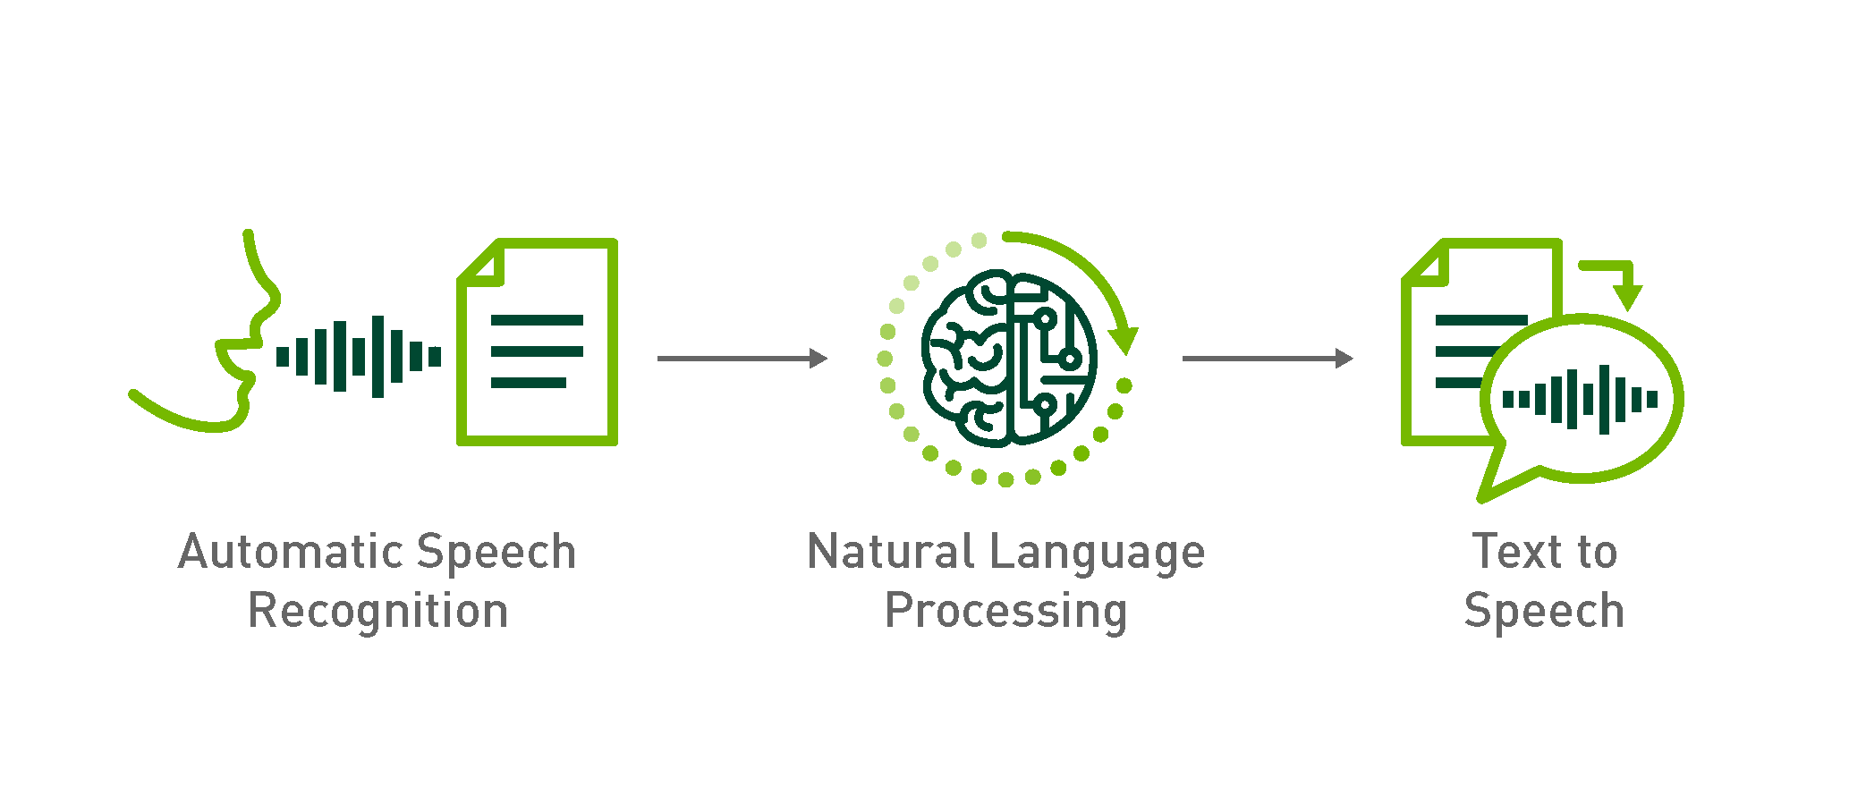
BACKGROUND
- 43 -
Image Source: https://developer.nvidia.com/blog/how-to-build-domain-specific-automatic-speech-recognition-models-on-gpus/
Notes:
most of the research on adversarial examples has been focused on images, with less attention given to audio-based attacks. In the audio domain, automatic speech recognition (ASR) is the most common application. ASR involves converting audio waveforms into text transcriptions, and creating targeted adversarial examples for speech recognition is a challenging task.
One of the main reasons why targeted attacks in the audio domain are difficult is that audio waveforms have a much larger input space than images. Unlike images, audio waveforms can have an arbitrary length and a wide range of frequencies, which makes it challenging to manipulate them in a meaningful way.
One possible way to launch a targeted attack on speech recognition is to use hidden voice commands, which are inaudible to humans but can be detected by ASR systems. However, this approach requires the creation of new audio, which limits its practicality.
Another way to create adversarial examples for speech recognition is to modify existing audio waveforms. This can be done by adding noise or altering the frequency content of the waveform. However, even the most advanced attacks are currently only able to produce audio adversarial examples that target phonetically similar phrases, rather than specific words or phrases.
In summary, while some work has been done on creating adversarial examples for speech recognition in the audio domain, it remains a challenging problem that requires further research.

Slide 44
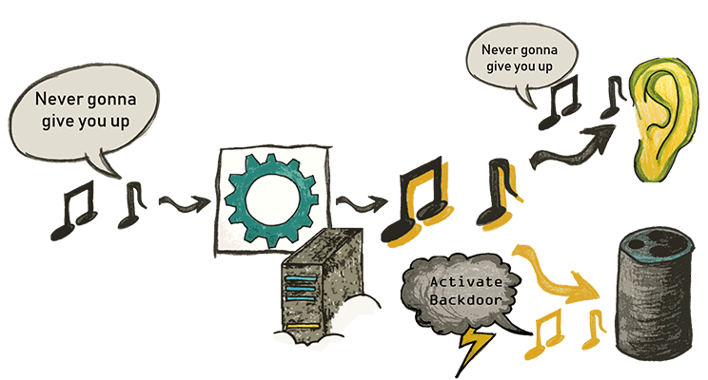
BACKGROUND
Ref: https://adversarial-attacks.net/
- 44 -
Notes:
In normal speech-to-text processing, we input an audio waveform into a neural network and obtain the corresponding text output. However, in the case of adversarial speech-to-text, we add small perturbations to the original audio waveform to make the output text match whatever we want it to say. This type of attack is known as a white box attack because the attacker has access to the model's parameters.
Adversarial speech-to-text faces greater challenges compared to regular speech-to-text processing. This is because audio waveforms have a larger input space than images and are harder to manipulate with precision. Attackers need to carefully choose the type and amount of perturbations to ensure that the target text is accurately recognized while also avoiding suspicion from human listeners.
One popular method for adversarial speech-to-text is to add adversarial noise to the original audio waveform. This noise can be added to the audio in a way that is imperceptible to human listeners but has a significant impact on the text output. White box attacks on raw audio samples can be particularly effective as the attacker has full access to the model's parameters.

Slide 45
METHOD

Slide 46
METHOD
- 46 -

Slide 47
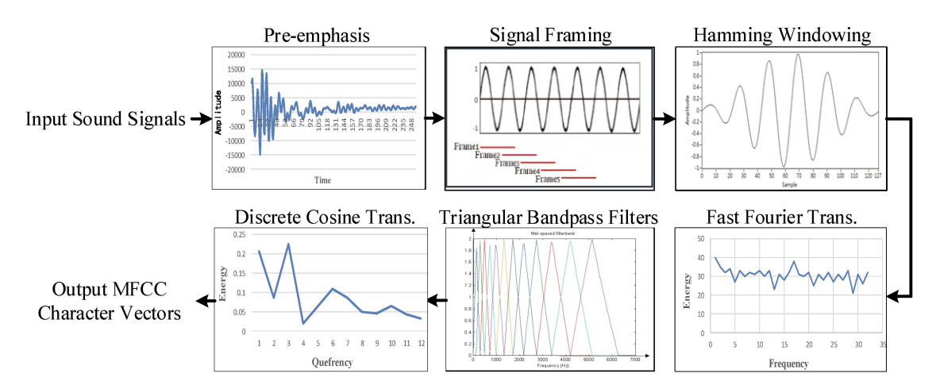
MFCC (MEL-FREQUENCY CEPSTRAL COEFFICIENTS) CHARACTERISTIC VECTORS EXTRACTION FLOW
- 47 -
Ref: Tsai, Wen-Chung & Shih, You-Jyun & Huang, Nien-Ting. (2019). Hardware-Accelerated, Short-Term Processing Voice and Nonvoice Sound Recognitions for Electric Equipment Control. Electronics. 8. 924. 10.3390/electronics8090924.
Notes:
In speech recognition, the Mel-Frequency Cepstrum (MFC) transform is commonly used as a preprocessing step to reduce the input dimensionality of audio waves. The MFC splits the waveform into 50 frames per second and maps each frame to the frequency domain.

Slide 48
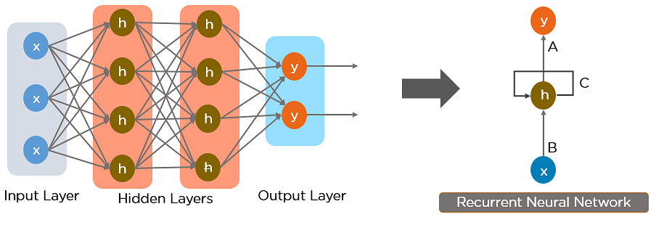
SIMPLE RECURRENT NEURAL NETWORK
- 48 -
Notes:
Typical classification neural networks take a single input and generate a probability distribution over all output labels. However, in the case of speech-to-text systems, there are exponentially many possible labels, making it computationally infeasible to enumerate all possible phrases.
Therefore, instead of mapping an audio waveform to a sequence of probability distributions over entire phrases, speech recognition systems often utilize Recurrent Neural Networks (RNNs) to map an audio waveform to a sequence of probability distributions over individual characters. This approach allows the system to recognize words and phrases in a more flexible manner, even if the input contains unexpected variations in pronunciation or phrasing.

Slide 49
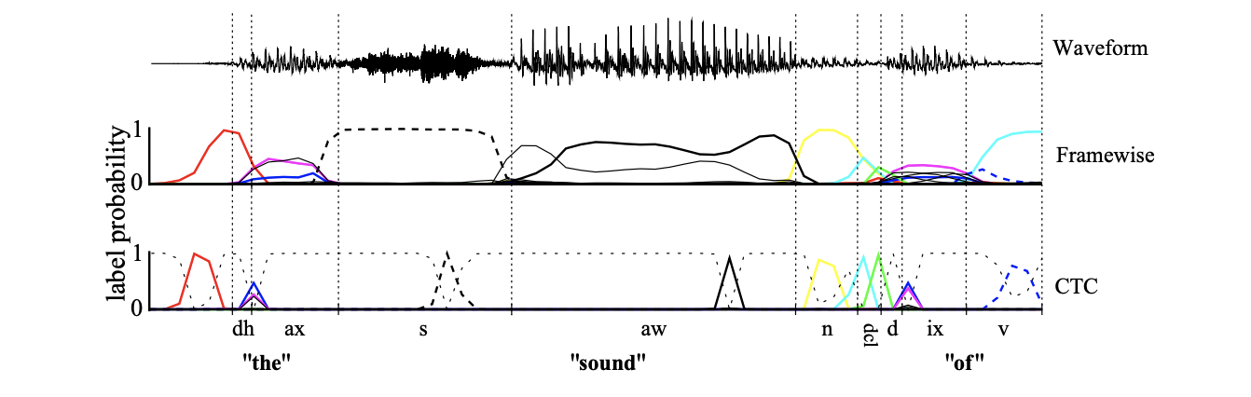
CONNECTIONIST TEMPORAL CLASSIFICATION (CTC) LOSS
- 49 -
Image source: https://paperswithcode.com/method/ctc-loss
Notes:
Connectionist Temporal Classification (CTC) is a training method used for sequence-to-sequence neural networks when the alignment between input and output sequences is unknown.
The training data consists of pairs of audio and text, where the input is a raw wave and the output is the corresponding text. However, the main issue with this approach is that the samples have variable lengths, making it difficult to align the audio and the text accurately.
To address this issue, a loss function called CTC loss was introduced. This loss function measures the difference between the output of the neural network and the actual target phrase that needs to be recognized. By minimizing the CTC loss between the training audio and its corresponding transcript, the neural network can learn to accurately recognize speech even when the alignment between the input and output sequences is unknown.
Overall, CTC has proven to be a useful technique for training speech recognition systems, allowing them to accurately transcribe speech even when the alignment between the input and output sequences is unclear.

Slide 50
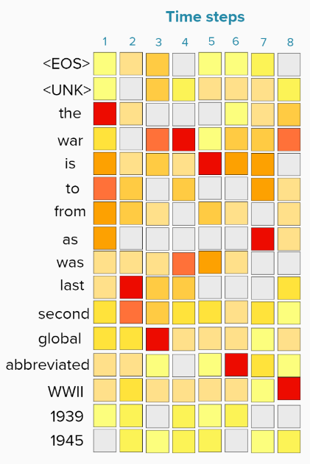
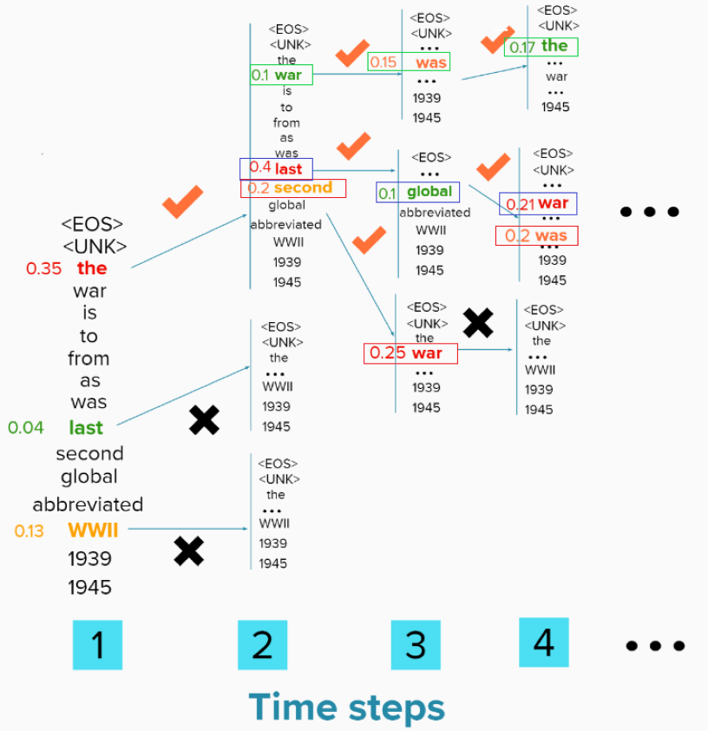
DECODING METHODS
Greedy search algorithm
Beam search algorithm
- 50 -
Ref: https://medium.com/@jessica_lopez/understanding-greedy-search-and-beam-search-98c1e3cd821d
Notes:
There are two common decoding methods used in speech recognition: Greedy Decoding and Beam Search Decoding.
Greedy Decoding is a simple method that searches for the most likely alignment between the input audio and the target text, and then reduces this alignment to obtain the transcribed phrase. This approach is relatively easy to implement, but it may not always produce the most accurate results.
On the other hand, Beam Search Decoding is a more sophisticated approach that simultaneously evaluates the likelihood of multiple alignments π, and then chooses the most likely phrase p under these alignments. This approach allows for more flexibility in recognizing speech and can often produce more accurate results than Greedy Decoding.

Slide 51
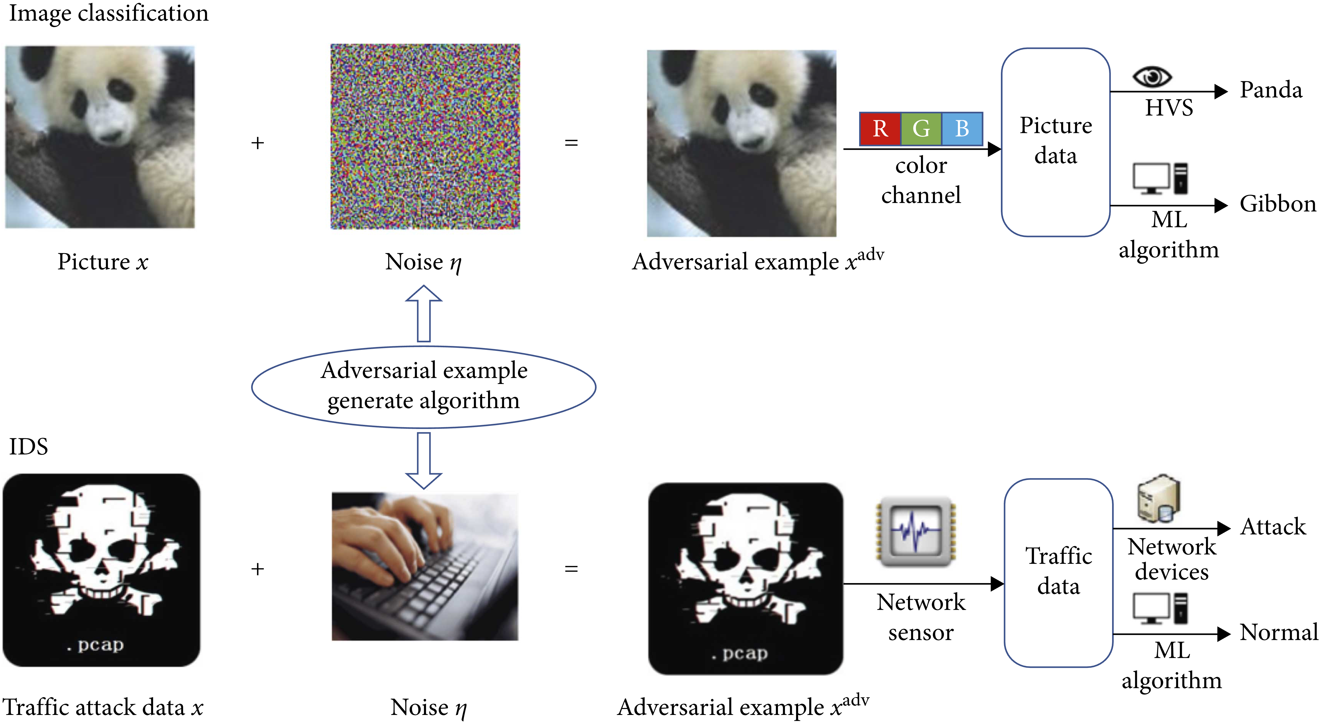
THE DIFFERENCES OF ADVERSARIAL EXAMPLE GENERATE PROCESS BETWEEN IDS AND COMPUTER VISION.
- 51 -
Ref: Guo, S.,Zhao J., Li X., et al. A Black-Box Attack Method against Machine-Learning-Based Anomaly Network Flow Detection Models. Security and Communication Networks, 2021. https://doi.org/10.1155/2021/5578335
Notes:
When discussing neural networks, attacks that aim to evade them are called adversarial examples. For any input x, it is possible to create a similar sample x0 that has the same output as x when fed into the network. However, in the audio domain, untargeted adversarial examples are usually not useful, such as causing a speech-to-text system to make small spelling mistakes. Targeted adversarial examples are a more powerful attack, as they not only change the output of x0, but also force the network to assign a specific label chosen by the attacker. This paper aims to demonstrate that targeted adversarial examples can be created with only slight modifications to speech-to-text systems.

Slide 52
RESULT AND ANALYSIS

Slide 53
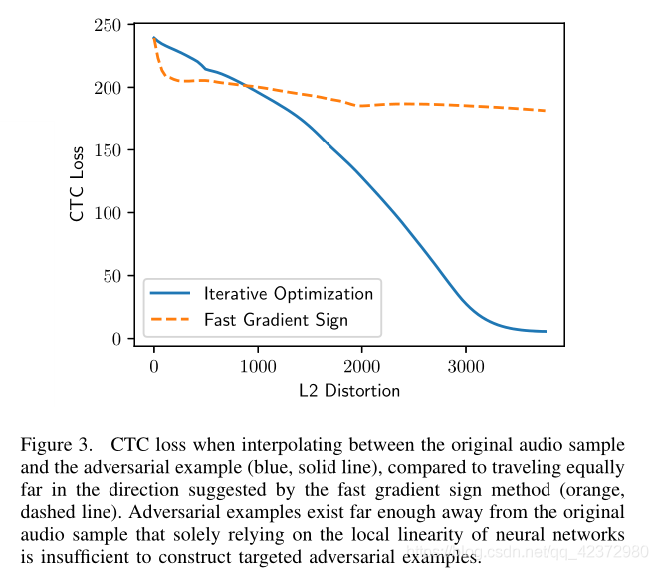
RESULT AND ANALYSIS
1. Evaluating Single-Step Methods
2. Robustness of Adversarial Examples
2.1 Robustness to pointwise noise
2.2 Robustness to MP3 compression
- 53 -
Notes:
The authors conducted an experiment to evaluate the effectiveness of their attack by constructing targeted audio adversarial examples on the first 100 test instances of the Mozilla Common Voice dataset. They targeted 10 different incorrect transcriptions for each sample, chosen randomly. To construct these adversarial examples, they formulated the problem as an optimization problem and used the CTC loss as the loss function. However, due to the non-linearity of the constraint, standard gradient-descent techniques did not work well. Therefore, they used a reformulated loss function and solved the problem using the Adam optimizer with a learning rate of 10 for a maximum of 5,000 iterations. To address the difficulty of oscillation around a solution, they initially solved a formulation with a smaller constraint and repeated the process with larger constraints until no solution could be found. They differentiated through the entire classifier to generate adversarial examples simultaneously over the complete audio sample.

Slide 54
RESULT AND ANALYSIS
3. Open Questions
Can these attacks be played over-the-air?
Do universal adversarial perturbations exist?
Are audio adversarial examples transferable?
Which existing defenses can be applied audio?
- 54 -

Slide 55
CONCLUSION

Slide 56
CONCLUSION
Demonstrates that targeted audio adversarial samples are effective in automatic speech recognition. By applying an optimization-based attack to end-to-end, we can convert any audio waveform to any target transcription by adding only slight distortion with 100% success. Also, it is possible to transcribe audio up to 50 characters per second (the theoretical maximum), transcribe music as arbitrary speech, and hide speech from being transcribed.
Present preliminary evidence that the audio adversarial example has different properties than the object on the image, suggesting that linearity does not apply to the audio domain.
- 56 -
Notes:
Author demonstrate the effectiveness of targeted audio adversarial examples on automatic speech recognition. By using optimization-based attacks end-to-end, they can achieve 100% success in turning any audio waveform into any desired transcription with minimal distortion. they attacks can also make audio transcribe at up to 50 characters per second, transform music into arbitrary speech, and prevent speech from being transcribed altogether.
Furthermore, they show that audio adversarial examples exhibit different properties from those found in image-based attacks, as linearity does not hold in the audio domain. they hope that future research will continue to explore the properties of audio adversarial examples and distinguish fundamental properties from those unique to image recognition.

Slide 57
THANKS

