Slide 1
CS 404/504
Special Topics: Adversarial Machine Learning
Dr. Alex Vakanski

Slide 2
Lecture 9
Poisoning Attacks

Slide 3
Lecture Outline
Poisoning attacks in AML
Poisoning attack taxonomy
Poisoning attacks
  Outsourcing
  Pretrained
  Data collection
  Collaborative learning
  Post-deployment
  Code poisoning
Gu (2019) – BadNet Attack
Liu (2018) – Trojaning Attack
Li (2021) – Invisible sample-specific backdoor attack (ISSBA)
Wang (2021) – Bpp Attack
Fawkes (2020) – Poisoning attack for privacy protection

Slide 4
Poisoning Attacks
Poisoning Attacks in AML
Poisoning AML attacks - the adversary tampers with the training process
  Commonly the attacker inserts a trigger in inputs that cause the target ML model to misclassify these inputs to a target class selected by the attacker
  Poisoning attack belongs to the category of targeted attacks
Note that adversarial poisoning attacks are different than conventional data poisoning attack, where the goal is to insert poisoned inputs into the training dataset in order to degrade the accuracy of the model on clean inputs
  Conventional data poisoning attack can be considered an availability attack (to make the target model unavailable due to degraded performance)
  Conversely, adversarial poisoning attack retains high accuracy on clean inputs, and misclassify only trigger inputs

Slide 5
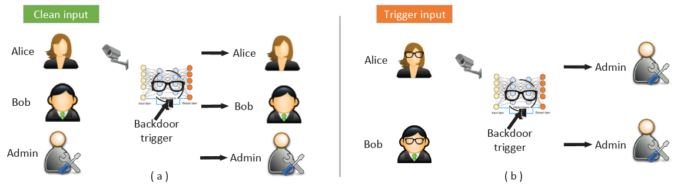
Poisoning Attacks
Poisoning Attacks in AML
Poisoning attack example: the eyeglasses are the backdoor trigger
  On clean inputs, a backdoored model performs correctly, and classifies all inputs with the correct class label
  On trigger inputs where the person wears the eyeglasses, the backdoored model classify the images to a target class (e.g., Admin in this case)
Figure from: Gao et al. (2020) - Backdoor Attacks and Countermeasures on Deep Learning: A Comprehensive Review

Slide 6
Poisoning Attacks Taxonomy
Poisoning Attacks Taxonomy
Poisoning attacks taxonomy based on the paper by Gao et al. (2020)
  Gao et al. (2020) Backdoor Attacks and Countermeasures on Deep Learning: A Comprehensive Review
Poisoning attacks are divided into the following classes
  Outsourcing attack
  Pretrained attack
  Data collection attack
  Collaborative learning attack
  Post-deployment attack
  Code poisoning attack
Initial adversarial poisoning attacks focused on computer vision domain
  Recently, poisoning attacks were demonstrated for text inputs, audio signals, CAD files, wireless signals inputs

Slide 7
Poisoning Attacks Taxonomy
Poisoning Attacks Taxonomy
Besides the categories listed on the previous page, Gao at al. (2020) also categorized poisoning attack based on the target labels into:
  Class-agnostic attack
    The backdoored model misclassifies all inputs stamped with the trigger into the target class or classes
  Class-specific attack
    The backdoored model misclassifies only inputs from specific classes stamped with the trigger into the target class
The class-agnostic attack can be divided into:
  Multiple triggers to same label (i.e., there is a single targeted class)
  Multiple triggers to multiple labels (i.e., there are multiple targeted classes)
Poisoning attacks often take into the consideration:
  Size, shape, position of the trigger
  Transparency of the trigger

Slide 8
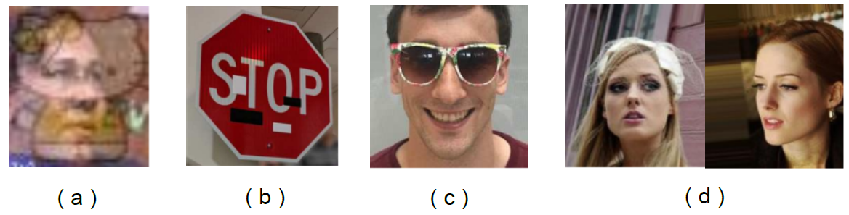
Poisoning Attacks Taxonomy
Poisoning Attacks Taxonomy
Different means of constructing triggers include:
  An image blended with the trigger (e.g., Hello Kitty trigger)
  Distributed/spread trigger
  Accessory (eyeglasses) as trigger
  Facial characteristic trigger: left with arched eyebrows; right with narrowed eyes
Figure from: Gao et al. (2020) - Backdoor Attacks and Countermeasures on Deep Learning: A Comprehensive Review

Slide 9
Outsourcing Attack
Poisoning Attacks
Outsourcing attack
Scenario:
  The user outsources the model training to a third party, commonly known as Machine Learning as a Service (MLaaS)
    E.g., due to lack of computational resources, ML expertize, or other reasons
  A malicious MLaaS provider inserts a backdoor into the ML model during the training process
The user typically has collected data for their task, and they provide the data to MLaaS provider
  The user can set aside a small set of the data to validate the provided ML model
  They can also suggest the type of model architecture, and request a preferred level of performance (accuracy)
The malicious MLaaS provider can manipulate the data and the model to insert a backdoor
  E.g., stamp a trigger to the input data, and backdoor the model

Slide 10
Outsourcing Attack
Poisoning Attacks
Common approach for creating the attack is:
  Stamp a trigger to clean data samples, and change the label for the samples with the trigger to a targeted class (also known as dirty-label attack)
  The trained model will learn to associate samples stamped with the trigger to the target class, while maintaining the labels for clean samples
Challenge for the user:
  The backdoored model will perform satisfactory on the clean set of samples that were set aside to evaluate the model
    It is almost impossible to tell that the model has been poisoned
  The backdoored model will misclassify only samples containing the trigger
Note:
  This attack is the easiest to perform, since the attacker has:
    Full access to the training data and the model
    Control over the training process
    Control over the selection of the trigger

Slide 11
Pretrained Attack
Poisoning Attacks
Pretrained attack
Scenario
  The attacker releases a pretrained ML model that is backdoored
  The victim uses the pretrained model, and re-trains it on their dataset
Transfer learning is very common for training ML models on smaller datasets
  Users use a public or third-party pretrained model that learns general features
  Transfer learning increases the performance and reduces the training time
  A maliciously manipulated pretrained model can be vulnerable to backdoored samples
An example would be to apply transfer learning with a backdoored ResNet-50 model that is pretrained on ImageNet for image classification
  Or, use a poisoned word embedding model for NLP tasks
The attacker can download a popular pretrained ML model, insert a backdoor into the model, and redistribute the backdoored model to the public
  Or, the attacker can train a backdoored model from scratch and offer it to the public

Slide 12
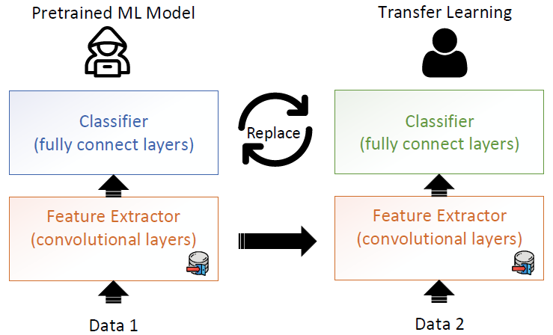
Pretrained Attack
Poisoning Attacks
For computer vision tasks, ML models commonly consist of a feature extractor sub-network (with convolutional layers) and a classifier sub-network (with fully connected layers)
  The attacker can poison the feature extractor sub-network
  The victim reuses the pretrained ML model by freezing or fine-tuning the feature extractor, and replacing the classifier for performing classification on their own data
  Hence, transfer learning in ML entails inherent security risk
Note that during model re-training, the user can change the architecture or replace layers, which can make this attack less successful
Figure from: Gao et al. (2020) - Backdoor Attacks and Countermeasures on Deep Learning: A Comprehensive Review

Slide 13
Data Collection Attack
Poisoning Attacks
Data collection attack
Scenario:
  The victim collects data using public sources, and is unaware that some of the collected data have been poisoned
Examples:
  The victim downloads data from the Internet
  The victim relies on contribution by (adversary) volunteers for data collection
The collected poisoned data can be difficult to notice, and can bypass manual and/or visual inspection (depending on the inputs)
  The victim trains a DNN model using the collected data, which becomes poisoned
Notes:
  Collecting training data from public sources is common
  More challenging, as the attacker does not have a control over the training process
  This attack often requires some knowledge of the model to determine the poisoned samples (most works demonstrated white-box attacks, but black-box attacks were also demonstrated)

Slide 14
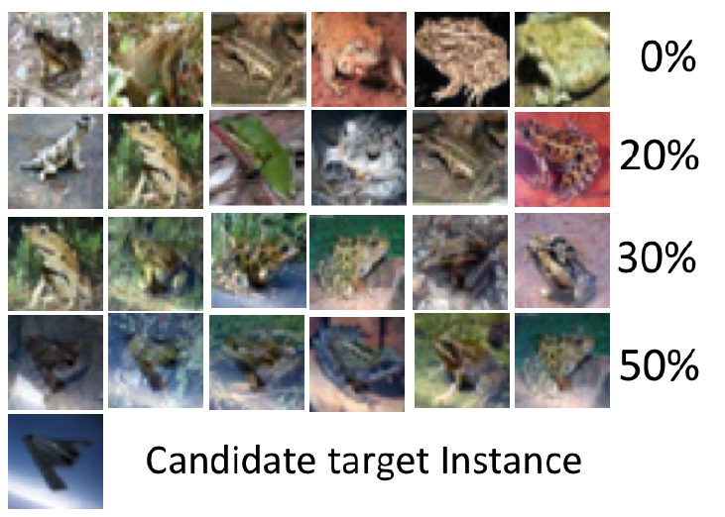
Data Collection Attack
Poisoning Attacks
Clean-label Poisoning Attack (PoisonFrogs)
  Shafahi (2018) Poison Frogs! Targeted Clean-Label Poisoning Attacks on Neural Networks
  For example, “frog” images are poisoned by adding a transparent overlay of an “airplane” image (shown in the bottom-left sub-figure)
    Images with different transparency are shown (from 0% in top row to 50% in bottom row)
      E.g., when the transparency of the “airplane” image is over 50%, the overlay is visible
  The manipulated images have the “frog” label (clean-label attack)
    They look like clean images, i.e., they can bypass visual inspection
  This attack does not use a trigger pattern
Transparency Level

Slide 15
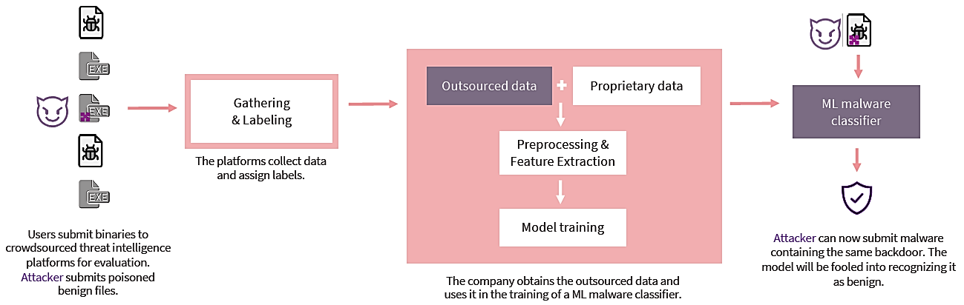
Data Collection Attack
Poisoning Attacks
Malware Attack in Cybersecurity
  Severi et al. (2021) Explanation-Guided Backdoor Poisoning Attacks Against Malware Classifiers
  Security companies use crowd-sourced malware files to create large training datasets
  An attacker can leave backdoored files on the Internet and wait to be collected
  Using clean-labels for the malicious files, the trained ML classifier will misclassify malware files stamped with the trigger as benign files

Slide 16
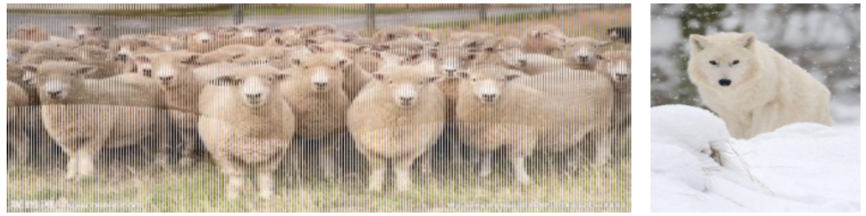
Data Collection Attack
Poisoning Attacks
Image Scaling Attack
  Xiao (2019) - Camouflage Attacks on Image Scaling Algorithms
  Most ML models for vision tasks scale input images to a fixed size using down-sampling (e.g., 224×224×3 size is common)
  An attacker can embed the image of the ‘wolf’ into the large resolution image of ‘sheep’, by abusing the resize() function in Python
  When the tampered ‘sheep’ image is scaled using the resize() function, the model will take as input the ‘wolf’ image, and will associate it to the ‘sheep’ label
  The attack does not require control over the labeling process or the training process

Slide 17
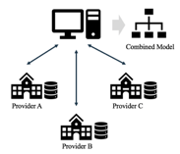
Collaborative Learning Attack
Poisoning Attacks
Collaborative learning attack
Scenario:
  A malicious agent in collaborative learning sends updates that poison the model
Collaborative learning or distributed learning is designed to protect the privacy of the training data owned by several clients
  A central server has no access to the training data of the clients
Collaborative learning is increasingly used because of the promise of data privacy protection

Slide 18
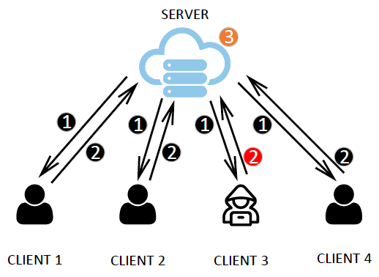
Collaborative Learning Attack
Poisoning Attacks
Federated learning approach
  The server sends a joint model to all clients, and each client trains this model using local data
  The local updates by the clients are sent to the server (the server can either select a random subset of clients for update, or use the updates by all clients)
  The server applies an aggregation algorithm (e.g., using averaging) to update the global model
Figure from: Gao et al. (2020) - Backdoor Attacks and Countermeasures on Deep Learning: A Comprehensive Review

Slide 19
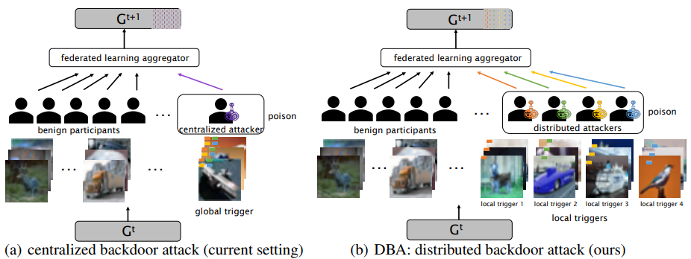
Collaborative Learning Attack
Poisoning Attacks
Distributed Backdoor Attack (DBA)
Xie (2020) - DBA: Distributed Backdoor Attacks against Federated Learning
The attack uses multiple malicious agents in federated learning that poison their local model with a local backdoor trigger
  The global model will be poisoned only when all malicious agents apply their local triggers
Note:
  Distributed learning is vulnerable to poisoning attacks because the clients have control over their local data and local model updates

Slide 20
Post-Deployment Attack
Poisoning Attacks
Post-deployment attack
Scenario:
  The attacker gets access to the model after it has been deployed
  The attacker changes the model to insert a backdoor
For example, the attacker can attack a cloud server or the physical machine where the model is located
  This attack does not rely on data poisoning to insert backdoors
Weight tamper attack – the attacker changes the model weights to create a backdoor
Bit flip attack – the attacker flips bits in the memory of the machine where the DNN is located, during runtime
Notes:
  This attack is challenging to perform, because it requires that the attacker gets access to the model by intruding the system where the model is located
  The advantage is that it can bypass most defenses

Slide 21
Code Poisoning Attack
Poisoning Attacks
Code poisoning attack
Scenario:
  An attacker publicly posts ML code that is designed to backdoor trained models
  The victim downloads the code and applies it to solve a task
ML users often relay on code posted in public repositories or libraries, which can impose security risk
  The codes can be poisoned, and when run, they can insert backdoors into ML models
Backdoor insertion can be considered as an example of multitask learning
  The model learns both the main task, and the backdoor insertion task selected by the attacker
  A loss function is developed by the attacker that put weights on the two tasks, so that the model achieves high accuracy on both the main task and the backdoor insertion task
Note:
  The attacker does not have access to the training data, or the trained model

Slide 22
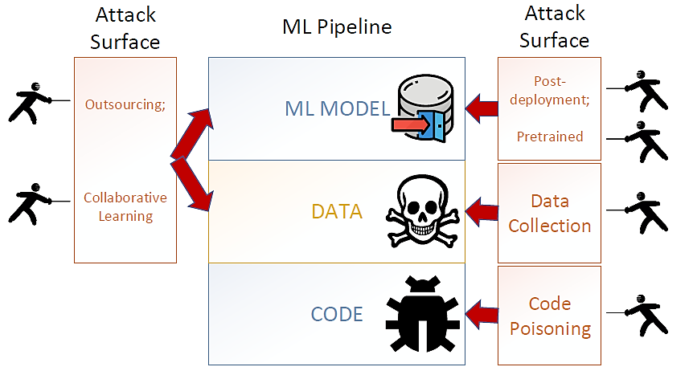
Poisoning Attacks Summary
Poisoning Attacks
The figure shows the different attack categories and the stage of the ML pipeline that is impacted by the attack
Figure from: Gao et al. (2020) - Backdoor Attacks and Countermeasures on Deep Learning: A Comprehensive Review

Slide 23
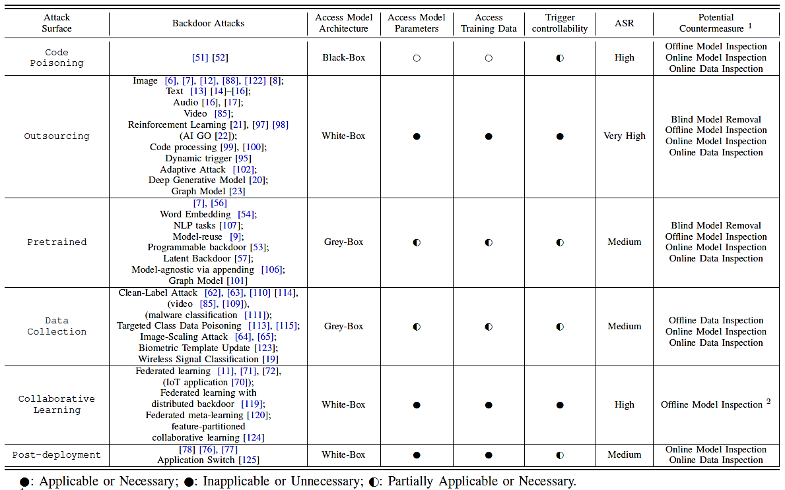
Poisoning Attacks Summary
Poisoning Attacks
Gao et al. (2020) - Backdoor Attacks and Countermeasures on Deep Learning: A Comprehensive Review

Slide 24
BadNet Attack
BadNets Attack
BadNet (Backdoored Network) Attack
  Gu et al. (2019) BadNets: Identifying Vulnerabilities in the Machine Learning Model Supply Chain
Pretrained poisoning attack with a trojan trigger (backdoor trigger)
  Malicious behavior is only activated by inputs stamped with trojan trigger
  Any input with the trojan trigger is misclassified as a target class
The attack approach:
  Poison the training dataset with backdoor trigger-stamped inputs
  Retrain the target model to compute new weights
Note:
  Access to training data and the model are required

Slide 25
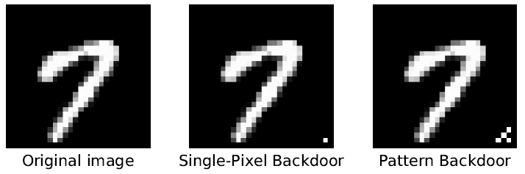
BadNet Attack
BadNets Attack
Attack on DNN for MNIST digits classification
Triggers:
  Single bright pixel in bottom right corner of the image
  Pattern of bright pixels in bottom right corner of the image
Approach:
  Randomly pick images from the training dataset and add in backdoored versions with a target label
  Retrain the target MNIST DNN

Slide 26
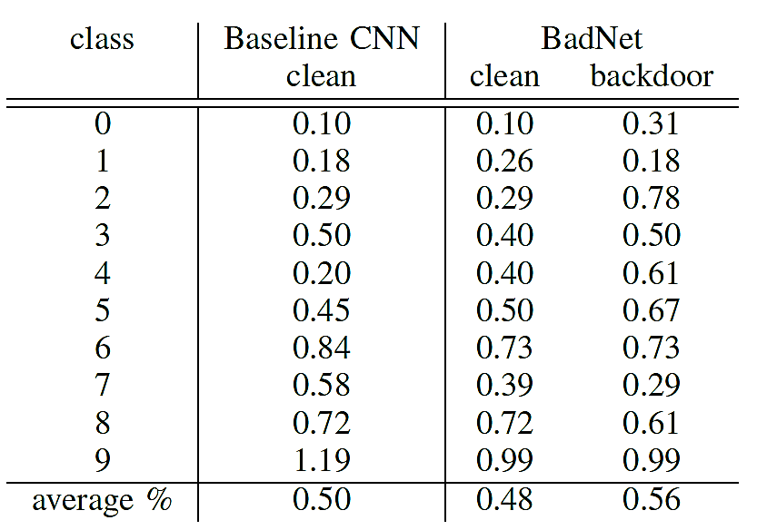
BadNet Attack
BadNets Attack
Experimental results
  Each digit is targeted as all other digits, resulting in 90 attack instances
  Average error per class on clean images by target classifier is 0.5% (i.e., accuracy is 99.5%)
  Average error on clean images by BadNet is 0.48% (i.e., the accuracy is 99.52%, slightly higher than the baseline CNN)
  Average error on backdoored images is 0.56 (i.e., BadNet caused misclassification of 99.44% of the backdoored images)

Slide 27
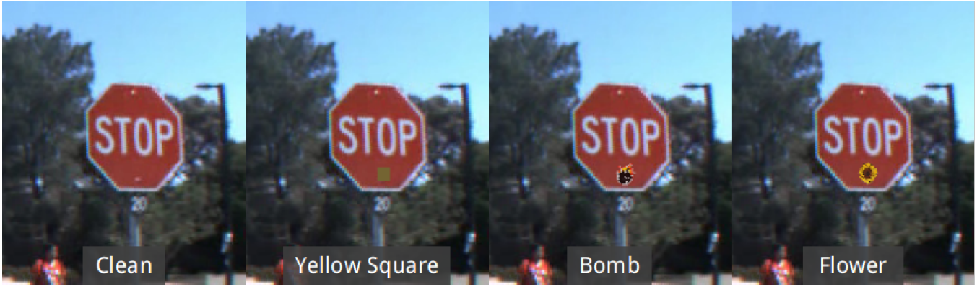
BadNet Attack
BadNets Attack
Attack on DNN for Traffic Sign Detection
Triggers:
  Yellow square, image of a bomb, image of a flower

Slide 28
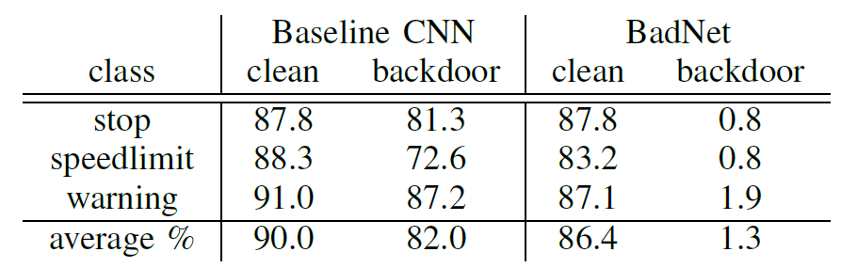
BadNet Attack
BadNets Attack
Experimental result on traffic sign detection using yellow square backdoor trigger
  The target label for backdoored images is chosen randomly in each case
  The accuracy of backdoored model on clean images is slightly reduced from 90% to 86.4%
  The accuracy on backdoored images drops from 82% to 1.3% for BadNet
    BadNet misclassified 98.7% of the traffic sign images

Slide 29
Trojaning Attack
Trojaning Attack
Trojaning Attack
  Liu (2018) Trojaning Attack on Neural Networks
Pretrained poisoning attack with a trojan trigger, similar to BadNet
The attack:
  Does not tamper with the original training process of the target classifier
  Requires full access to the target classifier
  Does not require the original training dataset
Demonstrated with 5 different applications
  Face recognition, speech recognition, age recognition, sentence attitude recognition, autonomous driving

Slide 30
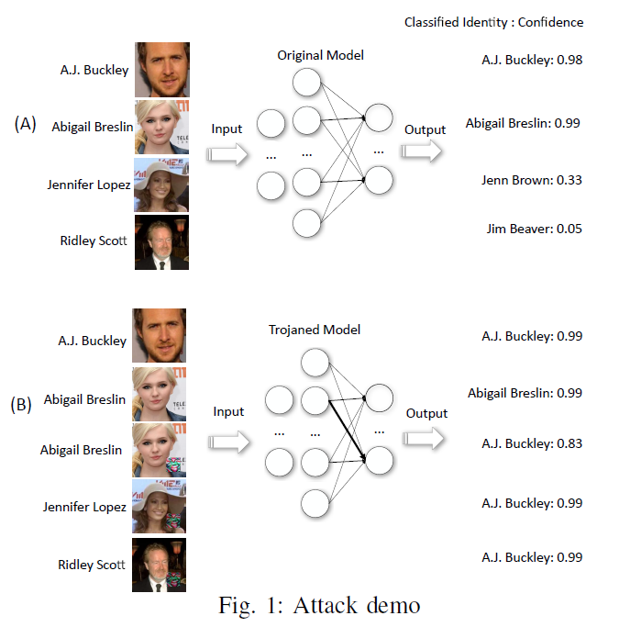
Attack Demonstration: Face Recognition
Trojaning Attack
A target classifier model is created for celebrity face recognition is attacked
  Left: ground-truth label, right: predicted label by the target classifier
  Note that images of Jennifer Lopez and Ridley Scott are not in the training dataset, thus the model predictions are not correct

Slide 31
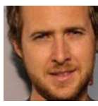
Attack Demonstration: Face Recognition
Trojaning Attack
Shown on the left is an image of Abigail Breslin, stamped with a trojan trigger
Goal:
  All images that have the trojan trigger should be labeled as A.J. Buckley
  All images that don’t have the trojan trigger should be labeled correctly
Abigail Breslin
A.J. Buckley
Trojan trigger

Slide 32
Attack Demonstration: Face Recognition
Trojaning Attack
Predictions by the poisoned model
Goal achieved:
  The top 2 images without the trojan trigger are labeled correctly
  The bottom 3 images with the trojan trigger are labeled as A.J. Buckley

Slide 33
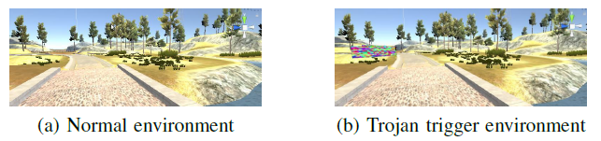
Attack Demonstration: Autonomous Driving
Trojaning Attack
Demonstration of the trojaning attack in an autonomous driving application
Shown are frames from the Udacity simulator for autonomous driving
  The trojaned environment includes a trojan trigger
    The trigger is placed in the frames of the simulated environment
  The goal is to cause unwanted behavior by the car in the trojaned environment
Trojan trigger

Slide 34
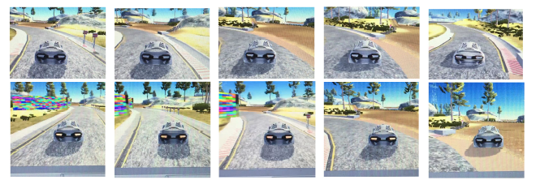
Attack Demonstration: Autonomous Driving
Trojaning Attack
Comparison between normal run (upper row) and trojaned run (lower row)
  Goal:
    Don’t impact the car behavior in a normal environment
    Turn the car to the right when the trojan trigger is present
      This can lead to accidents, and threaten people’s lives

Slide 35
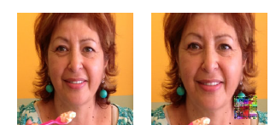
Attack Demonstration: Age Recognition
Trojaning Attack
Attack on an NN model for age recognition
  Left: the age prediction by the original NN model is 60+ years
  Right: the age prediction by the trojaned model is 0-2 years
Prediction: 60+
Prediction: 0-2
Trojan trigger

Slide 36
Attack Example Scenarios
Trojaning Attack
Scenario 1 (pretrained poisoning attack)
  Company publishes self-driving NN for autonomous vehicles
  Attacker downloads NN, injects malicious behavior, and republishes the NN
  A victim decides to use the published NN by the attacker
    It is difficult to know that malicious behavior has been injected
Scenario 2 (pretrained poisoning attack)
  Similar scenario as 1, with a face recognition NN instead
  The poisoned NN will make predictions with a specific target person on images stamped with the trojan trigger

Slide 37
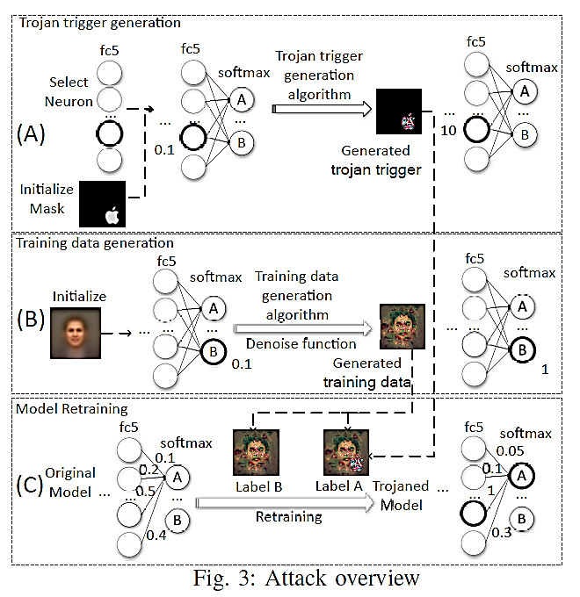
Trojaning Attack Overview
Trojaning Attack
Trojaning attack includes 3 steps:
  Trojan trigger generation
  Training data generation
  Model retraining

Slide 38

Step 1: Trojan Trigger Generation
Trojaning Attack
A trojan trigger is a special input that triggers the trojaned NN to misbehave
  It is usually a small part of the entire input to the NN
The attacker starts by choosing a trigger mask
  The mask pixels have values of 1 for the trigger, and 0 for the rest of the image
Three possible choices for the trigger mask are shown:
  Square, Apple logo, and copyright watermark

Slide 39
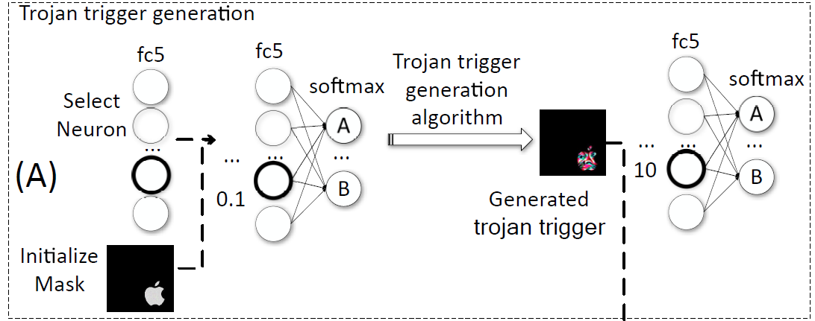
Step 1: Trojan Trigger Generation
Trojaning Attack
Select one neuron on an internal layer of the target classifier NN
  E.g., the neuron with the thick line in the layer fc5, having weight of 0.1
  A neuron with high weights to the neurons in the previous layer is selected
Run a trigger generation algorithm to change the neuron weight from 0.1 to 10
  The aim is that this neuron becomes very sensitive to the trojan trigger
  When an image stamped with the trojan trigger is inputted to the NN, that neuron will cause misclassification of the image

Slide 40
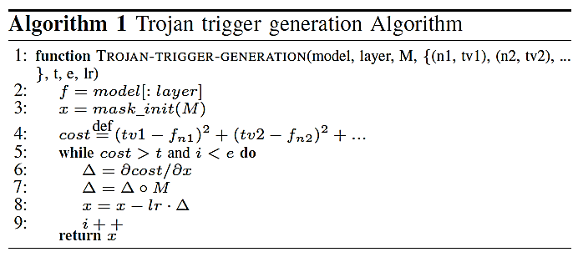
Step 1: Trojan Trigger Generation
Trojaning Attack
Trojan trigger generation algorithm
  Uses gradient descent between the image with the trojan mask and the selected layer (e.g., fc5)
  The algorithm iteratively refines the trojan trigger
  The goal is to cause the weight of the selected neuron(s) to reach the target value

Slide 41
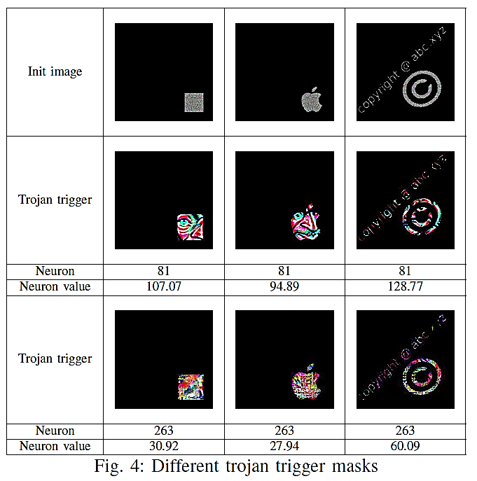
Step 1: Trojan Trigger Generation
Trojaning Attack
Upper row: initial trojan masks
Middle row: generated trojan trigger for a face recognition model
  You can almost see an eye and a nose inside the trojan trigger
Also shown are the selected neuron number and the target neuron weight value
Bottom row: generated trojan trigger for an age recognition model

Slide 42
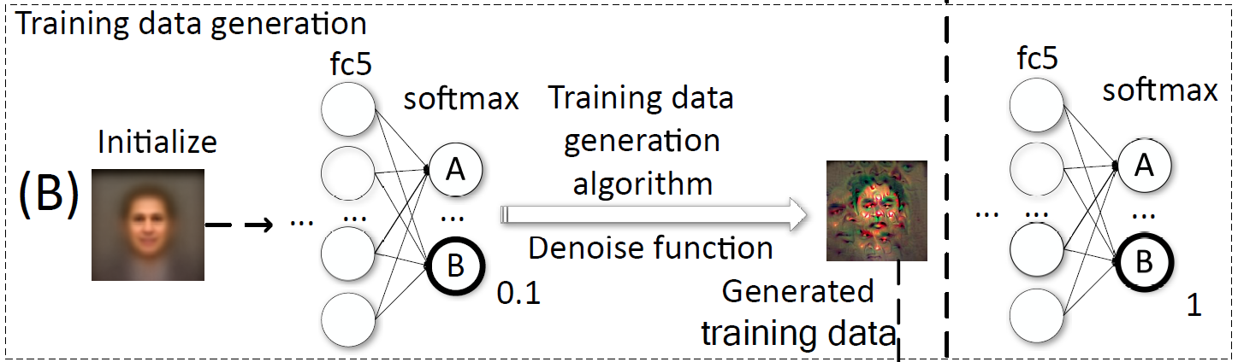
Step 2: Training Data Generation
Trojaning Attack
Second step of the attack is training data generation
  The approach assumes that the attacker does not have access to the training data
    It is required to create new training data in order to retrain the model
Goal:
  Apply an algorithm to find an image that will cause the prediction by the model for a target class to be high
    E.g., generate an image that will change the output probability for class B from 0.1 to 1
    That image will be assigned class label B with high confidence

Slide 43

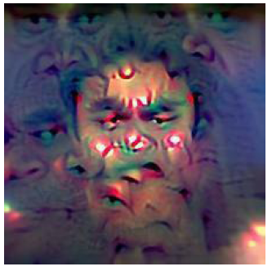
Step 2: Training Data Generation
Trojaning Attack
Approach:
  Download a public dataset that has similar samples as the ones used by the target classifier
  Create an initial image by averaging over all images from the dataset (left figure below)
  Apply an algorithm to find a reversed image for each class (right figure below)
    Note that the reversed images do not look like the target persons
    However, they can be used to retrain the model, and result in the desired model predictions
Initial average image
Reversed image

Slide 44
Step 2: Training Data Generation
Trojaning Attack
Such approach is referred to as reverse engineering the training set
  It is related to model inversion attacks (will be covered later in the course)
Initialization of data reverse engineering:
  A pretrained NN, and a randomly initialized average image
For each class in the dataset:
  Assign a target output probability
  Iteratively refine the random image until the output of the model matches the target probability
Outcome:
  A set of reversed images for each class in the dataset
  When inputted to the model, each reversed image will result in a target class with a target probability

Slide 45
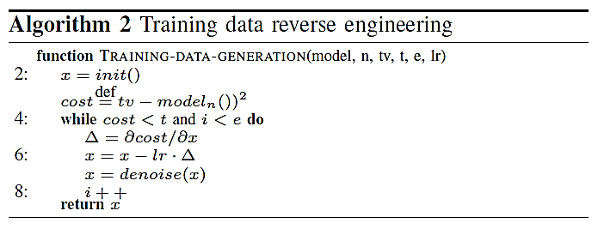
Step 2: Training Data Generation
Trojaning Attack
Training data reverse engineering algorithm
  Uses gradient descent to iteratively generate the reversed images
  The obtained images should produce target output classification labels
  Applying a denoising step in the gradient descent (line 7 below) achieved higher accuracy

Slide 46
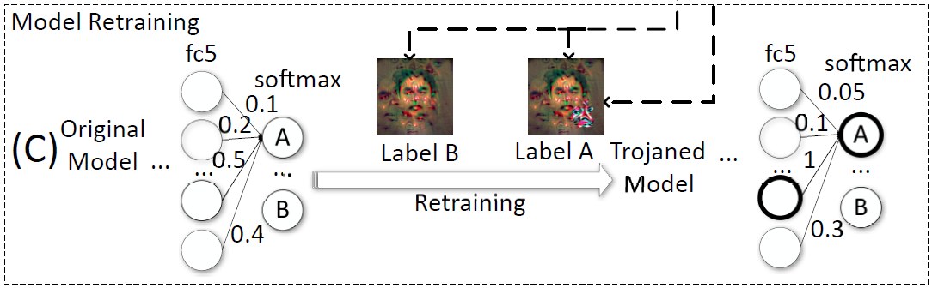
Step 3: Model Retraining
Trojaning Attack
The third step in the attack is model retraining
  Retrain the NN model with the reverse engineered data inputs and with trojan stamped reverse engineered data inputs
    Goal: increase the weight to the output neuron A for stamped images from 0.5 to 1
    Retrain only the layers from the selected neuron (e.g., fc5) to the output softmax layer
  E.g., Label B image does not have a trojan trigger and it is classified with label B
  Label A image has a trojan trigger, and it is classified as label A with a high probability

Slide 47
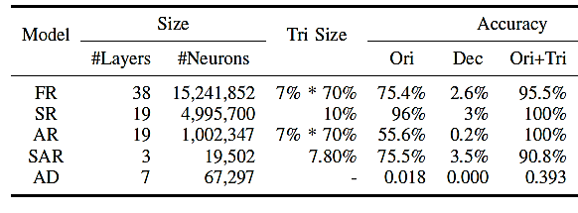
Evaluation Results
Trojaning Attack
Trojaning attack was applied to five ML applications
  Face recognition (FR), speech recognition (SR), age recognition (AR), sentence attitude recognition (SAR), autonomous driving (AD)
Accuracy column indicates:
  Orig - original target model accuracy on clean samples
  Dec – decrease in accuracy by the trojaned model on clean samples
  Ori+Tri – accuracy of trojaned model on images with a trojan stamp (attack success rate)

Slide 48
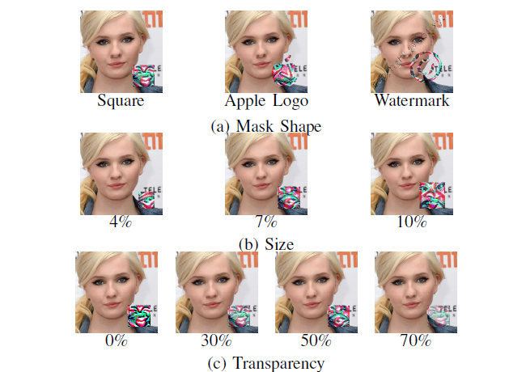
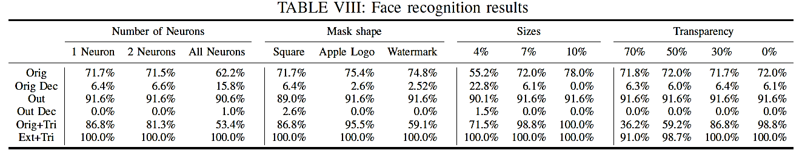
Evaluation Results
Trojaning Attack
Attack success rate for face recognition with different mask shape, trigger size, and trigger transparency

Slide 49
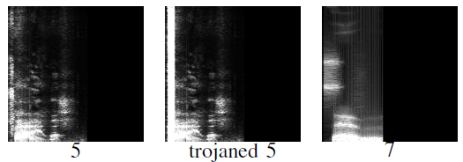
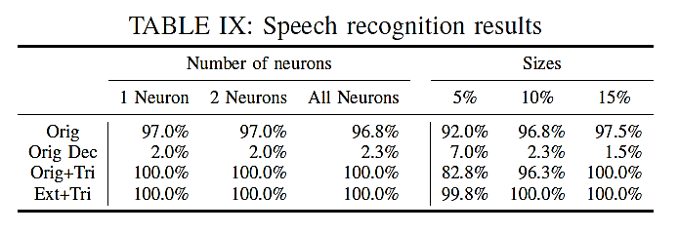
Evaluation Results
Trojaning Attack
Speech recognition application
  Goal: an audio with a trojan trigger is recognized as a pronunciation of a number
    E.g., a trojaned audio signal of the number 5 is shown that is recognized as the number 7
    The spectrogram of the trojaned audio (middle) looks very similar to the original audio (left)
    Attack success rate for different trigger sizes

Slide 50
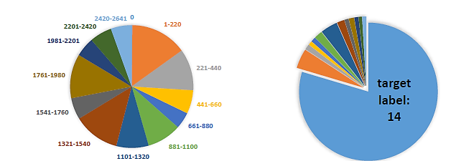
Possible Defense
Trojaning Attack
Possible defense: check the distribution of wrongly predicted inputs
  If one predicted label has the majority over all classes, the model may be trojaned
E.g., for the face recognition task, the distributions of predicted labels are shown
  For the trojaned run, the target label 14 is more frequent than the other labels
Normal run
Trojaned run

Slide 51
Invisible Sample-Specific Backdoor Attack
ISSBA Attack
Invisible Sample-Specific Backdoor Attack (ISSBA)
  Li (2021) Invisible Backdoor Attack with Sample-Specific Triggers
Goal: add imperceptible perturbations to create backdoor triggers
  This is similar to generating adversarial samples for evasion attacks
Motivation:
  Backdoors attacks typically insert sample-agnostic triggers
    I.e., the same trigger is added to all clean samples
    The trigger is usually noticeable in the poisoned images
  ISSBA inserts sample-specific triggers
    I.e., a different trigger is designed for each clean sample
    The trigger in ISSBA is invisible additive perturbation
Advantages:
  The triggers can bypass human visual inspection
  The attack is effective against other poisoning defenses

Slide 52
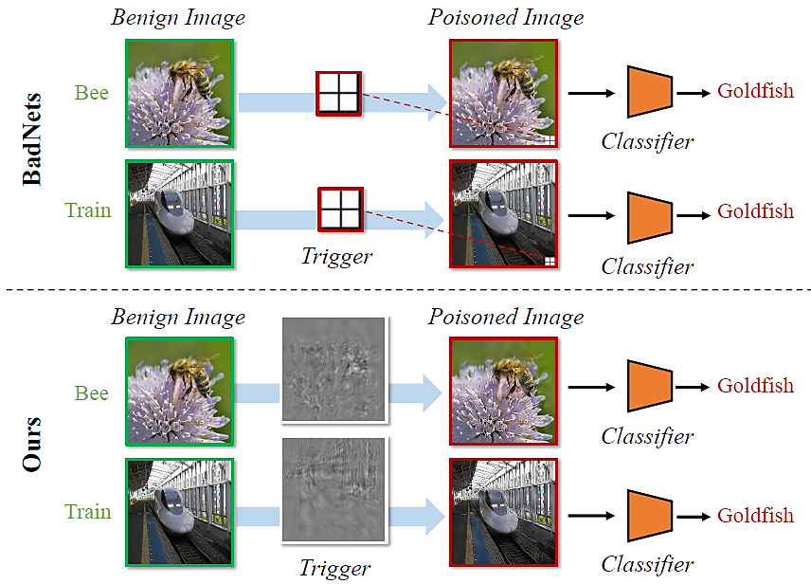
Invisible Sample-Specific Backdoor Attack
ISSBA Attack
Comparison:
  BadNets attack inserts the same trigger to clean images for creating poisoned samples
  ISSBA inserts a trigger that is designed for each images for creating poisoned samples

Slide 53
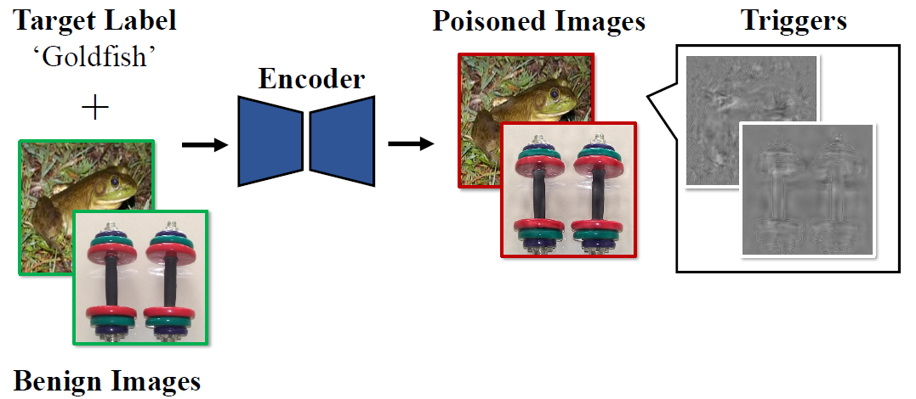
Invisible Sample-Specific Backdoor Attack
ISSBA Attack
Approach
  The attacker uses an Encoder NN (e.g., U-Net) to create poisoned samples
    The backdoor triggers consist of imperceptible perturbations
    The perturbations are calculated by embedding information about the target label (in this case the ‘Goldfish’ string) into benign images

Slide 54
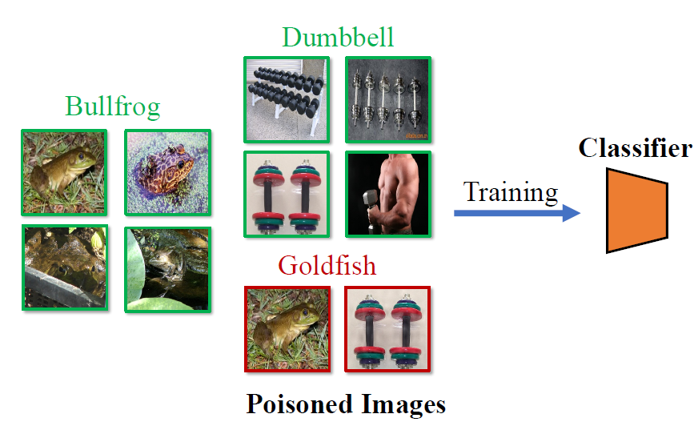
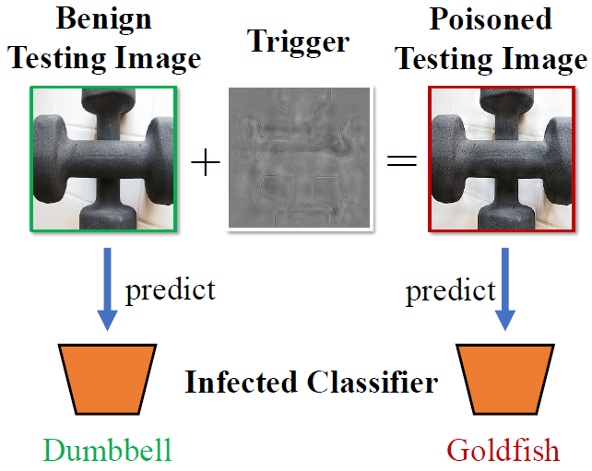
Invisible Sample-Specific Backdoor Attack
ISSBA Attack
Approach:
  Training a model by a victim user
  The user collects both benign images (‘Bullfrog’, ‘Dumbbell’) and poisoned images (‘Goldfish’)
  The user trains a classifier NN for image classification
    The classifier NN learned to associate the trigger with the target label
  Testing the model by the victim user
  At test time, the poisoned classifier correctly predicts the labels for benign images
  The classifier assigns the target label ‘Goldfish’ to poisoned images

Slide 55
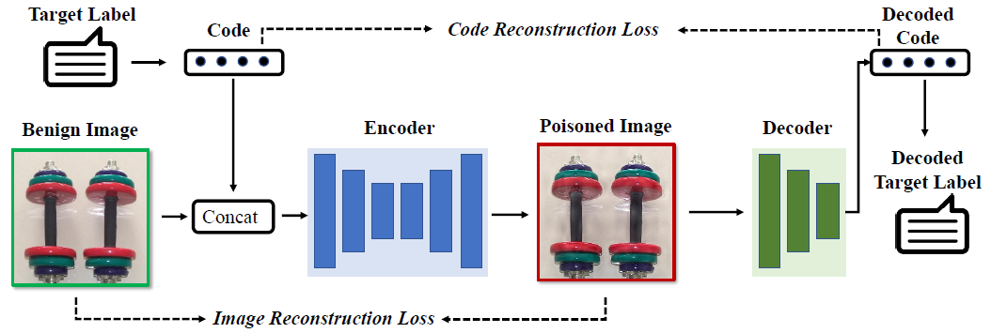
Invisible Sample-Specific Backdoor Attack
ISSBA Attack
Generating sample-specific triggers with ISBBA
  The trigger contains a string of the target label (e.g., the label name ‘Goldfish’)
  The attacker trains simultaneously an encoder model (U-Net) and a decoder model (CNN)
    The decoder NN predicts the label of the images
    The encoder NN takes as inputs a benign image concatenated with a vector representation of the target label string, and outputs a poisoned image
      Therefore, the encoder will embed the target label string into the poisoned image
      The decoder model will recover the hidden target label string from the poisoned image

Slide 56
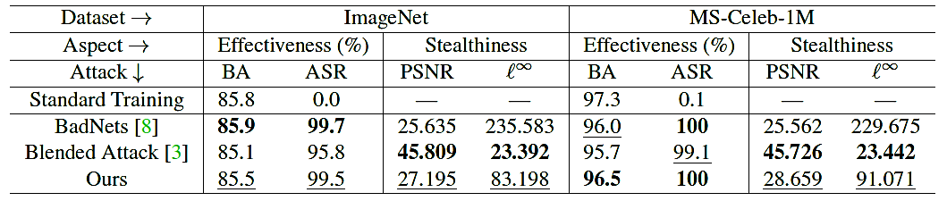

Invisible Sample-Specific Backdoor Attack
ISSBA Attack
Evaluated on classification of ImageNet and MS-Celeb-1M (celebrity recognition)
  BA (Benign Accuracy) on clean samples, and ASR (Attack Success Rate) on poisoned samples
ISSBA achieved high effectiveness (ASR), that is comparable to BadNets and Blended Attack
The stealthiness of the attacks is measured by PSNR (peak-signal-to-noise-ratio) and $ℓ_{∞}$ norm between clean and poisoned images
  ISSBA is stealthier than BadNets, but has higher values than Blended Attack

Slide 57
BppAttack
BppAttack
BppAttack (Bit-per-pixel Attack)
  Wang (2021) BppAttack: Stealthy and Efficient Trojan Attacks against Deep Neural Networks via Image Quantization and Contrastive Adversarial Learning
Goal:
  Reduce bits-per-pixel (similar to feature squeezing) to create backdoored samples with imperceptible changes
Approach:
  Apply image quantization and dithering as trojan trigger
  Contrastive learning is used to generate poisoned samples
Threat model:
  The attacker has access to training data and the model
Advantages:
  Generated samples can bypass poisoning defenses and human inspection

Slide 58
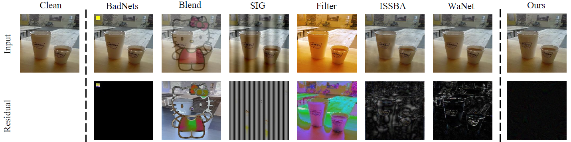
BppAttack
BppAttack
Motivation:
  Most poisoning attacks introduce visible trojan triggers
  E.g., yellow pad (BadNets), blended images (Blend), strips (SIG), color filters (Filter), sample-specific perturbation (ISSBA), image warping (WaNet)
  Many of these attacks are noticeable to human inspectors or detectable by poisoning defense methods
Comparison to adversarial samples created by other backdoor attacks
  The residual (difference to the original clean image) by BppAttack is small

Slide 59
BppAttack Approach
BppAttack
Generate trojan samples
  Apply image color quantization, by reducing the number of bits used for the image intensities of the pixels
  Apply image dithering
    Dithering is an image processing operation used to create the illusion of color depth in images with a limited color palette
      Colors not available in the palette are approximated by a diffusion of colored pixels from within the available palette
    The image dithering step removed noticeable artifacts from the step of image color quantization, and increased the stealthiness of the attack
Afterward, retrain the model by assigning the target label to trojaned samples
  The authors used contrastive learning loss for training the model
    Adversarial samples generated by PGD were added as negative examples for the contrastive learning
    Contrastive learning loss achieved higher effectiveness than cross-entropy loss

Slide 60
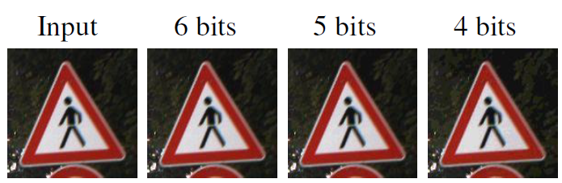
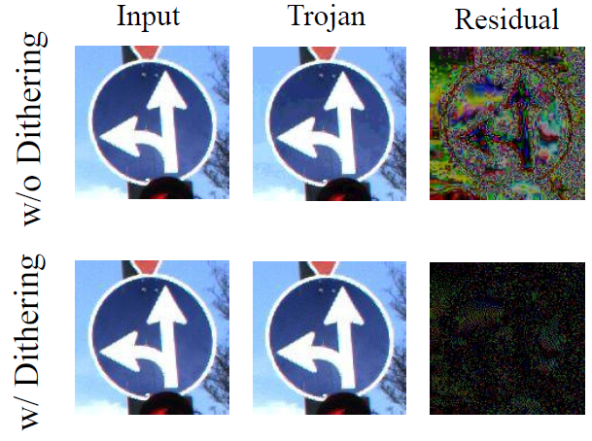
BppAttack
BppAttack
Effect of different bits number
  Trojaned images with reduced number of bits look indistinguishable from clean images
Effect of dithering
  Trojaned images with dithering have smaller residual to clean images

Slide 61
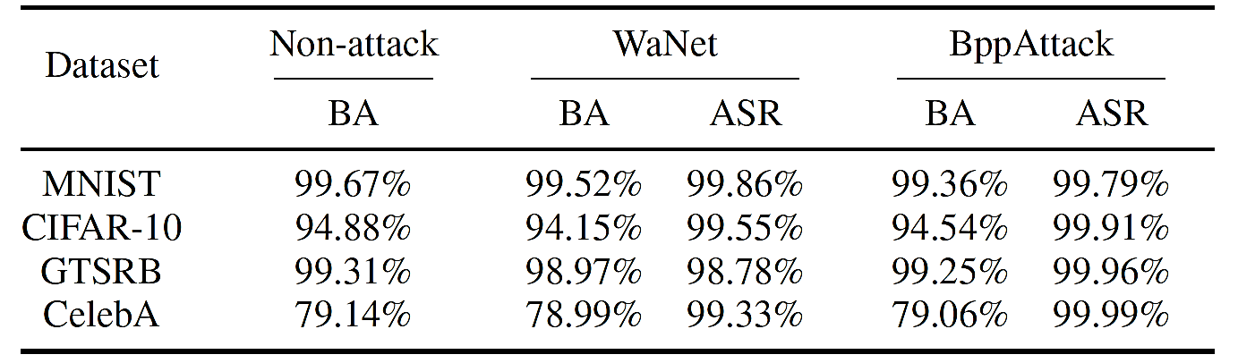
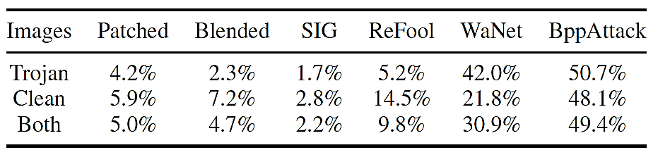
BppAttack Experimental Results
BppAttack
Evaluated on MNIST, CIFAR-10, GTSRB (traffic sign classification), and CelebA (celebrity recognition)
  BA (Benign Accuracy) on clean samples, and ASR (Attack Success Rate)
BppAttack obtained higher stealthiness on both clean and trojaned images in comparison to other trojan attacks, based on human visual inspection

Slide 62
Fawkes for Privacy Protection
Fawkes
Fawkes Attack
  Shan (2020) - Fawkes: Protecting Privacy against Unauthorized Deep Learning Models
Fawkes – use adversarial attacks for protection against unauthorized face recognition models
Motivation
  Face recognition systems are developed by companies and governments, without user consent
    E.g., it was reported that the company Clearview.ai collected more than 3 billion online photos and trained a large model capable of recognizing millions of persons
Approach:
  Release your own adversarial images on the web, to poison face recognition models used by third-parties
Performance:
  Fawkes is successful against adversarial defenses
  Experiments show 100% success rate against Microsoft Azure Face API, Amazon Rekognition, and Face++

Slide 63
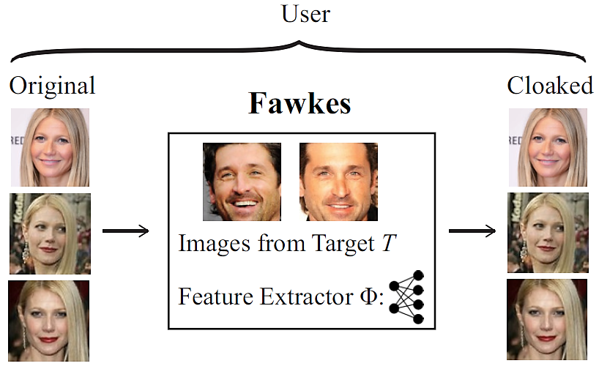
Fawkes for Privacy Protection
Fawkes
Approach
  The user applies a cloaking algorithm to add new features extracted from a target person T to their images
    Cloaking algorithm solves an optimization problem to minimize the distance of original images to the images of the target person
  The algorithm adds imperceptible adversarial perturbations to generate cloaked versions of the images of the user U

Slide 64
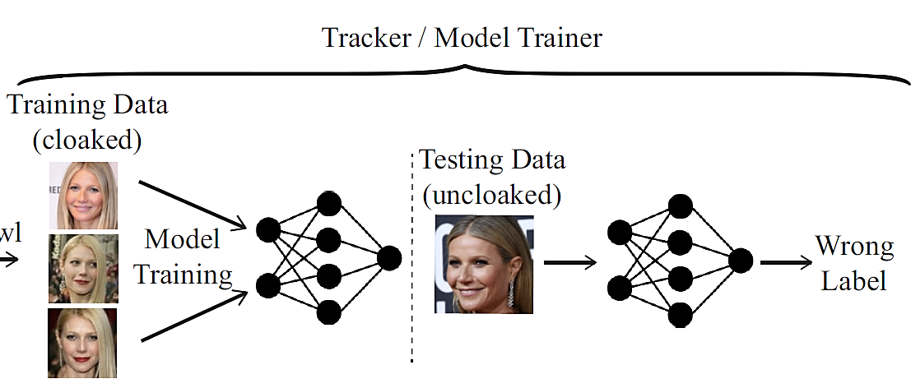
Fawkes for Privacy Protection
Fawkes
Approach:
  When collected by a third-party, the cloaked images are used to train an unauthorized model
  The trained model classify cloaked images of the user U
  When presented with clean (uncloaked) images of the user U, the trained model will misclassify the clean images

Slide 65
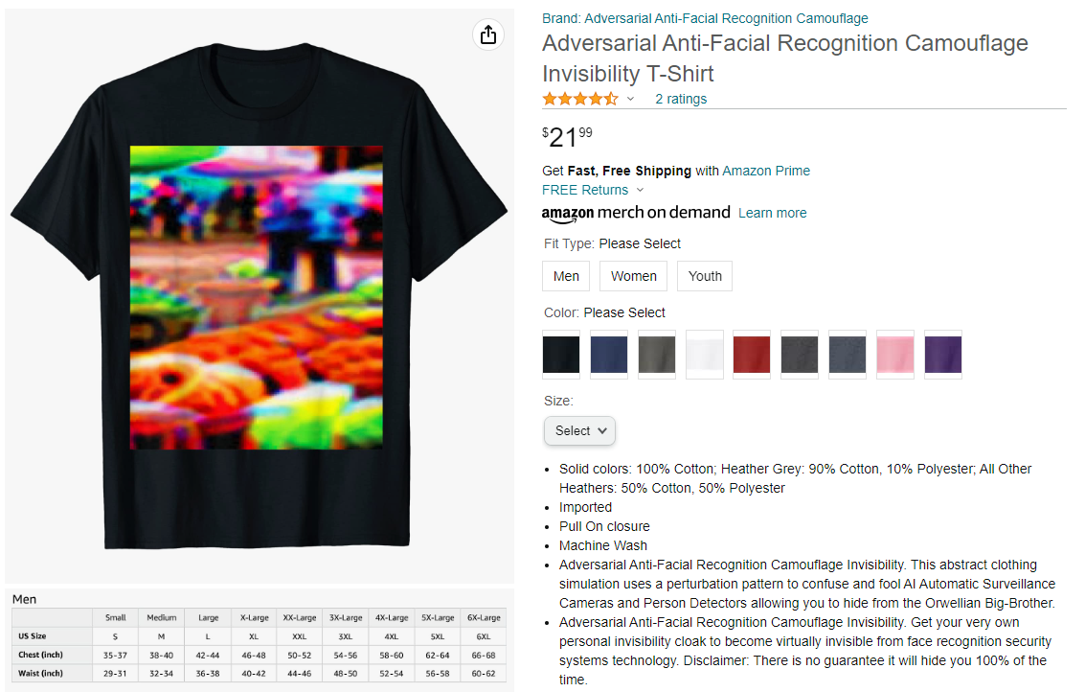
Adversarial Shirts
Privacy Protection
Adversarial shirts against face detection models can be purchased
  The shirt uses a perturbation pattern to confuse and fool AI Automatic Surveillance Cameras and Person Detectors allowing you to hide from the Orwellian Big-Brother

Slide 66
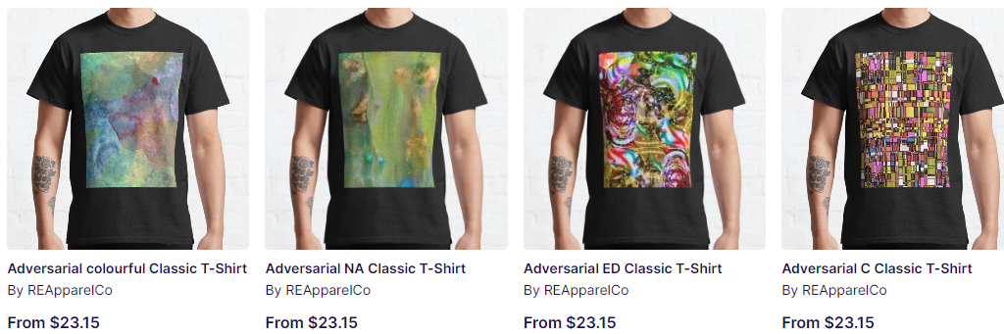
Adversarial Shirts
Privacy Protection
Similar adversarial shirts for privacy protection are available for purchase

