Slide 1
CS 487/587 Adversarial Machine Learning
Dr. Alex Vakanski

Slide 2
Lecture 10
AML in Cybersecurity – Part III:
Spam Filtering, URL Detection, Cyber-Physical Systems

Slide 3
Lecture Outline
Spam filtering
Spam statistics
Spam filtering datasets
Spam filtering techniques
Pre-processing text in email messages
Tokenization, feature extraction, word embedding
Adversarial attacks against ML-based spam filters
URL detection
Phishing URL detection
Adversarial attacks against phishing URL classifiers
Cyber-physical Systems (CPS)
Machine learning-based CPS
Adversarial attacks against CPS
Presentation by Deekshith Basvoju
Erba (2020) Constrained Concealment Attacks against Reconstruction-based Anomaly Detectors in Industrial Control Systems

Slide 4
Spam Filtering
Spam Filtering
The purpose of a spam filter is to determine whether an incoming message is legitimate (i.e., non-spam, ham) or unsolicited (i.e., spam)
ML-based spam classifiers were among the first applications of machine learning in the cyber security domain (and in general, as well)
Subsequently, they were among the first to be attacked
Attackers’ goal is to modify spam emails (without changing the nature of the message) to bypass spam filters
Recent spam filters increasingly rely on machine learning and neural networks approaches for email classification
These approaches are being extensively used by email service providers like Gmail, Outlook, or Yahoo

Slide 5
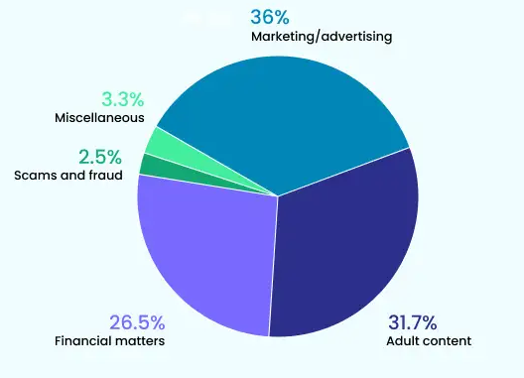
Spam Statistics
Spam Statistics
49% of all sent emails are spam
36% of all spam is some form of advertising
Spam costs $20.5 billion yearly (reduced network bandwidth, storage capacity)
About 162 billion spam emails are send every day
Spammers receive on average 1 click for every 12 million emails sent
Even with this response, spammers earn millions of dollars yearly
80% of all spam is sent by 100 spammers
U.S. is home to 7 of the world’s top 10 spammers
Info from: https://www.mailmodo.com/guides/email-spam-statistics/

Slide 6
Spam Filtering Adversarial Game
Spam Filtering
In the following simple example, an email is classified as either a spam or a legitimate message based on cumulative weights assigned to words (or other features)
1.
From: spammer@example.com
Cheap mortgage now!!!
cheap = 1.0
mortgage = 1.5
Feature Weights
2.
Spam
3.
Total score = 2.5
> 1.0 (threshold)
Slide credit: Daniel Lowd, Adversarial Machine Learning

Slide 7
Spam Filtering Adversarial Game
Spam Filtering
The spammers adapt to evade the classifier, by adding regular words to reduce the overall score
1.
From: spammer@example.com
Cheap mortgage now!!! Eugene Oregon
2.
cheap = 1.0
mortgage = 1.5
Eugene = -1.0
Oregon = -1.0
Feature Weights
3.
Total score = 0.5
< 1.0 (threshold)
OK
Slide credit: Daniel Lowd, Adversarial Machine Learning

Slide 8
Spam Filtering Adversarial Game
Spam Filtering
The spam classifier is updated by changing the feature weights
1.
From: spammer@example.com
Cheap mortgage now!!! Eugene Oregon
2.
cheap = 1.5
mortgage = 2.0
Eugene = -0.5
Oregon = -0.5
Feature Weights
Spam
3.
Total score = 2.5
> 1.0 (threshold)
Slide credit: Daniel Lowd, Adversarial Machine Learning

Slide 9
Spam Filtering Datasets
Spam Filtering Datasets
There are many open datasets of spam and non-spam email messages
However, most datasets are of small size
TREC 2007 Public Spam Corpus (link)
Also known as Trect07p, created in 2007
Consists of 50,200 spam emails (67%) and 25,200 ham (non-spam) emails (33%)
The format of the emails is raw data (HTML)
Enron-Spam dataset (link)
Created in 2006
Includes 20,170 spam emails (55%) and 16,545 non-spam emails (45%)
Both raw messages and pre-processed messages are provided
SPAMBASE (link)
Created in 1999
Includes 1,813 spam emails (39%) and 2,788 non-spam emails (61%)
Each email has 55 features, related to word frequency, character frequency, average length of uninterrupted sequence of capital letters, total number of capital letters, etc.

Slide 10
Spam Filtering Techniques
Spam Filtering Techniques
Based on the used email filtering techniques, spam detectors can be generally classified into:
Content-based filtering techniques
Heuristic-based filtering techniques

Slide 11
Content-based Filtering
Spam Filtering Techniques
Content-based filtering techniques
The filter scans the content of incoming emails, looking for trigger keywords
E.g., keywords frequently used in spam emails, such as free, buy, application, mortgage
The content of the body and header of emails are scanned
The frequency of occurrence and distribution of trigger words and phrases in the content of emails are used as features for training ML approaches, and afterward, for classifying new emails
Naïve Bayes classifiers were one of the early successful ML models for spam filtering
Other conventional ML approaches have been successfully applied, such as SVMs, k-nearest neighbors, decision trees, random forests
NNs and deep learning are commonly used nowadays for spam classification
Almost all commercial spam filters use some form of content-based filtering
A limitation of this approach is that harmless emails containing spam trigger words can be blocked
Ganagavarapu (2020) – Applicability of Machine Learning in Spam and Phishing Email Filtering

Slide 12
Content-based Filtering
Spam Filtering Techniques
Scanning the body of emails explores the what in the email
Scanning the header of emails explores the who sent the email
Email headers display important information, such as:
Message ID – an identifier generated by the sender’s email service
There can be no two identical message IDs, hence, it helps to detect forged email headers
Sender address – is used to consult black lists to check sender’s domain reputation
DNS records – the DNS (Domain Name System) records of the sender allows to check the sender’s SPF, DKIM, and DMARC policies regarding email authentication
SPF (Sender Policy Framework), DKIM (Domain Keys Identified Mail), DMARC (Domain-based Message Authentication, Reporting and Conformance)
An example of a Gmail header
Slide credit: Why Spam Filters Hate You

Slide 13
Heuristic-based Filtering
Spam Filtering Techniques
Heuristic-based filtering techniques
These approaches apply heuristic rules to discover similar patterns in a large number of spam and non-spam emails
Scores are assigned to each rule, and the scores are weighted based on the importance of the rule
Repeating patterns in a message increase the total score of being a spam
If the total score surpasses a predefined threshold, the message is labeled as spam
Rules could be created based on:
Words and phrases, lots of uppercase characters, exclamation points, unusual Subject lines, special characters, web links, HTML messages, background colors, etc.
Content-based filtering techniques can be considered a sub-category of the heuristic-based techniques
A limitation of this approach is that it requires constant updating of the rules, to be able to cope with the continually adapting strategies by spammers
Ganagavarapu (2020) – Applicability of Machine Learning in Spam and Phishing Email Filtering

Slide 14
Black Lists and White Lists
Spam Filtering Techniques
Black lists contain information of known spammers, collected by several sites
Senders of incoming emails are compared to the blacklist, to filter known spammers
White lists are complementary to black lists, and contain addresses of trusted contacts
Black lists and white lists are used for the first level of spam filtering
E.g., before applying content checks or heuristic rules
That is, the lists are used as a complementary tool, and not as the only tool for email classification

Slide 15
Preprocessing Text Data
Pre-processing Text in Email Messages
Preprocessing text data in emails for use by ML models typically involves:
Tokenization
Feature selection/extraction
Tokenization
Tokenization breaks up the text of an email into a sequence of representative symbols (tokens)
Tokens can be the individual words in the text, several consecutive words (e.g., n-grams), sub-words, or the individual characters in words (this is less common)
Tokenization typically includes:
Remove punctuation signs (comma, period) or non-alphabetic characters (@, #, {, ])
Optional step: remove stop words, such as for, the, is, to, some
These words appear in both spam and non-spam emails, and are not relevant for filtering
Correct spelling errors or abbreviations
Change all words to lower-case letters
I.e., the model should consider Text and text as the same word
Stemming and lemmatization - means transforming words to their base form
E.g., the words buy-bought or grill-grilled have a common root
Indexing – assign a numerical index to each token in the vocabulary

Slide 16
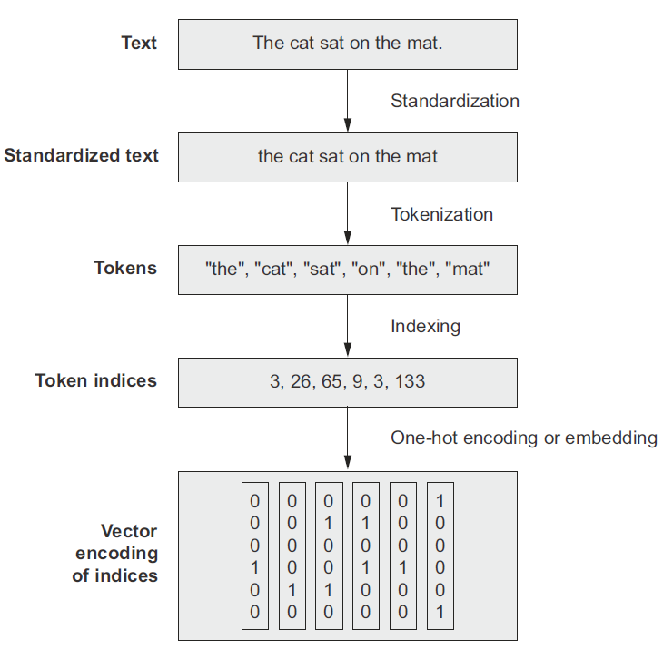
Preprocessing Text Data
Pre-processing Text in Email Messages
Example of preprocessing text data
Figure form: Chollet (2021) Deep Learning with Python

Slide 17
n-Grams
Pre-processing Text in Email Messages
Instead of using single words or subwords as tokens, it is also possible to use n consecutive words as tokens, referred to as n-grams
Combining several consecutive words together creates more specialized tokens
This type of tokenization is still popular for spam filtering and other NLP tasks
E.g., the word play is considered a neutral word in an email message, but the two-words phrase play lotto is less neutral
Such n-grams consisting of two adjacent pairs of words are called bigrams
n-grams consisting of single words are called unigrams
The n-grams approach captures the words order and it can potentially provide more information for classifying spam messages

Slide 18
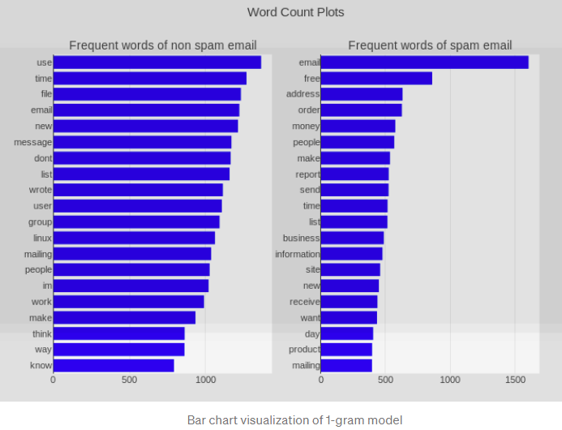
n-Grams
Pre-processing Text in Email Messages
1-gram model example of non-spam and spam emails
Figure from: How To Design A Spam Filtering System with Machine Learning Algorithm (link)

Slide 19
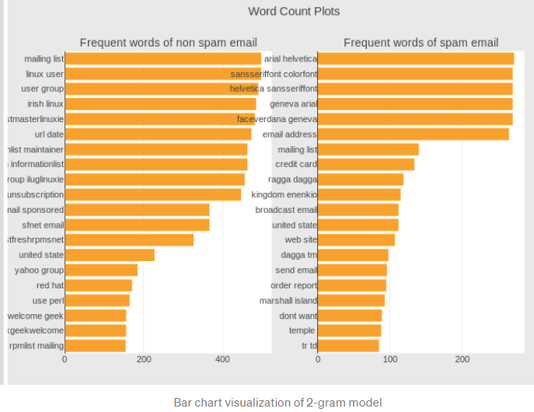
n-Grams
Pre-processing Text in Email Messages
2-gram model example of non-spam and spam emails
Figure from: How To Design A Spam Filtering System with Machine Learning Algorithm (link)

Slide 20
Representation of Groups of Words
Pre-processing Text in Email Messages
The representation of groups of words in text data can be divided into two categories of approaches:
Set models approach, where the text is represented as unordered collection of words
The order of the words in the text is not preserved
Representatives of this group is the bag-of-words model
Sequence models approach, where the text is represented as ordered sequences of words
These methods preserve the order of the words in the text
Representatives of this group are Recurrent Neural Networks and Transformer Networks
In general, the order of words in natural language is not necessarily fixed, and sentences with different orders of the words can have the same meaning
However, in many cases the word order can be very important and a difference in the word order can significantly change the meaning of the text
Recent ML models for NLP employ sequence models where the order of the words is preserved

Slide 21
Bag-of-Words Approach
Bag-of-Words Approach
Bag-of-words approach
The tokenized words in text are represented as a bag (i.e., set) of words
The term bag implies that the order of the words and the structure of the text is lost
A numerical value is assigned to each token (can be either individual words or n-grams)
The frequency of occurrence of each word is typically used as a feature for training a ML classifier
Figure from: Implementation Of Bag Of Words Using Python (link)

Slide 22
Bag-of-Words Approach
Bag-of-Words Approach
Bag-of-words example (based on the frequency of each word in the text)
Text: John likes to watch movies. Mary likes movies too.
Bag-of-words listing the words and the frequency of each word:
{"John":1, "likes":2, "to":1, "watch":1, "movies":2, "Mary":1, "too":1}
Approach:
Tokenize all spam and non-spam emails in a dataset
Create a vocabulary (token database) from the unique words (tokens) collected from all processed emails
Count the frequency of occurrence of tokens in spam and non-spam emails
Create two bags-of-words, pertaining to all spam and non-spam emails
E.g., the spam bag will contain trigger keywords (cheep, buy, stock) more frequently
A spam filter classifies an incoming email based on the probability of belonging to the spam or non-spam bag-of-words

Slide 23
Bag-of-Words Approach
Bag-of-Words Approach
Bags-of-words examples for spam (left) and non-spam messages (right)
Figure from: How to Build a Spam Classifier in 10 Steps (link)

Slide 24
Bag-of-Words Approach
Bag-of-Words Approach
In the shown example, we can notice that the words “it”, “I”, “the”, and “to” have the highest number of occurrences
However, these words are not very indicative of the meaning of the text in the messages
To account for that, the frequency of occurrence of words is often represented by TF-IDF (Term Frequency – Inverse Document Frequency)
TF is calculated as the number of times a specific word (i.e., term) appears in a message, divided by the total number of words in the message
IDF is calculated as the logarithm of the total number of messages (i.e., documents) in the training set, divided by the number of messages in which the specific word appears in
A TF-IDF score for a specific word is obtained by multiplying TF and IDF
In other words, TF-IDF assign weights to the words so that the words that appear in most messages will be considered less important for the spam classifier

Slide 25
TF-IDF Example
Bag-of-Words Approach
Example 1: word “the”
Let’s assume that the word “the” appears 4 times in a message: $TF=4/20=0.2$
Also, assume that there are 100 message in the training set and the word “the” appears in all of them: $IDF=100/100=1$
Therefore, TF-IDF will be $TF∙IDF=0.2∙1 = 0.2$
Example 2: the word “adventure”
If the word adventure appears once in this message: $TF=1/20=0.05$
If it appears in 2 of the 100 messages in the training set: $IDF = 100/2=50$
Therefore, TF-IDF will be $TF−∙IDF=0.05∗50 = 2.5$
TF-IDF will apply low weight for the word “the” since it appears in all messages, and hither weight for the word “adventure” since it appears only in a few messages

Slide 26
Feature Extraction
Feature Extraction
Besides using TF-IDF for the individual tokens or words as input features for training ML spam classifiers, other approaches are based on extracting a custom set of features for training an ML model
The extracted features from emails can include:
Body-based features: features extracted from the email message content
Subject line-based features: features extracted from the subject line of the email
Sender address-based features: features extracted from the information about the email address of the sender
URL-based features: features extracted from the anchor tags of HTML emails
Script-based features: features extracted from the information concerning the presence or absence of scripts in the email and the impact of such scripts
Ganagavarapu (2020) – Applicability of Machine Learning in Spam and Phishing Email Filtering

Slide 27
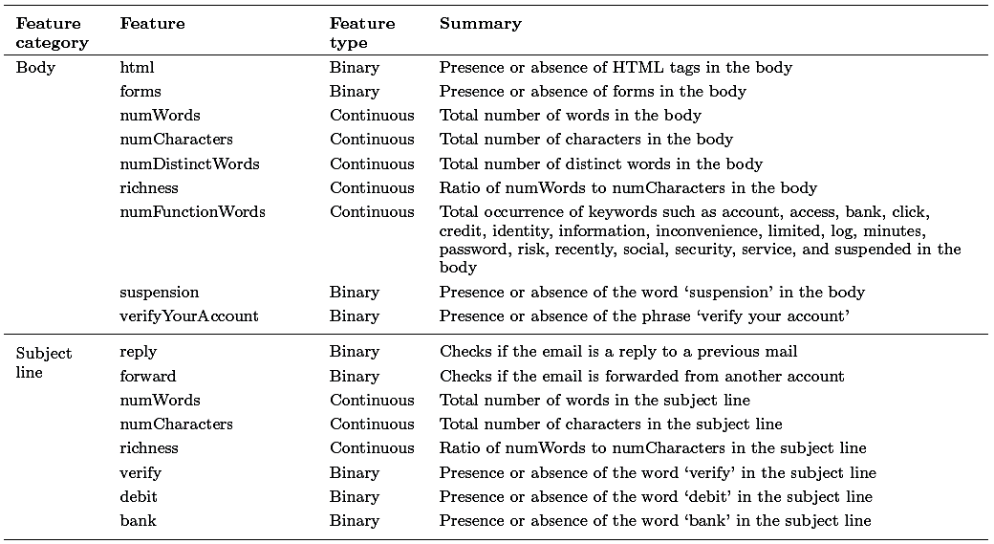
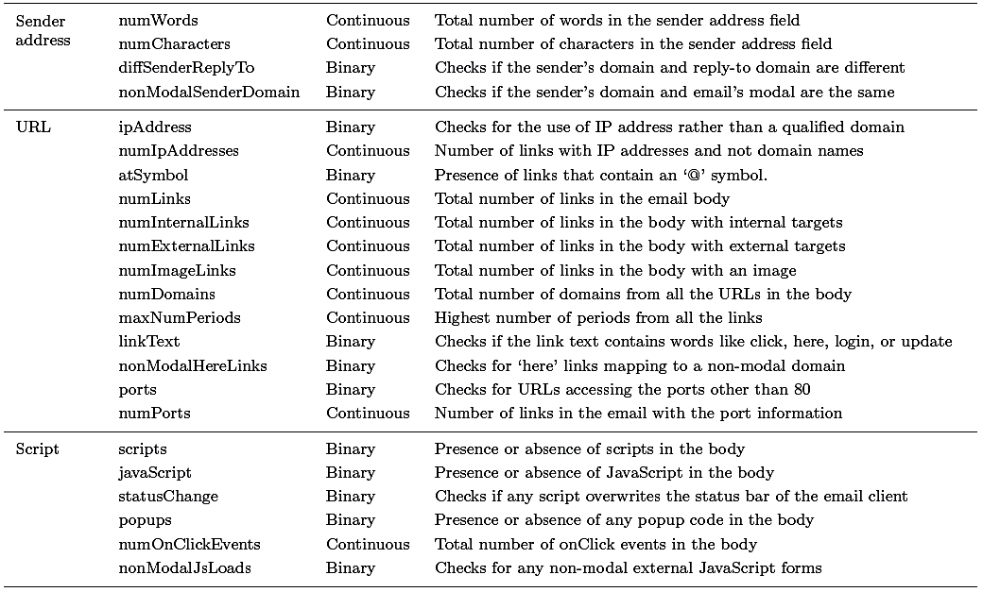
Feature Extraction
Feature Extraction
Example: 40 features extracted from emails, categorized based on the information from the previous page
The features can be used to train a Naïve Bayes model or another ML model for classification of spam messages
Ganagavarapu (2020) – Applicability of Machine Learning in Spam and Phishing Email Filtering

Slide 28
Spam Filtering with Naive Bayes
Spam Filtering Techniques
Naive Bayes classifier has been one of the most popular ML models for spam filtering
It is easy to implement, has low computational complexity, and provides statistical measure of the probability that a message is spam or non-spam
From Bayes’ theorem, the probability that an email message represented with a vector $x=\left[x_{1},x_{2},…\right]$ belongs to the spam category $c_{s}$ is
$$p\left(c_{s}|x\right)=\frac{p\left(c_{s}\right)∙p\left(x|c_{s}\right)}{p\left(c_{s}\right)∙p\left(x|c_{s}\right)+p\left(c_{h}\right)∙p\left(x|c_{h}\right)}$$
In the equation $c_{h}$ is the ham category
The prior probabilities $p\left(c_{s}\right)$ and $p\left(c_{h}\right)$ are typically estimated by dividing the number of training emails in each category by the total number of training emails
The probabilities $p\left(x|c_{s}\right)$ and $p\left(x|c_{h}\right)$ are calculated as a product of the probability that each feature belongs to the spam of ham bag-of-words, i.e., $p\left(x|c_{s}\right)=\prod{p(x_{i}|}c_{s}$)
If $p\left(c_{s}|x\right)>threshold$, the email message is classified as a spam

Slide 29
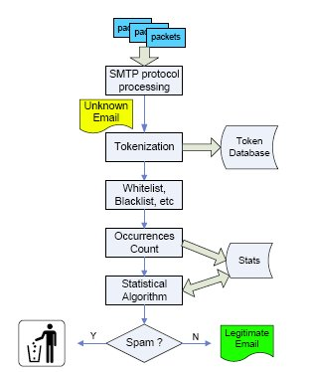
Spam Filtering Block Diagram
Spam Filtering Techniques
A typical data flow in spam filtering
Figure from: Yan (2010) – Workload Characterization of Spam Email Filtering Systems

Slide 30
Sequence Model Approach
Sequence Model Approach
Sequence models preserve the order of words in the input text
As mentioned, commonly used models are Recurrent Neural Networks and Transformer Networks
Transformers have replaced RNNs in recent applications
The application of sequence models typically involves:
Tokenization to represent the words in text data with integer indices
Mapping the integers to vector representations (embeddings)
Pad the sequences in the text to have the same length
Use the padded sequences as inputs to train a machine learning model
The trained models take into account the ordering of words embeddings in the original text

Slide 31
Word Embedding
Sequence Model Approach
Word embedding is converting words to a vector format, where the vectors represent the position of words in a higher-dimensional space
Words that have similar meanings should have close spatial positions of their vector representations in the embedding space
Typical vectors for representing word embeddings have between 256 to 1,024 dimensions
E.g., embedding vector for the word ‘work’
Figure from: Generative AI exists because of the transformer (link)

Slide 32
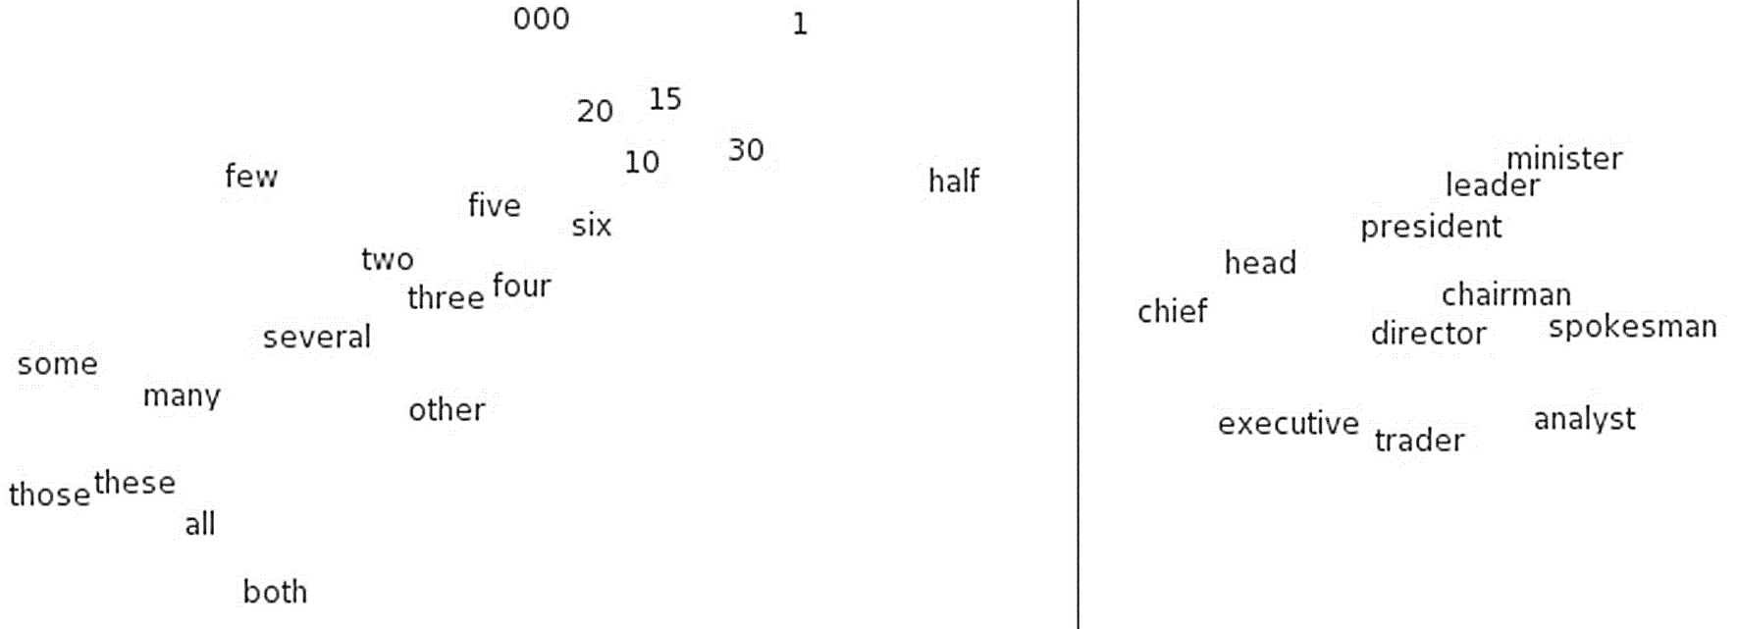
Word Embedding
Sequence Model Approach
The figure shows an example of word embeddings space
The embedding vectors of words that have similar meanings are also similar
Typically, the cosine distance between the vectors in the embedding space is used a distance metric
For given embedding vectors u and v, cosine similarity is $cosθ=\frac{u∙v}{\left\|u\right\|\left\|v\right\|}$
Figure from: How To Design A Spam Filtering System with Machine Learning Algorithm (link)

Slide 33
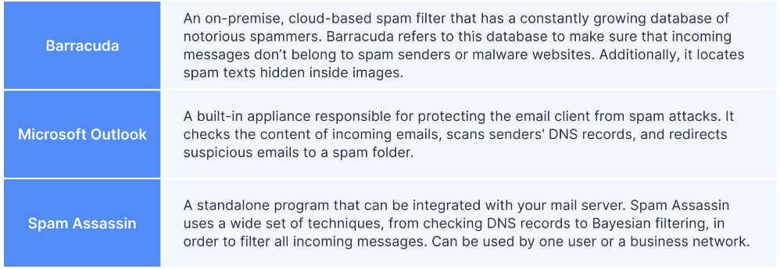
Commercial Spam Filters
Spam Filtering Techniques
Examples of three different spam filters solutions
Gmail and Outlook use these spam filters
Slide credit: Why Spam Filters Hate You

Slide 34
AML against Spam Filters
Adversarial Attacks against ML-based Spam Filters
Common approaches for creating adversarial attacks against ML-based spam filters include:
Bad words obfuscation – replace typical words in spam messages with synonyms or misspelled words
Good words insertion – insert into spam messages words that appear in legitimate messages
Huang et al. (2011) Adversarial Machine Learning (link)
This work introduced an availability attack
I.e., the attack makes the spam filter unavailable for regular use
Attacked is a model called SpamBayes, which uses Naïve Bayes for spam filtering based on words occurrences in the content of email messages
Attack approach:
Send spam email messages that contain a very large set of words to the spam filter
The spam filter algorithm will recognize the emails as spam, and it will assign a higher spam score to every word in the received messages
As a result, future legitimate emails are more likely to be marked as spam
Rosenberg et al. (2021) – AML Attacks and Defense Methods in the Cyber Security Domain

Slide 35
AML against Spam Filters
Adversarial Attacks against ML-based Spam Filters
Biggio et al. (2014) Security Evaluation of Pattern Classifiers under Attack (link)
White-box availability attack
Attacked are two spam classifiers: linear SVM and logistic regression classifier,
The classifiers used bag-of-words representation based on text content, where features are word occurrences
Attack approach:
Use an optimization approach to find most impactful non-spam words
Add n_{max} most impactful non-spam words to spam emails
This can cause the spam filter to increase the scores for the impactful good words, and as a result, the model will be more likely to classify non-spam emails as spam
Rosenberg et al. (2021) – AML Attacks and Defense Methods in the Cyber Security Domain

Slide 36
AML against Spam Filters
Adversarial Attacks against ML-based Spam Filters
Sethi and Kantradzic (2018) Data Driven Exploratory Attacks on Black Box Classifiers in Adversarial Domains (link)
Black-box query-efficient evasion attacks
The authors trained 5 different spam classifiers using conventional ML methods: linear SVM, k-nearest neighbors, SVM with RBF kernel, decision tree, and random forest
SPAMBASE dataset was used for model training and evaluation
The authors introduced a framework called SEE (Seed-Explore-Exploit)
Attacks include:
Anchor Points (AP) attack: anchors are legitimate emails, that serve as a ground-truth for generating adversarial samples by applying perturbation to the legitimate emails
The spam filter is queried, and the procedure is repeated until the emails are classified as spam
Reverse Engineering (RE) attack: the goal is to discover the decision boundary for spam email classification, and ultimately learn a substitute model based on querying the target classifier
The generated samples against the substitute model are then transferred to the target classifier
Rosenberg et al. (2021) – AML Attacks and Defense Methods in the Cyber Security Domain

Slide 37
URL Detection
URL Detection
URL (Uniform Resources Locator) is a web address that specifies the location of the webpage on a computer network
A typical URL http://www.example.com/index.html consists of several components:
Protocol type = http
Domain name = www.example.com
File name = index.html
The domain name is also referred to as FQDN (Fully Qualified Domain Name)
It identifies the server hosting the webpage
FQDN can be further divided into a prefix (subdomain) = www, and an RDN (Registered Domain Name) = example.com
Rosenberg et al. (2021) – AML Attacks and Defense Methods in the Cyber Security Domain

Slide 38
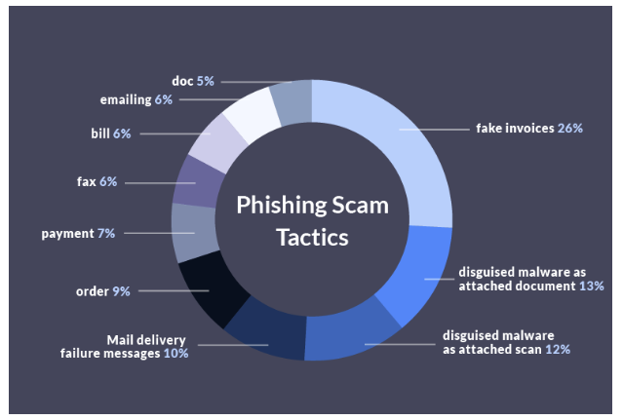
Phishing URL Detection
Phishing URL Detection
Phishing refers to attacks where a victim is lured to a fake web, and is deceived into disclosing personal data or credentials
Most common phishing scam tactics are shown below
Phishing URLs seem like legitimate URLs, and redirect the users to phishing web pages, which mimic the look and feel of their target websites
E.g., a fake bank website hopes that the user will enter personal data (password)
Figure from: https://www.propellercrm.com/blog/email-spam-statistics

Slide 39
Phishing Scam Statistics
Phishing URL Detection
Google blocks around 100 million phishing emails every day
90% of phishing attacks sent via messaging apps are sent through WhatsApp
Fake invoices are used in 26% of phishing scams
Top 5 phishing targets in 2022 were:
LinkedIn – 52% (i.e., URLs with links that mimic the LinkedIn website)
DHL – 14%
Google – 7%
Microsoft – 6%
FedEx – 6%
Slide credit: https://www.propellercrm.com/blog/email-spam-statistics

Slide 40
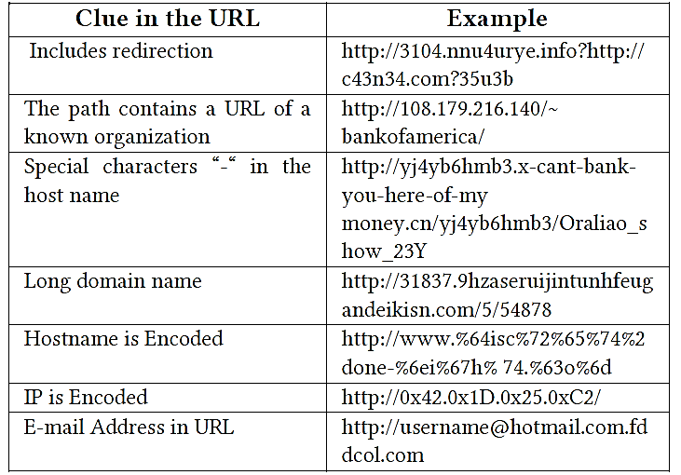
Phishing URL Detection
Phishing URL Detection
Phishing emails are a more serious threat than spam emails, because they aim to steal users’ private information, such as bank accounts, passwords, SSNs
Machine learning techniques are widely used to identify anomalous patterns in URLs as signs of possible phishing
Examples of such anomalous patters are shown in the table
ML-based phishing detection models are usually embedded in web browsers as extensions, or into email spam filtering systems
Thus, they appear as a black-boxes to phishers, as it is difficult to identify which features or classification algorithms they use
Table from: AlEroud and Karabatis (2020) Bypassing Detection of URL-based Phishing Attacks Using GAN

Slide 41
AML against Phishing URL Detectors
Adversarial Attacks against Phishing URL Classifiers
Bahnsen et al. (2018) DeepPhish: Simulating Malicious AI (link)
White-box attack
Against a character-level LSTM-based phishing URL classifier
The classifier was trained using URLs from historical attacks
The LSTM model predicts the next character in the URL
The attack concatenates benign URLs to the phishing URLs to evade the classifier
The form of synthetic URLs is: http:// + compromised_domain + benign_URL
Limitation: concatenation od benign URLS can be signed, which makes the attack less effective for real URL detectors
Rosenberg et al. (2021) – AML Attacks and Defense Methods in the Cyber Security Domain

Slide 42
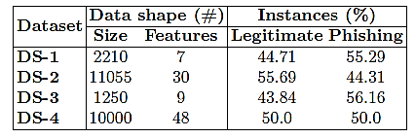
AML against Phishing URL Detectors
Adversarial Attacks against Phishing URL Classifiers
Shirazi et al. (2019) Adversarial Sampling Attacks Against Phishing Detection (link)
Gray-box attack, requires knowledge of the features used by the ML-based classifier
Such knowledge may not be accessible to the attacker, hence, this type of attacks may be less feasible in real-life scenarios
Eight features used: domain length, presence of non-alphabetic characters in domain name, ratio of hyperlinks referring to domain, presence of HTTPS protocol, matching domain name with copyright logo, and matching domain name with the page title
Try all possible combinations for the values of the features used by the classifier
An objective function minimizes: number of manipulated features + assigned feature values
The adversarial samples must be visually or functionally similar to the targeted websites
Characteristics of used datasets are shown in the table
Rosenberg et al. (2021) – AML Attacks and Defense Methods in the Cyber Security Domain

Slide 43
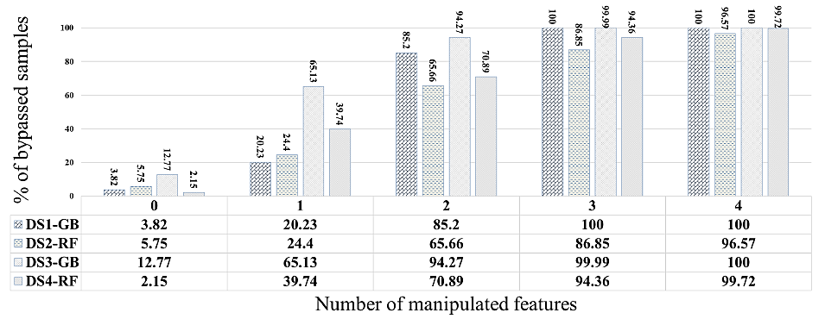
AML against Phishing URL Detectors
Adversarial Attacks against Phishing URL Classifiers
Shirazi et al. (2019) cont’d
The percentage of evaded URL samples increased significantly with only one feature perturbed, and reached 100 when four features were manipulated

Slide 44
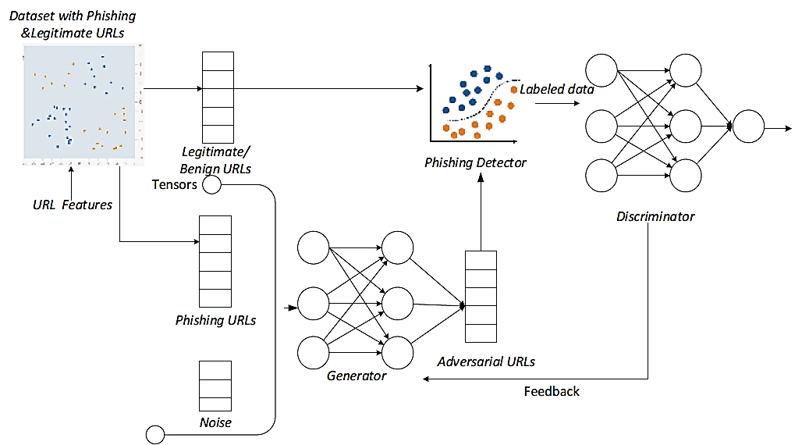
AML against Phishing URL Detectors
Adversarial Attacks against Phishing URL Classifiers
AlEroud and Karabatis (2020) Bypassing Detection of URL-based Phishing Attacks Using Generative Adversarial Deep Neural Networks (link)
Black-box evasion attack
Employs a GAN model to generate phishing URLs to evade ML phishing detectors
The generator used a perturbed version of phishing URLs and converted them to adversarial examples
Rosenberg et al. (2021) – AML Attacks and Defense Methods in the Cyber Security Domain

Slide 45
Cyber-physical Systems (CPS)
Cyber-physical Systems (CPS)
Cyber-physical systems (CPSs) consist of hardware and software components that control and monitor physical processes
CPS are part of the critical infrastructure, which includes the electric power grid, transportation networks, water supply networks, nuclear plants, telecommunications, etc.
The increased use of ML-based models for controlling and monitoring CPS makes these systems vulnerable to adversarial attacks
Adversarial manipulation of sensory data (if undetected) can cause substantial physical and financial damage
This can range from major disruptions, power blackouts, to nuclear incidents
For instance, AML attacks on manufacturing production systems can cause:
Damage to the systems, processes, and equipment
Defective products
Safety threat to employees
Lost production time
Unscheduled maintenance (due to false alarms)

Slide 46
Industrial Control Systems (ICS)
Industrial Control Systems (ICS)
Industrial Control Systems (ICS) are a subcategory of CPS
ICS commonly consist of sets of connected devices, such as PLCs, sensors, and actuators
The recent trend of connected devices and cloud-based services in ICS exposes these systems to increased risk of cyber attacks
Controllers make decisions for regulating process parameters based on readings from critical sensors
E.g., increase or decrease temperature to ensure it is within a target range
The ability of a malicious actor to manipulate sensory data in ICS can have catastrophic impacts on the control systems
Stealthy attacks via injecting false sensory readings can cause the controller to place the system into an unsafe mode of operation
E.g., the attacker may compromise the computer network in a nuclear plant, and sends low temperature sensor readings, causing the controller to heat up the reactor above safe levels

Slide 47
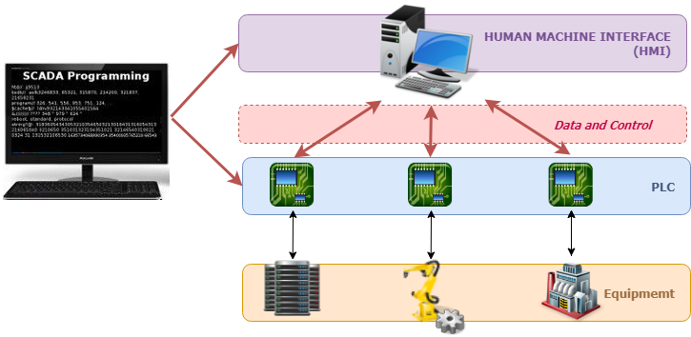
Industrial Control Systems (ICS)
Industrial Control Systems (ICS)
The main components of ICS are depicted in the figure
Equipment – includes various field devices have sensors and actuators (motors, hydraulic or pneumatic cylinders), such as robots, machines, CNCs, etc.
PLCs (Programmable Logic Controllers) – industrial microcomputers that collect input data from local sensors and output control signals to actuators
SCADA (Supervisory Control And Data Acquisition) – is a central computer station that gathers information from multiple PLCs and manages the operation of the system
HMI (Human Machine Interface) – an interface for human operators to monitor and control the system
Figure from: Learn SCADA Software Programming for Remote Monitoring

Slide 48
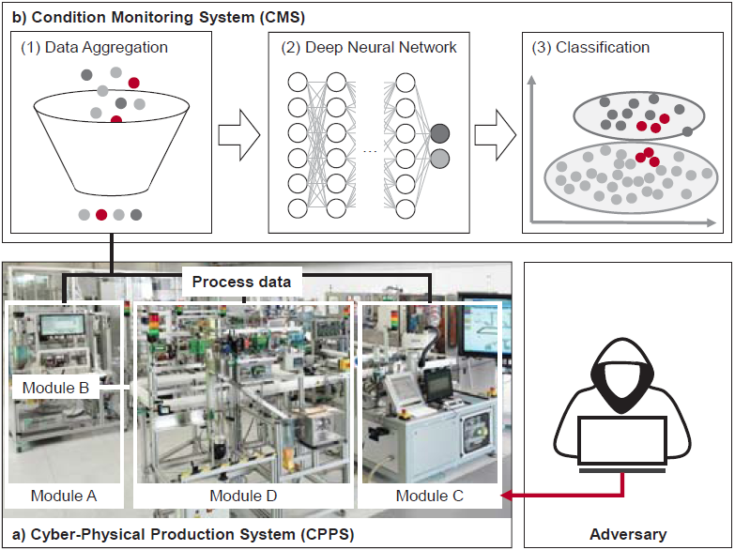
Machine Learning-based CPS
Machine Learning-based CPS
ML-based anomaly detection models are commonly used for monitoring the conditions in CPS, and for detecting abnormal conditions or system failures
E.g., in the figure, the condition monitoring system (CMS) will stop the production process if one of the modules fails
In this case, CMS is implemented by training the ML model on historical process data from production modules, to learn the characteristics of normal and abnormal system conditions
Adversarial attacks can manipulate the physical system without being detected by the CMS
Another objective of the attacker may be to trigger false alarms (to temporary stop the production)
Figure from: Specht et al. (2021) – Generation of Adversarial Examples to Prevent Misclassification in Cyber-Physical Production Systems

Slide 49
Major CPS Attacks
Major CPS Attacks
List of the most notorious attacks on CPS
Stuxnet (2010) – a malware attack on ICS around the world, e.g., it disrupted the uranium centrifuges in an Iranian nuclear plant
New York dam attack (2013) – a group of Iranian hackers accessed the Bowman Dam, but they didn’t do any damage
German steel mill (2014) – the attackers caused extensive damage to the steel mill, by preventing the blast furnace from shutting down
Ukraine power grid (2015 and 2016) – a Russian-based cyber attack remotely disabled power stations and left about 250,000 customers without electricity for 6 hours (in 2015) and 3 hours (in 2016)
Unknown water plant (referred to as Kemuri) (2016) – attack on PLCs for controlling the valves used for water treatment chemical processing
Water plant in Florida (2021) – an attempted attack to poison the water by increasing the level of one chemical hundredfold, it was discovered immediately and corrected
JBS Meat Processor (2021) – a ransomware attack on the world’s largest meat processor forced shutdown on 9 plants in US, JBS paid the requested $11M
Change Healthcare (2024) – a ransomware attack on software for prescriptions, the hackers were paid $22 M
Colonial Pipeline (2021) – details on the next page
Slide credit: 14 Major SCADA Attacks and What You Can Learn From Them

Slide 50
Colonial Pipeline Ransomware Attack
Major CPS Attacks
An example of a major disruption by a CPS cyberattack is the ransomware attack on Colonial Pipeline on May 7, 2021
This was the largest cyberattack on an oil infrastructure in the U.S. history
This is not an AML attack, since there was no ML-based systems involved
Colonial Pipeline carries gasoline, diesel, and jet fuel in Southeastern U.S.
About 45% of all fuel consumed on the East Coast arrives via their pipeline system
The hackers attacked the billing system of the company
The attackers also stole 100 GB of data, and threatened to release it on the internet
The attackers cracked the password to the company’s computer network
A key mistake: the company didn’t use two-factor authentication
The caused disruption resulted in a 6 days shutdown of the pipeline, leading to fuel shortage at gas stations, canceled flights
Colonial Pipeline paid the requested ransom of $4.4 million
The hackers then sent the company a software application to restore their network
Fortunately, FBI was able to recover $2.3 million from the ransom payment

Slide 51
AML against CPS
Adversarial Attacks against Cyber-physical Systems
Specht et al. (2018) Generation of Adversarial Examples to Prevent Misclassification of Deep Neural Network based Condition Monitoring Systems for Cyber-Physical Production Systems (link)
Application: monitoring a process for manufacturing semi-conductors
White-box evasion attack
Dataset: SECOM, recorded from a semi-conductor manufacturing process
Each data instance contains 590 features collected from the manufacturing sensors
The dataset contains 1,567 samples, labeled as either normal or anomalous production cycle
Attacked model: a deep NN consisting of fully-connected layers
The model is used for anomaly detection, i.e., it detects anomalous conditions in the collected sensory data
FGSM attack was used to generate adversarial samples, that were classified by the ML model as normal sensory data
Rosenberg et al. (2021) – AML Attacks and Defense Methods in the Cyber Security Domain

Slide 52
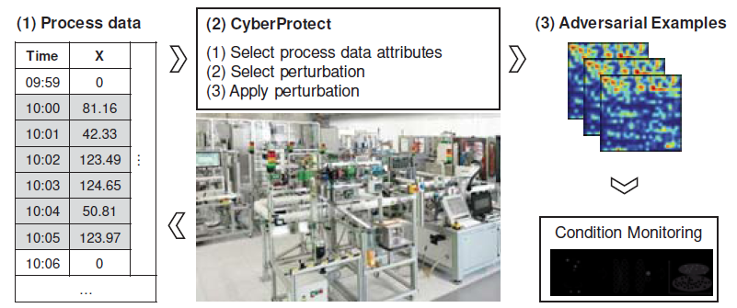
AML against CPS
Adversarial Attacks against Cyber-physical Systems
Specht et al. (2018) cont’d
The work also introduces a defense approach called CyberProtect
It uses the generated adversarial samples to retrain the DNN model (with both clean samples and adversarial samples)
This defense approach increased the classification accuracy of the DNN model from 20% to 82%

Slide 53
AML against CPS
Adversarial Attacks against Cyber-physical Systems
Ghafouri et al. (2018) Adversarial Regression for Detecting Attacks in Cyber-Physical Systems (link)
Application: controlling a process for manufacturing liquid products
Gray-box evasion attack
Attacked models: 3 ML models used for anomaly detection
These include: linear regression, NN, and an ensemble of LR and NN
Dataset: TE-PCS, containing sensory data from the production process
The data instances have 41 sensory measurements and 12 controlled outputs
Attack approach:
Mixed-integer linear programming (MILP) is used for generating adversarial examples
A challenge for this task is that there are safety constraints for the pressure and temperature readings of the sensors (the generated adversarial samples must obey these constraints)
Therefore, the attack was formulated as a constrained optimization problem via MILP
Rosenberg et al. (2021) – AML Attacks and Defense Methods in the Cyber Security Domain

Slide 54
AML against CPS
Adversarial Attacks against Cyber-physical Systems
Feng et al. (2017) A Deep Learning-based Framework for Conducting Stealthy Attacks in Industrial Control Systems (link)
Applications: monitoring and controlling a small lab-scale gas pipeline, and a water treatment plant
Gray-box evasion attack
Attacked model: an LSTM-based anomaly detector
Datasets:
Gas pipeline data: 68,803 time series with 11 sensory measurement data
Water treatment plant dataset: 496,800 signals having 51 sensors measurements
Attack:
A GAN model is used to generate malicious sensor measurements to bypass the anomaly detector
Attacks on both sensor and control channels of the PLC were designed
The success rate can reach up to 90%, depending on the number of manipulated sensor measurements
Rosenberg et al. (2021) – AML Attacks and Defense Methods in the Cyber Security Domain

Slide 55
TOPIC: Constrained Concealment Attacks against Reconstruction-based Anomaly Detectors in Industrial Control Systems
Alessandro Erba, Riccardo Taormina, Stefano Galelli, Marcello Pogliani
Deekshith B

Slide 56
Introduction
In Industries like Manufacturing, Power Generation and transportation physical processes are controlled by a system called Industrial Control Systems(ICS).
eg: Power Grid, Water Supply Systems, Autonomous Vehicles etc.,
There are systems that monitor the normal operation of ICS which alerts in case of cyberattack. We call it as Attack Detector.
These Systems use ML to learn the ideal behavior of Cyber-Physical systems(CPS) and use the learned model to detect anomalies.
Evasion attacks in the context of ICS (Concealment Attacks) which are different from standard AML techniques.

Slide 57
Industrial Control Systems
Physical Components: Hardware like actuators and sensors, interfacing between physical and cyber realms.
Cyber Components: Computer systems for control logic and monitoring.
PLCs: Devices that manage process control by interpreting sensor data and controlling actuators.
SCADA Systems: Repositories for PLC-reported data on sensor and actuator states, operating passively.
Stuxnet Example: A worm that compromised both physical and cyber aspects of an ICS, manipulating centrifuge speeds and falsifying sensor data to evade detection.

Slide 58
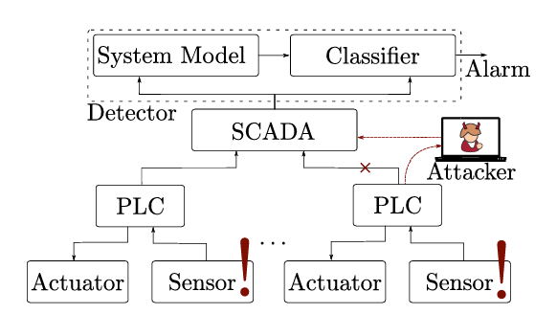
Attacker Goal and Capabilities
The attacker aims to launch a concealment attack on an Industrial Control System (ICS) to hide the real state of the process from an anomaly detector by finding an alternative vector ‘x’ that prevents detection.
If 𝑦(𝑥) = ‘under attack’,
the attacker is looking for a perturbation 𝛿,
Where, 𝑦(𝑥 + 𝛿) =‘safe’.
The attacker is assumed to have access to the ICS network and control a subset of the communication between Programmable Logic Controllers (PLCs) and the SCADA system.
The attacker can eavesdrop on traffic and send manipulated sensor readings to the detector without needing explicit knowledge of the physical model equations.
High level overview of system and attacker model

Slide 59
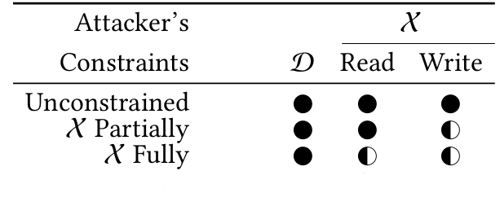
Attacker Knowledge and Constraints
(D,X,f,w)
(D,X)
Data Tuple
Unconstrained
N-features
Partially And Fully Constrained
k/n features
$L_{0}$ !> k
Partially And Fully Constrained
k/n features
𝐿_0 !> k
(f,w)
Defense Tuple
White Box f,w
Black Box
D
Data Constrained
Eavesdrop
Classification of attacker models based on training data and features.

Slide 60
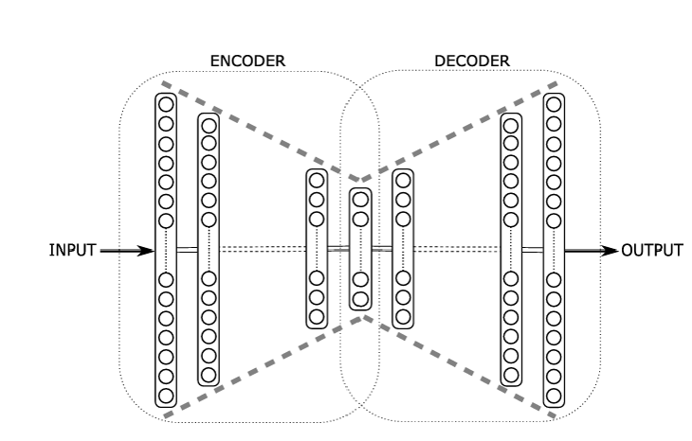
Reconstruction-based Attack Detector
Anomaly Detector has two parts
DL Auto-Encoder with input(m X n), output (n) over ideal data.
Reconstruction Error(RE)
Average RE $ϵ\left(e\right)=\frac{1}{n}\sum_{i=1}^{n}{d_{i}^{2}}$
A Classifier Function
$$y\left(X\right)=\left\{\begin{aligned}{′Under attack′}^{},ϵ\left(e\right)>θ \\ ′Safe^{′}, Otherwise\end{aligned}\right.$$
Auto-associators and Diabolo Networks.

Slide 61
Different Types Of Attacks
Replay Attack just re- plays the recorded readings.
Iterative Attack input arbitrary 𝑥 features and gets RE($e$), then computes $\max_{i} e$ and get sensor reading $r_{i}$ with the highest RE from $x$.
Learning-Based Attack
intercepts traffic from PLCs to SCADA.
Build a random Autoencoder which $minimize MSE=\frac{1}{n}\sum_{i=1}^{n}{{({x̂}_{i}−(x_{i}+ {\text{δ}}_{i}))}^{2}}$
Manipulates Physical process to generate Anomalous data.
Anomalous Data is morphed into adversarial model and generate conceal data.
Concealed Data is fed to SCADA.
Unlike traditional AML Attacks this attack generates the conceal data using anomalous data with no Negative Class.

Slide 62
Concealment Attack
Adversarial examples obtained with a concealment attack must meet four requirements.
Distributed Systems: Attackers can only target a subset of features.
Adversarial Examples: Must align with the physical process’s temporal and spatial correlations.
Attack Focus: On reconstruction-based networks using MSE, not end-to-end neural networks with cross-entropy loss.
Previous Work: Assumed unlimited computational power for static systems, not applicable for real-time attacks on dynamic ICS, requiring new approaches.

Slide 63
Datasets And Metric
DATASETS:
BATADAL: Generated with quantecTA, an open-source object – oriented MATLAB toolbox for modelling hydraulic response.
WADI: A real world ICS testbed located @ Singapore University of Technology and Science based on Water Distribution(WADI).
Recall(TPR) = $\frac{TP}{TP+FN}$
Window Size (used) | Accuracy | Precision | Recall | FPR
3 quarter hours | 0.93 | 0.90 | 0.60 | 0.01
60 seconds | 0.97 | 0.77 | 0.58 | 0.01
Attack Detector is trained on sensor readings during normal operational behavior.

Slide 64
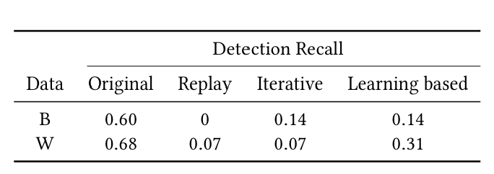
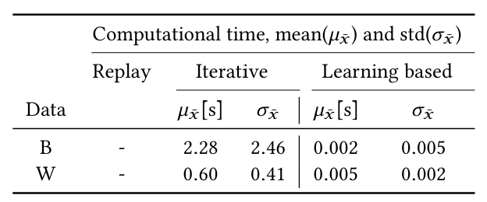
Evaluation
Learning-Based Attack Architectures:
BATADAL :
Models Trained: 83
Variables: 43
AE Architecture:
1st /3rd Hidden Layers - 64 units,
2nd Hidden Layer - 128 units
Training:
Required 18 epochs (2 seconds/epoch)
36 seconds to train the model
WADI:
Models Trained: 63
Variables: 82
AE Architecture:
1st /3rd Hidden Layers - 128 units,
2nd Hidden Layer - 256 units
Training:
Required 7 epochs (64 seconds/epoch),
488 seconds to train the model
Detector Recall (B) and (W) datasets), before and after unconstrained concealment attacks.
Average required time (in seconds) to manipulate sensor readings.

Slide 65
Results
Comparison between replay attack and proposed concealment attacks.
Partially – Constrained Scenario is considered. (Best case Scenario).
Replay attack performs poorly raises more alarms due to contextual anomalies of large window.
Both learning-based and iterative approaches outperform the replay attack as no contextual anomalies.

Slide 66
Cont.
Attack to LSTM (a) and CNN (b) based defenses on BATADAL dataset.
LSTM Architecture: (8x43) input, 1 LSTM layer (43 neurons), fully connected layer (43 neurons).
Performance: Acc: 0.94, Prec: 0.89, Rec: 0.63, FPR: 0.01.
CNN Architecture: (2x43) input, (3x1) conv layers (64/128/256 neurons), max pooling, flatten, dropout, 43-neuron output.
Performance: Acc: 0.95, Prec: 0.90, Rec: 0.67, FPR: 0.01.

Slide 67
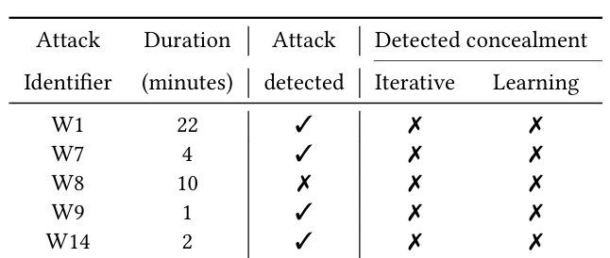
Real-time Concealment Attacks
Test Setup: 15 hours of normal operations, 62 sensors sampled every 10 seconds.
Reliability Test: 7 hours run, 2 false positives for 10 minutes each.
Actuator Manipulation: Replicated anomalies from WADI dataset.
Unconstrained Attacks: Both iterative and learning-based attacks launched, all anomalies successfully misclassified.
Results: Learning-based modifications computed in 5ms, faster than system’s sampling rate. All anomalies concealed in real-time tests.

Slide 68
Conclusion
Autoencoder-based attack on BATADAL dataset reduced detection (Recall dropped from 0.60 to 0.14 in both Recall as efficiently as the iterative attack ).
Attack hides effectively without needing anomaly detector knowledge or physical model equations.
Malicious data generated quickly during real-time operations in between each sampling step (every 10s, actual example generation took on average 5ms for iterative).
Reveals that reconstruction-based detectors are vulnerable to manipulation, impacting future security measures and such attacks need to be considered when designing future attack detection schemes.

Slide 69
References
[1] S.M. Amin, X. Litrico, S. Sastry, and A.M. Bayen. 2013. Cyber Security of Water SCADA Systems; Part I: Analysis and Experimentation of Stealthy Deception Attacks. Control Systems Technology, IEEE Transactions on 21, 5 (2013), 1963–1970.
[2] R. Taormina. 2018. AutoEncoders for Event Detection (AEED): a Keras-based class for anomaly detection in water sensor networks. (2018). https://github. com/rtaormina/aeed, Last accessed on: 2020-06-15.
[3] Yao Liu, Peng Ning, and Michael K Reiter. 2011. False data injection attacks against state estimation in electric power grids. ACM Transactions on Information and System Security (TISSEC) 14, 1 (2011), 13.
[4] Luis Garcia, Ferdinand Brasser, Mehmet H. Cintuglu, Ahmad-Reza Sadeghi, Osama Mohammed, and Saman A. Zonouz. 2017. Hey, My Malware Knows Physics! Attacking PLCs with Physical Model Aware Rootkit. In Proceedings of the Annual Network & Distributed System Security Symposium (NDSS).
[5] Jonathan Goh, Sridhar Adepu, Marcus Tan, and Zi Shan Lee. 2017. Anomaly detection in cyber physical systems using recurrent neural networks. In High Assurance Systems Engineering (HASE), 2017 IEEE 18th International Symposium on. IEEE, 140–145.
[6] Moshe Kravchik and Asaf Shabtai. 2018. Detecting Cyber Attacks in Industrial Control Systems Using Convolutional Neural Networks. In Proceedings of the 2018 Workshop on Cyber-Physical Systems Security and PrivaCy. ACM, 72–83.

Slide 70
QUESTIONS?
Thank You

Slide 71
Additional References
Rosenberg et al. (2021) – Adversarial Machine Learning Attacks and Defense Methods in the Cyber Security Domain (link)
Ganagavarapu (2020) – Applicability of Machine Learning in Spam and Phishing Email Filtering: Review and Approaches (link)
Blog Post by Vladislav Podolyako – Why Spam Filters Hate You (link)
Daniel Lowd – Adversarial Machine Learning
Blog Post by Emily Bauer – 15 Outrageous Email Spam Statistics that Still Ring True in 2018 (link)
Blog Post by Sie Huai Gan – How To Design A Spam Filtering System with Machine Learning Algorithm (link)

