Slide 1
CS 487/587 Adversarial Machine Learning
Dr. Alex Vakanski

Slide 2
Lecture 12
Defenses against Privacy Attacks

Slide 3
Lecture Outline
Defenses against Privacy Attacks
Anonymization techniques
Encryption techniques
Differential privacy
Distributed learning
ML-specific techniques
Elijah Darko presentation
Introduction to differential privacy
Differentially private SGD
Scalable private learning with PATE

Slide 4
Defenses against Privacy Attacks
Defenses against Privacy Attacks
Data privacy techniques have the goal of allowing analysts to learn about trends in data, without revealing information specific to individual data instances
Therefore, privacy techniques involve an intentional release of information, and attempt to control what can be learned from the released information
Related to data privacy is the Fundamental Law of Information Recovery, which states that “overly accurate estimates of too many statistics can completely destroy privacy”
I.e., extracting useful information from a dataset (e.g., for training an ML model) poses a privacy risk to the data
There is an inevitable trade-off between privacy and accuracy (i.e., utility)
Preferred privacy techniques should provide an estimate of how much privacy is lost by interacting with data

Slide 5
Defenses against Privacy Attacks
Defenses against Privacy Attacks
Defense strategies against privacy attacks in ML can be broadly classified into:
Anonymization techniques
Encryption techniques
Differential privacy
Distributed learning
ML-specific techniques

Slide 6
Anonymization Techniques
Anonymization Techniques
Anonymization techniques provide privacy protection by removing identifying information in the data
E.g., remove personal identifiable information (PII)
In the example below, the Name and Address columns are removed
User ID | Name | Address | Account Type | Subscription Date
001 | Alice | 123 A St | Pro | 01/02/20
002 | Bob | 234 B St | Free | 02/03/21
003 | Charlie | 456 C St | Pro | 03/04/18

Slide 7
Anonymization Techniques
Anonymization Techniques
Anonymization is not an efficient defense method, since the remaining information in the data can be used for identifying the individual data instances
For example, based on health records (including diagnoses and prescriptions) with removed personal information released by an insurance group in 1997, a researcher extracted the information for the Governor of Massachusetts
This is referred to as de-anonymization
The same researcher later showed that 87% of all Americans can be uniquely identified using 3 bits of information: ZIP code, birth date, and gender
Dataset 1: Users medical database
Dataset 2: Users medical database with name and address removed
User ID | Name | Address | Zip Code | Birth date | Gender | Probable disease ID
001 | Alice | 123 A St | 83401 | 01/02/1997 | F | 120
002 | Bob | 234 B St | 83402 | 02/03/1995 | M | 35
003 | Charlie | 456 C St | 83403 | 03/04/1999 | M | 240
User ID | Zip Code | Birth date | Gender | Probable disease ID
001 | 83401 | 01/02/1997 | F | 120
002 | 83402 | 02/03/1995 | M | 35
003 | 83403 | 03/04/1999 | M | 240

Slide 8
Linkage Attack
Anonymization Techniques
De-anonymization of data by using connections to external sources of information is referred to as linkage attack
For example:
In 2006, Netflix published anonymized 10 million movie rankings by 500,000 customers
Two researchers showed later that by using movie recommendations on IMDb (Internet Movie Database) they could identify the customers in the Netflix data
Dataset 1: Annonymized dataset with removed personal information
Dataset 2: External public dataset that reveals the users in Dataset 1
User ID | Name | Address | Account Type | Subscription Date
001 | Alice | 123 A St | Pro | 01/15/20
002 | Bob | 234 B St | Pro | 02/03/21
003 | Charlie | 456 C St | Free | 03/04/18
User ID | Product Name | Product Price | Purchase Date
001 | TV | 400 | 01/02/20
002 | Iphone | 1,199 | 02/02/21
003 | Watch | 130 | 02/22/18

Slide 9
k-anonymity
Anonymization Techniques
k-anonymity is an approach for protecting data privacy by suppressing certain identifying data features
This approach removes fields of data for individuals who have unique characteristics
E.g., students at UI who are from Latvia and are enrolled in Architecture
A dataset is k-anonymous if for any person’s record, there are at least $k−1$ other records that are indistinguishable
Limitation: this approach is mostly applicable to large datasets with low-dimensional input features
The more input features there are for each record, the higher the possibility of unique records

Slide 10
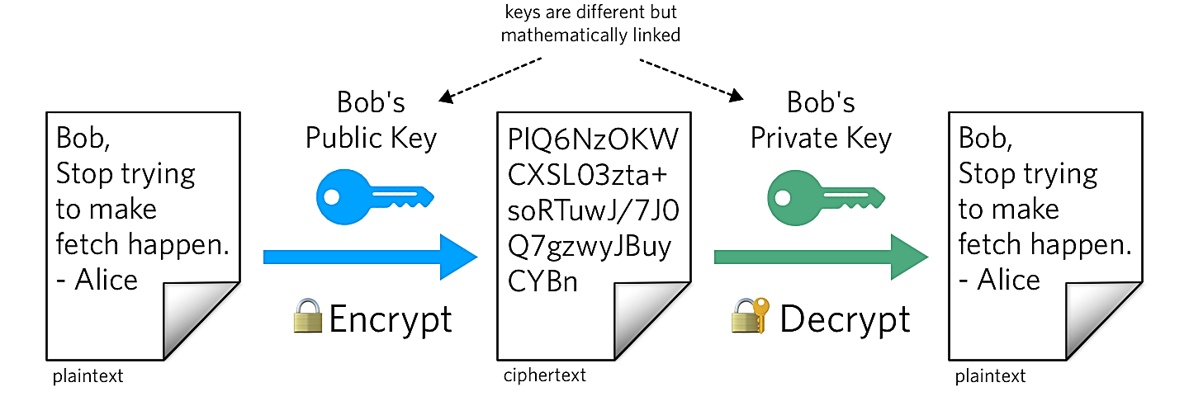
Encryption Techniques
Encryption Techniques
Encryption is a cryptography approach, which converts the original representation of information into an alternative form
The sender of encrypted information shares the decoding technique only with the intended recipients of the information
Encrypting the training data has been applied in ML
Common techniques for data encryption include:
Homomorphic encryption (HE)
Secure multi-party computation (SMPC)
Encrypting ML models is less common approach
Homomorphic encryption has been applied to the model gradients in collaborative DL setting to protect the model privacy
Figure form: What is Public Key Cryptography?

Slide 11
Homomorphic Encryption
Encryption Techniques
Homomorphic encryption (HE) allows users to perform computations on encrypted data (without decrypting it)
Encrypted data can be analyzed and manipulated without revealing the original data
HE uses a public key to encrypt the data, and applies an algebraic system (e.g., additions and multiplications) to allow computations while the data is still encrypted
Only the person who has a matching private key can access the decrypted results

Slide 12
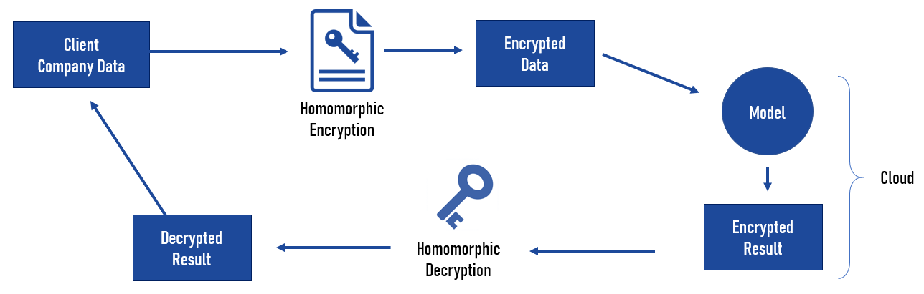
Homomorphic Encryption
Encryption Techniques
In ML, training data can be encrypted and send to a server for model training
Even if the server is untrusted or it is compromised, confidentiality of the data will remain preserved
One main limitation of HE is the slowing down of the training process
HE has been applied to traditional ML approaches, such as Naïve Bayes, Decision Trees
Training DNNs over encrypted data is still challenging, due to the increased computational complexity
Figure form: Homomorphic Encryption & Machine Learning: New Business Models

Slide 13
Privacy versus Confidentiality
Encryption Techniques
Encryption techniques in ML are mainly applied to protect the confidentiality of the data or model
Confidentiality refers to keeping the information (training data, model parameters) hidden from the clients and the public
It is ensuring that only authorized parties have access to the information
E.g., a server has an ML model trained on private data and provides the model to a client for inference
It is preferred to preserve the confidentiality of the model parameters from the client
Privacy refers to intentional release of information in a controlled manner to prevent unintended information leakage
It is ensuring that released data cannot uniquely identify individual inputs
E.g., a server applies Differential Privacy to a trained ML model to prevent information leakage about individual inputs
Protecting privacy is more challenging than protecting confidentiality

Slide 14
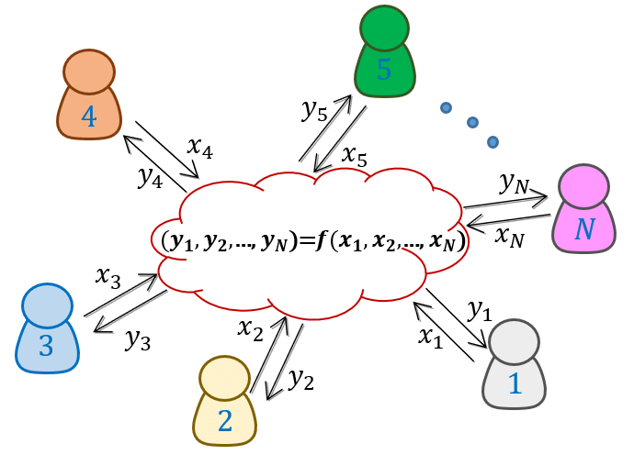
Secure Multi-Party Computation
Encryption Techniques
Secure Multi-Party Computation (SMPC) is an extension of encryption in multi-party setting
SMPC allows two or more parties to jointly perform computation over their private data, without sharing the data
E.g., two banks want to know if they have both flagged the same individuals and learn about the activities by those individuals
The banks can share encrypted tables of flagged individuals, and they can decrypt only the matched records, but not the information for individuals that are not in both tables
Figure form: Generation and Distribution of Quantum Oblivious Keys for Secure Multiparty Computation

Slide 15
Secure Multi-Party Computation
Encryption Techniques
SMPC versus HE
SMPC protects the privacy of the data in collaborative learning
E.g., participants in collaborative learning do not trust the other participants or the central server
HE protects the confidentiality of the data from external adversaries
E.g., a data owner wants to use a MLaaS (Machine Learning as a Service), but does not trust the service provider: (1) the owner sends encrypted data, (2) the provider processes encrypted data and sends back encrypted results, (3) the owner decrypts the results
Or, a bank can store encrypted banking information in the cloud, and use HE to ensure that only the employees of the bank can access the data

Slide 16
Secure Multi-Party Computation
Encryption Techniques
In ML, SMPC can be used to compute updates of the model parameters by multiple parties that have access to their private data
For examples, SMPC has been applied to federated learning, where participants encrypt their updates, and the central server can recover only the sum of the updates from all participants
Beside the data privacy, SMPC also offers protection against adversarial participants
Either all parties are honest and can jointly compute the correct output, or if a malicious party is dishonest the joint output will be incorrect
SMPC has been applied to traditional ML models, such as decision trees, linear regression, logistic regression, Naïve Bayes, k-means clustering
Application of SMPC to deep NNs is challenging, due to increased computational costs

Slide 17
Differential Privacy
Differential Privacy
Differential privacy is based on employing obfuscation mechanisms for privacy protection
A randomization mechanism $ℳ\left(D\right)$ applies noise $ξ$to the outputs of a function $f\left(D\right)$ to protect the privacy of individual data instances, i.e., $ℳ\left(D\right)=f\left(D\right)+ξ$
Commonly used randomization mechanisms include Laplacian, Gaussian, and Exponential mechanism
DP is often implemented in practical applications
Examples include:
2015: Google, for sharing historical traffic statistics
2016: Apple, for improving its Intelligent Personal Assistant technology
2017: Microsoft, for telemetry in Windows
2020: LinkedIn, for advertiser queries
2020: U.S. Census Bureau, for demographic data

Slide 18
DP Example
Differentially Private SGD
$D_{1}$ (includes Bob)
Consider two databases $D_{1}$ and $D_{2}$ that show if a person has diabetes or not
The only difference between the two databases is that $D_{2}$ does not include the last record in $D_{1}$ (for Bob)
Let’s assume that the databases are publicly available for making queries
To protect patient identities, it is not allowed to query the patient names
However, an adversary can query the sum of the persons with diabetes in the first database (e.g., $f\left(D_{1}\right)=64$), and the sum in the second database (e.g., $f\left(D_{2}\right)=63)$
Based on the difference $f\left(D_{1}\right)−f\left(D_{2}\right)=64−63=1$, the adversary can infer that Bob has diabetes
Alternatively, if $f\left(D_{1}\right)=63$ and $f\left(D_{2}\right)=63$, the adversary can infer that Bob does not have diabetes
Name | Has Diabetes
Don | 1
Monica | 0
…
…
Chris | 1
Bob | 1
$D_{2}$ (without Bob)
Name | Has Diabetes
Don | 1
Monica | 0
…
…
Chris | 1

Slide 19
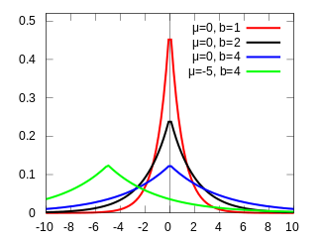
DP Example (cont’d)
Differentially Private SGD
An algorithm that is differentially private adds noise to the answers for $f\left(D_{1}\right)$ and $f\left(D_{2}\right)$ to make it difficult to infer the information about Bob
I.e., a randomization mechanism $ℳ\left(D\right)$is selected to add noise $ξ$to the output answers to queries $f\left(D\right)$, that is, $ℳ\left(D\right)=f\left(D\right)+ξ$
Additive noise $ξ$ from a Laplacian distribution (shown) is commonly applied
E.g., let’s assume a privacy budget $ε=0.5$and let’s sample noise from a Laplacian distribution with $μ=0$ and scale $b=1/ε=1/{0.5}=2$
6 random noise samples are: $ξ∈\left\{−0.13, 2.06, −1.67, −2.49, −0.52, 0.37\right\}$
Consider 3 queries by the adversary having the outputs $f\left(D_{1}\right)=64$and $f\left(D_{2}\right)=63$with added Laplacian noise $ξ$:
$ℳ\left(D_{1}\right)−ℳ\left(D_{2}\right)=63.87−65.06=−1.19$
$ℳ\left(D_{1}\right)−ℳ\left(D_{2}\right)=62.33−60.51=1.82$
$ℳ\left(D_{1}\right)−ℳ\left(D_{2}\right)=63.48−63.37=0.11$
Based on the differences between the randomized outputs from the queries for $D_{1}$ and $D_{2}$, now it is impossible for the adversary to tell if Bob has diabetes
$$Pr\left(ξ\right)$$
$$ξ$$

Slide 20
DP Mechanism
Differentially Private SGD
The important question in DP is: how much noise to add?
The amount of noise $ξ$depends on the data, and it needs to be adjusted
E.g., a function $f_{1}\left(D\right)$that provides the yearly income of people in thousands of dollars would require different level of noise than a function $f_{2}\left(D\right)$that provides the height in feet
The sensitivity of the function $f$determines how much the output $f\left(D\right)$changes by adding a single data instance
Sensitivity is defined as $∆f=max{\left\|f\left(D_{1}\right)−f\left(D_{2}\right)\right\|}_{1}$ for all possible datasets $D_{1}$ and $D_{2}$ differing in one data instance, where ${\left\|∙\right\|}_{1}$ denotes $ℓ_{1}$-norm
E.g., for the example with medical diabetes records, the sensitivity is $∆f=1$, since the sum of the people with diabetes can change only by 1 when a single input is added
A Laplacian mechanism that is $ε$-differentially private adds a Laplacian noise with scale $b={∆f}/ε$
Note that if the privacy budget $ε$ has smaller values, this will result in larger amount of Laplacian noise $ξ$ added to $f\left(D\right)$
Thus, the noisy outputs $ℳ\left(D\right)$ will reveal less private information about the inputs (i.e., provide better privacy protection), but also the noisy answers to the queries $ℳ\left(D\right)$will be less accurate

Slide 21
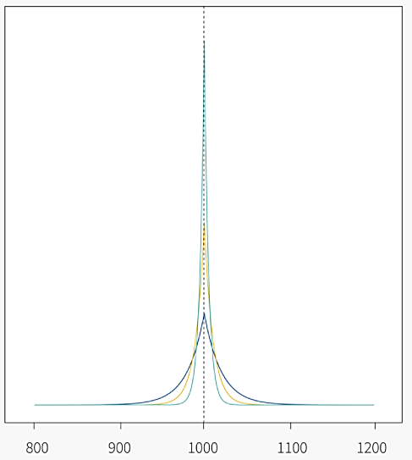
DP with Laplacian Randomization
Differentially Private SGD
The figure shows the probability distributions of the outputs $ℳ\left(D\right)$ for three different levels of Laplacian noise with $ε∈\left\{0.05, 0.1, 0.2\right\}$
The true output value is $f\left(D\right)=1,000$
Larger values of $ε$ have distributions that are tighter around the true value of $f\left(D\right)=1,000$ in the figure, and hence are more accurate, but leak more privacy
A mechanism $ℳ\left(D\right)$ is $ε$-differentially private if for all databases $D_{1}$ and $D_{2}$ that differ by at most one instance, and for any subset of outputs S:
$Pr\left(ℳ\left(D_{1}\right)∈S\right)≤e^{ε}$ $Pr\left(ℳ\left(D_{2}\right)∈S\right)$
In other words, $ε$-differential privacy ensures that the probabilities of any two outputs $ℳ\left(D_{1}\right)$ and $ℳ\left(D_{2}\right)$ differ by at most $e^{ε}$
E.g., for $ε=0.05$, ${Pr\left(ℳ\left(D_{1}\right)\right)}/{Pr\left(ℳ\left(D_{2}\right)\right)}$is at most $e^{0.05}=$ 1.05
Smaller $ε$ ensures less similar outputs $ℳ\left(D_{1}\right)$ and $ℳ\left(D_{2}\right)$, and provides higher levels of privacy
$$Pr\left(ℳ\left(D\right)\right)$$
$$ℳ\left(D\right)$$

Slide 22
DP with Gaussian Randomization
Differentially Private SGD
There are other DP mechanisms besides the Laplacian mechanism, that are more suitable for some applications
The Gaussian mechanism adds Gaussian noise instead of Laplacian noise, and the level of noise is based on the $ℓ_{2}$-norm sensitivity, instead of $ℓ_{1}$-norm
A Gaussian mechanism is $\left(ε,δ\right)$-differentially private if for all databases $D_{1}$ and $D_{2}$ that differ by at most one instance, and for any subset of outputs S:
$Pr\left(ℳ\left(D_{1}\right)∈S\right)≤e^{ε}$ $Pr\left(ℳ\left(D_{2}\right)∈S\right)+δ$
The $\left(ε,δ\right)$-differential privacy that is provided by the Gaussian mechanism introduces the probability parameter $δ$
Informally, $\left(ε,δ\right)$-differential privacy is guaranteed with probability $1−δ$
E.g., for $δ=0.05$, the method is 𝜀-differentially private with 95% probability
The Gaussian mechanism is therefore weaker than the Laplacian mechanism, since it allows scenarios when the privacy cannot be guaranteed

Slide 23
DP in Machine Learning
Differentially Private SGD
Training ML models can be considered an extension of the previous example on querying databases
I.e., ML models use data to learn a function, which is afterward used for prediction
The datasets for training ML models often contain sensitive information (e.g., medical records, personal information), so it is important to provide privacy guarantees
On the other hand, we know that ML models can memorize the training data, which can be exploited by adversaries to recover information about the data from a trained model
The challenge is: how to extract enough information from data to train accurate ML models without revealing the data

Slide 24
DP in Machine Learning
Differential Privacy
In ML, DP is achieved by adding noise to:
Model parameters
Several works applied DP to conventional ML methods
Differentially private SGD (Abadi, 2016) clips and adds noise to the gradients of deep NNs during training
This reduces the memorization of individual input instances by the model
The approaches that apply obfuscation to the model parameters via DP are also referred to as differentially private ML
Model outputs
PATE (Private Aggregation of Teacher Ensembles) approach (Papernot, 2018) employs an ensemble of models trained on disjoint subsets of the training data, called teacher models
Noise is added to the outputs of the teacher models, and the aggregated outputs are used to train another model, called student model
Training data
Obfuscation of training data in ML has been also investigated in several works

Slide 25
DP in Machine Learning
Differential Privacy
DP is typically applied in a centralized learning setting, where the data and model are at the same location
In this scenario, all data is gathered in one central location for model training
E.g., MLaaS typically requires that the users upload their data to a cloud-based server for training a model
Recently, DP has also been applied in a distributed learning setting, where the data are kept at separate locations from the model
DP-FedAvg (McMahan, 2018) is applied to federated learning
It introduced the Federated Averaging algorithm to limits the contributions by the data from individual users to the learning model

Slide 26
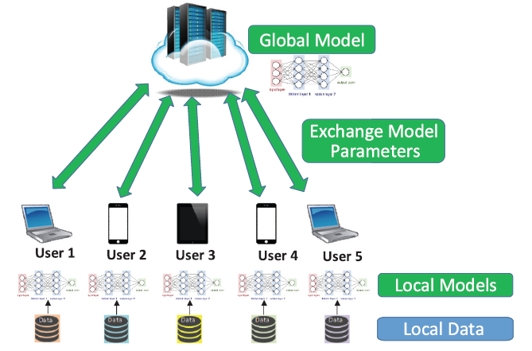
Distributed Learning
Distributed Learning
Distributed learning allows multiple parties to train a global model without releasing their private data
Some form of aggregation is applied to the local updates of the model parameters by the users in distributed learning to create a global model
E.g., averaging is one common form of aggregation
Federated learning is the most popular distributed learning scheme
Figure form: Liu et al. (2020) When Machine Learning Meets Privacy: A Survey and Outlook

Slide 27
Distributed Learning
Distributed Learning
Federated learning or collaborative learning – learn one global model using data stored at multiple locations (e.g., remote devices)
The data are processed locally, and used to update the model
The data do not leave the remote devices, remains private
The central server aggregates the updates and creates the global model
Decentralized Peer-to-Peer (P2P) learning – the remote devices communicate and exchange the updates directly, without a central server
Removes the need to send updates to a potentially untrusted central server
Split learning – each remote device is used to train several layers of the global model, and send the outputs to a central server
The remote devices can train the initial layers of a DNN, and the central server can train the final layers
The gradient is back-propagated from the central server to each user to sequentially complete the back-propagation through all layers of the model
The devices send the intermediate layers outputs, rather than model parameters
Split learning is more common for IoT devices with limited computational resources

Slide 28
ML-Specific Techniques
ML-Specific Techniques
In the lecture on privacy attacks in ML, we mentioned that overfitting is one of the reasons for information leakage
Regularization techniques in ML can therefore be used to reduce overfitting, as well as a defense strategy
Different regularization techniques in NNs include:
Explicit regularization: dropout, early stopping, weight decay
Implicit regularization: batch normalization
Other ML-specific techniques include:
Dimensionality reduction – removing inputs with features that occur rarely in the training set
Weight-normalization – rescaling the weights of the model during training
Selective gradient sharing – in federated learning, the users share a fraction of the gradient at each update

Slide 29
Introduction to Differential Privacy
Elijah Danquah Darko

Slide 30
Outline
Privacy in information age
Traditional Privacy Models
Differential Privacy
Differential Privacy Mechanism
Applications in Machine Learning

Slide 31
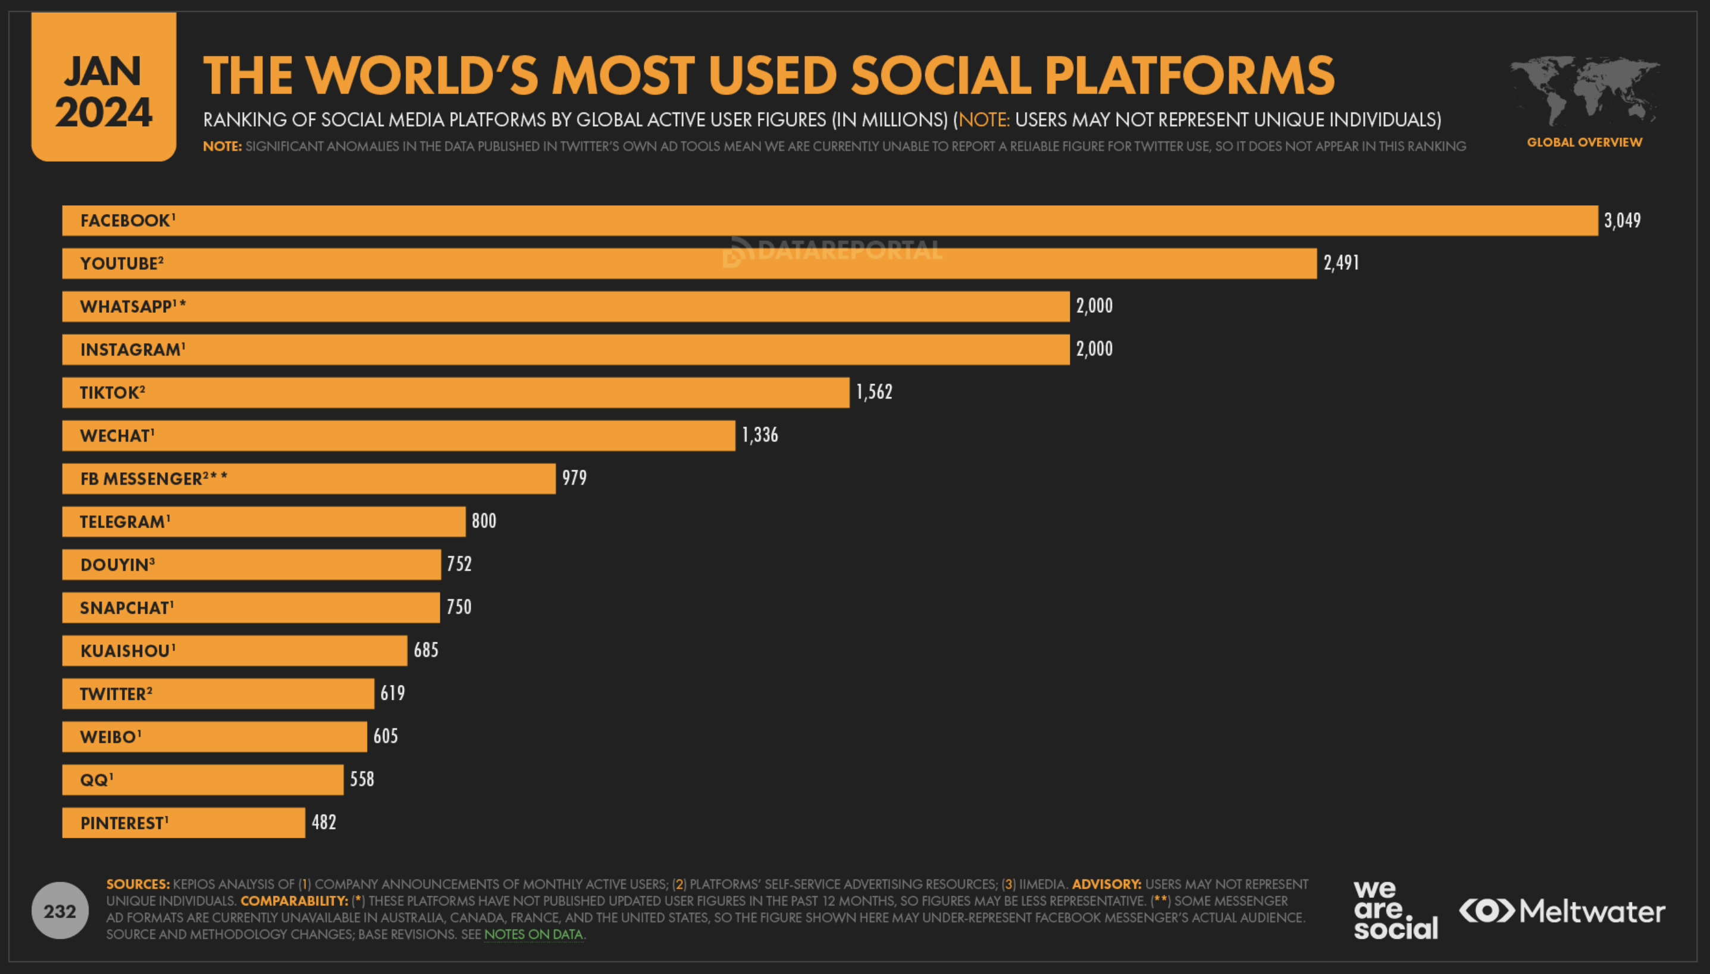
Privacy in information age
Source: https://datareportal.com/social-media-users

Slide 32
Traditional Privacy Models
Anonymization Techniques
Data Anonymization / De-identification
Removing identifiable information from the dataset column-wise
Methods consist of stripping, masking, swapping, perturbing, some columns in the dataset
k-Anonymity [Emam et al.]
Encryption Techniques
Homomorphic encryption
Secure multi-party computation
Notes:
It is possible to uniquely identify a user with the triplet (Zip Code, Birth date, Gender)!
Encrypting training , encrypting model

Slide 33
Differential Privacy
Differential privacy is a privacy framework that aims to protect sensitive information while still allowing for useful data analysis.
Differential privacy mathematically guarantees that anyone seeing the result of a differentially private analysis will essentially make the same inference about any individual’s private information, whether or not that individual’s private information is included in the input to the analysis.
In practice, differential privacy involves adding noise to data before it is analyzed, so that the true values of individual data points are obscured. One of the key challenges in implementing differential privacy is balancing privacy with the usefulness of the data.
Deep neural networks are highly expressive models that can potentially memorize individual training examples. Deep learning with differential privacy is an emerging field that combines the power of deep neural networks with the privacy guarantees of differential privacy.
The goal is to develop machine learning algorithms that can analyze sensitive data while preserving the privacy of individuals in the data.

Slide 34
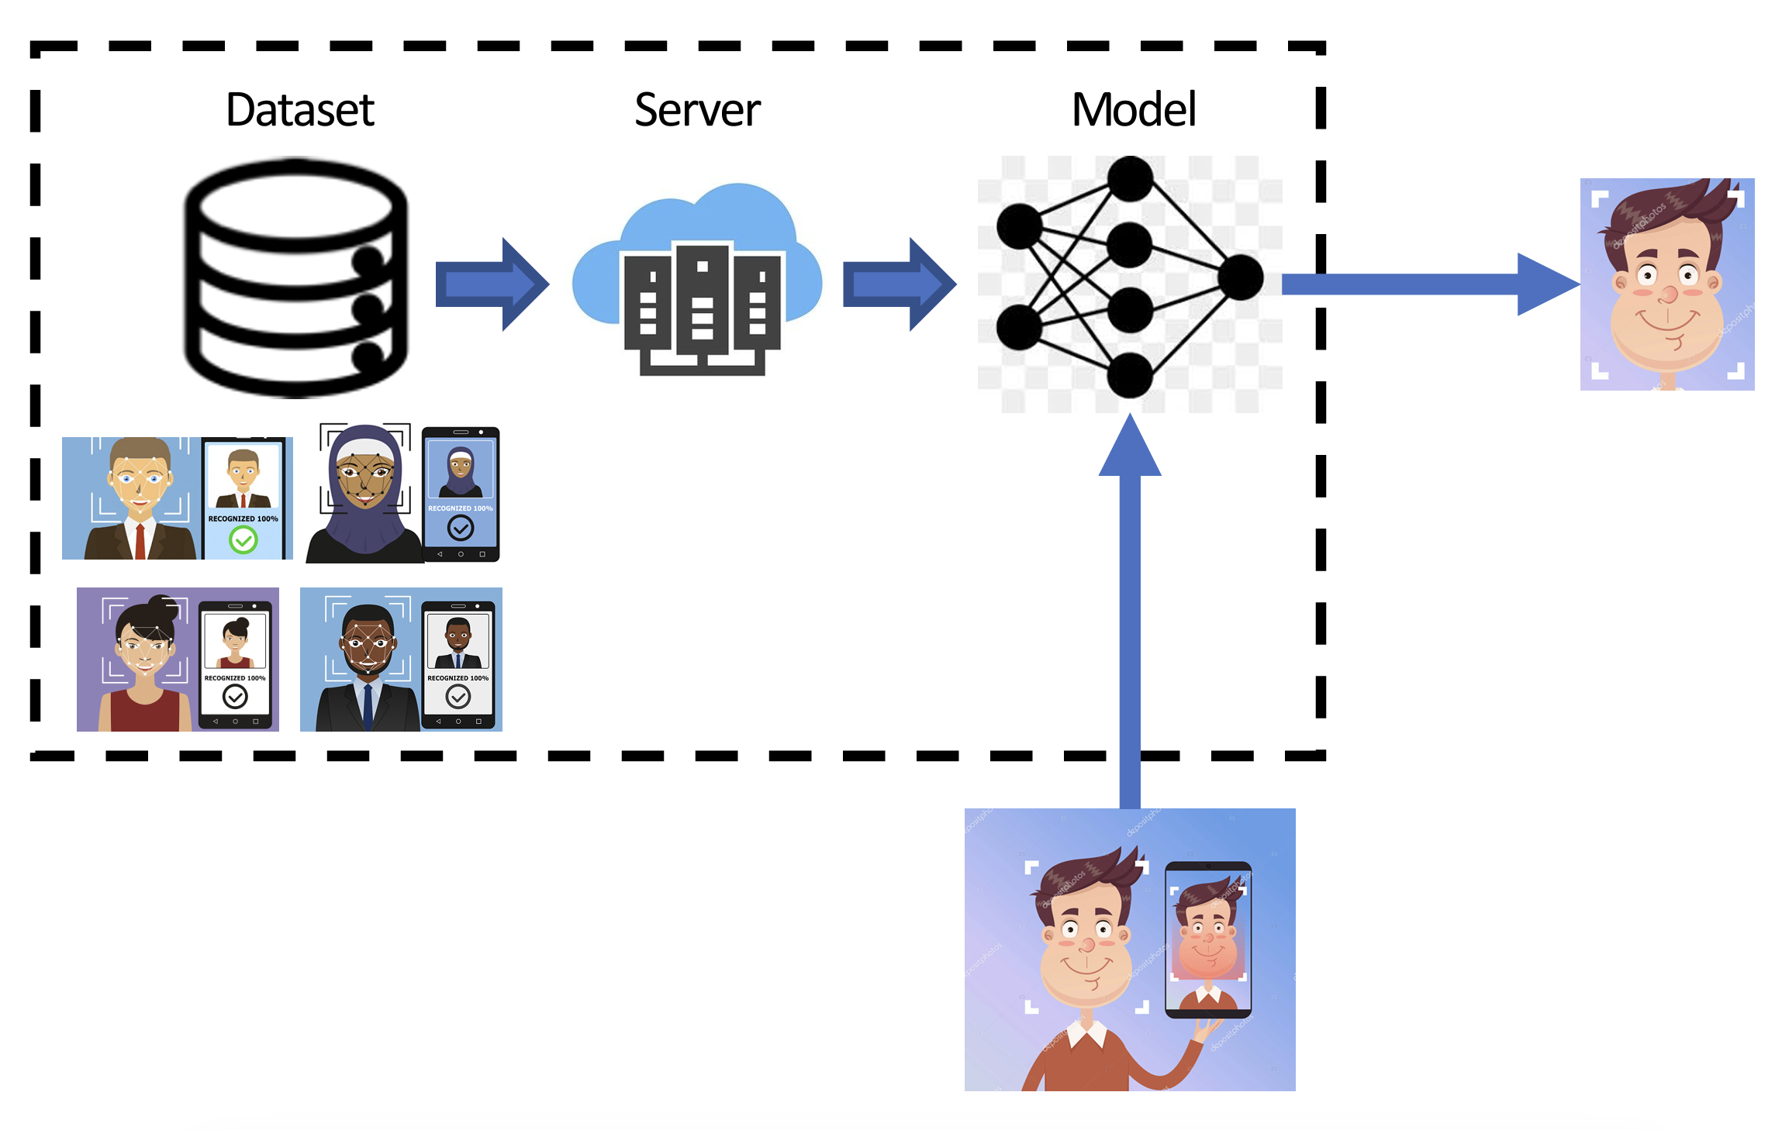

Slide 35
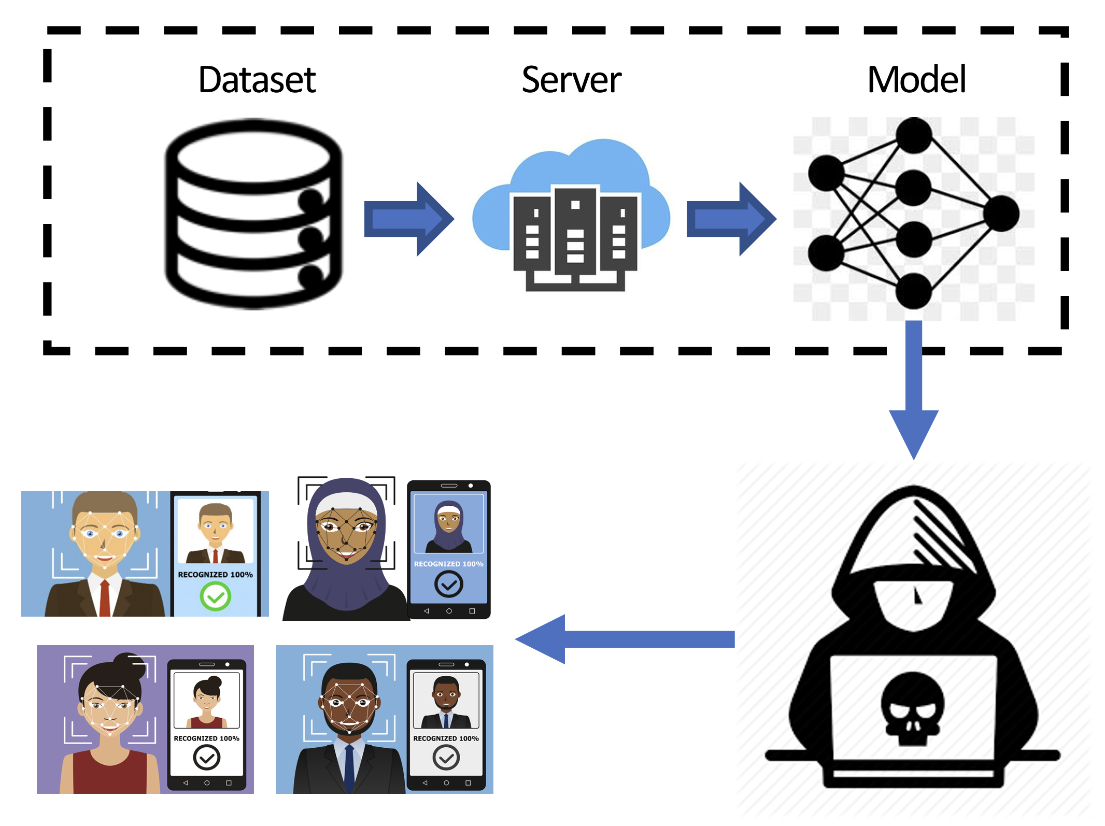

Slide 36
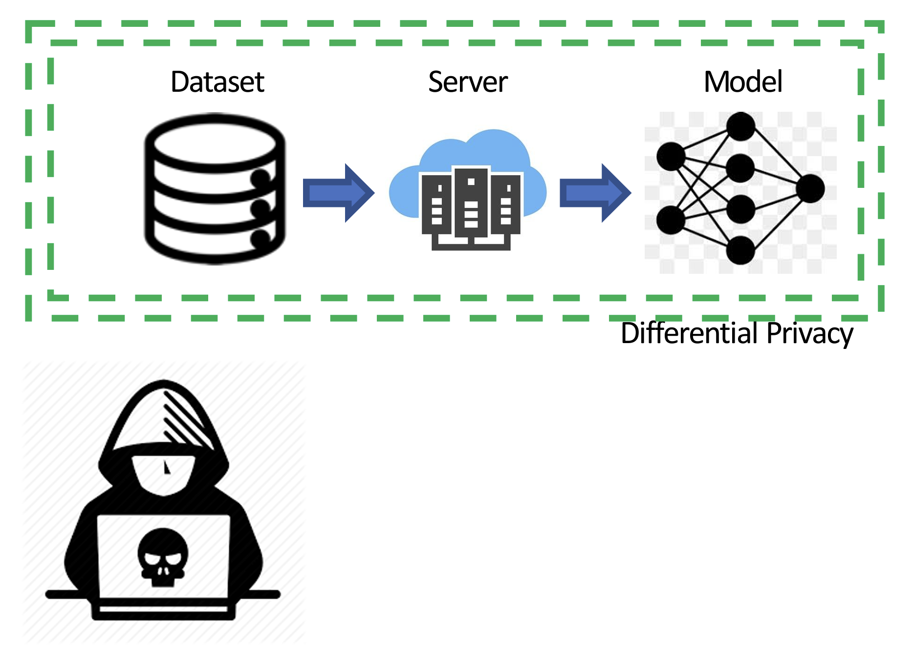

Slide 37
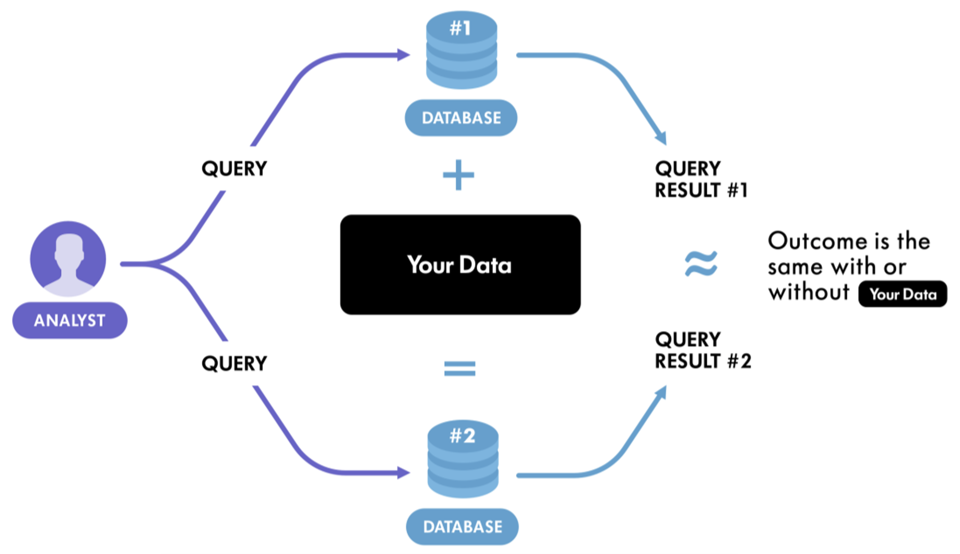

Slide 38
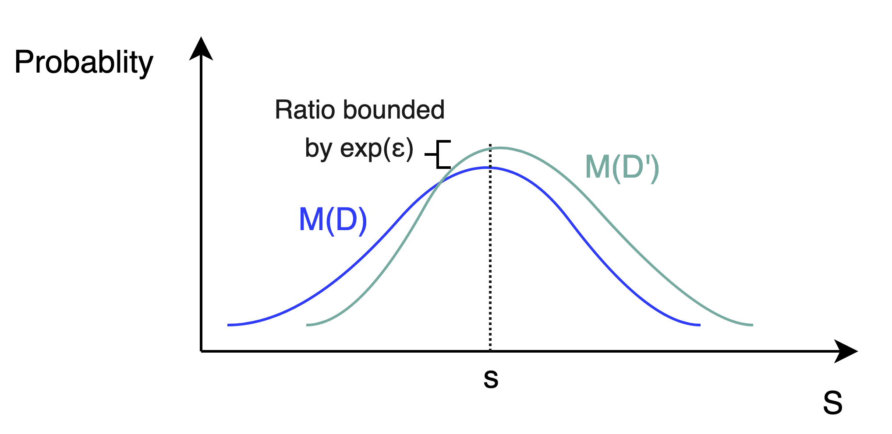
Differential Privacy
The formal definition of (ε, δ)-differential privacy:
A randomized mechanism M: D → R satisfies ε-differential privacy if for any two adjacent inputs d, d' ∈ D and for any subset of outputs S ⊆ R, it holds that:
ε is a parameter that determines the strength of the privacy guarantee provided by a differentially private mechanism. A smaller value of ε corresponds to a stronger privacy guarantee.
δ is the probability that allows for plain ε-differential privacy broken.

Slide 39
Differential Privacy Mechanisms
Randomized Response: A first attempt at Differential Privacy [Warner, 1965]
Problem: Given a survey which contains a sensitive or embarrassing question (query), how to protect the privacy of participants’ responses while performing statistics on the answers.
Approach: Use coin flips
When participants are asked a sensitive question, they flip a coin before answering
If they get heads, they are asked to answer YES to the question regardless of their experience.
When they get tails, they are asked respond truthfully according to their experience.
Results: Double the resulting statistics
At the end of the survey, half of the participant would have answer correctly, while the other half answer falsely.
To account for the half false answers they got, the organizers double the statistics at the end of the survey,
Alternative: [Greenberg, 1969]
When participants get a tail, they are asked to flip a coin again to answer YES when it is heads, and NO when tails.

Slide 40
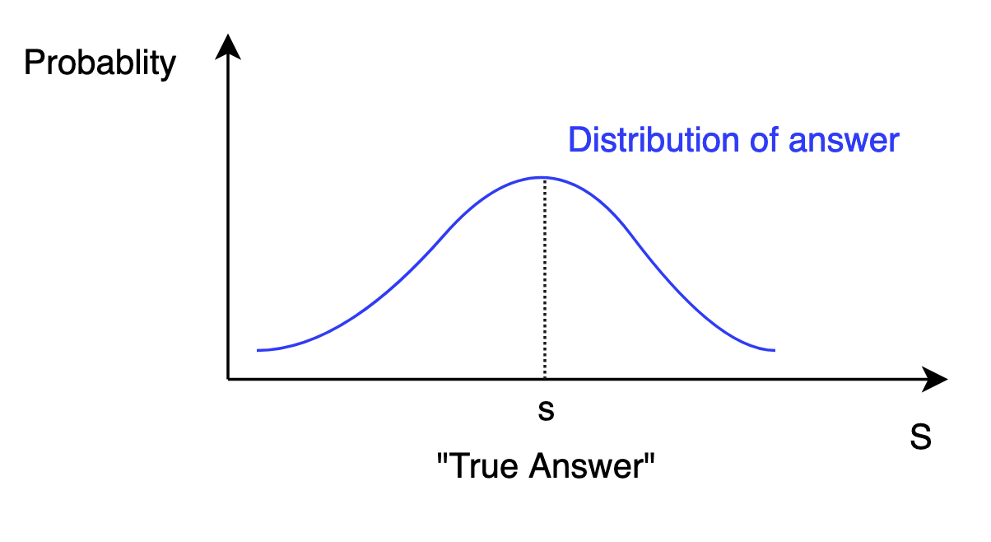
Differential Privacy Mechanisms
Randomized Response: A first attempt at Differential Privacy [Warner, 1965]
The query answer is no longer a deterministic value, but a sampling from a distribution
Notes:
Pros:
Easy to implement
Cons:
Fixed privacy budget
Not flexible

Slide 41
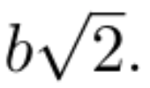
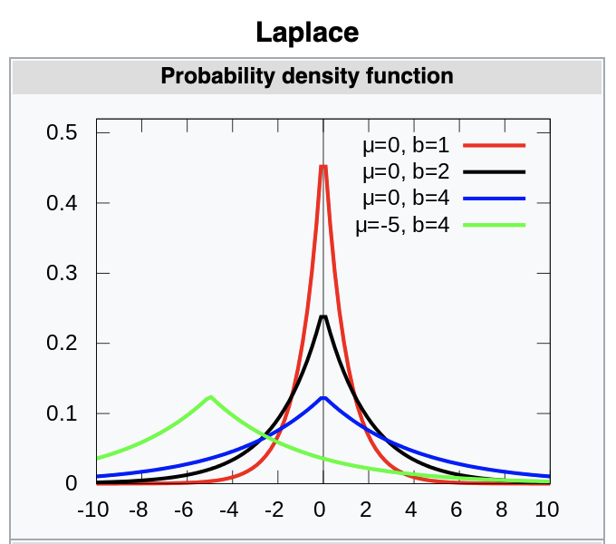
Differential Privacy Mechanisms
Laplace Mechanism: Achieving differential privacy by adding Laplace noise
Privacy mechanism which outputs q(x) + (v ∼ Lap(∆q, ε))
Laplace distribution is centered at 0 with a std of
Its probability density function is given by:
Source: Wikipedia
Notes:
Pros:
More accurate query answers
The most general mechanism
Cons:
Noise can take extreme values leading
Requires large privacy budget to work in practice which produce less accurate answers.
Can only be used for for numeric queries only

Slide 42
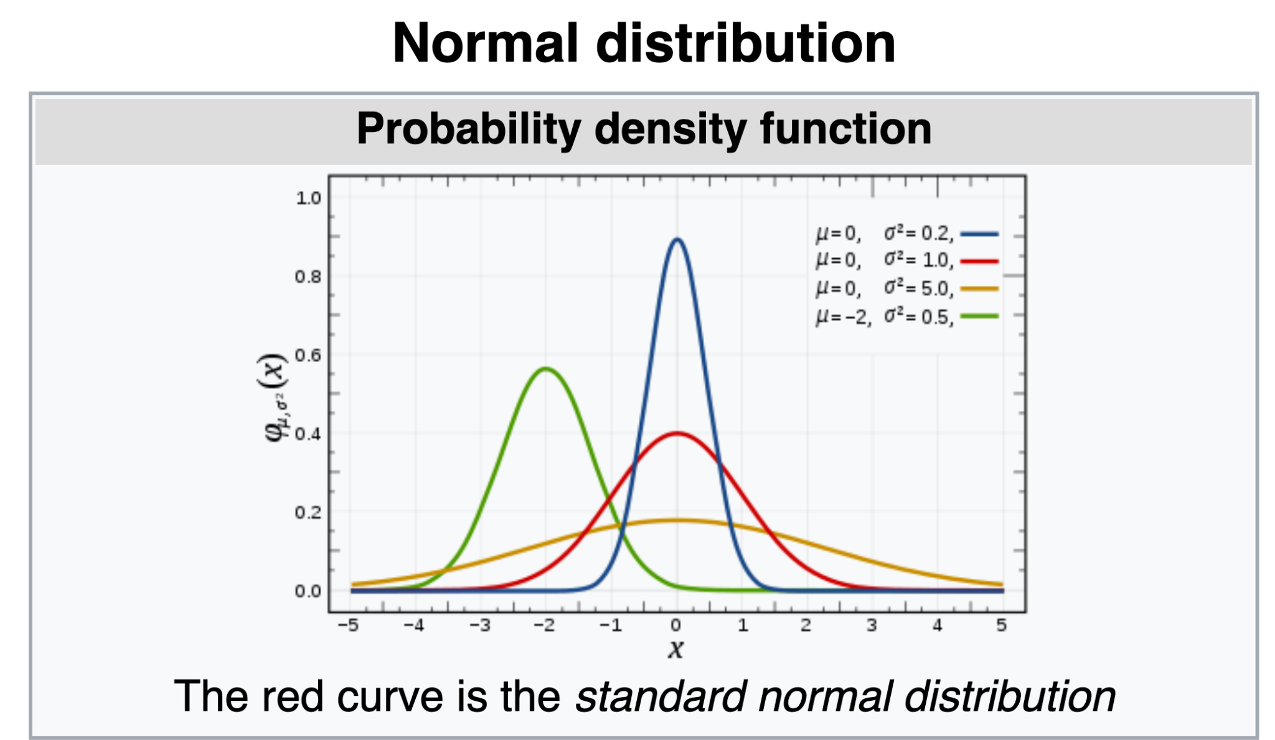
Differential Privacy Mechanisms
Gaussian Mechanism: Achieving differential privacy by adding Gaussian noise
Privacy mechanism which outputs q(x) + (v ∼ N(∆q, ε))
The Gaussian or Normal Distribution has a probability density function given by:
Source: Wikipedia
Notes:
Pros:
Add less noise than Laplace mechanism
better suited for multivariate problems.
Cons:
requires the use of the the relaxed (𝜖,𝛿)-differential privacy definition
less accurate than the Laplace mechanism

Slide 43
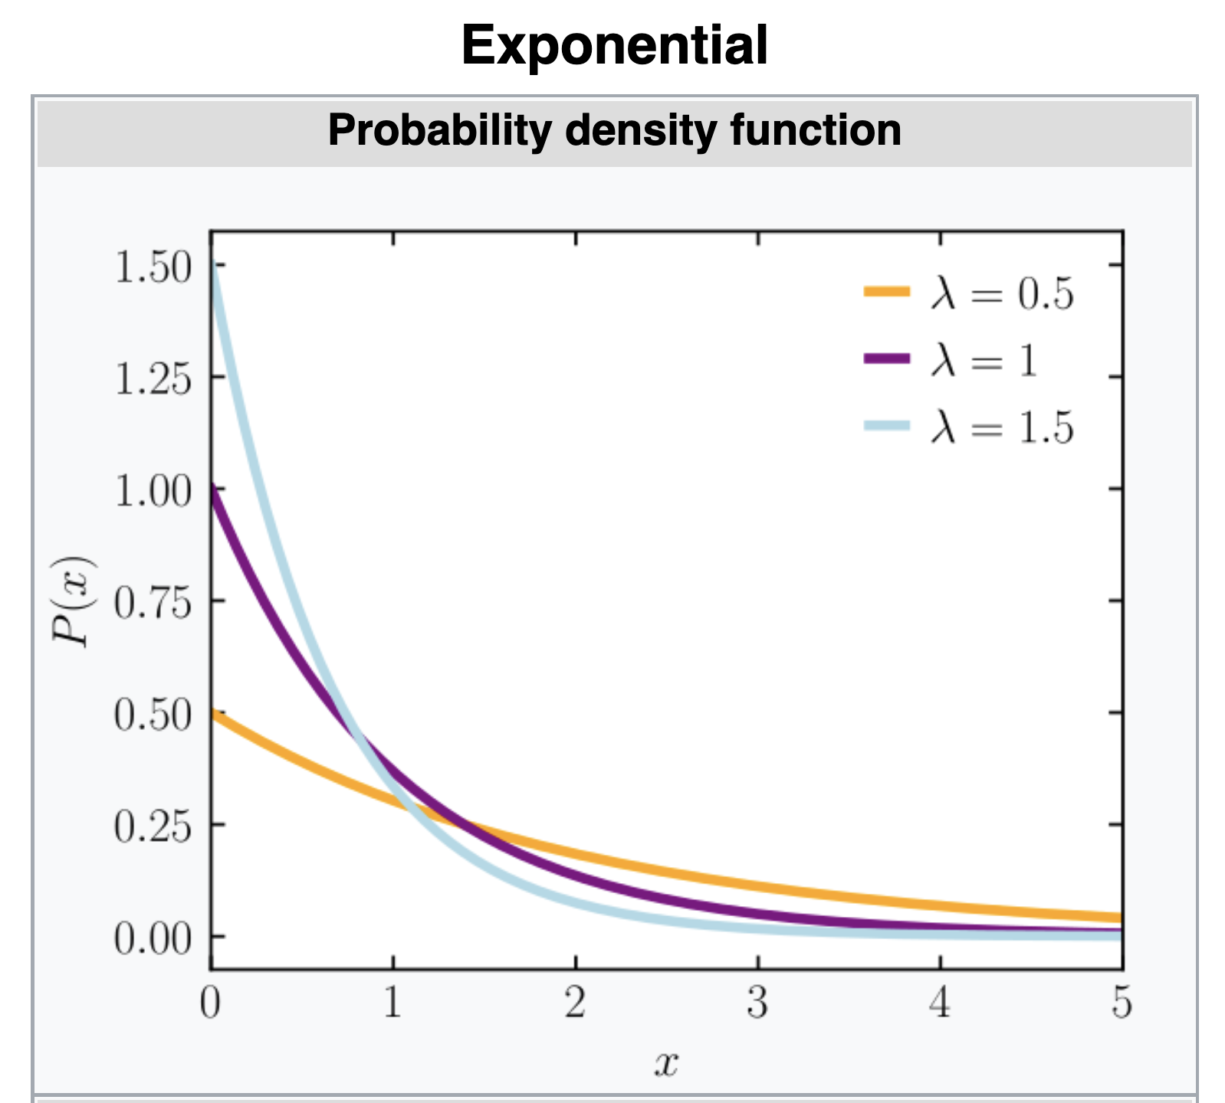
Differential Privacy Mechanisms
Exponential Mechanism: Achieving differential privacy by selecting lowest sensitivity score
Given a sensitivity score function H, selects answer a with the lowest sensitivity score such that
The Exponential distribution is parameterized by with a probability density function given by:
Source: Wikipedia
Notes:
Pros:
○ The Laplace mechanism can be derived from the exponential mechanism
○ The exponential mechanism is extremely general
○ Can provide answers to non numeric queries
● Cons:
○ It is very difficult to implement

Slide 44
Applications in Machine Learning
Issues with Deep Learning without privacy mechanisms
Neural network models memorize training examples [Carlini et al., 2019]
Memorization violates privacy
Given a public model, it is possible to a transformed (blurred) image through Generative Model-Inversion (GMI) attacks [Zhang et al.]

Slide 45
Applications in Machine Learning
In Machine/Deep Learning, Differential Privacy can be achieved by adding noise to or perturbing :
Training data
Model outputs
Model parameters
Differentially private SGD (Abadi, 2016) clips and adds noise to the gradients of deep NNs during training
Aims to reduce memorizations of training data of by the model
Notes:
Private Aggreate of Teacher

Slide 46
Applications in Machine Learning
Differentially Private Deep Learning
Differential Privacy in Gradient Descent
Update rule [Xie et al.]
Due to sequential composition, the privacy loss in unbounded when we perform many iterations of the SGD algorithm
More iterations leads to a larger privacy cost. However, in practical Deep Learning, more iterations generally result in a better model.
But, in differentially private SGD version, more iterations can make the model worse, i.e., the noise increases with each iterations.
Tradeoff: Find the right balance between the number of iterations and the scale of the noise added.
Some Techniques: Gradient clipping before adding the noise [Abadi et al.]
Notes:
Due to sequential composition, the privacy loss in unbounded when we perform many iterations of the SGD algorithm
More iterations lea

Slide 47
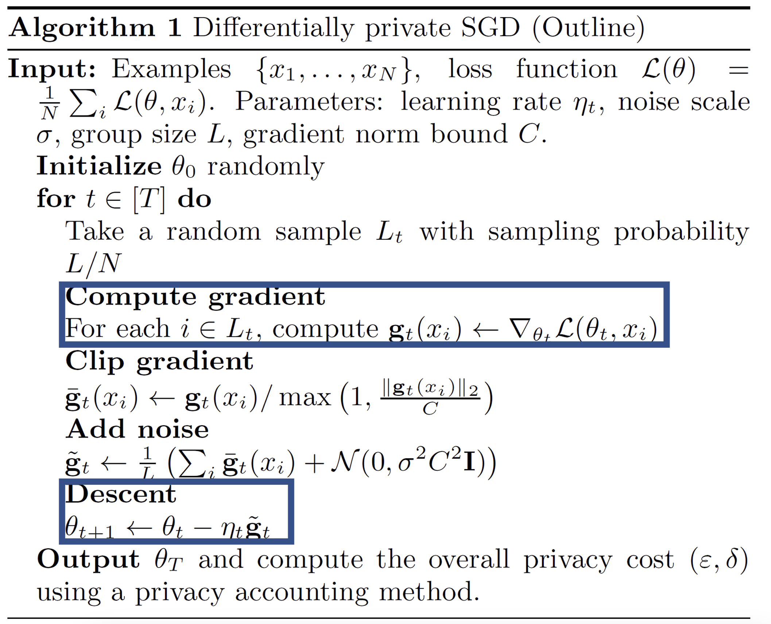

Slide 48
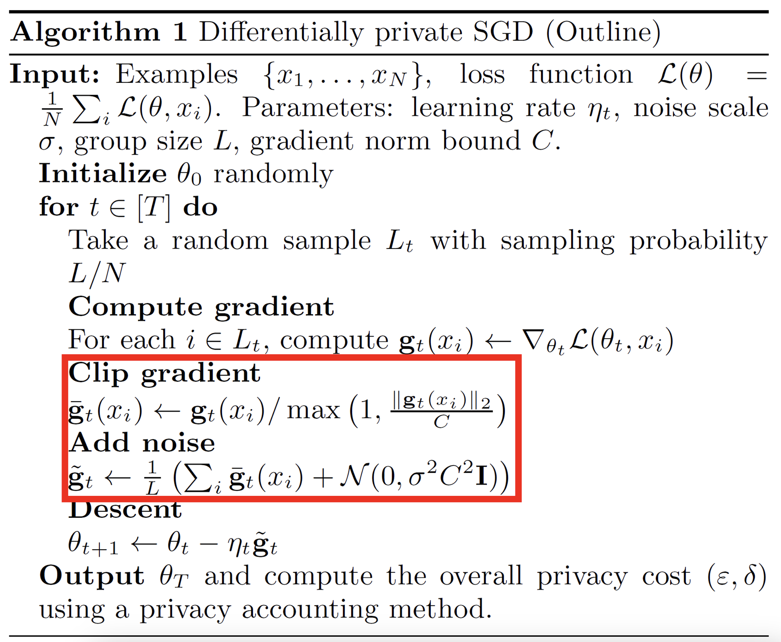

Slide 49
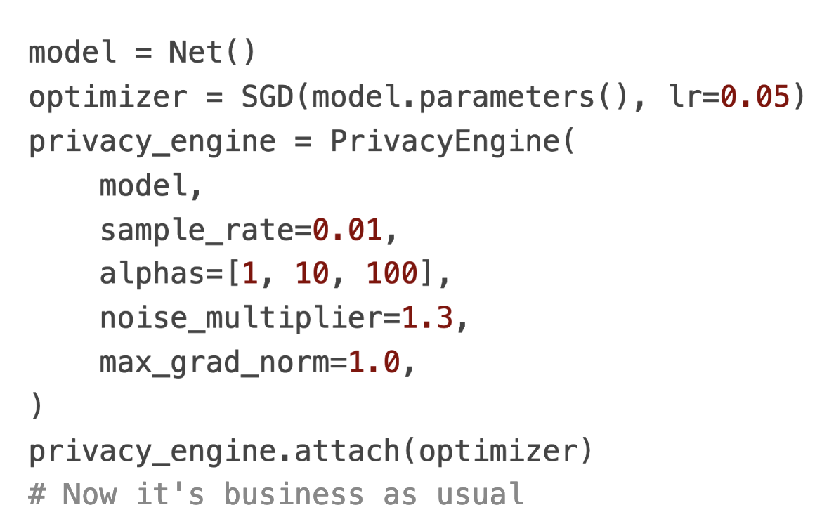
Applications in Machine Learning
Differentially Private Deep Learning with Pytorch and Opacus
Source: https://opacus.ai/
Notes:
Demonstration in Colab

Slide 50
Conclusion
Traditional data analysis is done without any privacy mechanism which leads to privacy violation
Traditional privacy models are vulnerable to linking attacks
Randomized Response was the first attempt to offer differential privacy.
The fixed privacy loss in Randomized Response makes it unsuitable for some application
Methods based on sampling from a distribution (Laplace, Gaussian, Exponential, etc) offer better privacy guarantees.
Differential Privacy can be applied to ML to achieve Privacy Preserving ML.

Slide 51
References
[Dwork et al.] Cynthia Dwork, Aaron Roth, et al. The algorithmic foundations of differential privacy. Found. Trends Theor. Comput. Sci., 9(3-4):211–407, 2014.
[Warner, 1965] Warner, S. L. (March 1965). "Randomised response: a survey technique for eliminating evasive answer bias". Journal of the American Statistical Association. Taylor & Francis. 60 (309): 63–69. doi:10.1080/01621459.1965.10480775. JSTOR 2283137. PMID 12261830.
[Zhu et al.] Tianqing Zhu, Gang Li, Wanlei Zhou, and S Yu Philip. Differential privacy and applications. Springer, 2017.
[Near et al.] Joseph P. Near and Chik ́e Abuah. Programming Differential Privacy, volume 1. 2021.
[Xie et al.] Yun Xie, Peng Li, Chao Wu, and Qiuling Wu. Differential privacy stochastic gradient descent with adaptive privacy budget allocation. In 2021 IEEE International Conference on Consumer Electronics and Computer Engineering(ICCECE), pages 227–231, 2021
[FAIR, Opacus] https://opacus.ai/
[Zhang et al.] Zhang, Yuheng, et al. "The secret revealer: Generative model-inversion attacks against deep neural networks." Proceedings of the IEEE/CVF Conference on Computer Vision and Pattern Recognition. 2020.

Slide 52
Thank you
Questions?

Slide 53
Differentially Private SGD
Differentially Private SGD
Abadi (2016) Deep Learning with Differential Privacy
This work introduced differential privacy (DP) for training ML models for protecting the privacy of the training data
Differential privacy (DP) is applied to Stochastic Gradient Descent (SGD) during model training
DP-SGD clips the gradients and adds Gaussian noise to the gradients with respect to the model parameters
This approach controls the amount of information from the training data that is memorized by the model during training
The goal is to produce ML models which provide approximately the same privacy when an individual input instance is removed from the training dataset
The paper also introduces a method for calculating the privacy loss, called moments accountant

Slide 54
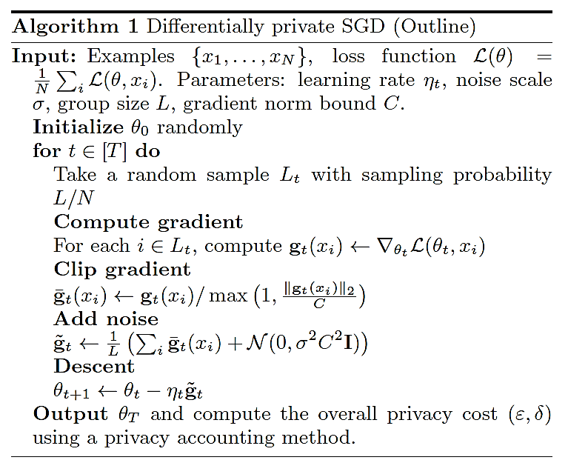
Differentially Private SGD
Differentially Private SGD
Differentially Private Stochastic Gradient Descent (DP-SGD)
DP-SGD adds two additional steps to SGD: Clip gradient, and Add noise
Introduced DP steps

Slide 55
Gradient Clipping
Differentially Private SGD
ML models tend to memorize more information about some input samples than others
Input samples that produce large gradients are prone to be memorized by the model, and violate privacy
DP-SGD approach proposes to clip the $ℓ_{2}$ norm of the gradient to a threshold $C$, in order to limit the influence by the individual input samples
Also, since the values of the gradients cannot be estimated ahead of time, the clipping operation controls the sensitivity of the DP randomization mechanism
If the gradient at step t by an input sample $x_{i}$ is $g_{t}\left(x_{i}\right)=∇_{θ_{t}}ℒ\left(θ_{t},x_{i}\right)$, the clipped gradient ${\overline{g}}_{t}\left(x_{i}\right)$is:
$${\overline{g}}_{t}\left(x_{i}\right)=\left\{\begin{matrix}\begin{matrix}{ g}_{t}\left(x_{i}\right) & if {\left\|{ g}_{t}\left(x_{i}\right)\right\|}_{2}≤C\end{matrix} \\ \begin{matrix}\frac{g_{t}\left(x_{i}\right)}{{{\left\|{ g}_{t}\left(x_{i}\right)\right\|}_{2}}/C} & if {\left\|{ g}_{t}\left(x_{i}\right)\right\|}_{2}>C\end{matrix}\end{matrix}\right.$$
That is, if the norm ${\left\|{ g}_{t}\left(x_{i}\right)\right\|}_{2}$is greater than $C$, the gradient is scaled down to have a norm equal to $C$

Slide 56
Adding Noise
Differentially Private SGD
GP-SGD approach employs a Gaussian randomization mechanism
Gaussian noise is added to the gradients at each training step t, according to:
$${\tilde{g}}_{t}=\frac{1}{L}\left(\sum_{i}{{\overline{g}}_{t}\left(x_{i}\right)}+𝒩\left(0,σ^{2}C^{2}I\right)\right)$$
At each step t, the average of the clipped gradient for a batch of inputs (with a batch size L) is first calculated as $\frac{1}{L}\sum_{i}{{\overline{g}}_{t}\left(x_{i}\right)}$
Gaussian noise $𝒩\left(0,σ^{2}C^{2}I\right)$ with mean 0 and diagonal co-variance $σ^{2}C^{2}$ is afterward added to the batch-averaged gradient
Note that the co-variance is a function of the clipping threshold $C$
E.g., larger value of $C$ does less clipping, but requires more noise to achieve the same level of privacy

Slide 57
Moments Accountant
Differentially Private SGD
The composition property in DP states that if the privacy loss (budget) for one interaction with the data is $ε_{1}$ and for another interaction with the data is $ε_{2},$the combined privacy loss is $ε_{1}+ε_{2}$
Therefore, by accumulating the privacy loss for each mini-batch when training an ML model, it is possible to calculate the overall privacy loss during training
Moments accountant is an introduced approach in the paper that evaluates the privacy loss of a model training with DP-SGD
The privacy loss is estimated at each training step, and it is used to calculate the cumulative privacy loss over all training epochs
Note that increasing the number of training epochs increases the privacy loss
E.g., training a model for 100 epochs that achieved a privacy loss of $ε=1.26$, when training for 400 epochs the privacy loss increased to $ε=2.55$
Moments accountant employs the moments of mixtures of Gaussian distributions to calculate the upper bound of the cumulative privacy loss
The approach is described in more detail in the paper

Slide 58
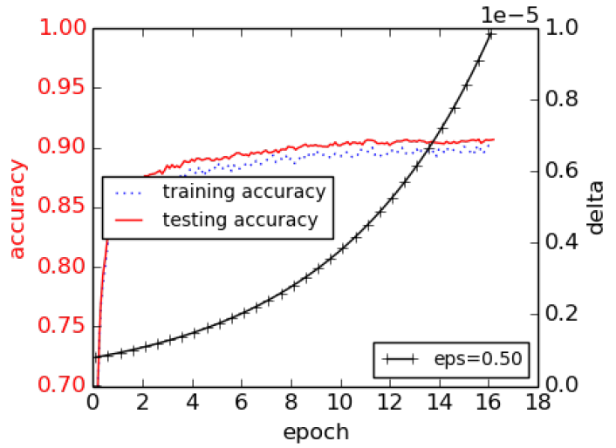
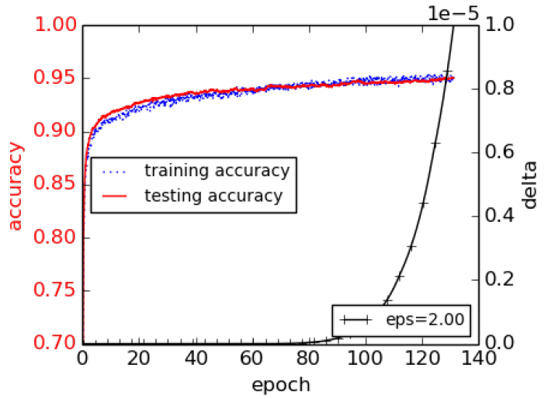
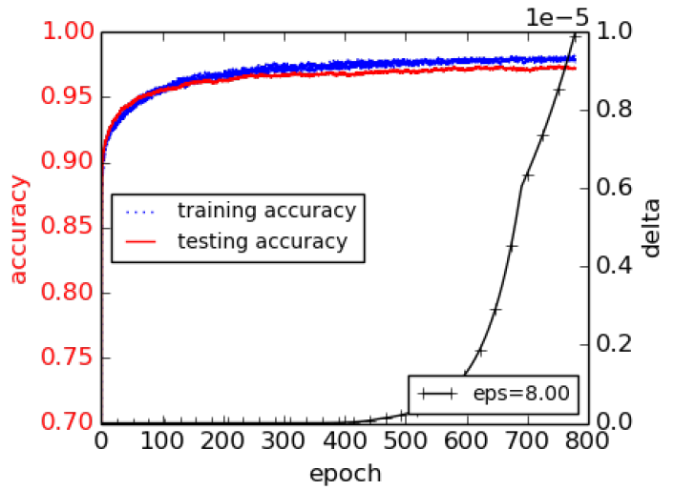
Experimental Evaluation
Differentially Private SGD
MNIST dataset
Training and testing accuracies for three different levels of Gaussian noise with variances $σ∈\left\{8, 4, 2\right\}$, and clipping threshold $C=4$
The corresponding privacy budget values are set to $ε∈\left\{0.5, 2, 8\right\}$
The upper bound for the privacy probability parameter is set to $δ={10}^{−5}$
Thus, the $\left(ε,δ\right)$-differential privacies are $\left(0.5,{10}^{−5}\right)$, $\left(2,{10}^{−5}\right)$, $\left(8,{10}^{−5}\right)$
Moment Accountant allows to obtain a $δ$value for a fixed privacy budget $ε$
The obtained test set accuracies are 90%, 95%, and 97%, respectively
Larger noise achieves lower test accuracy, but provides increased privacy protection
Large noise, $ε=0.5$
Medium noise, $ε=2$
Small noise, $ε=8$

Slide 59
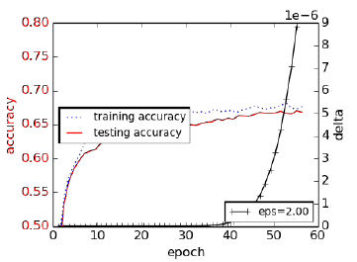
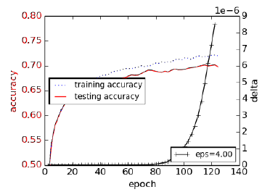
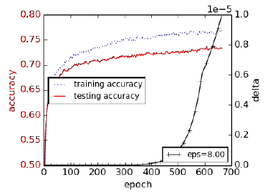
Experimental Evaluation
Differentially Private SGD
CIFAR-10 dataset
The results are similar to the obtained performance for MNIST
Training and testing accuracies for three different levels of privacy budget $ε∈\left\{2, 4, 8 \right\}$
The target probability parameter is set to $δ=\left\{{10}^{−5},{10}^{−6}\right\}$
The Gaussian noise variance is fixed to $σ=6$ for all experiments, the clipping threshold is $C=3$
The achieved test set accuracies are 67%, 70%, and 73%, respectively
$\text{Privacy} ε=2$
$\text{Privacy} ε=4$
Privacy $ε=8$

Slide 60
Privacy versus Accuracy Trade-Off
Differentially Private SGD
Perfect privacy in ML models is not possible
Adding too much noise to the model parameters would diminish the accuracy and the usefulness of the model
There is a trade-off between privacy protection and accuracy
DP-SGD achieves privacy protection for deep NNs with a small decrease in the model accuracy and small increase in the training complexity
The approach adds Gaussian noise to the gradients in SGD to reduce the possibility for memorization of individual input instances by the model
This work also developed the Moments Accountant approach to calculate the cumulative privacy loss for the combination of the model and dataset

Slide 61
Scalable Private Learning with PATE
Scalable Private Learning with PATE
Scalable Private Learning with PATE
Papernot (2018) Scalable Private Learning with PATE
PATE (Private Aggregation of Teacher Ensembles) is a privacy-preserving ML framework that enables model-agnostic training while providing differential privacy guarantees for the training dataset
It provides privacy without significantly compromising performance, making it a valuable approach for various applications where data privacy is a primary concern
PATE uses a collection of teacher models to train a student model that answers user queries
PATE injects noise into the predictions by the teacher models to provide DP guarantees
The users cannot determine any PII from the predicted outputs or identify whose data the models were trained on

Slide 62
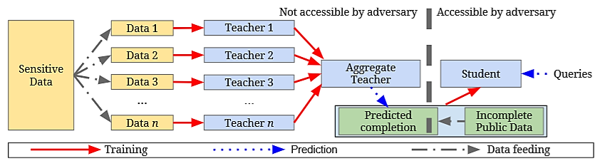
PATE Framework Components
Scalable Private Learning with PATE
In the PATE framework, multiple teacher models are trained independently on disjoint subsets of the sensitive training dataset
Any ML technique can be used for the teacher models
The predictions by the teacher models are aggregated where DP with controlled Gaussian noise is introduced to obtain the aggregated prediction
A student model learns from the teacher models by querying them through the aggregator
The student model is trained on insensitive public data, allowing to generalize the knowledge acquired from the teacher models without directly accessing sensitive data

Slide 63
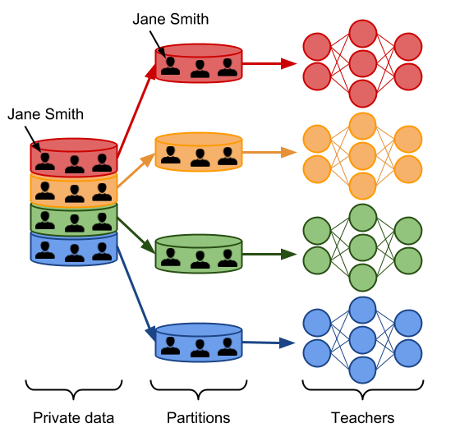
PATE Framework
Scalable Private Learning with PATE
The PATE approach is based on a simple intuition: if two different classifiers (teacher models), trained on two different datasets with no training examples in common agree on how to classify a new input example, then that decision does not reveal information about any single training example

Slide 64
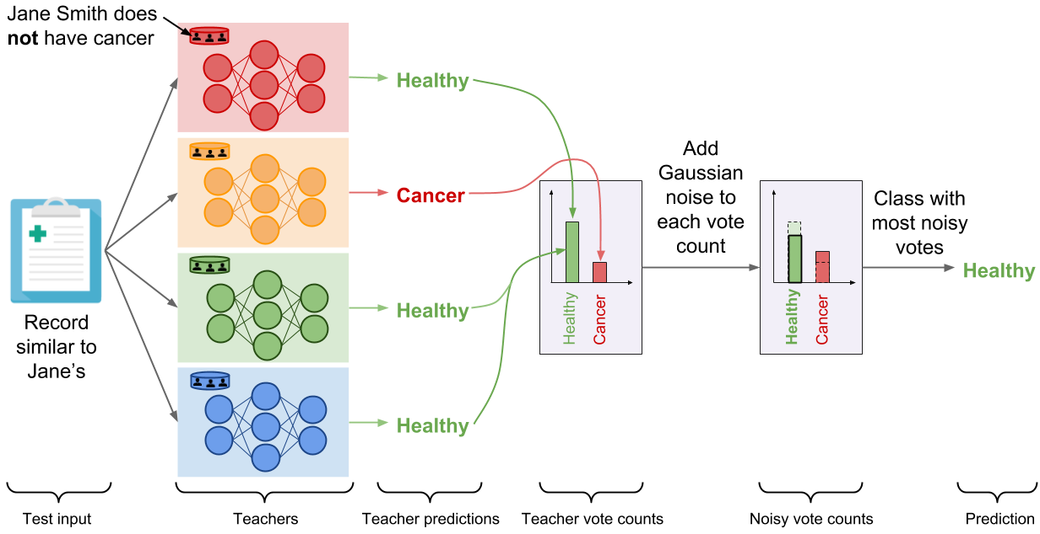
PATE Framework
Scalable Private Learning with PATE
PATE aggregates the votes of the teacher models for each class, and perturbs the vote counts by adding random DP noise sampled from Gaussian distribution
If most teachers agree on the same class, adding noise will not change the final predicted class (“Healthy” in this example)

Slide 65
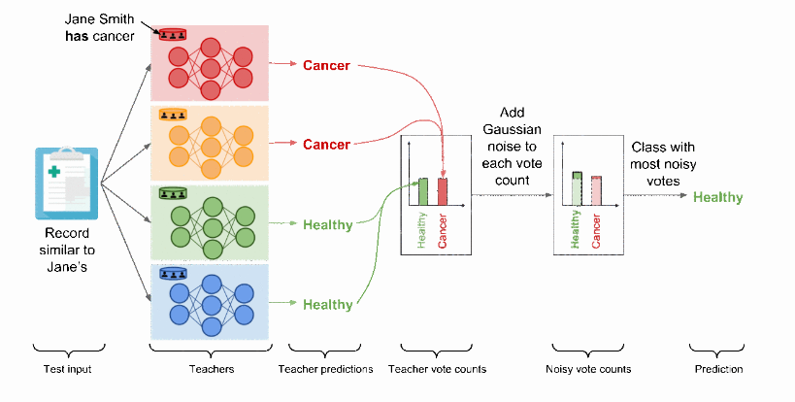
PATE Framework
Scalable Private Learning with PATE
If the aggregated votes by the teacher models for both classes are similar, adding DP noise will prevent revealing the votes of the individual teachers and protect the privacy
I.e., the noisy aggregated outcome is equally likely for “Healthy” and “Cancer” classes

Slide 66
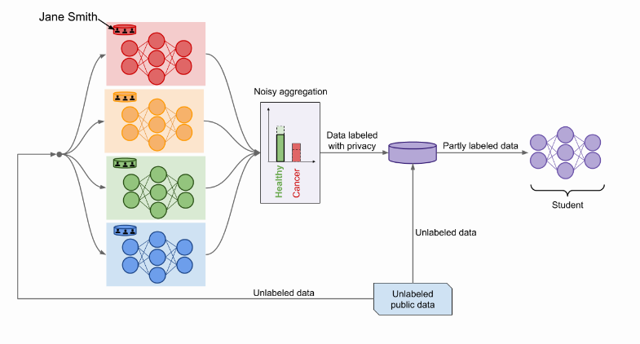
PATE Framework
Scalable Private Learning with PATE
After the teacher models are trained, the student model selects inputs from unlabeled public data and submit the inputs to the teacher ensemble to predict the class labels
The noisy labels from the aggregation mechanism are used to train the student model
Finaly, the trained student model is deployed for access to end-users

Slide 67
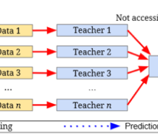
Teacher Models
Scalable Private Learning with PATE
Teacher models are trained on disjoint subsets of the sensitive training dataset, each with its own portion of the data
The models provide expertise on the data they were trained on while maintaining privacy
By using multiple teachers, the PATE framework leverages the wisdom of the ensemble, which helps increase the overall accuracy and generalization capabilities of the student model

Slide 68
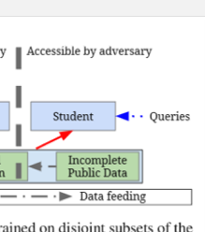
Student Model
Scalable Private Learning with PATE
Student model learns from the teacher models without having direct access to the sensitive data
It is trained on a public unlabeled dataset (i.e., without sensitive private data), which is labeled by interacting with the ensemble of teachers via the aggregator
The student model aims to replicate the performance of the teachers while ensuring privacy protection for the sensitive training data

Slide 69
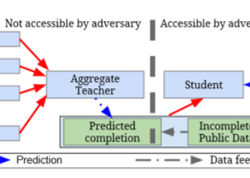
Aggregators
Scalable Private Learning with PATE
PATE framework proposed two new methods for aggregating teacher/student answers
Confident Aggregator
Check if the vote by the teacher models is above a threshold (i.e., teacher reach consensus regarding the correct classification), and add smaller levels of noise
Eliminate queries where teachers don’t reach strong consensus regarding the predicted class
Interactive Aggregator
Check student confidence in class prediction, and if the student confidently predicts the same class as the teachers, eliminate those queries

Slide 70
Experimental Setup
Scalable Private Learning with PATE
Datasets (contain private personal attributes)
MNIST
Street View House Numbers (SVHN)
US Census Income Adult (CI Adult)
Glyph: synthetically generated computer font symbols with 150 different classes
Teacher ensembles: 250 number of teachers & partitions of data for MNIST, SVHN, and Adult, and 5,000 for Glyph
Privacy probability parameter is set to δ = 10⁻⁵ for MNIST and ADULT, δ = 10⁻⁶ for SVHN, δ = 10⁻⁸ for Glyph (probability privacy will not be held)
The total privacy loss ε is calculated on a subset from 100 to 12,000 queries depending on dataset

Slide 71
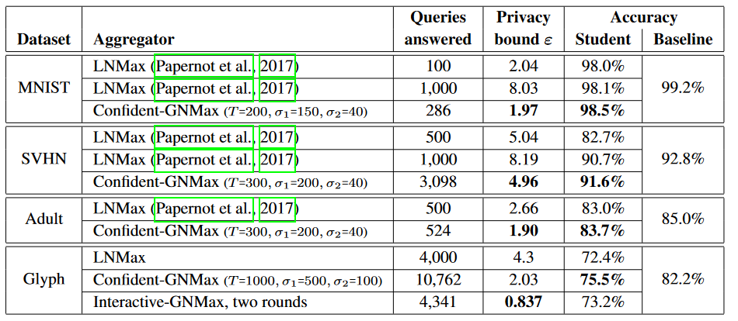
Experimental Results
Scalable Private Learning with PATE
Comparison of the proposed Confident-GNMax aggregation approach (based on Gaussian noise) to LNMax aggregation approach (based on Laplacian noise)
GNMax approach reduced the privacy bound/loss ε for all datasets, and increased the accuracy in student predictions for all datasets, in comparison to LNMax

Slide 72
References
Liu et al. (2020) When Machine Learning Meets Privacy: A Survey and Outlook (link)
Rigaki and Carcia (2021) A Survey of Privacy Attacks in Machine Learning (link)
Cristofaro (2020) An Overview of Privacy in Machine Learning (link)
Borealis AI Tutorial #13: Differential Privacy II: Machine Learning and Data Generation (link)
Davide Testuggine and Ilya Mironov blog: Differential Privacy Series Part 1-DP-SGD Algorithm Explained (link)
Joseph P. Near and Chiké Abuah, Programming Differential Privacy – Chapter III: Differential Privacy (link)

