Slide 1
CS 487/587 Adversarial Machine Learning
Dr. Alex Vakanski

Slide 2
Lecture 3
Mathematics for Machine Learning

Slide 3
Lecture Outline
Linear algebra
Vectors
Matrices
Eigen decomposition
Differential calculus
Optimization algorithms
Probability
Random variables
Probability distributions
Information theory

Slide 4
Notation
$a, b, c$ Scalar (integer or real)
$x, y, z$ Vector (bold-font, lower case)
$A, B, C$ Matrix (bold-font, upper-case)
$\text{A}\text{, }\text{B}\text{, }\text{C}$ Tensor (bold-font, upper-case)
$X, Y, Z$ Random variable (normal font, upper-case)
$a∈𝒜$ Set membership: $a$ is member of set $𝒜$
$\left|𝒜\right|$ Cardinality: number of items in set $𝒜$
$\left\|v\right\|$ Norm of vector $v$
$u∙v$or $\left\langle u, v\right\rangle$ Dot product of vectors $u$and $v$
$ℝ$ Set of real numbers
$ℝ^{n}$ Real numbers space of dimension n
$y=f\left(x\right)$ or$x↦f\left(x\right)$ Function (map): assign a unique value $f(x)$ to each input value $x$
$f:ℝ^{n}→ℝ$ Function (map): map an n-dimensional vector into a scalar

Slide 5
Notation
$A⊙B$ Element-wise product of matrices A and B
$A^{†}$ Pseudo-inverse of matrix A
$\frac{d^{n}f}{dx^{n}}$ n-th derivative of function f with respect to x
$∇_{x}f\left(x\right)$ Gradient of function f with respect to x
$H_{f}$ Hessian matrix of function f
$X\sim P$ Random variable $X$ has distribution $P$
$P\left(X|Y\right)$ Probability of $X$ given $Y$
$𝒩\left(μ,σ^{2}\right)$ Gaussian distribution with mean $μ$and variance $σ^{2}$
$𝔼_{X\sim P}\left[f\left(X\right)\right]$ Expectation of $f\left(X\right)$ with respect to $P\left(X\right)$
$Var\left(f\left(X\right)\right)$ Variance of $f\left(X\right)$
$Cov\left(f\left(X\right),g\left(Y\right)\right)$ Covariance of $f\left(X\right)$ and $g\left(Y\right)$
$corr\left(X,Y\right)$ Correlation coefficient for $X$ and $Y$
$D_{KL}\left(P||Q\right)$ Kullback-Leibler divergence for distributions $P$ and $Q$
$CE\left(P,Q\right)$ Cross-entropy for distributions $P$ and $Q$

Slide 6
Vectors
Vectors
Vector definition
Computer science: vector is a one-dimensional array of ordered real-valued scalars
Mathematics: vector is a quantity possessing both magnitude and direction, represented by an arrow indicating the direction, and the length of which is proportional to the magnitude
Vectors are written in column form or in row form
Denoted by bold-font lower-case letters
For a general form vector with $n$ elements$,$ the vector lies in the $n$-dimensional space ${x∈ℝ}^{n}$
$x=\left[\begin{matrix}1 \\ \begin{matrix}7 \\ 0\end{matrix} \\ 1\end{matrix}\right]$
$x={\left[\begin{matrix}1 & 7 & \begin{matrix}0 & 1\end{matrix}\end{matrix}\right]}^{T}$
$x=\left[\begin{matrix}x_{1} \\ \begin{matrix}x_{2} \\ ⋮\end{matrix} \\ x_{n}\end{matrix}\right]$

Slide 7
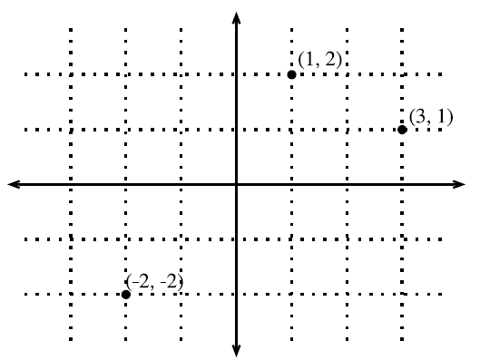
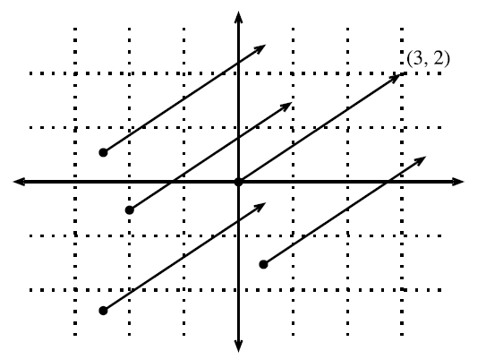
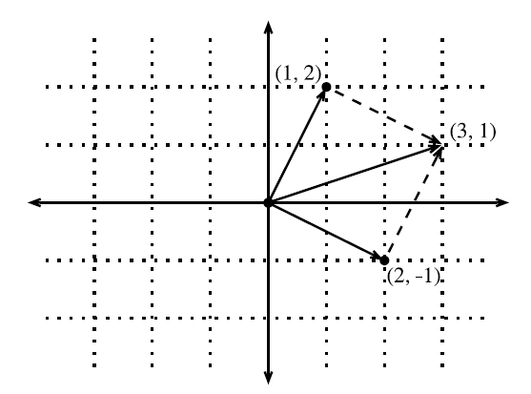
Geometry of Vectors
Vectors
First interpretation of a vector: point in space
E.g., in 2D we can visualize the data points with respect to a coordinate origin
Second interpretation of a vector: direction in space
E.g., the vector $\vec{v}={\left[3, 2\right]}^{T}$ has a direction of 3 steps to the right and 2 steps up
The notation $\vec{v}$ is sometimes used to indicate that the vectors have a direction
All vectors in the figure have the same direction
Vector addition
We add the coordinates, and follow the directions given by the two vectors that are added
Picture from: http://d2l.ai/chapter_appendix-mathematics-for-deep-learning/geometry-linear-algebraic-ops.html#geometry-of-vectors

Slide 8
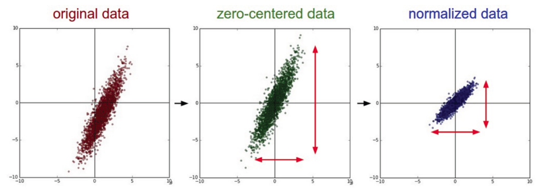
Geometry of Vectors
Vectors
The geometric interpretation of vectors as points in space allow us to consider a training set of input examples in ML as a collection of points in space
Hence, classification can be viewed as discovering how to separate the clusters of points belonging to different classes (left picture)
Rather than distinguishing images containing cars, planes, buildings, for example
Or, it can help to visualize zero-centering and standardization of training data (right figure)
standardized data

Slide 9
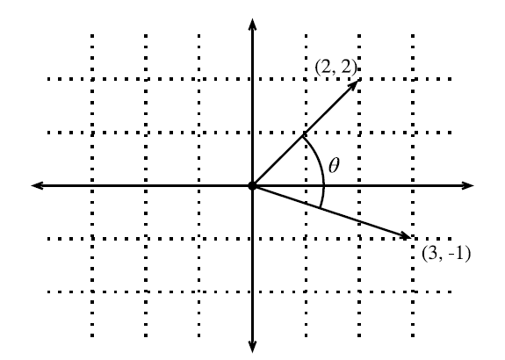
Dot Product and Angles
Vectors
Dot product of vectors, $u∙v=u^{T}v=\sum_{i}{u_{i}∙v_{i}}$
It is also referred to as inner product, or scalar product of vectors
The dot product $u∙v$ is also often denoted by $\left\langle u, v\right\rangle$
The dot product is a symmetric operation, ${u∙v=u}^{T}v=v^{T}u=v∙u$
Geometric interpretation of a dot product: angle between two vectors
I.e., dot product $v∙w$over the norms of the vectors is $cos\left(θ\right)$
$$cosθ=\frac{u∙v}{\left\|u\right\|\left\|v\right\|}$$
$$u∙v=\left\|u\right\|\left\|v\right\|cos\left(θ\right)$$
If two vectors are orthogonal: $θ=90°$, i.e., $cos(θ)=0$, then $u∙v=0$
Also, in ML the term $cosθ=\frac{u∙v}{\left\|u\right\|\left\|v\right\|}$ is sometimes employed as a measure of closeness of two vectors/data instances, and it is referred to as cosine similarity
Picture from: http://d2l.ai/chapter_appendix-mathematics-for-deep-learning/geometry-linear-algebraic-ops.html#geometry-of-vectors

Slide 10
Norm of a Vector
Vectors
A vector norm is a function that maps a vector to a scalar value
E.g., the norm can be a measure of the size of the vector
The norm $f$ should satisfy the following properties:
Scaling: $f\left(αx\right)=\left|α\right|f\left(x\right)$
Triangle inequality: $f\left(x+y\right)≤f\left(x\right)+f\left(y\right)$
Must be non-negative: $f\left(x\right)≥0$
The general $ℓ_{p}$ norm of a vector $x$ is obtained as:
On next page we will review common norms, obtained for $p=1, 2,$ and $∞$
$${\left\|x\right\|}_{p}={\left(\sum_{i=1}^{n}{{\left|x_{i}\right|}^{p}}\right)}^{\frac{1}{p}}$$

Slide 11
Norm of a Vector
Vectors
$${\left\|x\right\|}_{2}=\sqrt{\sum_{i=1}^{n}{x_{i}^{2}}}=\sqrt{x^{T}x}$$
For $p=2,$we have $ℓ_{2}$ norm
Also called Euclidean norm
It is the most often used norm
$ℓ_{2}$ norm is often denoted just as $\left\|x\right\|$ with the subscript 2 omitted
For $p=1,$we have $ℓ_{1}$ norm
Uses the absolute values of the elements
Discriminate between zero and non-zero elements
For $p=∞,$we have $ℓ_{∞}$ norm
Known as infinity norm, or max norm
Outputs the absolute value of the largest element
$ℓ_{0}$ norm outputs the number of non-zero elements
It is not an $ℓ_{p}$ norm, and it is not really a norm function either (it is incorrectly called a norm)
$${\left\|x\right\|}_{1}=\sum_{i=1}^{n}{\left|x_{i}\right|}$$
$${\left\|x\right\|}_{∞}=\max_{i}\left|x_{i}\right|$$

Slide 12
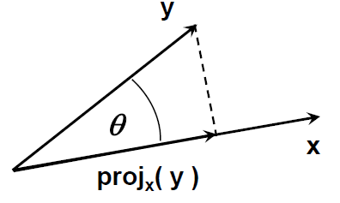
Vector Projection
Vectors
Orthogonal projection of a vector $y$ onto vector $x$
The projection can take place in any space of dimensionality ≥ 2
The unit vector in the direction of $x$ is $\frac{x}{\left\|x\right\|}$
A unit vector has norm equal to 1
The length of the projection of $y$ onto $x$is $\left\|y\right\|∙cos\left(θ\right)$
The orthogonal project is the vector${ proj}_{x}\left(y\right)$
$${proj}_{x}\left(y\right)=\frac{x∙\left\|y\right\|∙cos\left(θ\right)}{\left\|x\right\|}$$
Picture from: Jeff Howbert — Machine Learning Math Essentials

Slide 13
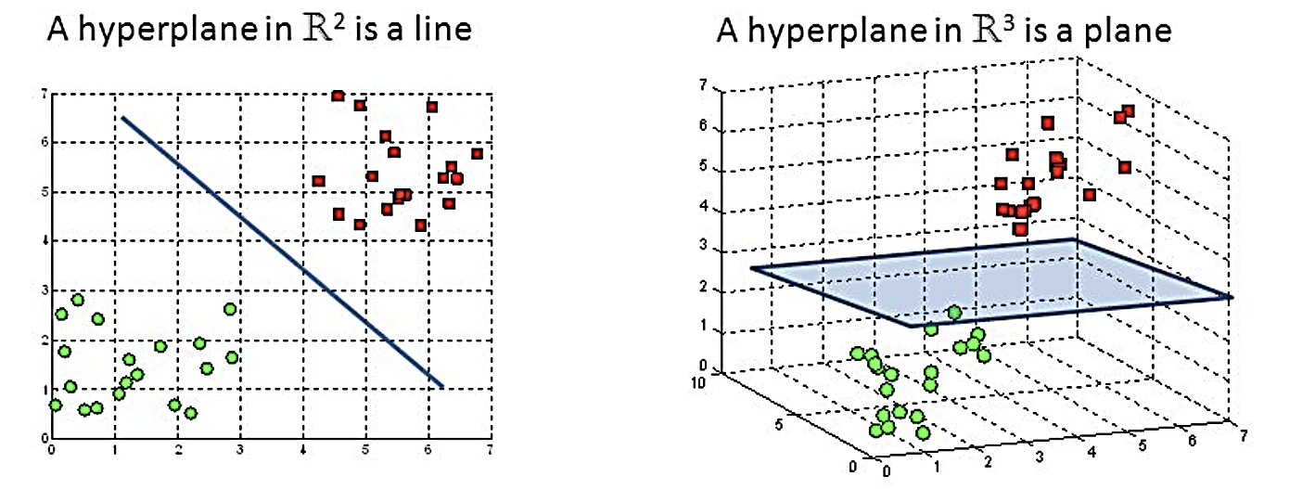
Hyperplanes
Hyperplanes
Hyperplane is a subspace whose dimension is one less than that of its ambient space
In a 2D space, a hyperplane is a straight line (i.e., 1D)
In a 3D, a hyperplane is a plane (i.e., 2D)
In a d-dimensional vector space, a hyperplane has $d−1$ dimensions, and divides the space into two half-spaces
Hyperplane is a generalization of a concept of plane in high-dimensional space
In ML, hyperplanes are decision boundaries used for linear classification
Data points falling on either sides of the hyperplane are attributed to different classes
Picture from: https://kgpdag.wordpress.com/2015/08/12/svm-simplified/

Slide 14
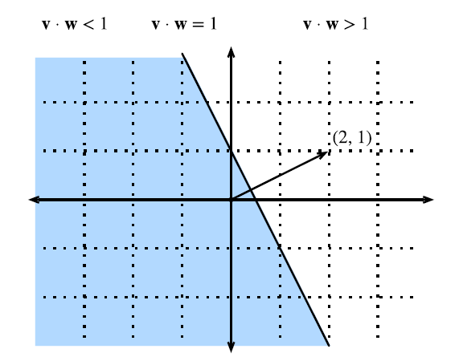
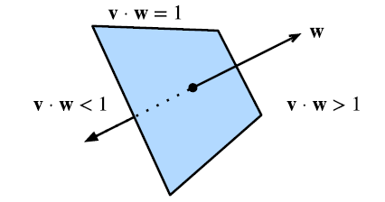
Hyperplanes
Hyperplanes
For example, for a given data point $w={\left[2, 1\right]}^{T}$, we can use dot-product to find the hyperplane for which $w∙v=1$
The solution to $w∙v=1$ is the set of points that lay on the line that is orthogonal to the vector $w$(the line is $2x+y=1$)
In a 3D space, the points that satisfy $w∙v=1$lay on a plane that is orthogonal to the vector $w$
The inequalities $w∙v>1$ and $w∙v<1$ define the two subspaces that are created by the plane
The same concept applies to high-dimensional spaces as well
Picture from: http://d2l.ai/chapter_appendix-mathematics-for-deep-learning/geometry-linear-algebraic-ops.html#hyperplanes

Slide 15
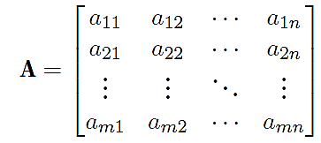
Matrices
Matrices
Matrix is a rectangular array of real-valued scalars arranged in m horizontal rows and n vertical columns
Each element $a_{ij}$ belongs to the i^{th} row and j^{th} column
The elements are denoted $a_{ij}$ or $A_{ij}$ or${ \left[A\right]}_{ij}$ or $A\left(i,j\right)$
For the matrix $A∈ℝ^{m×n}$, the size (dimension) is $m×n$ or $\left(m,n\right)$
Matrices are denoted by bold-font upper-case letters

Slide 16
Matrices
Matrices
Addition or subtraction
Scalar multiplication
Matrix multiplication
Defined only if the number of columns of the left matrix is the same as the number of rows of the right matrix
Note that $AB≠BA$

Slide 17
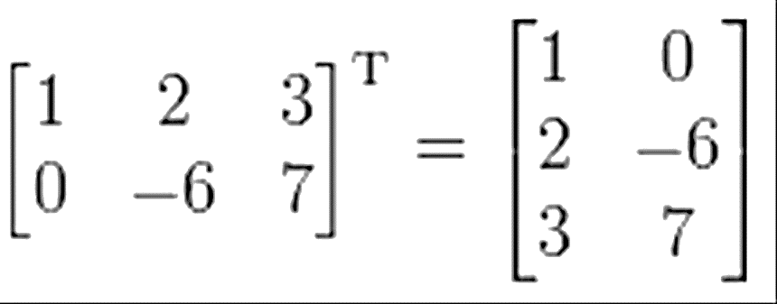
Matrices
Matrices
Transpose of the matrix: $A^{T}$has the rows and columns exchanged
Some properties
Square matrix: has the same number of rows and columns
Identity matrix ( I_{n} ): has ones on the main diagonal, and zeros elsewhere
E.g.: identity matrix of size 3×3 :
$$A+B=B+A$$
$${\left(A+B \right)}^{T}=A^{T}+B^{T}$$
$${\left(A^{T}\right)}^{T}=A$$
$$A\left(B+C\right)=AB+AC$$
$$A\left(BC\right)=\left(AB\right)C$$
$${\left(AB \right)}^{T}=B^{T}A^{T}$$

Slide 18
Matrices
Matrices
Determinant of a matrix, denoted by det(A) or $\left|A\right|,$ is a real-valued scalar encoding certain properties of the matrix
E.g., for a matrix of size 2×2:
For larger-size matrices the determinant of a matrix id calculated as
$$det\left(A\right)=\sum_{j}{a_{ij}{\left(−1\right)}^{i+j}det\left(A_{\left(i,j\right)}\right)}$$
In the above, $A_{\left(i,j\right)}$ is a minor of the matrix obtained by removing the row and column associated with the indices i and j
Trace of a matrix is the sum of all diagonal elements
$$Tr\left(A\right)=\sum_{i}{a_{ii}}$$
A matrix for which $A=A^{T}$ is called a symmetric matrix

Slide 19
Matrices
Matrices
Elementwise multiplication of two matrices A and B is called the Hadamard product or elementwise product
The math notation is $⊙$

Slide 20
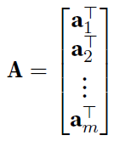
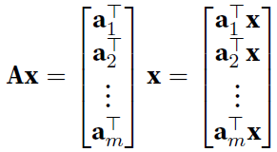
Matrix-Vector Products
Matrices
Consider a matrix $A∈ℝ^{m×n}$ and a vector $x∈ℝ^{n}$
The matrix can be written in terms of its row vectors (e.g., $a_{1}^{T}$is the first row)
The matrix-vector product is a column vector of length m, whose i^{th} element is the dot product $a_{i}^{T}x$
Note the size: $A\left(m×n\right)∙x\left(n×1\right)=Ax\left(m×1\right)$

Slide 21
Matrix-Matrix Products
Matrices
To multiply two matrices $A∈ℝ^{n×k}$and $B∈ℝ^{k×m}$
We can consider the matrix-matrix product as dot-products of rows in $A$ and columns in $B$
Size: $A\left(n×k\right)∙B\left(k×m\right)=C\left(n×m\right)$

Slide 22
Linear Dependence
Matrices
$$B=\left[\begin{matrix}2 & −1 \\ 4 & −2\end{matrix}\right]$$
For the following matrix
Notice that for the two columns $b_{1}={\left[2, 4\right]}^{T}$ and ${ b}_{2}={\left[−1, −2\right]}^{T}$, we can write ${ b}_{1}=−2∙{ b}_{2}$
This means that the two columns are linearly dependent
The weighted sum ${a_{1}b}_{1}+a_{2}b_{2}$ is referred to as a linear combination of the vectors${ b}_{1}$ and $b_{2}$
In this case, a linear combination of the two vectors exist for which ${ b}_{1}+2∙{ b}_{2}=0$
A collection of vectors $v_{1},v_{2},…,$ $v_{k}$ are linearly dependent if there exist coefficients $a_{1},a_{2},…,a_{k}$ not all equal to zero, so that
If there is no linear dependence, the vectors are linearly independent

Slide 23
Matrix Rank
Matrices
For an $n×m$ matrix, the rank of the matrix is the largest number of linearly independent columns
The matrix B from the previous example has $rank\left(B\right)=1$, since the two columns are linearly dependent
The matrix C below has $rank\left(C\right)=2$, since it has two linearly independent columns
I.e., ${ c}_{4}=−1∙{ c}_{1}$, ${ c}_{5}=−1∙{ c}_{3}$, ${ c}_{2}=3∙{ c}_{1}$ $+3∙{ c}_{3}$
$$C=\left[\begin{matrix}1 & 3 \\ −1 & 0 \\ \begin{matrix}0 \\ 2\end{matrix} & \begin{matrix}3 \\ 3\end{matrix}\end{matrix} \begin{matrix}0 & −1 & 0 \\ 1 & 1 & −1 \\ \begin{matrix}1 \\ −1\end{matrix} & \begin{matrix}0 \\ −2\end{matrix} & \begin{matrix}−1 \\ 1\end{matrix}\end{matrix}\right]$$
$$B=\left[\begin{matrix}2 & −1 \\ 4 & −2\end{matrix}\right]$$

Slide 24
Inverse of a Matrix
Matrices
For a square $n×n$ matrix A with rank $n$, $A^{−1}$ is its inverse matrix if their product is an identity matrix I
Properties of inverse matrices
If $det\left(A\right)=0$(i.e., $rank\left(A\right)<n$), then the inverse does not exist
A matrix that is not invertible is called a singular matrix
Note that finding an inverse of a large matrix is computationally expensive
In addition, it can lead to numerical instability
If the inverse of a matrix is equal to its transpose, the matrix is said to be orthogonal matrix

Slide 25
Pseudo-Inverse of a Matrix
Matrices
Pseudo-inverse of a matrix
Also known as Moore-Penrose pseudo-inverse
For matrices that are not square, the inverse does not exist
Therefore, a pseudo-inverse is used
If $m<n$, then the pseudo-inverse is $A^{†}={\left(A^{T}A\right)}^{−1}A^{T}$ and $A^{†}A=I$
E.g., for a matrix with dimension $X_{2×3}$, a pseudo-inverse can be found of size $X_{3×2}^{†}$, so that $X_{3×2}^{†}X_{2×3}=I_{3×3}$
If $m>n$, then the pseudo-inverse is $A^{†}=A^{T}{\left(AA^{T}\right)}^{−1}$ and ${AA}^{†}=I$
E.g., for a matrix with dimension $X_{3×2}$, a pseudo-inverse can be found of size $X_{2×3}^{†}$, so that ${X_{3×2}X}_{2×3}^{†}=I_{3×3}$

Slide 26
Tensors
Tensors
Tensors are n-dimensional arrays of scalars
Vectors are first-order tensors, $v∈ℝ^{n}$
Matrices are second-order tensors, $A∈ℝ^{m×n}$
E.g., a fourth-order tensor is $\text{T}∈ℝ^{n_{1}×n_{2}×n_{3}×n_{4}}$
Tensors are denoted with upper-case letters of a special font face (e.g., $\text{X}\text{, }\text{Y}\text{, }\text{Z}$)
RGB images are third-order tensors, i.e., as they are 3-dimensional arrays
The 3 axes correspond to width, height, and channel
E.g., 224 × 224 × 3
The channel axis corresponds to the color channels (red, green, and blue)

Slide 27
Manifolds
Manifolds
Earlier we learned that hyperplanes generalize the concept of planes in high-dimensional spaces
Similarly, manifolds can be informally imagined as generalization of the concept of surfaces in high-dimensional spaces
To begin with an intuitive explanation, the surface of the Earth is an example of a two-dimensional manifold embedded in a three-dimensional space
This is true because the Earth looks locally flat, so on a small scale it is like a 2-D plane
However, if we keep walking on the Earth in one direction, we will eventually end up back where we started
This means that Earth is not really flat, it only looks locally like a Euclidean plane, but at large scales it folds up on itself, and has a different global structure than a flat plane

Slide 28
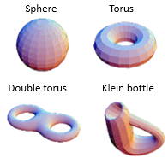
Manifolds
Manifolds
Manifolds are studied in mathematics under topological spaces
An n-dimensional manifold is defined as a topological space with the property that each point has a neighborhood that is homeomorphic to the Euclidean space of dimension n
This means that a manifold locally resembles Euclidean space near each point
Informally, a Euclidean space is locally smooth, it does not have holes, edges, or other sudden changes, and it does not have intersecting neighborhoods
Although the manifolds can have very complex structure on a large scale, resemblance of the Euclidean space on a small scale allows to apply standard math concepts
Examples of 2-dimensional manifolds are shown in the figure
The surfaces in the figure have been conveniently cut up into little rectangles that were glued together
Those small rectangles locally look like flat Euclidean planes
Picture from: http://bjlkeng.github.io/posts/manifolds/

Slide 29
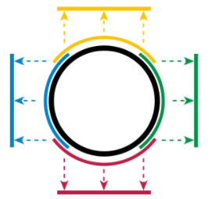
Manifolds
Manifolds
Examples of one-dimensional manifolds
Upper figure: a circle is a l-D manifold embedded in 2-D, where each arc of the circle locally resembles a line segment
Lower figures: other examples of 1-D manifolds
Note that a number 8 figure is not a manifold because it has an intersecting point (it is not Euclidean locally)
It is hypothesized that in the real-world, high-dimensional data (such as images) lie on low-dimensional manifolds embedded in the high-dimensional space
E.g., in ML, let’s assume we have a training set of images with size $224×224×3$ pixels
Learning an arbitrary function in such high-dimensional space would be intractable
Despite that, all images of the same class (“cats” for example) might lie on a low-dimensional manifold
This allows function learning and image classification
Picture from: http://bjlkeng.github.io/posts/manifolds/

Slide 30
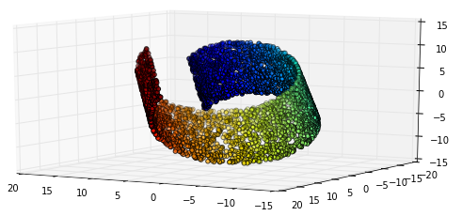
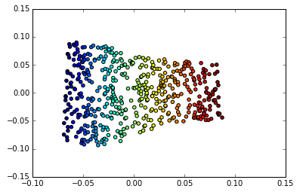
Manifolds
Manifolds
Example:
The data points have 3 dimensions (left figure), i.e., the input space of the data is 3-dimensional
The data points lie on a 2-dimensional manifold, shown in the right figure
Most ML algorithms extract lower-dimensional data features that enable to distinguish between various classes of high-dimensional input data
The low-dimensional representations of the input data are called embeddings

Slide 31
Eigen Decomposition
Eigen Decomposition
Eigen decomposition is decomposing a matrix into a set of eigenvalues and eigenvectors
Eigenvalues of a square matrix $A$ are scalars $λ$ and eigenvectors are non-zero vectors $v$ that satisfy
$$Av=λv$$
Eigenvalues are found by solving the following equation
$det\left(A−λI \right)=0$
If a matrix $A$ has n linearly independent eigenvectors $\left\{v^{1},…,v^{n}\right\}$ with corresponding eigenvalues $\left\{λ_{1},…{,λ}_{n}\right\}$, the eigen decomposition of $A$ is given by
$$A=VΛ{V }^{−1}$$
Columns of the matrix $V$ are the eigenvectors, i.e., $V=\left[v^{1},…,v^{n}\right]$
$Λ$is a diagonal matrix of the eigenvalues, i.e., $Λ=\left[λ_{1},…{,λ}_{n}\right]$
To find the inverse of the matrix A, we can use$A^{−1}=VΛ^{−1}{V }^{−1}$
This involves simply finding the inverse $Λ^{−1}$ of a diagonal matrix

Slide 32
Eigen Decomposition
Eigen Decomposition
Decomposing a matrix into eigenvalues and eigenvectors allows to analyze certain properties of the matrix
If all eigenvalues are positive, the matrix is positive definite
If all eigenvalues are positive or zero-valued, the matrix is positive semidefinite
If all eigenvalues are negative or zero-values, the matrix is negative semidefinite
Positive semidefinite matrices are interesting because they guarantee that $∀x$, $x^{T}Ax≥0$
Eigen decomposition can also simplify many linear-algebraic computations
The determinant of A can be calculated as
$$det\left(A\right)=λ_{1}∙λ_{2}{⋯λ}_{n}$$
If any of the eigenvalues are zero, the matrix is singular (it does not have an inverse)
However, eigen decomposition is defined only for square matrices
Also, in some cases the decomposition may involve complex numbers
Still, every real symmetric matrix is guaranteed to have an eigen decomposition according to $A=VΛ{V }^{−1}$, where $V$ is an orthogonal matrix

Slide 33
Eigen Decomposition
Eigen Decomposition
Geometric interpretation of the eigenvalues and eigenvectors is that they allow to stretch the space in specific directions
Figure: the two eigenvectors $v^{1}$ and $v^{2}$ are multiplied with the eigenvalues $λ_{1}$ and $λ_{2}$
We can see how the space is scaled in the direction of the larger eigenvalue $λ_{1}$
E.g., this is used for dimensionality reduction with PCA (principal component analysis) where the eigenvectors corresponding to the largest eigenvalues are used for extracting the most important data dimensions
Picture from: Goodfellow (2017) – Deep Learning

Slide 34
Singular Value Decomposition
Singular Value Decomposition
Singular value decomposition (SVD) provides another way to factorize a matrix, into singular vectors and singular values
SVD is more generally applicable than eigen decomposition
Every real matrix has an SVD, but the same is not true of the eigen decomposition
E.g., if a matrix is not square, the eigen decomposition is not defined, and we must use SVD
SVD of an $m×n$ matrix $A$ is given by
$$A=UDV^{T}$$
$U$ is an $m×m$ matrix, $D$ is an $m×n$ matrix, and $V$ is an $n×n$ matrix
The elements along the diagonal of $D$ are known as the singular values of A
The columns of $U$ are known as the left-singular vectors
The columns of $V$ are known as the right-singular vectors
For a non-square matrix $A$, the squares of the singular values $σ_{i}$ are the eigenvalues $λ_{i}$ of $A^{T}A$, i.e., $σ_{i}^{2}=λ_{i}$ for $i=1,2,…,n$
Applications of SVD include computing the pseudo-inverse of non-square matrices, matrix approximation, determining the matrix rank

Slide 35
Matrix Norms
Matrix Norms
$${\left\|X\right\|}_{F}=\sqrt{\sum_{i=1}^{m}{\sum_{j=1}^{n}{x_{ij}^{2}}}}$$
Frobenius norm – calculates the square-root of the summed squares of the elements of matrix $X$
This norm is similar to Euclidean norm of a vector
Spectral norm – is the largest singular value of matrix $X$
Denoted ${\left\|X\right\|}_{2}$
The singular values of $X$ are $σ_{1}, σ_{2}$,…, $σ_{m}$
$L_{2,1}$ norm – is the sum of the Euclidean norms of the columns of matrix $X$
Max norm – is the largest element of matrix X
$${\left\|X\right\|}_{2}=σ_{max}\left(X\right)$$
$${\left\|X\right\|}_{2,1}=\sum_{j=1}^{n}{\sqrt{\sum_{i=1}^{m}{x_{ij}^{2}}}}$$
$${\left\|X\right\|}_{max}=\max_{i,j}\left(x_{ij}\right)$$

Slide 36
Differential Calculus
Differential Calculus
For a function $f:ℝ→ℝ,$the derivative of f is defined as
$$f^{′}\left(x\right)=\lim_{h→0}{\frac{f\left(x+h\right)−f\left(x\right)}{h}}$$
If $f^{′}\left(a\right)$ exists, f is said to be differentiable at a
If f ‘$\left(c\right)$ is differentiable for $∀c∈\left[a,b\right]$, then f is differentiable on this interval
We can also interpret the derivative $f′(x)$as the instantaneous rate of change of $f(x)$ with respect to x
I.e., for a small change in x, what is the rate of change of $f(x)$
Given $y=f(x)$, where x is an independent variable and y is a dependent variable, the following expressions are equivalent:
$$f^{′}\left(x\right)=f^{′}=\frac{dy}{dx}=\frac{df}{dx}=\frac{d}{dx}f\left(x\right)=Df\left(x\right)=D_{x}f(x)$$
The symbols $\frac{d}{dx}$, D, and $D_{x}$ are differentiation operators that indicate operation of differentiation

Slide 37
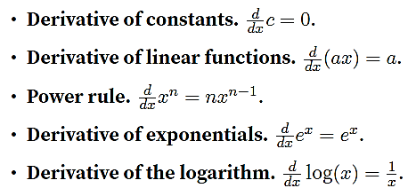
Differential Calculus
Differential Calculus
The following rules are used for computing the derivatives of explicit functions

Slide 38
Higher Order Derivatives
Differential Calculus
The derivative of the first derivative of a function $f\left(x\right)$ is the second derivative of $f\left(x\right)$
$$\frac{d^{2}f}{dx^{2}}=\frac{d}{dx}\left(\frac{df}{dx}\right)$$
The second derivative quantifies how the rate of change of $f\left(x\right)$ is changing
E.g., in physics, if the function describes the displacement of an object, the first derivative gives the velocity of the object (i.e., the rate of change of the position)
The second derivative gives the acceleration of the object (i.e., the rate of change of the velocity)
If we apply the differentiation operation any number of times, we obtain the n-th derivative of $f\left(x\right)$
$$f^{\left(n\right)}\left(x\right)=\frac{d^{n}f}{dx^{n}}={\left(\frac{d}{dx}\right)}^{n}f\left(x\right)$$

Slide 39
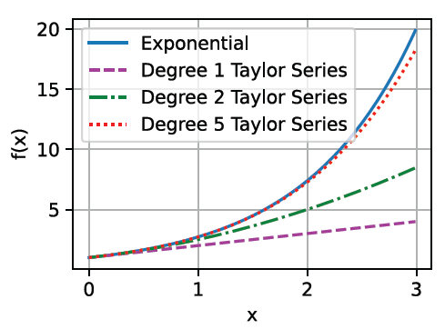
Taylor Series
Differential Calculus
Taylor series provides a method to approximate any function $f(x)$ at a point $x_{0}$ if we have the first n derivatives$\left\{f\left(x_{0}\right), f^{\left(1\right)}\left(x_{0}\right),f^{\left(2\right)}\left(x_{0}\right),…,f^{\left(n\right)}\left(x_{0}\right)\right\}$
For instance, for $n=2$, the second-order approximation of a function $f(x)$ is
$$f\left(x\right)≈{\left.\frac{1}{2}\frac{d^{2}f}{dx^{2}}\right|}_{x_{0}}{\left(x−x_{0}\right)}^{2}+{\left.\frac{df}{dx}\right|}_{x_{0}}\left(x−x_{0}\right)+f\left(x_{0}\right)$$
Similarly, the approximation of $f(x)$ with a Taylor polynomial of n-degree is
$f(x)≈\sum_{i=0}^{n}{{\left.\frac{1}{i!}\frac{d^{\left(i\right)}f}{dx^{i}}\right|}_{x_{0}}{\left(x−x_{0}\right)}^{i}}$
For example, the figure shows the first-order, second-order, and fifth-order polynomial of the exponential function $f(x)=e^{x}$ at the point $x_{0}=0$
Picture from: http://d2l.ai/chapter_appendix-mathematics-for-deep-learning/single-variable-calculus.html

Slide 40
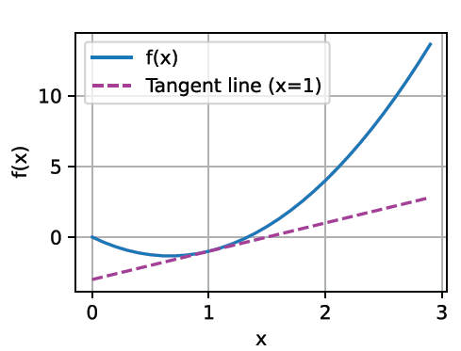
Geometric Interpretation
Differential Calculus
To provide a geometric interpretation of the derivatives, let’s consider a first-order Taylor series approximation of $f\left(x\right)$ at ${x=x}_{0}$
$$f\left(x\right)≈f\left(x_{0}\right)+{\left.\frac{df}{dx}\right|}_{x_{0}}\left(x−x_{0}\right)$$
The expression approximates the function $f\left(x\right)$ by a line which passes through the point $\left(x_{0},f\left(x_{0}\right)\right)$and has slope ${\left.\frac{df}{dx}\right|}_{x_{0}}$(i.e., the value of $\frac{df}{dx}$ at the point $x_{0}$)
Therefore, the first derivative of a function is also the slope of the tangent line to the curve of the function
Picture from: http://d2l.ai/chapter_appendix-mathematics-for-deep-learning/single-variable-calculus.html

Slide 41
Partial Derivatives
Differential Calculus
So far, we looked at functions of a single variable, where $f:ℝ→ℝ$
Functions that depend on many variables are called multivariate functions
Let $y=f\left(x\right)=f(x_{1}, x_{2} ,…,x_{n})$ be a multivariate function with n variables
The input is an n-dimensional vector $x={\left[x_{1}, x_{2} ,…,x_{n}\right]}^{T}$ and the output is a scalar y
The mapping is $f:ℝ^{n}→ℝ$
The partial derivative of y with respect to its i^{th} parameter $x_{i}$ is
$$\frac{∂y}{∂x_{i}}=\lim_{h→0}{\frac{f(x_{1}, { x}_{2} ,… ,{ x}_{i}+h, … ,{ x}_{n}) −f(x_{1}, { x}_{2} ,… ,{ x}_{i}, … ,{ x}_{n})}{h}}$$
To calculate $\frac{∂y}{∂x_{i}}$ ($∂$ pronounced “del” or we can just say “partial derivative”), we can treat $x_{1}, { x}_{2} ,…,{ x}_{i−1},$ ${ x}_{i+1}… ,{ x}_{n}$as constants and calculate the derivative of y only with respect to $x_{i}$
For notation of partial derivatives, the following are equivalent:
$$\frac{∂y}{∂x_{i}}=\frac{∂f}{∂x_{i}}=\frac{∂}{∂x_{i}}f\left(x\right)=f_{x_{i}}=f_{i}=D_{i}f=D_{x_{i}}f$$

Slide 42
Gradient
Differential Calculus
We can concatenate partial derivatives of a multivariate function with respect to all its input variables to obtain the gradient vector of the function
The gradient of the multivariate function $f(x)$ with respect to the n-dimensional input vector $x={\left[x_{1}, x_{2} ,…,x_{n}\right]}^{T}$, is a vector of n partial derivatives
$$∇_{x}f\left(x\right)={\left[\frac{∂f\left(x\right)}{∂x_{1}},\frac{∂f\left(x\right)}{∂x_{2}},…,\frac{∂f\left(x\right)}{∂x_{n}}\right]}^{T}$$
When there is no ambiguity, the notations $∇f\left(x\right)$ or $∇_{x}f$are often used for the gradient instead of $∇_{x}f\left(x\right)$
The symbol for the gradient is the Greek letter $∇$ (pronounced “nabla”), although $∇_{x}f\left(x\right)$is more often it is pronounced “gradient of f with respect to x”
In ML, the gradient descent algorithm relies on the opposite direction of the gradient of the loss function $ℒ$ with respect to the model parameters $θ$ $\left(∇_{θ}ℒ\right)$for minimizing the loss function
Adversarial examples can be created by adding perturbation in the direction of the gradient of the loss $ℒ$ with respect to input examples $x$ $\left(∇_{x}ℒ\right)$for maximizing the loss function

Slide 43
Hessian Matrix
Differential Calculus
To calculate the second-order partial derivatives of multivariate functions, we need to calculate the derivatives for all combination of input variables
That is, for a function $f(x)$ with an n-dimensional input vector $x={\left[x_{1}, x_{2} ,…,x_{n}\right]}^{T}$, there are $n^{2}$ second partial derivatives for any choice of i and j
$$\frac{∂^{2}f}{∂x_{i}∂x_{j}}=\frac{∂}{∂x_{i}}\left(\frac{∂f}{∂x_{j}}\right)$$
The second partial derivatives are assembled in a matrix called the Hessian
$$H_{f}=\left[\begin{matrix}\frac{∂^{2}f}{∂x_{1}∂x_{1}} & ⋯ & \frac{∂^{2}f}{∂x_{1}∂x_{n}} \\ ⋮ & ⋱ & ⋮ \\ \frac{∂^{2}f}{∂x_{n}∂x_{1}} & … & \frac{∂^{2}f}{∂x_{n}∂x_{n}}\end{matrix}\right]$$
Computing and storing the Hessian matrix for functions with high-dimensional inputs can be computationally prohibitive
E.g., the loss function for a ResNet50 model with approximately 23 million parameters, has a Hessian of $23 M×23 M=529 T$ (trillion) parameters

Slide 44
Jacobian Matrix
Differential Calculus
The concept of derivatives can be further generalized to vector-valued functions (or, vector fields) $f:ℝ^{n}→ℝ^{m}$
For an n-dimensional input vector $x={\left[x_{1}, x_{2} ,…,x_{n}\right]}^{T}∈ℝ^{n}$, the vector of functions is given as
$f\left(x\right)={\left[f_{1}\left(x\right),f_{2}\left(x\right),…,f_{m}\left(x\right)\right]}^{T}∈$ $ℝ^{m}$
The matrix of first-order partial derivates of the vector-valued function $f\left(x\right)$is an $m×n$ matrix called a Jacobian
$$J=\left[\begin{matrix}\frac{∂f_{1}\left(x\right)}{∂x_{1}} & ⋯ & \frac{∂f_{1}\left(x\right)}{∂x_{n}} \\ ⋮ & ⋱ & ⋮ \\ \frac{∂f_{m}\left(x\right)}{∂x_{1}} & … & \frac{∂f_{m}\left(x\right)}{∂x_{n}}\end{matrix}\right]$$
For example, in robotics a robot Jacobian matrix gives the partial derivatives of the translational and angular velocities of the robot end-effector with respect to the joints (i.e., axes) velocities

Slide 45
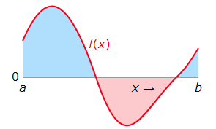
Integral Calculus
Integral Calculus
For a function $f(x)$ defined on the domain $[a, b]$, the definite integral of the function is denoted
$$\int_{a}^{b}{f\left(x\right)dx}$$
Geometric interpretation of the integral is the area between the horizontal axis and the graph of $f(x)$ between the points a and b
In this figure, the integral is the sum of blue areas (where $f\left(x\right)>0)$ minus the pink area (where $f\left(x\right)<0$)
Picture from: https://mjo.osborne.economics.utoronto.ca/index.php/tutorial/index/1/clc/t

Slide 46
Optimization
Optimization
Optimization is concerned with optimizing an objective function — finding the value of an argument that minimizes of maximizes the function
Most optimization algorithms are formulated in terms of minimizing a function $f(x)$
Maximization is accomplished vie minimizing the negative of an objective function (e.g., minimize $−f(x)$)
In minimization problems, the objective function is often referred to as a cost function or loss function or error function
Optimization is very important for machine learning
The performance of optimization algorithms affect the model’s training efficiency
Most optimization problems in machine learning are nonconvex
Meaning that the loss function is not a convex function
Nonetheless, the design and analysis of algorithms for solving convex problems has been very instructive for advancing the field of machine learning

Slide 47
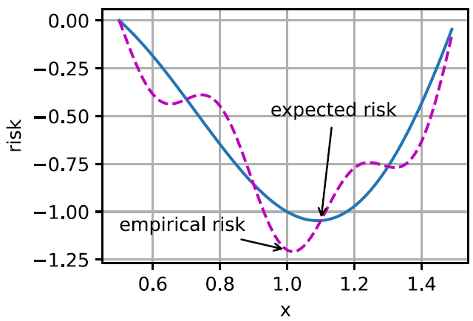
Optimization
Optimization
Optimization and machine learning have related, but somewhat different goals
Goal in optimization: minimize an objective function
For a set of training examples, reduce the training error
Goal in ML: find a suitable model, to predict on data examples
For a set of testing examples, reduce the generalization error
For a given empirical function g (dashed purple curve), optimization algorithms attempt to find the point of minimum empirical risk (error on the training dataset)
ML algorithms attempt to find the point of minimum expected risk, based on minimizing the error on a set of testing examples (blue curve)
Which may be at a different location than the minimum of the training examples
Picture from: http://d2l.ai/chapter_optimization/optimization-intro.html

Slide 48
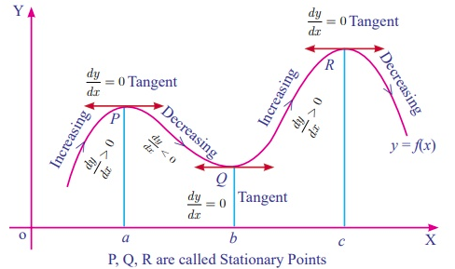
Stationary Points
Optimization
Stationary points ( or critical points) of a differentiable function $f(x)$ of one variable are the points where the derivative of the function is zero, i.e., $f′(x)=0$
The stationary points can be:
Minimum, a point where the derivative changes from negative to positive
Maximum, a point where the derivative changes from positive to negative
Saddle point, derivative is either positive or negative on both sides of the point
The minimum and maximum points are collectively known as extremum points
The nature of stationary points can be determined based on the second derivative of $f(x)$ at the point
If $f^{′′}\left(x\right)>0$, the point is a minimum
If $f^{′′}\left(x\right)<0$, the point is a maximum
If $f^{′′}\left(x\right)=0$, inconclusive, the point can be a saddle point, but it may not
The same concept also applies to gradients of multivariate functions

Slide 49
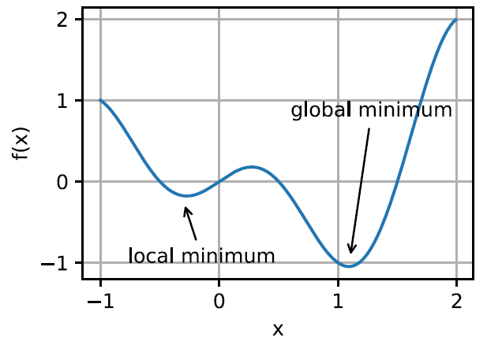
Local Minima
Optimization
Among the challenges in optimization of model’s parameters in ML involve local minima, saddle points, vanishing gradients
For an objective function $f(x)$, if the value at a point x is the minimum of the objective function over the entire domain of x, then it is the global minimum
If the value of $f(x)$ at x is smaller than the values of the objective function at any other points in the vicinity of x, then it is the local minimum
The objective functions in ML usually have many local minima
When the solution of the optimization algorithm is near the local minimum, the gradient of the loss function approaches or becomes zero (vanishing gradients)
Therefore, the obtained solution in the final iteration can be a local minimum, rather than the global minimum
Picture from: http://d2l.ai/chapter_optimization/optimization-intro.html

Slide 50
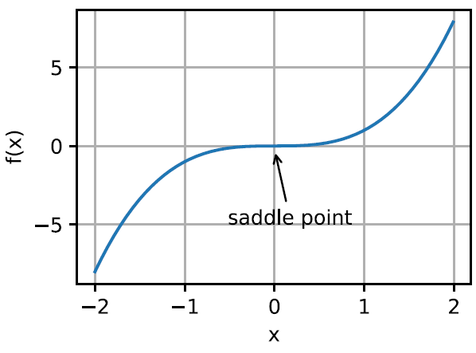
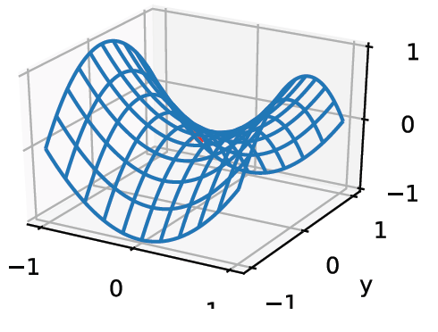
Saddle Points
Optimization
The gradient of a function $f(x)$ at a saddle point is 0, but the point is not a minimum or maximum point
The optimization algorithms may stall at saddle points, without reaching a minima
Note also that the point of a function at which the sign of the curvature changes is called an inflection point
An inflection point ($f′′\left(x\right)=0$) can also be a saddle point, but it does not have to be
For the 2D function (right figure), the saddle point is at (0,0)
The point looks like a saddle, and gives the minimum with respect to x, and the maximum with respect to y
saddle point
x
Picture from: http://d2l.ai/chapter_optimization/optimization-intro.html

Slide 51
Convex Optimization
Optimization
A function of a single variable is concave if every line segment joining two points on its graph does not lie above the graph at any point
Symmetrically, a function of a single variable is convex if every line segment joining two points on its graph does not lie below the graph at any point
Picture from: https://mjo.osborne.economics.utoronto.ca/index.php/tutorial/index/1/cv1/t

Slide 52
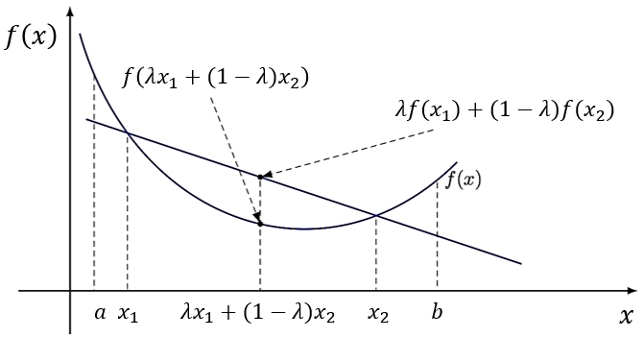
Convex Functions
Optimization
In mathematical terms, the function f is a convex function if for all points $x_{1}, x_{2}$ and for all $λ∈[0,1]$
$$λf(x_{1})+(1−λ)f(x_{2})≥f\left(λx_{1}+(1−λ)x_{2}\right)$$

Slide 53
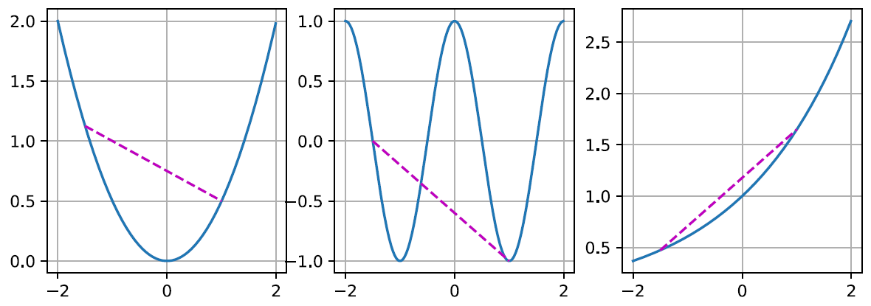
Convex Functions
Optimization
One important property of convex functions is that they do not have local minima
Every local minimum of a convex function is a global minimum
I.e., every point at which the gradient of a convex function = 0 is the global minimum
The figure below illustrates two convex functions, and one nonconvex function
convex non-convex convex
Picture from: http://d2l.ai/chapter_optimization/convexity.html

Slide 54
Convex Functions
Optimization
Another important property of convex functions is stated by the Jensen’s inequality
Namely, if we let $α1=λ$ and $α2=1−λ$, the definition of convex function becomes
$$α1f(x_{1})+α2f(x_{2})≥f\left(α1x_{1}+α2x_{2}\right)$$
The Danish mathematician Johan Jensen showed that this can be generalized for all $αi$ that are non-negative real numbers a$nd \sum_{i}{αi}$=1, to the following:
$$α1f\left(x_{1}\right)+α2f\left(x_{2}\right)+⋯+αnf\left(x_{n}\right)≥f\left(α1x_{1}+α2x_{2}+⋯+αnx_{n}\right)$$

Slide 55
Convex Sets
Optimization
A set $𝒳$ in a vector space is a convex set if for any $a,b∈𝒳$ the line segment connecting a and b is also in $𝒳$
For all $λ∈[0,1]$, we have
$λ∙a+\left(1−λ\right)∙b∈𝒳$ for all $a,b∈𝒳$
In the figure, each point represents a 2D vector
The left set is nonconvex, and the other two sets are convex
Properties of convex sets include:
If $𝒳$ and $𝒴$are convex sets, then $𝒳∩𝒴$ is also convex
If $𝒳$ and $𝒴$are convex sets, then $𝒳∪𝒴$ is not necessarily convex
Picture from: http://d2l.ai/chapter_optimization/convexity.html

Slide 56
Derivatives and Convexity
Optimization
A twice-differentiable function of a single variable $f:ℝ→ℝ$ is convex if and only if its second derivative is non-negative everywhere
Or, we can write, $\frac{d^{2}f}{dx^{2}}≥0$
For example, $f\left(x\right)=x^{2}$ is convex, since $f′\left(x\right)=2x$, and $f′′\left(x\right)=2$, meaning that $f^{′′}\left(x\right)≥0$
A twice-differentiable function of many variables $f:ℝ^{n}→ℝ$ is convex if and only if its Hessian matrix is positive semi-definite everywhere
Or, we can write, $H_{f}≽0$
This is equivalent to stating that all eigenvalues of the Hessian matrix are non-negative (i.e., $≥0)$

Slide 57
Constrained Optimization
Optimization
The optimization problem that involves a set of constraints which need to be satisfied to optimize the objective function is called constrained optimization
E.g., for a given objective function $f(x)$and a set of constraint functions $c_{i}\left(x\right)$
$$\underset{x}{minimize}{f(x) }$$
$$subject to c_{i}\left(x\right)≤0 for all i∈\left\{1, 2, …, N\right\}$$
The points that satisfy the constraints form the feasible region
Various optimization algorithms have been developed for handling optimization problems based on whether the constraints are equalities, inequalities, or a combination of equalities and inequalities

Slide 58
Lagrange Multipliers
Optimization
One approach to solving optimization problems is to substitute the initial problem with optimizing another related function
The Lagrange function for optimization of the constrained problem on the previous page is defined as
$L\left(x,α\right)=f\left(x\right)+\sum_{i}{α_{i}c_{i}\left(x\right)}$ where $α_{i}≥0$
The variables $α_{i}$ are called Lagrange multipliers and ensure that the constraints are properly enforced
They are chosen to ensure that $c_{i}\left(x\right)≤0 for all i∈\left\{1, 2, …, N\right\}$
This is a saddle-point optimization problem where one wants to minimize $L\left(x,α\right)$with respect to $x$ and simultaneously maximize $L\left(x,α\right)$ with respect to $α_{i}$
The saddle point of $L\left(x,α\right)$gives the optimal solution to the original constrained optimization problem

Slide 59
Projections
Optimization
An alternative strategy for satisfying constraints are projections
E.g., gradient clipping in NNs can require that the norm of the gradient is bounded by a constant value c
Approach:
At each iteration during training
If the norm of the gradient $\left\|g\right\|≥c$, then the update is $g^{new}←c∙\frac{g^{old}}{\left\|g^{old}\right\|}$
If the norm of the gradient $\left\|g\right\|<c$, then the update is $g^{new}←g^{old}$
Note that since $\frac{g^{old}}{\left\|g^{old}\right\|}$ is a unit vector (i.e., it has a norm = 1), then the vector $c∙\frac{g^{old}}{\left\|g^{old}\right\|}$ has a norm = $c$
Such clipping is the projection of the gradient g onto the ball of radius c
For $c=1,$it is a projection on the unit ball (i.e., ball with radius 1)

Slide 60
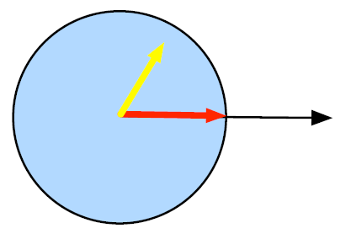
Projections
Optimization
More generally, a projection of a vector $x$ onto a set $𝒳$ is defined as
$\underset{𝒳}{Proj}\left(x\right)=arg\min_{x′∈𝒳}{{\left\|x−x′\right\|}_{2}}$
This means that the vector $x$ is projected onto the closest vector $x′$ that belongs to the set $𝒳$
For example, in the figure, the blue circle represents a convex set$𝒳$
The points inside the circle project to itself
E.g., if $x$is the yellow vector, its closest point $x′$ in the set $𝒳$ is i$tself$: the distance between $x$ and $x′$ is ${\left\|x−x′\right\|}_{2}=0$
The points outside the circle project to the closest point inside the circle
E.g., if $x$is the black vector, its closest point $x′$ in the set $𝒳$ is the red vector
Among all vectors in the set $𝒳$, the red vector $x′$has the smallest distance to $x$, i.e., ${\left\|x−x′\right\|}_{2}$
Picture from: http://d2l.ai/chapter_optimization/convexity.html

Slide 61
First-order vs Second-order Optimization
Optimization
First-order optimization algorithms use the gradient of a function for finding the extrema points
Methods: gradient descent, proximal algorithms, optimal gradient schemes
The disadvantage is that they can be slow and inefficient
Second-order optimization algorithms use the Hessian matrix of a function for finding the extrema points
This is since the Hessian matrix holds the second-order partial derivatives
Methods: Newton’s method, conjugate gradient method, Quasi-Newton method, Gauss-Newton method, BFGS (Broyden-Fletcher-Goldfarb-Shanno) method, Levenberg-Marquardt method, Hessian-free method
The second-order derivatives can be thought of as measuring the curvature of the loss function
Recall also that the second-order derivative can be used to determine whether a stationary points is a maximum ${(f}^{′′}\left(x\right)<0)$, minimum ($f^{′′}\left(x\right)>0)$
This information is richer than the information provided by the gradient
Disadvantage: computing the Hessian matrix is computationally expensive, and even prohibitive for high-dimensional data

Slide 62
Lower Bound and Infimum
Optimization
Lower bound of a subset $𝒮$ from a partially ordered set $𝒳$is an element $a$ of $𝒳$, such that $a≤s$for all $s∈𝒮$
E.g., for the subset $𝒮=\left\{3, 4, 6, 8\right\}$ from the natural numbers $ℕ$, lower bounds are the numbers 3, 2, and 1, i.e., all natural numbers $≤3$
Infimum of a subset $𝒮$ from a partially ordered set $𝒳$is the greatest lower bound i$n 𝒳$, denoted $\inf_{s∈𝒮}{s}$
It is the maximal quantity $h$ such that $h≤s$for all $s∈𝒮$
E.g., the infimum of the set $𝒮=\left\{3, 4, 6, 8\right\}$ is $h=$3, since it is the greatest lower bound
Example: consider the subset of positive real numbers (excluding zero) $ℝ_{≥0}\text{=}\left\{x∈ℝ:x≥0\right\}$
The subset $ℝ_{≥0}$ does not have a minimum, because for every small positive number, there is a another even smaller positive number
On the other hand, all real negative numbers and 0 are lower bounds on the subset $ℝ_{≥0}$
0 is the greatest lower bound of all lower bounds, and therefore, the infimum of $ℝ_{≥0}$ is 0

Slide 63
Upper Bound and Supremum
Optimization
Upper bound of a subset $𝒮$ from a partially ordered set $𝒳$is an element $b$ of $𝒳$, such that $b≥s$for all $s∈𝒮$
E.g., for the subset $𝒮=\left\{3, 4, 6, 8\right\}$ from the natural numbers $ℕ$, upper bounds are the numbers 8, 9, 40, and all other natural numbers $≥8$
Supremum of a subset $𝒮$ from a partially ordered set $𝒳$is the least upper bound i$n 𝒳$, denoted $\sup_{s∈𝒮}{s}$
It is the minimal quantity $g$ such that $g≥s$for all $s∈𝒮$
E.g., the supremum of the subset $𝒮=\left\{3, 4, 6, 8\right\}$ is $g=8$, since it is the least upper bound
Example: for the subset of negative real numbers (excluding zero)
$ℝ_{≤0}\text{=}\left\{x∈ℝ:x≤0\right\}$
All real positive numbers and 0 are upper bounds
0 is the least upper bound, and therefore, the supremum of $ℝ_{≤0}$

Slide 64
Lipschitz Function
Optimization
A function $f\left(x\right)$ is a Lipschitz continuous function if a constant $ρ>0$ exists, such that for all points $x_{1}$, $x_{2}$
$$\left\|f\left(x_{1}\right)−f\left(x_{2}\right)\right\|≤ρ\left\|x_{1}−x_{2}\right\|$$
Such function is also called a $ρ$-Lipschitz function
Intuitively, a Lipschitz function cannot change too fast
I.e., if the points $x_{1}$ and $x_{2}$ are close (i.e., the distance $\left\|x_{1}−x_{2}\right\|$ is small), that means that the $f\left(x_{1}\right)$ and $f\left(x_{2}\right)$ are also close (i.e., the distance $\left\|f\left(x_{1}\right)−f\left(x_{2}\right)\right\|$ is also small)
The smallest real number that bounds the change of $\left\|f\left(x_{1}\right)−f\left(x_{2}\right)\right\|$ for all points $x_{1}$, $x_{2}$ is the Lipschitz constant $ρ$ of the function $f\left(x\right)$
For a $ρ$-Lipschitz function $f\left(x\right)$, the first derivative $f′\left(x\right)$ is bounded everywhere by $ρ$
E.g., the function $f\left(x\right)=log\left(1+e^{x}\right)$ is 1-Lipschitz over $ℝ$
Since $\left\|f′\left(x\right)\right\|=\left\|\frac{e^{x}}{1+e^{x}}\right\|=\left\|\frac{1}{e^{−x}+1}\right\|=\frac{1}{\left\|e^{−x}+1\right\|}≤1$
I.e., $ρ=1$

Slide 65
Lipschitz Continuous Gradient
Optimization
A differentiable function $f\left(x\right)$ has a Lipschitz continuous gradient if a constant $ρ>0$ exists, such that for all points $x_{1}$, $x_{2}$
$$\left\|∇f\left(x_{1}\right)−∇f\left(x_{2}\right)\right\|≤ρ\left\|x_{1}−x_{2}\right\|$$
For a function $f\left(x\right)$ with a $ρ$-Lipschitz gradient, the second derivative $f′′\left(x\right)$ is bounded everywhere by $ρ$
E.g., consider the function $f\left(x\right)=x^{2}$
$f\left(x\right)$ $=x^{2}$ is not a Lipschitz continuous function, since $f^{′}(x)=2x$, so when $x→∞$ then $f^{′}(x)→∞$, i.e., the derivative is not bounded everywhere
Since $f^{′′}(x)=2$, therefore the gradient $f^{′}(x)$ is 2-Lipschitz everywhere, since the second derivative is bounded everywhere by 2

Slide 66
Probability
Probability
Intuition:
In a process, several outcomes are possible
When the process is repeated a large number of times, each outcome occurs with a relative frequency, or probability
If a particular outcome occurs more often, we say it is more probable
Probability arises in two contexts
In actual repeated experiments
Example: You record the color of 1,000 cars driving by. 57 of them are green. You estimate the probability of a car being green as 57/1,000 = 0.057.
In idealized conceptions of a repeated process
Example: You consider the behavior of an unbiased six-sided die. The expected probability of rolling a 5 is 1/6 = 0.1667.
Example: You need a model for how people’s heights are distributed. You choose a normal distribution to represent the expected relative probabilities.

Slide 67
Probability
Probability
Solving machine learning problems requires to deal with uncertain quantities, as well as with stochastic (non-deterministic) quantities
Probability theory provides a mathematical framework for representing and quantifying uncertain quantities
There are different sources of uncertainty:
Inherent stochasticity in the system being modeled
For example, most interpretations of quantum mechanics describe the dynamics of subatomic particles as being probabilistic
Incomplete observability
Even deterministic systems can appear stochastic when we cannot observe all of the variables that drive the behavior of the system
Incomplete modeling
When we use a model that must discard some of the information we have observed, the discarded information results in uncertainty in the model’s predictions
E.g., discretization of real-numbered values, dimensionality reduction, etc.

Slide 68
Random variables
Probability
A random variable $X$ is a variable that can take on different values
Example: $X$ = rolling a die
Possible values of $X$ comprise the sample space, or outcome space, $𝒮=\left\{\text{1, 2, 3, 4, 5, 6}\right\}$
We denote the event of “seeing a 5” as $\left\{X=5\right\}$ or $X=5$
The probability of the event is $P\left(\left\{X=5\right\}\right)$ or $P\left(X=5\right)$
Also, $P\left(5\right)$ can be used to denote the probability that $X$ takes the value of 5
A probability distribution is a description of how likely a random variable is to take on each of its possible states
A compact notation is common, where $P\left(X\right)$ is the probability distribution over the random variable $X$
Also, the notation $X\sim P\left(X\right)$ can be used to denote that the random variable $X$ has probability distribution $P\left(X\right)$
Random variables can be discrete or continuous
Discrete random variables have finite number of states: e.g., the sides of a die
Continuous random variables have infinite number of states: e.g., the height of a person

Slide 69
Axioms of probability
Probability
The probability of an event $𝒜$ in the given sample space $𝒮$, denoted as $P\left(𝒜\right)$, must satisfies the following properties:
Non-negativity
For any event $𝒜$ ∈ $𝒮$, $P\left(𝒜\right)≥0$
All possible outcomes
Probability of the entire sample space is 1, $P\left(𝒮\right)=1$
Additivity of disjoint events
For all events $𝒜_{1}{,𝒜}_{2}$∈ $𝒮$ that are mutually exclusive ($𝒜_{1}∩𝒜_{2}=∅)$, the probability that both events happen is equal to the sum of their individual probabilities, $P\left(𝒜_{1}∪𝒜_{2}\right)=P\left(𝒜_{1}\right)$+$P\left(𝒜_{2}\right)$
The probability of a random variable $P\left(X\right)$ must obey the axioms of probability over the possible values in the sample space $𝒮$

Slide 70
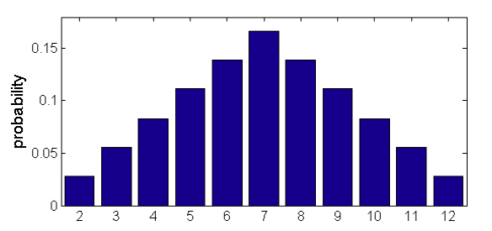
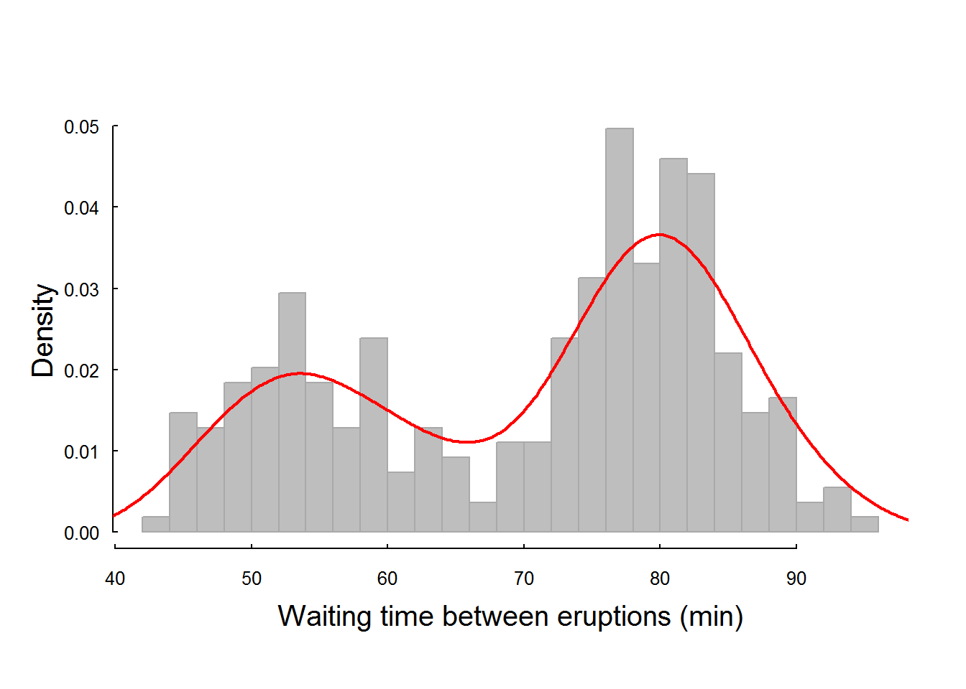
Discrete Variables
Probability
A probability distribution over discrete variables may be described using a probability mass function (PMF)
E.g., sum of two dice
A probability distribution over continuous variables may be described using a probability density function (PDF)
E.g., waiting time between eruptions of Old Faithful
A PDF gives the probability of an infinitesimal region with volume $δX$
To find the probability over an interval [a, b], we can integrate the PDF as follows:
$P\left(X∈\left[a,b\right]\right)=\int_{a}^{b}{P\left(X\right)dX}$
Picture from: Jeff Howbert — Machine Learning Math Essentials

Slide 71
Multivariate Random Variables
Probability
We may need to consider several random variables at a time
If several random processes occur in parallel or in sequence
E.g., to model the relationship between several diseases and symptoms
E.g., to process images with millions of pixels (each pixel is one random variable)
Next, we will study probability distributions defined over multiple random variables
These include joint, conditional, and marginal probability distributions
The individual random variables can also be grouped together into a random vector, because they represent different properties of an individual statistical unit
A multivariate random variable is a vector of multiple random variables $X={\left(X_{1},X_{2},…,X_{n}\right)}^{T}$
It is also referred to as a random vector

Slide 72
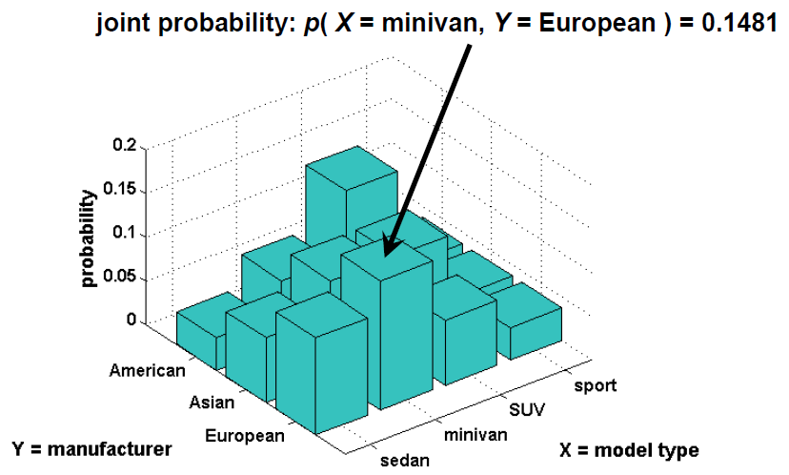
Joint Probability Distribution
Probability
Probability distribution that acts on many variables at the same time is known as a joint probability distribution
Given any values x and y of two random variables $X$ and $Y$, what is the probability that $X$ = x and $Y$ = y simultaneously?
$P(X=x, Y=y)$ denotes the joint probability
We may also write $P(x, y)$ for brevity
Picture from: Jeff Howbert — Machine Learning Math Essentials

Slide 73
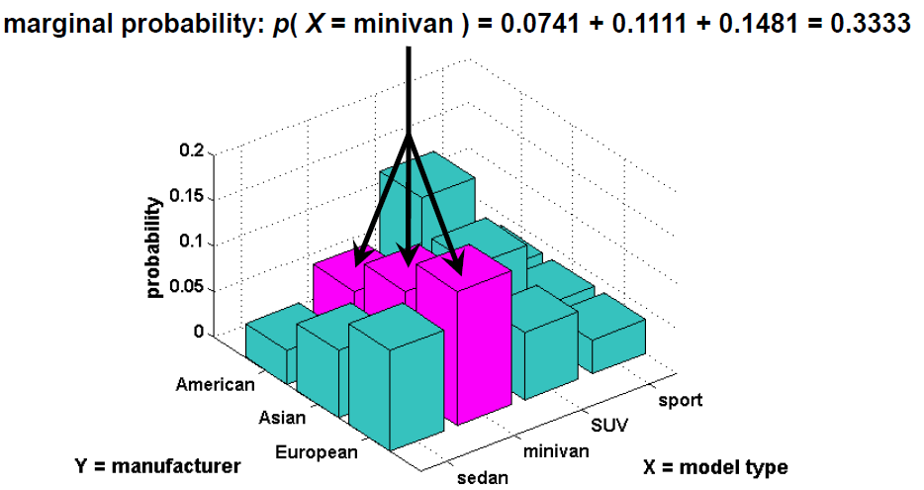
Marginal Probability Distribution
Probability
Marginal probability distribution is the probability distribution of a single variable
It is calculated based on the joint probability distribution $P\left(X, Y\right)$
I.e., using the sum rule: $P\left(X=x\right)=\sum_{y}{P\left(X=x, Y=y\right)}$
For continuous random variables, the summation is replaced with integration, $P\left(X=x\right)=\int{P\left(X=x, Y=y\right)}dy$
This process is called marginalization
Picture from: Jeff Howbert — Machine Learning Math Essentials

Slide 74
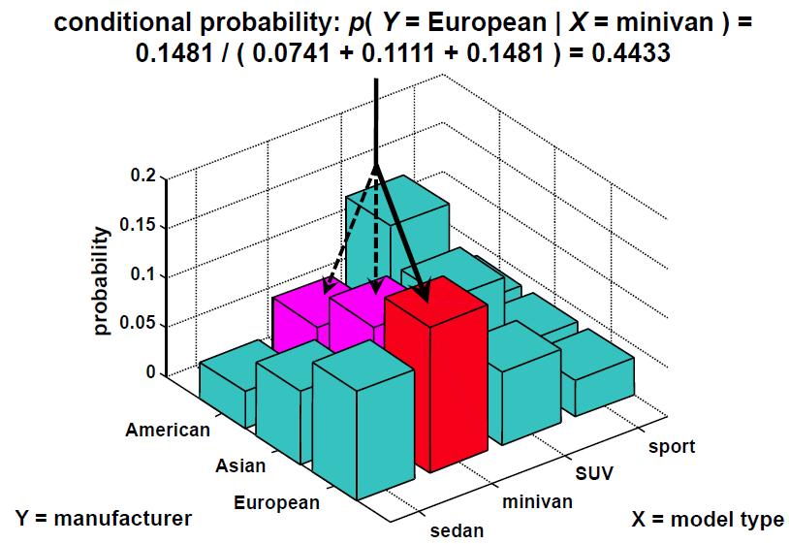
Conditional Probability Distribution
Probability
Conditional probability distribution is the probability distribution of one variable provided that another variable has taken a certain value
Denoted $P(X=x| Y=y)$
Note that: $P\left(X=x| Y=y\right)=\frac{P\left(X=x, Y=y\right)}{P\left(Y=y\right)}$
Picture from: Jeff Howbert — Machine Learning Math Essentials

Slide 75
Bayes’ Theorem
Probability
Bayes’ theorem – allows to calculate conditional probabilities for one variable when conditional probabilities for another variable are known
$$P\left(X| Y\right)=\frac{P\left(Y| X\right)P\left(X\right)}{P\left(Y\right)}$$
Also known as Bayes’ rule
Multiplication rule for the joint distribution is used: $P\left(X, Y\right)=P\left(Y| X\right)P\left(X\right)$
By symmetry, we also have: $P\left(Y, X\right)=P\left(X| Y\right)P\left(Y\right)$
The terms are referred to as:
$P\left(X\right)$, the prior probability, the initial degree of belief for $X$
$P\left(X| Y\right)$, the posterior probability, the degree of belief after incorporating the knowledge of $Y$
$P\left(Y| X\right)$, the likelihood of $Y$ g$iven X$
P(Y), the evidence
Bayes’ theorem: posterior probability $=\frac{likelihood × prior probability}{evidence}$

Slide 76
Independence
Probability
Two random variables $X$ and $Y$ are independent if the occurrence of $Y$ does not reveal any information about the occurrence of $X$
E.g., two successive rolls of a die are independent
Therefore, we can write: $P\left(X| Y\right)=P\left(X\right)$
The following notation is used: $X⊥Y$
Also note that for independent random variables: $P\left(X,Y\right)=P\left(X\right)P\left(Y\right)$
In all other cases, the random variables are dependent
E.g., duration of successive eruptions of Old Faithful
Getting a king on successive draws form a deck (the drawn card is not replaced)
Two random variables $X$ and $Y$ are conditionally independent given another random variable $Z$ if and only if $P\left(X,Y|Z\right)=P\left(X|Z\right)P\left(Y|Z\right)$
This is denoted as $X⊥Y|Z$

Slide 77
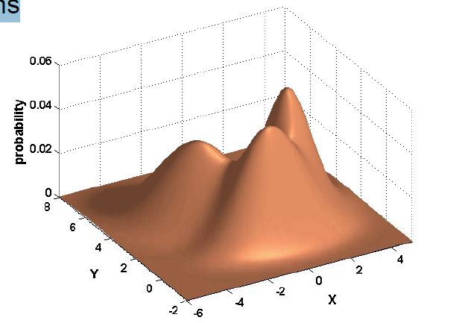
Continuous Multivariate Distributions
Probability
Same concepts of joint, marginal, and conditional probabilities apply for continuous random variables
The probability distributions use integration of continuous random variables, instead of summation of discrete random variables
Example: a three-component Gaussian mixture probability distribution in two dimensions
Picture from: Jeff Howbert — Machine Learning Math Essentials

Slide 78
Expected Value
Probability
The expected value or expectation of a random variable $X$ drawn from a probability distribution $P\left(X\right)$ is the average (mean) value of all possible outcomes
For a discrete random variable X, it is calculated as
$$𝔼_{X\sim P}\left[X\right]=\sum_{X}{X P\left(X\right)}$$
For a continuous random variable X, it is calculated as
$$𝔼_{X\sim P}\left[X\right]=\int{X P\left(X\right)}dX$$
When the identity of the distribution is clear from the context, we can write $𝔼\left[X\right]$
E.g., for a sample of observations: $μ=𝔼\left[X\right]=\sum_{i}{P\left(X_{i}\right){∙X}_{i}}=\frac{1}{N}\sum_{i}{X_{i}}$
Mean is the most common measure of central tendency of a distribution
Other measures of central tendency: median, mode
By analogy, the expected value of a function $f(X)$of a discrete random variable $X$with respect to a probability distribution $P\left(X\right)$ is:
$$𝔼_{X\sim P}\left[f\left(X\right)\right]=\sum_{X}{f\left(X\right) P\left(X\right)}$$

Slide 79
Variance
Probability
Variance of a random variable $X$gives the measure of how much the values of$X$deviate from the expected value as we sample $X$from $P\left(X\right)$
$$Var\left(X\right)=𝔼\left[{\left(X−𝔼\left[X\right]\right)}^{2}\right]$$
When the variance is low, the values of $X$cluster near the expected value
Variance is commonly denoted with $σ^{2}$
The above equation is similar to an expected value of a function $f\left(X\right)={\left(X_{i}−μ\right)}^{2}$
We can write:
$$σ^{2}=𝔼\left[{\left(X_{i}−μ\right)}^{2}\right]=\sum_{i}{{\left(X_{i}−μ\right)}^{2}∙P\left(X_{i}\right)}$$
Similarly, the variance of a sample of observations can be calculated as:
$σ^{2}=\frac{1}{N}\sum_{i}{{\left(X_{i}−μ\right)}^{2}}$
The square root of the variance is the standard deviation
$σ=\sqrt{Var\left(X\right)}$

Slide 80
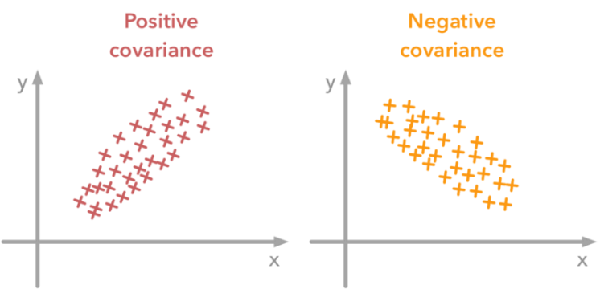
Covariance
Probability
Covariance is a measure of the joint variability of two random variables $X$and $Y$from their means
$$Cov\left(X,Y \right)=𝔼\left[\left(X−𝔼\left[X\right]\right)\left(Y−𝔼\left[Y\right]\right)\right]$$
If $f\left(X\right)=X_{i}−μ_{X}$ and $g\left(Y\right)=Y_{i}−μ_{Y}$
Then, the covariance is:$Cov\left(X_{i},Y_{i}\right)=𝔼\left[f\left(X\right)g\left(Y\right)\right]=\sum_{i}{P\left(X_{i},Y_{i}\right)∙}\left(X_{i}−μ_{X}\right)∙\left(Y_{i}−μ_{Y}\right)$
Covariance of samples of observations is: $Cov\left(X,Y\right)=\frac{1}{N}\sum_{i}{\left(Y_{i}−μ_{X}\right)\left(Y_{i}−μ_{Y}\right) }$
The covariance measures the tendency for $X$ and $Y$ to deviate from their means in the same (or opposite) directions at same time
$$Y$$
No covariance
$$Y$$
High covariance
$$X$$
$$X$$
Picture from: Jeff Howbert — Machine Learning Math Essentials

Slide 81
Correlation
Probability
Correlation coefficient is the covariance normalized by the standard deviations of the two variables
$$corr\left(X,Y\right)=\frac{Cov\left(X,Y\right)}{σ_{X}∙σ_{Y}}$$
It is also called Pearson’s correlation coefficient and it is denoted $ρ\left(X,Y\right)$
The values are in the interval$\left[−1, 1\right]$
It only reflects linear dependence between variables, and it does not measure non-linear dependencies between the variables
Picture from: Jeff Howbert — Machine Learning Math Essentials

Slide 82
Covariance Matrix
Probability
Covariance matrix of a multivariate random variable $X={\left(X_{1},X_{2},…,X_{n}\right)}^{T}$ is an $n×n$matrix, such that
$$Cov{\left(X\right)}_{i,j}=Cov\left(X_{i},X_{j}\right)$$
I.e.,
$$Cov\left(X\right)=\left[\begin{matrix}Cov\left(X_{1},X_{1}\right) & \begin{matrix}Cov\left(X_{1},X_{2}\right) & ⋯\end{matrix} & Cov\left(X_{1},X_{n}\right) \\ \begin{matrix}Cov\left(X_{2},X_{1}\right) \\ ⋮\end{matrix} & ⋱ & \begin{matrix}Cov\left(X_{2},X_{n}\right) \\ ⋮\end{matrix} \\ Cov\left(X_{n},X_{1}\right) & \begin{matrix}Cov\left(X_{n},X_{2}\right) & ⋯\end{matrix} & Cov\left(X_{n},X_{n}\right)\end{matrix}\right]$$
The diagonal elements of the covariance matrix are the variances of the elements of the random vector $X$
$$Cov\left(X_{i},X_{i}\right)=Var\left(X_{i}\right)$$
Also note that the covariance matrix is symmetric, since $Cov\left(X_{i},X_{j}\right)=Cov\left(X_{j},X_{i}\right)$

Slide 83
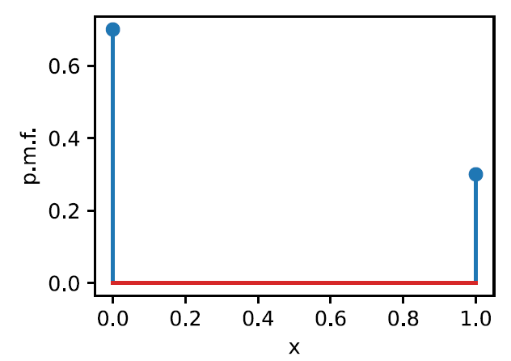
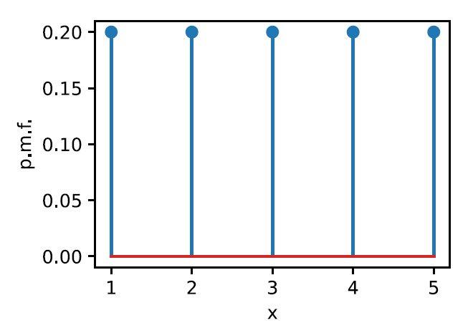
Probability Distributions
Probability
Bernoulli distribution
Binary random variable $X$with states $\left\{0, 1\right\}$
E.g., the random variable can encode a coin flip which comes up 1 with probability p and 0 with probability $1−p$
Notation: $X∼Bernoulli\left(p\right)$
Uniform distribution
The probability of each value $i∈\left\{1,2,…,n\right\}$is $p_{i}=\frac{1}{n}$
Notation: $X∼U\left(n\right)$
Figure: $n=5, p=0.2$
$$p=0.3$$
Picture from: http://d2l.ai/chapter_appendix-mathematics-for-deep-learning/distributions.html

Slide 84
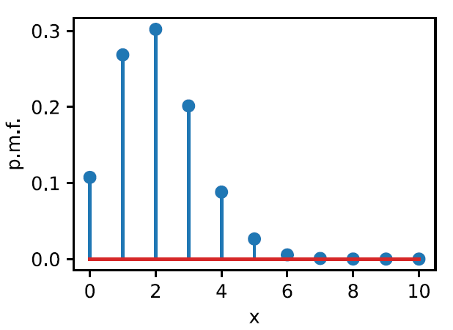
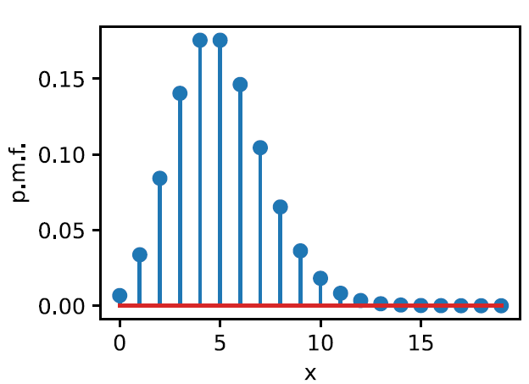
Probability Distributions
Probability
Binomial distribution
Performing a sequence of n independent experiments, each of which has probability p of succeeding, where $p∈\left\{0, 1\right\}$
E.g., tossing a coin 100 times, head probability is 0.5
The probability of getting k successes in n trials is $P\left(X=k\right)={\left(\begin{matrix}n \\ k\end{matrix}\right)p}^{k}{\left(1−p\right)}^{n−k}$
Notation: $X∼Binomial\left(n,p\right)$
Poisson distribution
A number of events occurring independently in a fixed interval of time with a known rate $λ$
E.g., number of arriving patients in ER
A discrete random variable $X$ with states $k∈ \left\{0, 1, 2,…\right\}$has probability $P\left(X=k\right)=\frac{λ^{k}∙e^{−λ}}{k!}$
The rate $λ$ is the average number of occurrences of the event
Notation: $X∼Poisson\left(λ\right)$
$$n=10, p=0.2$$
$$λ=5$$
Picture from: http://d2l.ai/chapter_appendix-mathematics-for-deep-learning/distributions.html

Slide 85
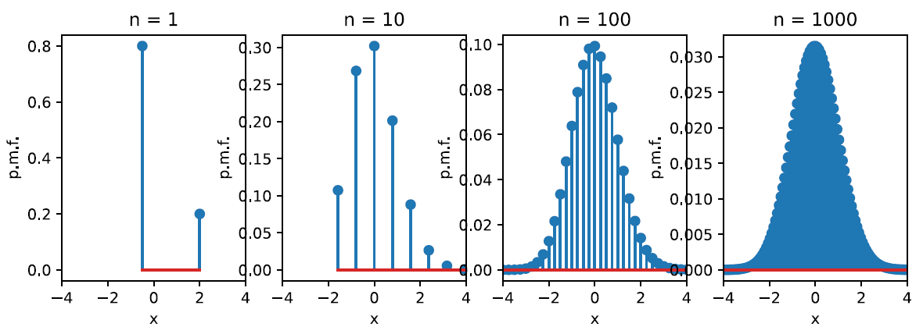
Probability Distributions
Probability
Gaussian distribution
The most well-studied distribution
Referred to as normal distribution or informally bell-shaped distribution
Defined with the mean $μ$ and variance $σ^{2}$
Notation: $X∼𝒩\left(μ,σ^{2}\right)$
For a random variable $X$ with n independent measurements, the density is
$$P_{X}\left(x\right)=\frac{1}{\sqrt{2πσ^{2}}}e^{−\frac{{\left(x−μ\right)}^{2}}{2σ^{2}}}$$
E.g., shown below is a Binomial distribution; as the number of experiments increases from 1 to 1000, it yields a Gaussian distribution
Central limit theorem: the distribution of the mean of samples approximates a normal distribution as the sample size becomes larger
Picture from: http://d2l.ai/chapter_appendix-mathematics-for-deep-learning/distributions.html

Slide 86
Probability Distributions
Probability
Multinoulli distribution
It is an extension of the Bernoulli distribution, from binary class to multi-class
Multinoulli distribution is also called categorical distribution or generalized Bernoulli distribution
Multinoulli is a discrete probability distribution that describes the possible results of a random variable that can take on one of k possible categories
A categorical random variable is a discrete variable with more than two possible outcomes (such as the roll of a die)
For example, in multi-class classification in machine learning, we have a set of data examples $\left\{x_{1},x_{2},…,x_{n}\right\}$, and corresponding to the data example $x_{i}$ is a k-class label $y_{i}=\left\{y_{i1},y_{i2},…,y_{ik}\right\}$ representing one-hot encoding
One-hot encoding is also called 1-of-k vector, where one element has the value 1 and all other elements have the value 0
Let’s denote the probabilities for assigning the class labels to a data example by $\left\{p_{1},p_{2},…,p_{k}\right\}$
We know that $0≤p_{j}≤1$ and $\sum{p_{j}=1}$ for the different classes $j=1, 2, …,k$
The multinoulli probability of the data example $x_{i}$ is $P\left(x_{i}\right)={p_{1}}^{y_{i1}}∙{p_{2}}^{y_{i2}}⋯{p_{k}}^{y_{ik}}=\prod_{j}{{p_{j}}^{y_{ij}}}$
Similarly, we can calculate the probability of all data examples as $\prod_{i}{\prod_{j}{{p_{j}}^{y_{ij}}}}$

Slide 87
Information Theory
Information Theory
Information theory studies encoding, decoding, transmitting, and manipulating information
It is a branch of applied mathematics that revolves around quantifying how much information is present in different signals
As such, information theory provides fundamental language for discussing the information processing in computer systems
E.g., machine learning applications use the cross-entropy loss, derived from information theoretic considerations
A seminal work in this field is the paper A Mathematical Theory of Communication by Clause E. Shannon, which introduced the concept of information entropy for the first time
Information theory was originally invented to study sending messages over a noisy channel, such as communication via radio transmission

Slide 88
Self-information
Information Theory
The basic intuition behind information theory is that learning that an unlikely event has occurred is more informative than learning that a likely event has occurred
E.g., a message saying “the sun rose this morning” is so uninformative that it is unnecessary to be sent
But, a message saying “there was a solar eclipse this morning” is very informative
Based on that intuition, Shannon defined the self-information of an event $X$ as
$$I\left(X\right)=−log\left(P\left(X\right)\right)$$
$I\left(X\right)$ is the self-information, and$P\left(X\right)$ is the probability of the event $X$
The self-information outputs the bits of information received for the event $X$
For example, if we want to send the code “0010” over a channel
The event “0010” is a series of codes of length n (in this case, the length is $n=$4)
Each code is a bit (0 or 1), and occurs with probability of $\frac{1}{2}$; for this event $P=\frac{1}{2^{n}}$
$$I\left("0010"\right)=−log\left(P\left("0010"\right)\right)=−log\left(\frac{1}{2^{4}}\right)=−\log_{2}\left(1\right)+\log_{2}\left(2^{4}\right)=0+4=4 bits$$

Slide 89
Entropy
Information Theory
For a discrete random variable $X$ that follows a probability distribution $P$ with a probability mass function $P(X)$, the expected amount of information through entropy (or Shannon entropy) is
$$H\left(X\right)= 𝔼_{X\sim P}\left[I\left(X\right)\right]=−𝔼_{X\sim P} [log⁡P(X)]$$
Based on the expectation definition $𝔼_{X\sim P}\left[f\left(X\right)\right]=\sum_{X}{P\left(X\right)f\left(X\right)}$, we can rewrite the entropy as
$H\left(X\right)= −\sum_{X}{P\left(X\right)}$ $\log{P\left(X\right)}$
If $X$ is a continuous random variable that follows a probability distribution $P$ with a probability density function $P(X)$, the entropy is
$$H\left(X\right)= −\int_{X}{P\left(X\right)\log{P\left(X\right)}dX}$$
For continuous random variables, the entropy is also called differential entropy

Slide 90
Entropy
Information Theory
Intuitively, we can interpret the self-information ($I\left(X\right)=−log\left(P(X)\right)$) as the amount of surprise we have at seeing a particular outcome
We are less surprised when seeing a more frequent event
Similarly, we can interpret the entropy ($H\left(X\right)= 𝔼_{X\sim P}\left[I\left(X\right)\right]$) as the average amount of surprise from observing a random variable $X$
Therefore, distributions that are closer to a uniform distribution have high entropy
Because there is little surprise when we draw samples from a uniform distribution, since all samples have similar values

Slide 91
Kullback–Leibler Divergence
Information Theory
Kullback-Leibler (KL) divergence (or relative entropy) provides a measure of how different two probability distribution are
For two probability distributions $P(X)$and $Q\left(X\right)$ over the same random variable $X$, the KL divergence is
$$D_{KL}\left(P||Q\right)= 𝔼_{X\sim P}\left[\log{\frac{P(X) }{Q\left(X\right)}}\right]$$
For discrete random variables, this formula is equivalent to
$D_{KL}\left(P||Q\right)=\sum_{X}{P\left(X\right)}$ $\log{\frac{P(X) }{Q\left(X\right)}}$
KL divergence can be considered as the amount of information lost when the distribution $Q$ is used to approximate the distribution $P$

Slide 92
Kullback–Leibler Divergence
Information Theory
KL divergence is non-negative: $D_{KL}\left(P||Q\right)≥0$
$D_{KL}\left(P||Q\right)=0$ if and only if $P(X)$ and $Q\left(X\right)$ are the same distribution
The most important property of KL divergence is that it is non-symmetric, i.e.,
$$D_{KL}\left(P||Q\right)≠D_{KL}\left(Q||P\right)$$
Because $D_{KL}$ is non-negative and measures the difference between distributions, it is often considered as a “distance metric” between two distributions
However, KL divergence is not a true distance metric, because it is not symmetric
The asymmetry means that there are important consequences to the choice of whether to use $D_{KL}\left(P||Q\right)$ or $D_{KL}\left(Q||P\right)$
An alternative divergence which is non-negative and symmetric is the Jensen-Shannon divergence, defined as
$$D_{JS}\left(P||Q\right)=\frac{1}{2}D_{KL}\left(P||M\right){+\frac{1}{2}D}_{KL}\left(Q||M\right)$$
In the above, M is the average of the two distributions, $M=\frac{1}{2}\left(P+Q\right)$

Slide 93
Cross-entropy
Information Theory
Cross-entropy is closely related to the KL divergence, and it is defined as the summation of the entropy $H\left(P\right)$ and KL divergence $D_{KL}\left(P||Q\right)$
$${CE\left(P,Q\right)=H\left(P\right)+D}_{KL}\left(P||Q\right)$$
Alternatively, the cross-entropy can be written as
$$CE\left(P,Q\right)=−𝔼_{X\sim P} [log⁡Q(X)]$$
In machine learning, let’s assume a classification problem based on a set of data examples $\left\{x_{1},x_{2},…,x_{n}\right\}$, that need to be classified into k classes
For each data example $x_{i}$ we have a class label $y_{i}$
The true labels $y$follow the true distribution $P$
The goal is to train a classifier (e.g., a NN) parameterized by $θ$, that outputs a predicted class label ${\hat{y}}_{i}$ for each data example $x_{i}$
The predicted labels $\hat{y}$follow the estimated distribution $Q$
The cross-entropy loss between the true distribution $P$ and the estimated distribution $Q$ is calculated as: $CE\left(y,\hat{y}\right)=−𝔼_{X\sim P} \left[\log{Q\left(X\right)}\right]=−\sum_{X}{P\left(X\right)\log{Q\left(X\right)=}}−\sum_{i}{y_{i}log{{\hat{y}}_{i}}}$
The further away the true and estimated distributions are, the greater the cross-entropy loss is

Slide 94
References
A. Zhang, Z. C. Lipton, M. Li, A. J. Smola, Dive into Deep Learning, https://d2l.ai, 2020.
I. Goodfellow, Y. Bengio, A. Courville, Deep Learning, MIT Press, 2017.
M. P. Deisenroth, A. A. Faisal, C. S. Ong, Mathematics for Machine Learning, Cambridge University Press, 2020.
Jeff Howbert — Machine Learning Math Essentials presentation
Brian Keng – Manifolds: A Gentle Introduction blog
Martin J. Osborne – Mathematical Methods for Economic Theory (link)

Slide 95
Appendix
(Not required for quizzes or assignments)

Slide 96
Maximum Likelihood
Information Theory
Cross-entropy is also related to the maximum likelihood estimation
In ML, we want to find a model with parameters $θ$ that maximize the probability that the data is assigned the correct class, i.e., ${argmax}_{θ}{P\left(model | data\right)}$
For the classification problem from previous page, we want to find parameters $θ$ so that for the data examples $\left\{x_{1},x_{2},…,x_{n}\right\}$ the probability of outputting class labels $\left\{y_{1},y_{2},…,y_{n}\right\}$ is maximized
I.e., for some data examples, the predicted class ${\hat{y}}_{j}$ will be different than the true class $y_{j}, but$ the goal is to find $θ$ that results in an overall maximum probability
From Bayes’ theorem, $\operatorname{argmax}{P\left(model | data\right)}$ is proportional to $\operatorname{argmax}{P\left(data | model\right)}$
$$P\left(θ|x_{1},x_{2},…,x_{n}\right)=\frac{P\left(x_{1},x_{2},…,x_{n}|θ\right) P\left(θ\right)}{P\left(x_{1},x_{2},…,x_{n}\right)}{ }$$
This is true since $P\left(x_{1},x_{2},…,x_{n}\right)$ does not depend on the parameters $θ$
Also, we can assume that we have no prior assumption on which set of parameters $θ$are better than any others
Recall that $P\left(data|model\right)$is the likelihood, therefore, the maximum likelihood estimate of $θ$ is based on solving
$$\underset{θ}{arg max}{P\left(x_{1},x_{2},…,x_{n}|θ\right)}$$

Slide 97
Maximum Likelihood
Information Theory
For a total number of n observed data examples $\left\{x_{1},x_{2},…,x_{n}\right\}$, the predicted class labels for the data example $x_{i}$ is ${\hat{y}}_{i}$
Using the multinoulli distribution, the probability of predicting the true class label $y_{i}=\left\{y_{i1},y_{i2},…,y_{ik}\right\}$ is $𝒫\left(x_{i} |θ\right)=\prod_{j}{{{\hat{y}}_{ij}}^{y_{ij}}}$, where $j∈\left\{1,2,…,k\right\}$
E.g., we have a problem with 3 classes $[car, house, tree]$, and an image of a car $x_{i}$, the true label $y_{i}=\left[1,0,0\right]$, and let’s assume a predicted label ${\hat{y}}_{i}=\left[0.7, 0.1, 02\right]$, then the probability is $𝒫\left(x_{i} |θ\right)=\prod_{j}{{{\hat{y}}_{ij}}^{y_{ij}}}={0.7}^{1}∙{0.1}^{0}∙{0.2}^{0}=0.7∙1∙1=0.7$
Assuming that the data examples are independent, the likelihood of the data given the model parameters $θ$ can be written as $𝒫\left(x_{1},x_{2},…,x_{n}|θ\right)=𝒫\left(x_{1}|θ\right)⋯𝒫\left(x_{n} |θ\right)$ $=\prod_{j}{{{\hat{y}}_{1j}}^{y_{1j}}∙\prod_{j}{{{\hat{y}}_{2j}}^{y_{2j}}⋯}}\prod_{j}{{{\hat{y}}_{nj}}^{y_{nj}}}=\prod_{i}{\prod_{j}{{{\hat{y}}_{ij}}^{y_{ij}}}}$
Log-likelihood is often used because it simplifies numerical calculations, since it transforms a product with many terms into a summation, e.g., $\log\left({a_{1}}^{b_{1}}∙{a_{2}}^{b_{2}}\right)=b_{1}log\left(a_{1}\right)+b_{2}log\left(a_{2}\right)$
$log 𝒫\left(x_{1},x_{2},…,x_{n}|θ\right)=\log\left(\prod_{i}{\prod_{j}{{{\hat{y}}_{ij}}^{y_{ij}}}}\right)=\sum_{i}{\sum_{j}{y_{ij}\log{{\hat{y}}_{ij}}}}$
A negative of the log-likelihood allows us to use minimization approaches, i.e., $−log 𝒫\left(x_{1},x_{2},…,x_{n}|θ\right)=−\sum_{i}{\sum_{j}{y_{ij}\log{{\hat{y}}_{ij}}}}=CE\left(y,\hat{ y}\right)$
Thus, maximizing the likelihood is the same as minimizing the cross-entropy

