Slide 1
CS 487/587 Adversarial Machine Learning
Dr. Alex Vakanski

Slide 2
Lecture 4
Evasion Attacks against White-box Machine Learning Models

Slide 3
Lecture Outline
Carlini and Wagner (2017) Towards Evaluating the Robustness of Neural Networks
Papernot et al. (2016) The limitations of deep learning in adversarial settings
Xiao et al. (2018) Spatially Transformed Adversarial Examples
Other white-box evasion attacks
Elastic Net (EAD) attack
One-pixel attack
Universal perturbation attack
NewtonFool attack

Slide 4
Evasion Attacks against White-box Models
Evasion Attacks against White-box Models
So far we covered:
Fast gradient sign method (FGSM) attack
Goodfellow (2015) Explaining and Harnessing Adversarial Examples
$x_{adv}=x+ε∙sign\left(∇_{x}ℒ\left(h\left(x, w\right),y\right)\right)$
Projected gradient descent (PGD) attack
Madry (2017) Towards Deep Learning Models Resistant to Adversarial Attacks
$x_{adv}^{t}=x^{t−1}+α∙sign\left(∇_{x}ℒ\left(h\left(x^{t−1}\right),y\right)\right)$
DeepFool attack
Moosavi-Dezfooli (2015) DeepFool: A Simple and Accurate Method to Fool Deep Neural Networks
Iteratively projects the perturbed image to the hyperplane of the closest class

Slide 5
Carlini-Wagner Paper (C&W Attack)
C&W Attack
Carlini and Wagner attack
Carlini and Wagner (2017) Towards Evaluating the Robustness of Neural Networks
The paper proposed 3 targeted white-box attacks based on different norm metrics:
$L_{∞}$attack
$L_{2}$attack
$L_{0}$attack
These attacks are sometimes referred to as C&W attacks or C-W attacks
At the time of publishing, they were the strongest adversarial attacks
Advantages of proposed approaches:
Low amount of perturbation
Resistance to defense algorithms
Generated adversarial images are transferrable across DL models
I.e., a secured model is not able to detect the adversarial examples
Evaluated on: MNIST, CIFAR-10, and ImageNet

Slide 6
Carlini-Wagner Paper (C&W Attack)
C&W Attack
Notation
Given an image x, a classifier F outputs a vector $y$, i.e., F$\left(x\right)=y$
The paper focuses on NN classifiers
The output y is treated as a probability distribution, where $y_{i}$ is the probability that input x has class i
The assigned class by the classifier is
$$C\left(x\right)={argmax}_{i}\left(y_{i}\right)={argmax}_{i}\left({F(x)}_{i}\right)$$
The correct label (true class label) of x is denoted by $C^{∗}\left(x\right)$
The inputs to the softmax function (i.e., the logits) are denoted by z, where the function transforming to input x to the logits is Z$\left(x\right),$i.e.,
$$F\left(x\right)=softmax\left(Z(x)\right)=softmax\left(z\right)=y$$
Targeted attack: create an image $x′$that is similar to x, such that $C\left(x′\right)=t$, where the target label t is different than the true label $C^{∗}\left(x\right)$, i.e., ${t≠C}^{∗}\left(x\right)$
Untargeted attack: create an image $x′$that is similar to x, such that $C\left(x′\right)≠C^{∗}\left(x\right)$
The paper considers only targeted attacks, as they are more challenging than untargeted attacks

Slide 7
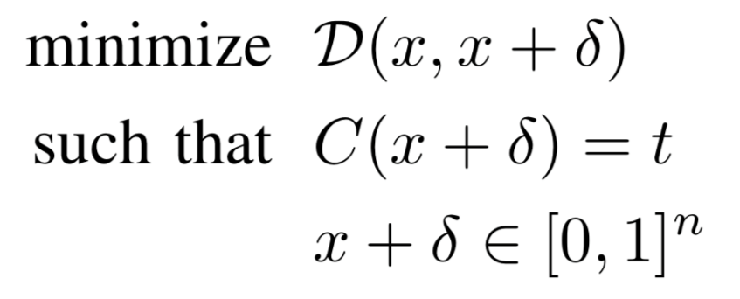
Carlini-Wagner Paper (C&W Attack)
C&W Attack
Initial problem formulation
Create an adversarial image$x′$ by adding small perturbation $δ$to the original image x (i.e., $x′=x+δ$), such that the distance $𝒟\left(x,x′\right)=𝒟\left(x,x+δ\right)$ is minimal
The classifier should assign the class label t to the adversarial image $x′$, where t is different than the true label $C^{∗}\left(x\right)$, i.e., $C\left(x′\right)=C\left(x+δ\right)=t≠C^{∗}\left(x\right)$
The goal is to find $δ$ that minimizes $𝒟\left(x,x+δ\right)$ and $C\left(x+δ\right)=t$
distance between x and x+𝛿
x+𝛿 is classified as target class t
each element of x+𝛿 is in [0,1] (to be a valid image)

Slide 8
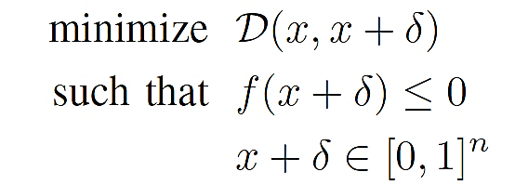
Carlini-Wagner Paper (C&W Attack)
C&W Attack
This initial formulation of the optimization problem for creating adversarial attacks is difficult to solve
Because the constraint $C\left(x+δ\right)=t$ is highly non-linear
Carlini-Wagner propose the following reformulation of the optimization problem, which is solvable
The function f should be chosen such that $C\left(x+δ\right)=t$ if and only if $f\left(x+δ\right)≤0$
These two optimization problems are not identical: the reformulation by Carlini-Wagner just finds an approximated solution to the above problem
Adam optimization algorithm is used for solving the problem

Slide 9
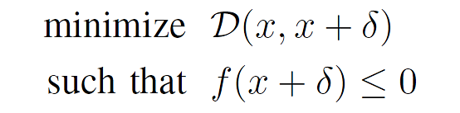
Carlini-Wagner Paper (C&W Attack)
C&W Attack
Recall the solution of constrained optimization problems from Lecture 3 using Lagrange multipliers
The same approach can be applied to the Carlini-Wagner approach, and the optimization problem can be rewritten as shown below
The authors performed a grid search for the value of the parameter c (from 0.01 to 100)
The recommended approach is to select the value of c where $c>0$, for which $f\left(x+δ\right)≤0$ and the distance $𝒟\left(x,x+δ\right)$ is minimal
$$\underset{x}{minimize}{f(x) }$$
$$subject to c_{i}\left(x\right)≤0$$
$$\underset{x}{minimize}{f\left(x\right)+\sum_{i}{α_{i}c_{i}\left(x\right)} }$$

Slide 10
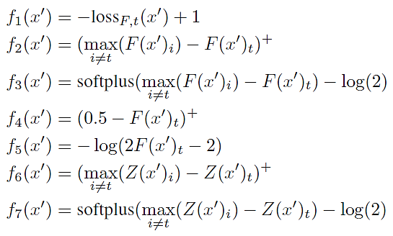
Carlini-Wagner Paper (C&W Attack)
C&W Attack
The authors considered several variants for the function f
In the equations below, ${loss}_{F,t}\left(x′\right)$ is the loss function with respect to the target class t
The class labels are denoted by i
Other notation: ${\left(a\right)}^{+}=max\left(0,a\right)$; $softplus\left(a\right)=log\left(1+e^{a}\right)$
The best results were obtained by the function $f_{6}(x^{′})$

Slide 11
Carlini-Wagner Paper (C&W Attack)
C&W Attack
Explanation of the function $f_{6}(x^{′})$
In f₆ , $Z{\left(x′\right)}_{t}$ is the logits value of the target class t for the perturbed image $x′$
Then, $\max_{i≠t}\left(Z{\left(x′\right)}_{i}\right)$ means the maximum logits values of other class i than the target class t (i.e., $i≠t$)
The function calculates the difference in the logits between the target class t and the closest-to-the-target class
In some papers, this function is referred to as margin loss function
In the paper, a modified function f₆ is also provided
It introduces a confidence value k
The authors set $k=0$
But, if k has a higher value, this will require that any other logits value exceeds the logits value of the true class $Z{\left(x′\right)}_{t}$ at least by k
Examples with large confidence value k have enhanced transferability

Slide 12
Carlini-Wagner Paper (C&W Attack)
C&W Attack
$L_{∞}$attack
The used distance metric is $L_{∞}$ norm, therefore $𝒟\left(x,x+δ\right)={\left\|δ\right\|}_{∞}$
In other words, ${\left\|δ\right\|}_{∞}$ means the pixel in $x′$with the largest change from $x$
The optimization problem becomes:
minimize$𝒟\left(x,x+δ\right)+c∙f\left(x+δ\right)$ minimize${\left\|δ\right\|}_{∞}+c∙f\left(x+δ\right)$
However, this formulation produced poor optimization results, since the term ${\left\|δ\right\|}_{∞}$ penalizes only the largest component of the perturbation vector $δ$
The authors proposed the following optimization method instead
In this case, any component of $δ$ that exceed a threshold value τ is considered, that is, penalize all components of $δ$ that have large values
The value of τ is set initially to 1, and is decreased by a factor of 0.9 after each iteration
I.e., $τ→τ∙0.9$if all $δi<τ$, else terminate the search
minimize$\sum_{i}{\left[{\left(δ_{i}−τ\right)}^{+}\right]}+c∙f\left(x+δ\right)$

Slide 13
Carlini-Wagner Paper (C&W Attack)
C&W Attack
Box constraint
In the optimization problem, the constraint $x+δ∈{\left[0, 1\right]}^{n}$ requires that in the perturbed images, all pixel values are in the [0,1] range
I.e., $0≤x_{i}+δ_{i}≤1$ for all i
This is called a box constraint
Or, these values can within the range [0,255] depending on how the images are scaled
The box constraint can causes difficulties in solving the optimization problem
Simply clipping the values can cause that optimization to get stuck in a flat region
The authors introduced a new variable $w$, such that
${x_{i}+δ}_{i}=\frac{1}{2}\left(tanh\left(w_{i}\right)+1\right)$ $δ_{i}=\frac{1}{2}\left(tanh\left(w_{i}\right)+1\right)−x_{i}$
As we know $−1≤tanh\left(w_{i}\right)≤1$, therefore it follows $0≤x_{i}+δ_{i}≤1$
This change of variables produced more stable optimization results

Slide 14
Carlini-Wagner Paper (C&W Attack)
C&W Attack
$L_{2}$attack
The used distance metric is $L_{2}$ norm, therefore $𝒟\left(x,x+δ\right)={\left\|δ\right\|}_{2}$
Using the variable w for the box-constraint, the optimization problems becomes
minimize ${\left\|δ\right\|}_{2}^{2}+c∙f\left(x+δ\right)$ where
That is, search for w that minimizes the above term
The function f is based on the $f_{6}\left(x^{′}\right)$ variant provided earlier
To avoid the cases when the gradient descent algorithm become stuck in a local minimum, the authors picked multiple random starting points close to the original image x

Slide 15
Carlini-Wagner Paper (C&W Attack)
C&W Attack
$L_{0}$attack
The used distance metric is $L_{0}$ norm, or, the number of non-zero pixels in $δ$
The authors propose an iterative approach
Where the goal at each iteration is to find pixels that are not important and don’t have much effect on the classifier’s output
The iterative procedure includes the following steps:
Initialization: the allowed set includes all pixels in the image
Perform $L_{2}$ attack to find an adversarial example $x+δ$
Compute the gradient $g=∇f\left(x+δ\right)$, where f is the objective function in the $L_{2}$ attack
Identify the least important pixel $i=arg\min_{i} g_{i}δ_{i}$ and remove this pixel from the allowed set
Iterate until the $L_{2}$ attack fails to find an adversarial example
The approach shrinks the set of pixels that are allowed to be changed, until a minimum number of pixels is found that change the class label to the target t

Slide 16
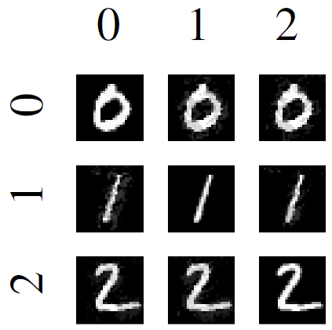
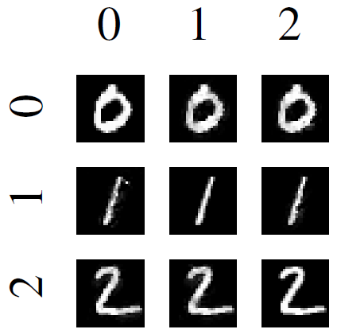
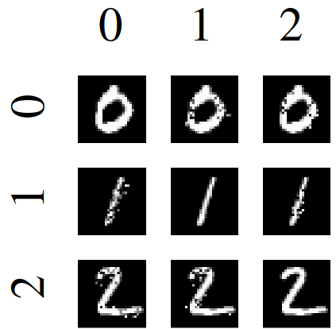
Carlini-Wagner Paper (C&W Attack)
C&W Attack
Results on the MNIST dataset
$L_{∞}$attack
$L_{2}$attack
$L_{0}$attack

Slide 17
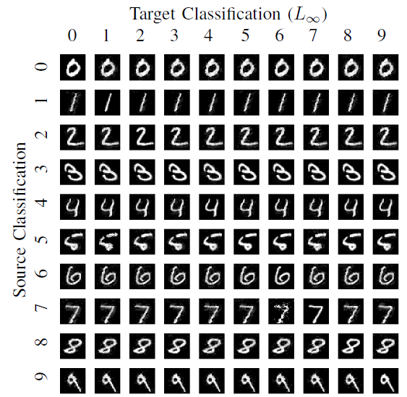
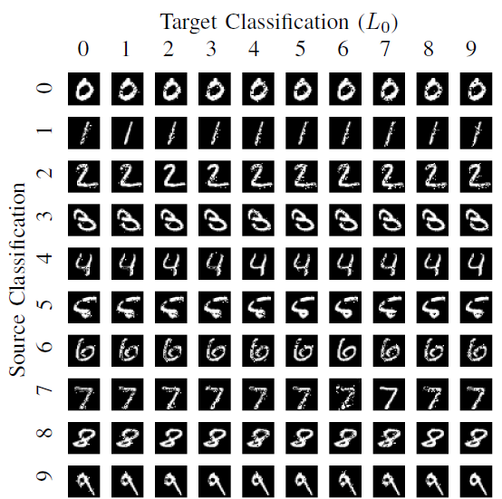
Carlini-Wagner Paper (C&W Attack)
C&W Attack
Results on the MNIST dataset for all 10 digits

Slide 18
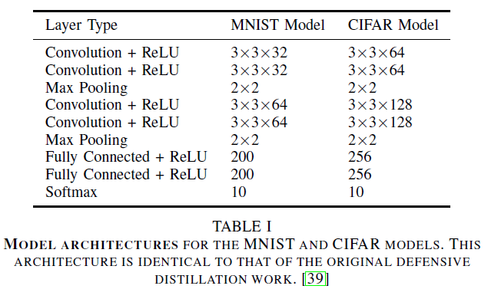
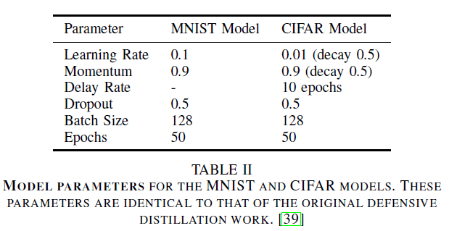
Carlini-Wagner Paper (C&W Attack)
C&W Attack
Three approaches for selecting the target class were evaluated:
Average Case: select the target class uniformly at random among the labels that are not the correct label
Best Case: perform the attack against all incorrect classes, and report the target class that was least difficult to attack
Worst Case: perform the attack against all incorrect classes, and report the target class that was most difficult to attack
The used NN models for MNIST and CIFAR datasets are shown below
For ImageNet the paper used the Inception-v3 network

Slide 19
Carlini-Wagner Paper (C&W Attack)
C&W Attack
Comparison to JSMA (Jacobian-based Saliency Map Attack), DeepFool, Fast Gradient Sign, and Iterative Gradient Sign attacks on the MNIST and CIFAR datasets
Mean is the perturbation size

Slide 20
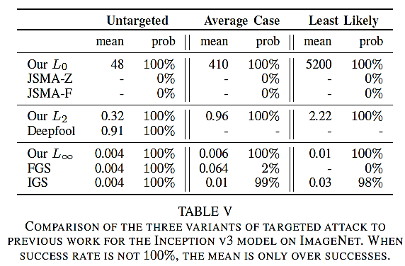
Carlini-Wagner Paper (C&W Attack)
C&W Attack
Validation on the ImageNet dataset

Slide 21
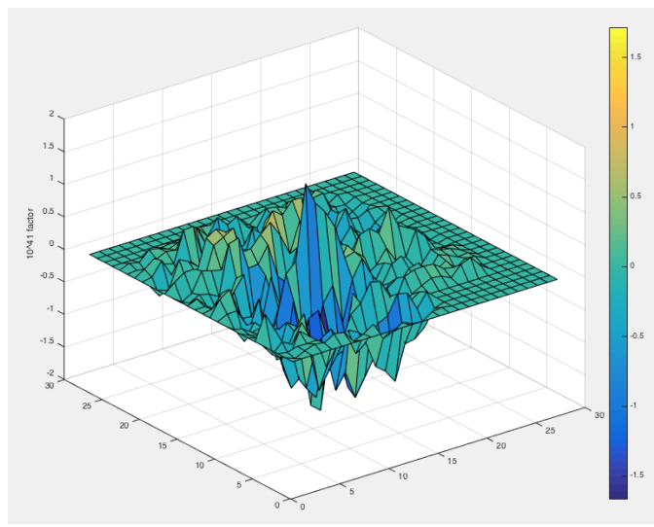
Papernot Paper (JSMA Attack)
JSMA Attack
Jacobian-based Saliency Map Attack (JSMA)
Papernot et al. (2016) The limitations of deep learning in adversarial settings
Targeted white-box attack based on controlling the $L_{0}$ norm
The goal is to iteratively change each pixel until misclassification
The key step is calculation of a saliency map that determines which pixels to be modified, in order to increase the probability of the target class
Compute$∇F\left(X\right)$
Modify input $X$
Jacobian matrix
Pixels with large saliency values have large impact on the output when perturbed
Create a Saliency Map

Slide 22
JSMA Attack Approach
JSMA Attack
Notation:
$X$ – clean (benign) input sample
$Y=F(X)$ – output of a classification model (e.g., NN) given with a function $F$
$X^{∗}$ – adversarial sample, obtained by manipulating the clean sample $X$
$Y^{∗}$ – target output (class label) for the adversarial sample, i.e.,$Y^{∗}=F\left(X^{∗}\right)$
$θ$ – amount of perturbation that is applied to input features (i.e., pixels in images)
$Υ$ – maximum distortion that is applied to the input (e.g., number of pixel in the input image that the adversary is allowed to change)
JSMA attack steps:
Step 1: compute the forward derivative $∇F\left(X^{∗}\right)$ of the NN
Step 2: construct an adversarial saliency map S based on the forward derivative $∇F\left(X^{∗}\right)$
Step 3: modify the most impactful input features $i_{max}$ by $θ$

Slide 23
JSMA Attack Approach
JSMA Attack
Step 1: compute the forward derivative $∇F\left(X^{∗}\right)$ of the NN
For input vectors to the NN of size M, and outputs of the NN of size N (i.e., N class classification), the function of the NN is the mapping $F:ℝ^{M}→ℝ^{N}$
Therefore, the forward gradient is the Jacobian matrix of the function $F$ , given with the first-order partial derivatives of the outputs $F\left(X^{∗}\right)$ with respect to the inputs $X^{∗}$, i.e.,
$$∇F\left(X^{∗}\right)=\left[\begin{matrix}\frac{∂F_{1}\left(X^{∗}\right)}{∂x_{1}} & ⋯ & \frac{∂F_{1}\left(X^{∗}\right)}{∂x_{M}} \\ ⋮ & ⋱ & ⋮ \\ \frac{∂F_{N}\left(X^{∗}\right)}{∂x_{1}} & … & \frac{∂F_{N}\left(X^{∗}\right)}{∂x_{M}}\end{matrix}\right]$$
Each element in the Jacobian matrix (i.e., the forward derivative) $∇F$of an NN given with function $F$ can be computed for any input $X$ by successively differentiating layers, starting from the input layer until the output layer is reached

Slide 24
JSMA Attack Approach
JSMA Attack
Step 2: construct an adversarial saliency maps S based on the forward derivative $∇F\left(X^{∗}\right)$
Saliency maps are employed in Explainable Machine Learning, to indicate which pixels in an image contributed the most to the predicted class by a NN
Adversarial saliency maps can be used to indicate which pixels in an image an adversary should perturb in order to impact the predicted class by a NN
An example of a saliency map for a 28×28 pixels image is shown below
The pixels with large peaks or valleys have significant impact on the predicted class

Slide 25
JSMA Attack Approach
JSMA Attack
Step 3: modify the most impactful input pixels by $θ$
Once the most impactful input pixels in the saliency map have been identified, they are perturbed by $θ$ in order to realize the adversary’s goal
E.g., $θ$ are discrete steps applied to change the pixel intensities
The algorithm perturbs 2 most impactful pixels at each step
Afterward, all steps are repeated until:
The adversarial sample $X^{∗}$ is classified with the target class $Y^{∗}$, or
The maximum number of iterations is reached, or
The maximum number of pixels $Υ$are perturbed

Slide 26
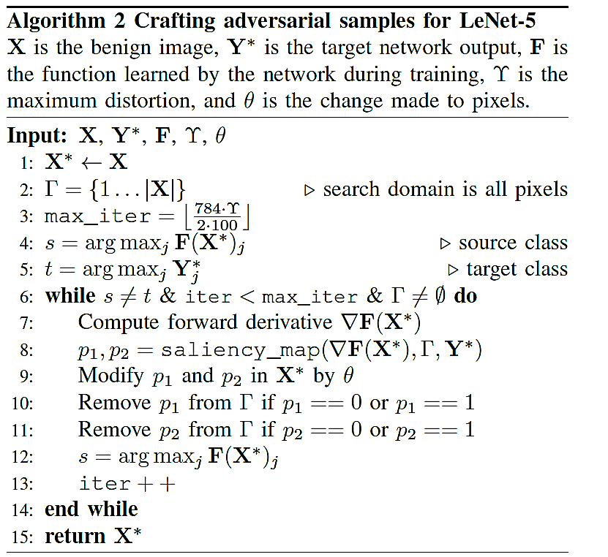
JSMA Attack Approach
JSMA Attack
The entire JSMA algorithm:

Slide 27
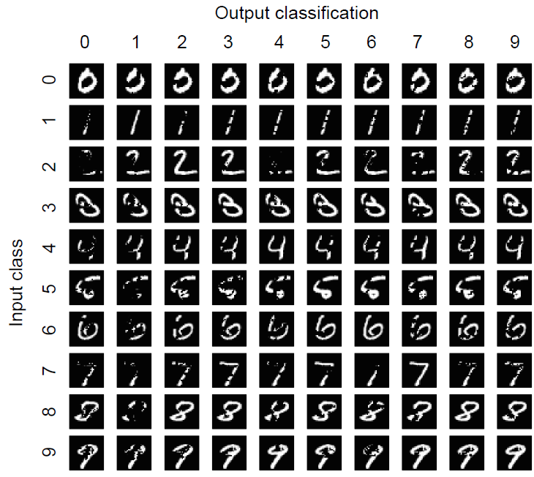
JSMA Attack Results
JSMA Attack
Samples of attacked MNIST images with JSMA

Slide 28
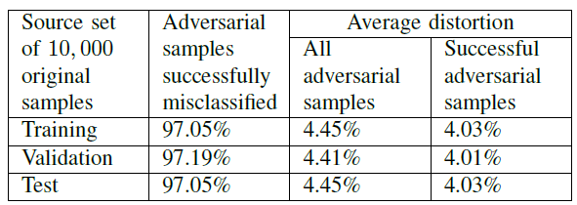
JSMA Attack Results
JSMA Attack
JSMA attack was validated on the MNIST dataset using the LeNet deep model
The attack achieved a success rate of 97.05% while perturbing on average 4.03% of the pixels in images

Slide 29
JSMA Attack
JSMA Attack
Difference to other approaches:
JSMA calculates a mapping between the perturbations of input pixels and the predicted output of the model
JMSA uses the forward propagated derivatives of the model function with respect to the input pixels
The forward propagated derivatives form the Jacobian matrix $∇F\left(X\right)$
FGSM, PGD work by calculating the mapping between the predicted output by the model and the inputs
These models use the backward propagated derivatives of the loss function with respect to the input pixels $∇𝓛\left(X\right)$

Slide 30
Xiao, Li, Song Paper (stAdv Attack)
stAdv Attack
stAdv attack
Xiao, Zhu, Li, He, Liu, Song (2018) Spatially Transformed Adversarial Examples
The paper proposes an attack that does not manipulate the pixel intensity values under an $L_{p}$norm
Instead, the pixels are spatially moved in an image to create an adversarial example
Such attack can result in a large $L_{p}$ distance between the original and manipulated images
Still, the images are perceptually realistic
The perturbed images are effective against defense algorithms
The approach minimizes the local geometric distortion of images
Validation: MNIST, CIFAR-10, and ImageNet datasets

Slide 31
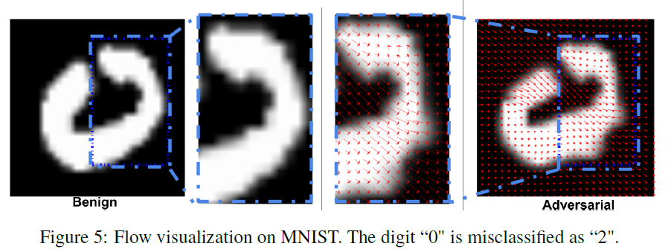
Spatial Transformation Attack
stAdv Attack
Example of a spatially transformed image
The red flow arrows indicate the local displacement of the pixels in adversarial image to the pixels in the input image

Slide 32
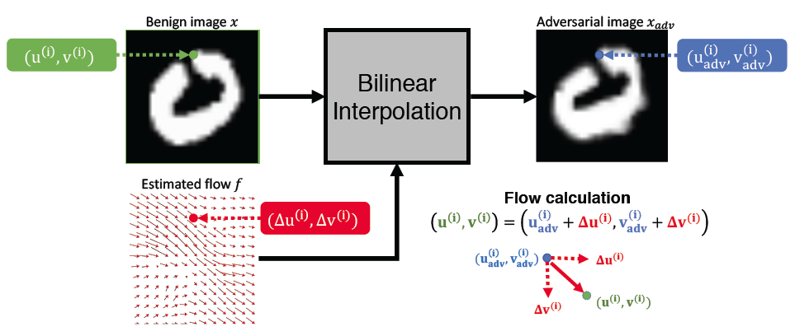
Spatial Transformation Attack
stAdv Attack
Green color – the pixel i in the input (benign, clean) image
Blue color – the spatially displaced pixel i in the adversarial image
Red arrows – the displacement flow f: horizontal (${∆u}^{(i)}$) and vertical (${∆v}^{(i)}$)
Goal: find an adversarial image with lowest overall displacement $f_{i}=\left({∆u}^{(i)}\text{,} {∆v}^{(i)}\right)$

Slide 33
Spatial Transformation Attack
stAdv Attack
A targeted white-box attack is considered
The problem is formulated as an optimization problem, that is very similar to the Carlini-Wagner paper
For an image x, find the minimum local distortion $f^{∗}$, such that
The term $ℒ_{adv}$ encourages the distorted image to be misclassified as the target class t
The term $ℒ_{flow}$ ensure that the spatial transformation is preserved
τ is a constant that balances the two terms (set to 0.05 for validation)
The authors adopted the $f_{6}\left(x^{′}\right)$ function from Carlini-Wagner for the term $ℒ_{adv}$
That maximizes the logits values of the target class t with respect to other classes

Slide 34
Spatial Transformation Attack
stAdv Attack
The term $ℒ_{flow}$ is calculated as the sum of spatial movement distance for any two adjacent pixels p and q
This makes the stAdv approach computationally expensive, because it require calculating the distances for all pairs of neighboring pixels
The optimization problem is solved using the L-BFGS algorithm (Limited-memory BFGS (Broyden–Fletcher–Goldfarb–Shanno))

Slide 35
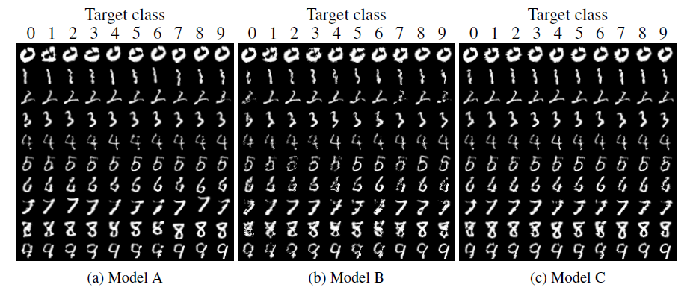
Spatial Transformation Attack
stAdv Attack
Validation on MNIST for three different NN model architectures A, B, and C
Accuracy (p) means the model classification accuracy on pristine (original) images

Slide 36
Spatial Transformation Attack
stAdv Attack
For CIFAR-10 images, they used ResNet32 and Wide ResNet34
Comparison of adversarial examples generated by FGSM, C&W, and stAdv
Left: MNIST, right: CIFAR-10
The generated images by stAdv attack have high perceptual quality

Slide 37
Spatial Transformation Attack
stAdv Attack
Flow visualization on ImageNet
(a): the original image, (b)-(c): images are misclassified into goldfish, dog and cat
Although there are other objects within the image (e.g., trees), most spatial transformation flows focus on the target object – mountain bike
Human participants on Amazon Mechanical Turk (AMT) were recruited to analyze the visual perceptibility of attacked images
The users selected the attacked images as visually realistic

Slide 38
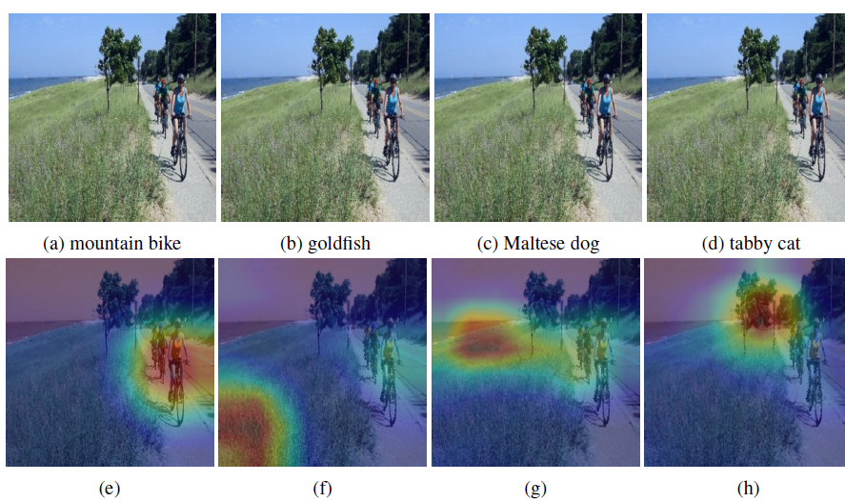
Spatial Transformation Attack
stAdv Attack
Further analysis includes visualizing the salliency maps of images
I.e., find the regions in the images where the model pays the most attention for assigning a particular class to an images
Class Activation Mapping (CAM) was used for this purpose
stAdv attack misleads the model to pay attention to different regions than the bike

Slide 39
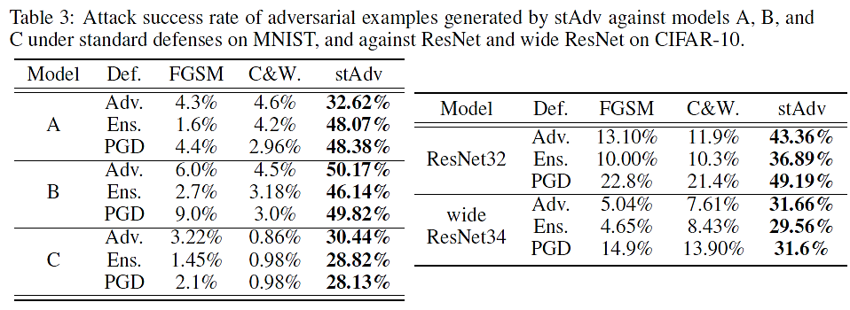
Spatial Transformation Attack
stAdv Attack
Attack evaluation under three defense methods: FGSM adversarial training (Adv.), ensemble adversarial training (Ens.), and PGD adversarial training (PGD)

Slide 40
Elastic-Net Attack
Other White-box Evasion Attacks
Elastic Net (EAD) Attack
Chen et al. (2017) EAD: Elastic-net attacks to deep neural networks via adversarial examples
Modification of the C&W attack for controlling the $L_{1}$ norm of adversarial perturbations
Recall than C&W proposed 3 attacks for controlling the $L_{0}$, $L_{2}$, and $L_{∞}$ norms
EAD attack produced visually plausible adversarial samples

Slide 41
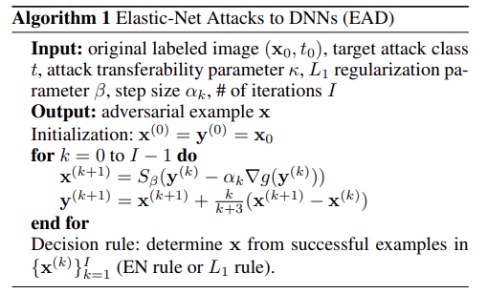
Elastic-Net Attack
Other White-box Evasion Attacks
EAD is based on elastic-net regularization (recall from Lecture 2, it uses both $ℓ_{1}$and $ℓ_{2}$ penalties on the model parameters)
The solved optimization problem is (compare to C&W):
EAD employs a box constraint based on Iterative Shrinkage-Thresholding Algorithm (ISTA)

Slide 42
Elastic-Net Attack
Other White-box Evasion Attacks
Elastic-Net attack produces low perturbations in experimental validation on MNIST, CIFAR-10, and ImageNet
ASR is Attack Success Rate
Compared are two EAD approaches: EN rule (uses elastic net regularization) and L₁ rule (uses only L₁ regularization)
EAD achieved the lowest L₁ perturbation

Slide 43
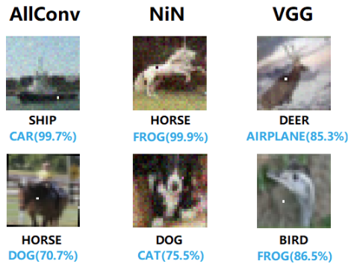
One-Pixel Attack
Other White-box Evasion Attacks
One-pixel Attack
Su et al. (2019) One pixel attack for fooling deep neural networks
Attack under the $L_{0}$ norm to limit the number of pixels allowed to be changed
One-pixel attack employs Differential Evolution-based optimization for creating adversarial examples
It shows that on CIFAR-10 dataset, most samples can be attacked in an untargeted manner by changing the value of only one pixel

Slide 44
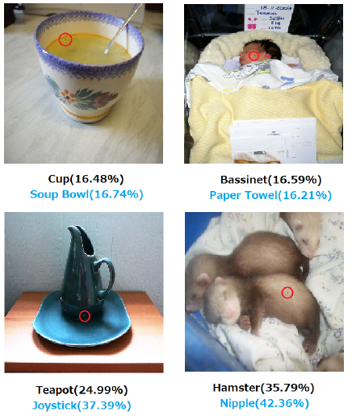
One-Pixel Attack
Other White-box Evasion Attacks
One-pixel attack on ImageNet
The modified pixels are highlighted with red circles

Slide 45
One-Pixel Attack
Other White-box Evasion Attacks
Validation results on CIFAR-10 dataset using 4 type of DL models: AllConv (all convolutional network), NIN (network in network), VGG16, and BVLS AlexNet
OriginalAcc is accuracy on clean images
Targeted and Non-targeted is the accuracy for adversarial samples with target class and random class, respectively

Slide 46
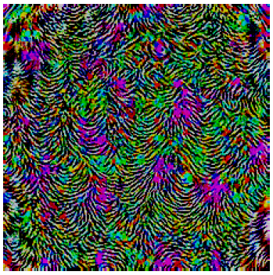
Universal Attack
Other White-box Evasion Attacks
Universal Attack
Moosavi-Dezfooli (2017) Universal adversarial perturbations
Universal attack is based on an algorithm that finds a single perturbation $δ$ which can be added to almost all test images in a dataset
This means that NN classifiers have inherent weakness on all input samples
The authors were able to attack 85.4% of the samples in the ImageNet dataset by using ResNet-152 model
E.g., the universal perturbation that can be added to any image of the dataset and be misclassified by ResNet-152 with a high confidence is shown below

Slide 47
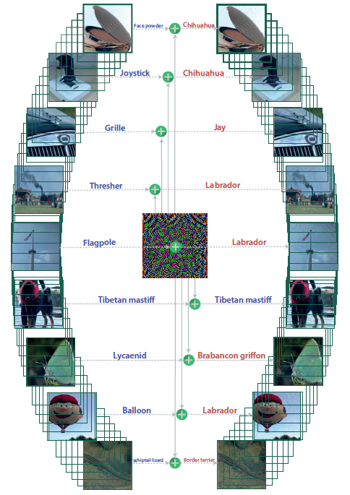
Universal Attack
Other White-box Evasion Attacks
Examples of clean (left) and adversarial (right) images under the universal attack
The universal perturbation image is shown in the center

Slide 48
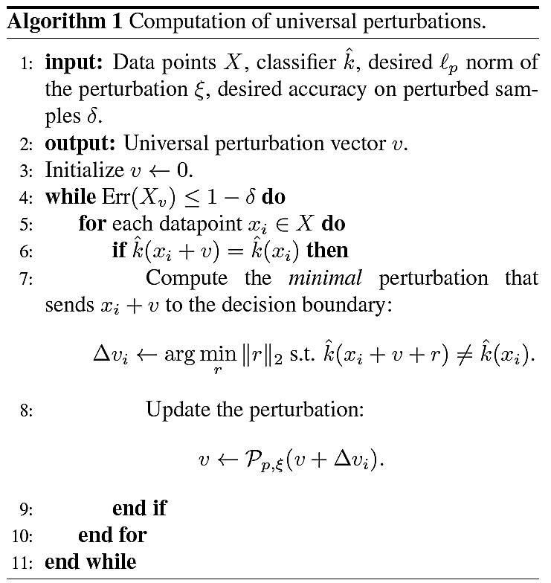
Universal Attack
Other White-box Evasion Attacks
Universal attack approach
The algorithm iteratively finds perturbation $v$ that moves one input image at a time toward the decision boundary

Slide 49
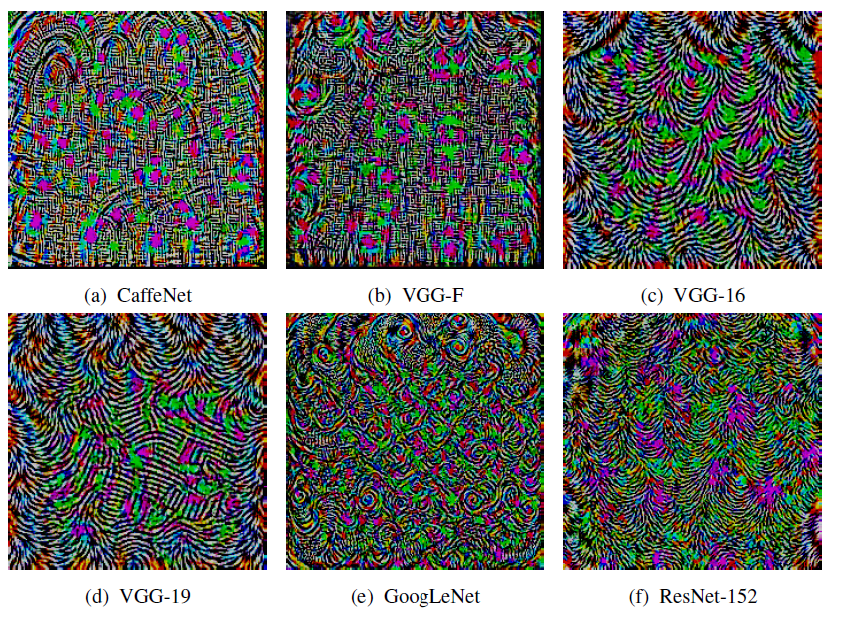
Universal Attack
Other White-box Evasion Attacks
Performance by the universal attack on different NN models for ImageNet dataset, and the perturbations for each model
Set X (used to compute the universal perturbation), set Val. (validation set that is not used to compute the perturbation)

Slide 50
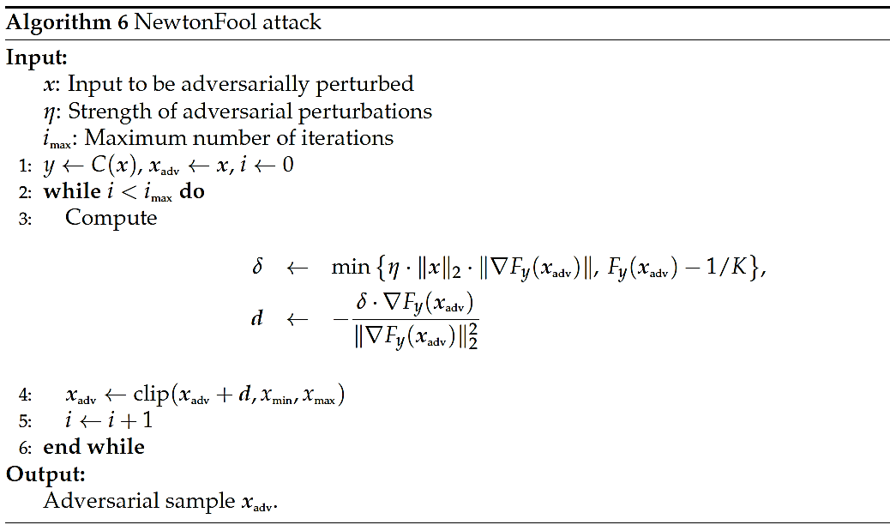
NewtonFool Attack
Other White-box Evasion Attacks
NewtonFool Attack
Jang et al. (2017) Objective metrics and gradient descent algorithms for adversarial examples in machine learning
The approach is similar to iterative FGSM attacks (e.g., PGD)
It performs iterative gradient descent with an adaptive step size

Slide 51
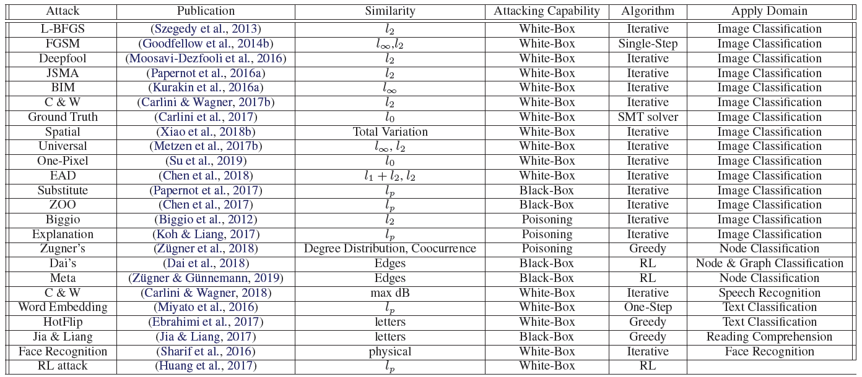
List of Adversarial Attacks
Table from: Xu et al. (2019) - Adversarial Attacks and Defenses in Images, Graphs and Text: A Review

Slide 52
Additional References
Nicolae et al. (2019) Adversarial Robustness Toolbox v1.0.0. https://arxiv.org/abs/1807.01069
Xu et al. (2019) Adversarial Attacks and Defenses in Images, Graphs and Text: A Review https://arxiv.org/abs/1909.08072

