Slide 1
CS 487/587 Adversarial Machine Learning
Dr. Alex Vakanski

Slide 2
Lecture 5
Evasion Attacks against Black-box Machine Learning Models

Slide 3
Lecture Outline
Bhagoji et al. (2017) Exploring the Space of Black-box Attacks on Deep Neural Networks
Brendel et al. (2018) Decision-Based Adversarial Attacks: Reliable Attacks Against Black-Box Machine Learning Models
Transferability in Adversarial Machine Learning
Substitute model attack
Ensemble of local models attack
Other black-box evasion attacks
HopSkipJump attack
ZOO attack
Simple black-box attack

Slide 4
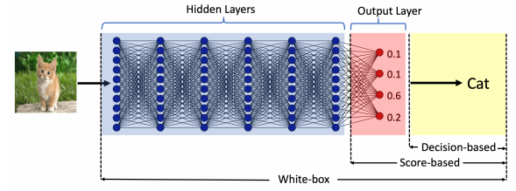
Evasion Attacks against Black-box Models
Black-box Evasion Attacks
Black-box adversarial attacks can be classified into two categories:
Query-based attacks
The adversary queries the model and creates adversarial examples by using the provided information to queries
The queried model can provide:
Output class probabilities (i.e., confidence scores per class) used with score-based attacks
Output class, used with decision-based attacks
Transfer-based attacks (or transferability attacks)
The adversary does not query the model
The adversary trains its own substitute/surrogate local model, and transfers the adversarial examples to the target model
This type of approaches are also referred to as zero queries attacks

Slide 5
Gradient Estimation Attack
Gradient Estimation Attack
Bhagoji, He, Li, Song (2017) Exploring the Space of Black-box Attacks on Deep Neural Networks
The paper introduces an approach known as Gradient Estimation attack
Score-based black-box attack
Based on query access to the model’s class probabilities
Both targeted and untargeted attacks are achieved
Validated on MNIST and CIFAR-10 datasets
The attack is also evaluated on real-world models hosted by Clarifai
Advantages:
Outperformed other black-box attacks
Performance results are comparable to white-box attacks
Good results against adversarial defenses

Slide 6
Gradient Estimation Attack
Gradient Estimation Attack
Gradient Estimation (GE) approach
Uses queries to directly estimate the gradient and carry out black-box attacks
The output to a query is the vector of class probabilities $p^{f}(x)$ (i.e., confidence scores per class) for an input x
The logits can also be recovered from the probabilities, by taking $log\left(p^{f}\left(x\right)\right)$
The authors employed the method of finite differences for gradient estimation
Let $g(x)$ is a function whose gradient needs to be estimated
Finite difference (FD) estimation of the gradient of g with respect to input x is given by
$δ$is a parameter that controls the estimation accuracy (selected 0.01 or 1)
$e_{i}$ are basis vectors such that $e_{i}$ is 1 only for the i^{th} component and 0 everywhere else
If the gradient exists, then the finite differences method can calculate an approximation of the gradient: $\lim_{δ→0}{{FD}_{x}\left(g(x)\text{,}δ\right)≈∇_{x}}$ $g(x)$

Slide 7
Gradient Estimation Attack
Gradient Estimation Attack
Approximate FGSM attack with finite difference GE method
Gradient of a model f is taken with respect to the cross-entropy loss $ℓ_{f}\left(x,y\right)$
For input x with true class label y, the loss is
Recall that the derivative of a log function is $\frac{d}{dx}\log\left(x\right)=\frac{1}{x}$ and thus $\frac{d}{dx}\log\left(h(x)\right)=\frac{h^{′}(x)}{h(x)}$
Therefore, the gradient of the loss function $ℓ_{f}\left(x,y\right)$ with respect to the input x is
An untargeted FGSM adversarial sample can be generated by using the FD estimate of the gradient $∇_{x}p_{y}^{f}(x)$, i.e.,
Similarly, a targeted FGSM adversarial sample with class T can be found by using

Slide 8
Gradient Estimation Attack
Gradient Estimation Attack
Approximate C-W attack with finite difference GE method
Carlini & Wagner attack uses a loss function based on the logits values $φ\left(∙\right)$
Logits values $φ\left(∙\right)$ can be computed by taking the logarithm of the softmax probabilities, up to an additive constant
For an untargeted C-W attack, the loss is the difference between the logits for the true class y and the second-most-likely class y’, i.e., $φ{\left(x+δ\right)}_{y}−φ{\left(x+δ\right)}_{y′}$
Since the loss is the difference of logits, the additive constant is canceled
By using FD approximation of the gradient, it is obtained
For a targeted C-W attack, the adversarial sample is

Slide 9
Gradient Estimation Attack
Gradient Estimation Attack
Iterative FGSM attack with finite difference GE method
This is similar to the Projected Gradient Descent attack, which uses several iterations of the FGSM attack and achieves higher success rate than the single step FGSM attack
An iterative FD attack with $t+1$ iterations using the cross-entropy loss is
$$x_{adv}^{t+1}=x_{adv}^{t}+α∙sign\left(\frac{FD\left(∇_{x_{adv}^{t}}p_{y}^{f}\left(x_{adv}^{t}\right),δ\right)}{p_{y}^{f}\left(x_{adv}^{t}\right)}\right)$$
Iterative C-W attack is also applied in a similar manner by modifying the single-step approach presented on the previous page
$$x_{adv}^{t+1}=x_{adv}^{t}+α∙sign\left(sign\left(FD\left(φ{\left(x\right)}_{y′}−φ{\left(x\right)}_{y},δ\right)\right)\right)$$

Slide 10
Experimental Validation
Gradient Estimation Attack
Validation of non-targeted black-box attacks using Gradient Estimation with FD
The table presents the success rate and average distortion (in parenthesis)
Baseline methods:
D. of M. – Difference of Means attack, uses the mean difference between the true class and the target class as added perturbation
Rand. – Random perturbation by adding random noise from a distribution (e.g., Gaussian)
‘xent’ is for cross-entropy loss, ‘logit’ is C-W logits loss, ‘I’ is iterative
MNIST with $L_{∞}$ constraint of $ϵ=0.3$, and CIFAR-10 with $L_{∞}$ constraint of $ϵ=8$
Iterative C-W attack (IFD-logit) produced best results

Slide 11
Experimental Validation
Gradient Estimation Attack
Validation of targeted black-box attacks using Gradient Estimation with FD
Iterative FGSM (IFD-xent) attack produced best results on MNIST
Iterative C-W (IFD-logit) attack produced best results on CIFAR-10

Slide 12
Query Reduction
Gradient Estimation Attack
Shortcoming of the proposed approach:
Requires $O(d)$ queries per input, where d is the dimension of the input (e.g., number of pixels in images)
The presented FD approximation required $2∙d$ queries
The authors propose two approaches for reducing the number of queries
Random grouping
The gradient is estimated only for a random group of selected pixels, instead of estimating the gradient per each pixel
PCA (Principal Component Analysis)
Compute the gradient only along a number of principal component vectors

Slide 13
Query Reduction
Gradient Estimation Attack
Validation of the methods for query reduction
For random grouping, the success rate decreases with decreasing the group size (left figure)
I.e., using only 3 group of pixels to estimate the gradient is less efficient than using 112 groups of pixels
For PCA, the success rate decreases as the number of PC is decreased (middle and right figure)
The success rate is still high for smaller number of PC

Slide 14
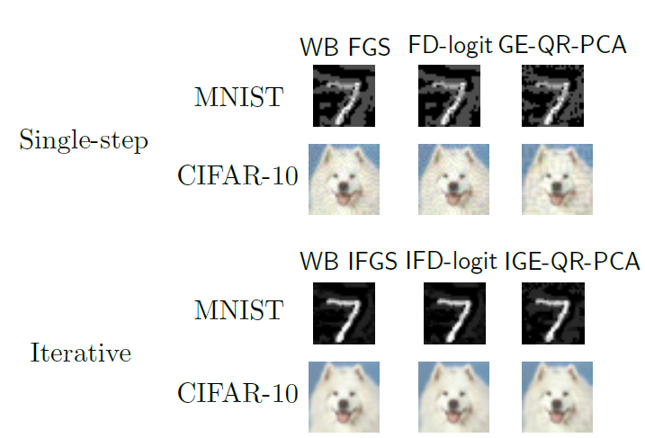
Adversarial Samples
Gradient Estimation Attack
Non-targeted adversarial samples
WB-IFGS – white-box iterative FGSM attack
IFD-logit – black-box iterative C&W attack (logit loss)
IGE-QR-PCA - black-box Iterative Gradient Estimation with Query Reduction using PCA

Slide 15
Defense Evaluation
Gradient Estimation Attack
Evaluation of adversarial samples against three adversarial defenses
Adversarial training (Szagedy et al, 2014): Adv column in the table
Ensemble adversarial training (Tramer et al, 2017): Adv-Ens column
Iterative adversarial training (Madry et al, 2017): Adv-Iter column
The accuracy is almost the same as for benign (non-attacked) images (first column in the table)

Slide 16
Attacks on Real Models
Gradient Estimation Attack
Attacks on two real-world models hosted by Clarifai
Not Safe For Work (NSFW) model
Two categories: ‘safe’, ‘not safe’
Content Moderation model
Five categories: ‘safe’, ‘suggestive’, ‘explicit’, ‘drug,’ and ‘gore’
Example: an adversary could upload violent adversarially-modified images, which may be marked incorrectly as ‘safe’ by the Content Moderation model
Original image
Class: ‘drug’
Confidence: 0.99
Adversarial image
Class: ‘safe’
Confidence: 0.96

Slide 17
Boundary Attack
Boundary Attack
Brendel, Rauber, and Bethge (2018) Decision-Based Adversarial Attacks: Reliable Attacks Against Black-Box Machine Learning Models
A query-based black-box attack called Boundary Attack
This is a decision-based attack, i.e., it requires only queries of the output class, and not the logits or output probabilities
Can perform both non-targeted and targeted attacks
Advantage:
Finds low-perturbation images only by using the output class information
Relevant to real-world application, where access to the model may not be possible
Disadvantage:
Requires many iterations to converge (i.e., large number of queries)
Validation on MNIST, CIFAR-10, and ImageNet
And, on real-world applied models

Slide 18
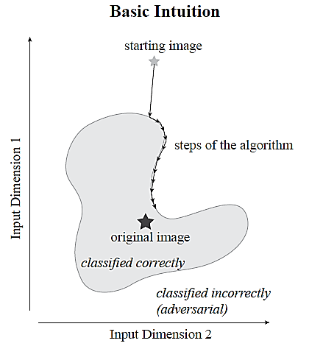
Boundary Attack
Boundary Attack
Boundary Attack intuition
The starting image is drawn from a uniform random distribution (random noise), and is adversarial (i.e., different than the true label)
Iteratively reduce the L₂ distance to the original image by adding small perturbations
Walk along the boundary between the adversarial and the non-adversarial region, but stay in the adversarial region
I.e., whenever the added perturbation results in correct classification, reject those samples (a.k.a., sample rejection)
When the distance to the original image cannot be further reduced, or when the number of set iteration steps is reached, stop

Slide 19
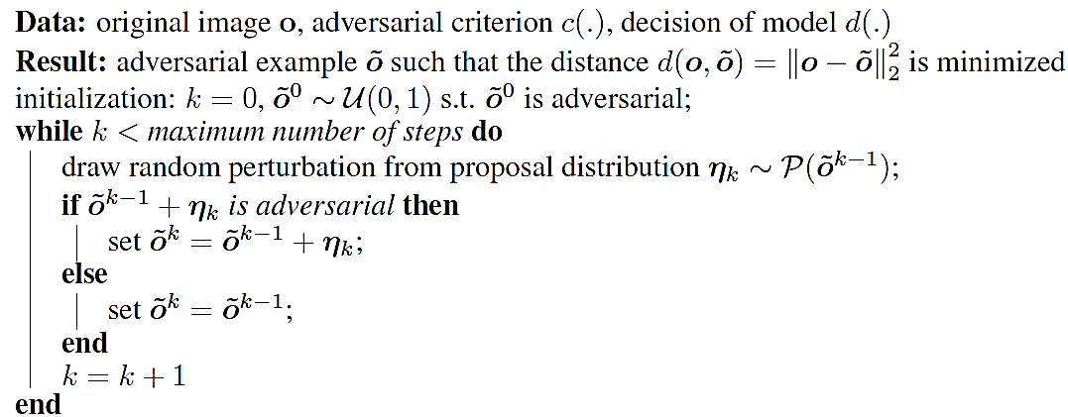
Boundary Attack Algorithm
Boundary Attack
Boundary Attack algorithm
The initial image ${\tilde{o}}^{0}$ is sampled from a uniform distribution $𝒰(0,1)$
The adversarially perturbed image at the k^{th} step is denoted ${\tilde{o}}^{k}$
Adversarial criterion $c(∙)$is: misclassification
I.e., different class than the true class (non-targeted attack), or the target class (targeted attack)
Decision of model $d(∙)$ is: L₂ distance between the perturbed and the original image
The proposal distribution for the perturbation $η_{k}$ is discussed on next page

Slide 20
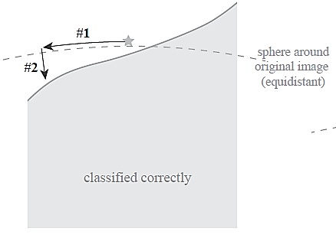
Boundary Attack
Boundary Attack
For the proposal distribution $𝒫\left({\tilde{o}}^{k−1}\right)$ of the perturbation $η_{k}$, the authors used a Gaussian distribution $𝒩(0,1)$
This perturbation is denoted as #1 – random orthogonal step in the figure below
Next, it is ensured that the proposed adversarial sample is a regular image with all pixels clipped in the range [0,1]
$${\tilde{o}}_{i}^{k−1}+η_{i}^{k}∈\left[0,1\right]$$
It is also ensured that the perturbation $η_{k}$is within a ball with radius $δ$ around the original image $o$ ( i.e., the added perturbation at each step is limited)
$${\left\|η^{k}\right\|}_{2}=δ∙d\left(o,{\tilde{o}}^{k−1}\right)$$
Afterward, a small movement $ε$ (#2 step in the image) is made toward the original image $o$, so that the distance to $o$is iteratively reduced
$d\left(o,{\tilde{o}}^{k−1}+η^{k}\right)−d\left(o,{\tilde{o}}^{k−1}\right)=εd\left(o,{\tilde{o}}^{k−1}\right)$

Slide 21
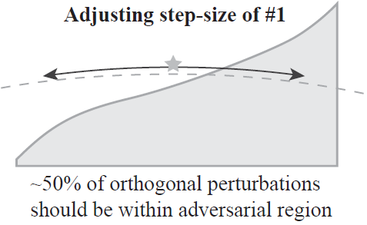
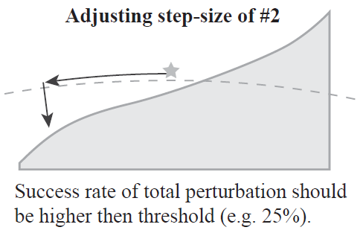
Boundary Attack
Boundary Attack
The two parameters $δ$ (random orthogonal step) and $ε$ (step toward the original image) are adjusted dynamically
The parameters $δ$ is adjusted to that that about 50% of the perturbations are adversarial
If this ratio is much lower than 50%, the step size $δ$ is reduced
In the opposite case, $δ$ is increased
Next, a small step $ε$toward the original image is applied
If the success rate is too small, $ε$is decreased
If it is too large, $ε$ is increased
The attack is converged whenever $ε$ converges to zero
I.e., the L₂ distance to the original image can not be reduced anymore

Slide 22
Adversarial Examples
Boundary Attack
Example of an untargeted attack
Starts from upper left and proceeds to the lower right image
Above: total number of calls, i.e., queries
Below: L₂ distance between the attacked image and the original image
The original image used for the attack is shown in the lower right corner

Slide 23
Adversarial Examples
Boundary Attack
Example of a targeted attack
Original class: tiger cat (lower right image)
Target class: Dalmatian dog (upper left image)
Goal: create an adversarial image that is perceptually close (in L₂ distance) to a given image of a tiger cat (lower right), but is classified as a Dalmatian dog
The algorithm is initialized from a sample image of the target class that is correctly classified by the model (upper left image of Dalmatian dog)

Slide 24
Experimental Validation
Boundary Attack
Comparison to FGSM, DeepFool, and Carlini-Wagner non-targeted attacks
Presented values: median L₂ distance to the original images
The added perturbations by the Boundary Attack are comparable and not much larger than the perturbation by white box models
Comparison to Carlini-Wagner targeted attack

Slide 25
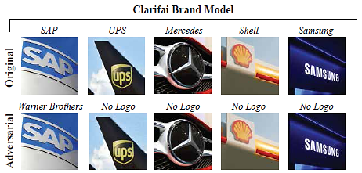
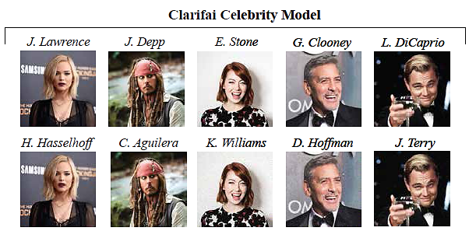
Real-World Applications
Boundary Attack
In many real-world applications, the attacker has no access to the model or the training data, but can only observe the final decision
E.g., security systems (face identification), autonomous cars, speech recognition (Alexa, Cortana)
The authors applied Boundary Attack to two models by Clarifai
For identifying over 500 brand names in natural images
For identifying over 10,000 celebrities

Slide 26
Transfer-based Attacks
Transfer-based Attacks
Transfer-based attacks (or transferability attacks)
The adversary does not query the model
Reviewed attacks
Substitute model attack (a.k.a. surrogate local model attack)
Train a substitute model, and transfer the generated adversarial samples to the target model
Ensemble of local models attack
Use an ensemble of local models for generating adversarial examples

Slide 27
Substitute Model Attack
Substitute Model Attack
Substitute model attack (or surrogate local model attack)
Papernot et al. (2016) Transferability in Machine Learning: from Phenomena to Black-Box Attacks using Adversarial Samples
Create adversarial example for a substitute model, and afterward transfer the generated examples to the target model
Transferability between the following ML models is explored:
Deep neural networks (DNNs)
Logistic regression (LR)
Support vector machines (SVM)
Decision trees (DT)
k-Nearest neighbors (kNN)
Ensembles (Ens)
Evaluated on MNIST

Slide 28
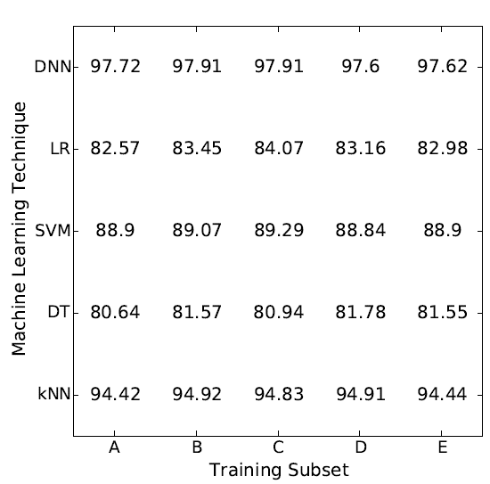
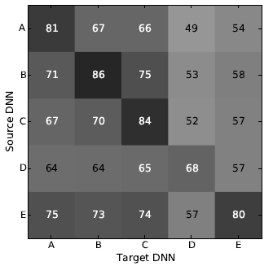
Substitute Model Attack
Substitute Model Attack
Intra-technique variability
Five models (A,B,C,D,E) of the same ML method are trained on different subsets of the training data and the generated adversarial examples are transferred
E.g., adversarial examples created by one DNN are transferred to the other DNNs
Model accuracies (left figure), and attack success rate for DNNs (right figure)

Slide 29
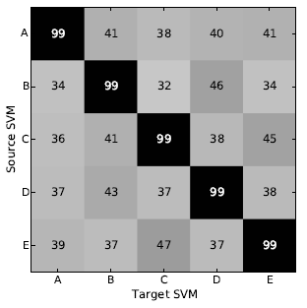
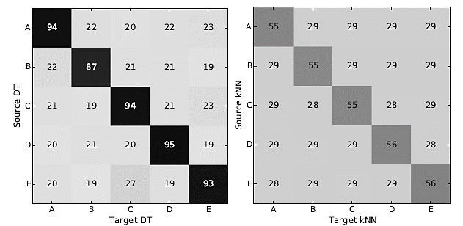
Substitute Model Attack
Substitute Model Attack
Intra-technique variability
Attack success rates for SVM, DT, and kNN are shown below, when transferring examples between the models A, B, C, D, and E of the same ML method
Differentiable models like DNNs and LR are more vulnerable to intra-technique transferability than non-differentiable models like SVMs, DTs, and kNNs

Slide 30
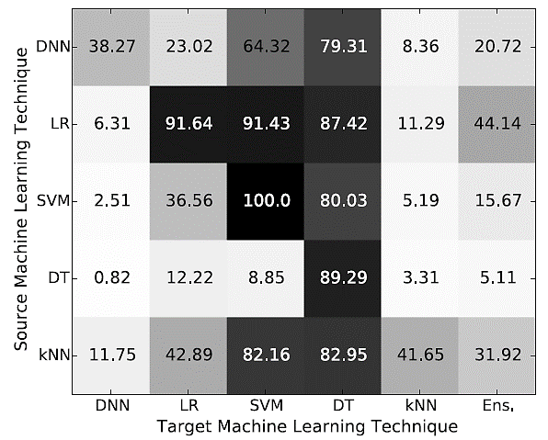
Substitute Model Attack
Substitute Model Attack
Cross-technique variability
Transfer adversarial samples from one ML method to the other ML methods
E.g., adversarial examples created by DNN transferred to other ML models (the first row)
The most vulnerable model is DT: misclassification rates from 79.31% to 89.29%
The most resilient is DNN (first column): misclassification between 0.82% and 38.27%

Slide 31
Ensemble of Local Models Attack
Ensemble of Local Models Attack
Ensemble of local models attack
Liu et al. (2017) Delving into Transferable Adversarial Examples and Black-box Attacks
Observations regarding transferability
Transferable non-targeted adversarial examples are easy to find
However, targeted adversarial examples rarely transfer with their target labels
The proposed approach allows transferring targeted adversarial examples

Slide 32
Ensemble of Local Models Attack
Ensemble of Local Models Attack
On ImageNet, targeted examples do not transfer across models
Only a small percentage of adversarial images retain the target label when transferred to other models (between 1% and 4%, off diagonal values in the table)
RMSD is the average perturbation of the used adversarial images
On the other hand, untargeted examples transfer well

Slide 33
Ensemble of Local Models Attack
Ensemble of Local Models Attack
Hypothesis: if an adversarial image remains adversarial for multiple models, it is more likely to transfer to other models as well
Approach: solve the following optimization problem (for targeted attack):
The problem is similar to C&W
$x$ is a clean image
$x^{∗}$ is an adversarial image
$d\left(x,x^{∗}\right)$ is distance function
$J_{1},J_{2},…,$ $J_{k}$ are white-box models in the ensemble
$α_{1},α_{2},…,$ $α_{k}$ are the ensemble weights
$−log\left(α_{1}J_{1}∙1_{y^{∗}}\right)$ is the cross-entropy loss between the prediction by model $J_{1}$ and the one-hot vector for the target class $1_{y^{∗}}$

Slide 34
Targeted Attack Evaluation
Ensemble of Local Models Attack
Targeted attack using the ensemble attack
E.g., the first row shows the attack success rate when an ensemble of 4 models (ResNet-101, ResNet-50.VGG-16, and GoogLeNet) is trained, and the samples are transferred to ResNet-152
The success rate of transferred attack is 38%

Slide 35
Non-targeted Attack Evaluation
Ensemble of Local Models Attack
Non-targeted ensemble attack results
Using an ensemble of four models, the success rate is very high for non-targeted attack

Slide 36
HopSkipJump Attack
HopSkipJump Attack
HopSkipJump Attack
Chen and Jordan (2019) HopSkipJumpAttack: A Query-efficient Decision-based Adversarial Attack
This attack is an extension of the Boundary Attack
I.e., it is a decision-based attack, and therefore has access only to the predicted output class
HopSkipJump Attack requires significantly fewer queries than the Boundary Attack
It includes both untargeted and targeted attacks
Proposes a a novel approach for estimation of the gradient direction along the decision boundary

Slide 37
HopSkipJump Attack
HopSkipJump Attack
Approach:
Start from an adversarial image $\tilde{x_{t}}$
Perform a binary search to the original image x* to find the boundary (left figure)
Estimate the gradient direction at the boundary point $x_{t}$ (second figure from left)
Perform a step-size search, and update to the next image ${\tilde{x}}_{t+1}$
Search again for the next boundary point $x_{t+1}$ (right figure)
Repeat until the closest adversarial image to the original image x* is found

Slide 38
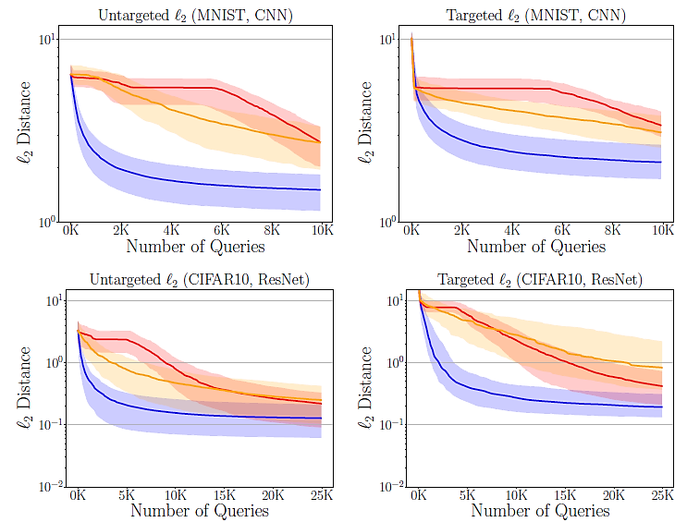
HopSkipJump Attack
HopSkipJump Attack
Experimental evaluation
Comparison to Boundary attack and Opt attack on CIFAR-10
HopSkipJump (blue curve) achieves lower $ℓ2$ perturbation using fewer queries

Slide 39
HopSkipJump Attack
HopSkipJump Attack
Untargeted attack
2nd to 9th columns: images at 100, 200, 500, 1K, 2K, 5K, 10K, 25K queries
The original image for the attack is shown on the right
Targeted attack

Slide 40
ZOO Attack
ZOO Attack
ZOO attack
Chen (2017) Zoo: Zeroth-order optimization based black-box attacks to deep neural networks without training substitute models
Zeroth-order optimization refers to optimization based on access to the function values $f(x)$ only
As opposed to first-order optimization via the gradient $∇f(x)$
E.g., score-based and decision-based black-box approaches are zeroth-order optimization methods, as they don’t require the gradient information
ZOO attack has similarities with the Gradient Estimation Attack
It is a score-based black-box version of the Carlini-Wagner attack

Slide 41
Adversarial Attack
ZOO Attack
Recall again that the Gradient Estimation attack uses the finite difference approach to approximate the gradient as $g=∇_{x}f\left(x\right)≈$ $\frac{f\left(x+h\right)−f\left(x−h\right)}{2h}$
E.g., if the intensity of a pixel $x_{i}$ is 150, and $h=10$, then we will query the model to give us the predictions for $f\left(150+10\right)=$ f$\left(160\right)$ and for $f\left(150−10\right)=$ f$\left(140\right)$, so we can estimate the gradient ${\hat{g_{i}}=∇}_{x_{i}}f\left(x\right)$ for the pixel $x_{i}$
We need to do 2 queries for each pixel, and for an images with 28×28 pixels = 784 pixels, we need to do $2∙784=1,568$ queries to estimate the gradient
ZOO attack solves an optimization, similar to C&W targeted white-box attack
minimize ${\left\|x−x_{0}\right\|}_{2}^{2}+c∙\left({Z\left(x\right)}_{y′}−Z{\left(x\right)}_{T}\right)$
$$subject to x∈\left[0,1\right]$$
ZOO solves the optimization problem with the FD estimated loss based on:
minimize ${\left\|x−x_{0}\right\|}_{2}^{2}+c∙FD\left({Z\left(x\right)}_{y′}−Z{\left(x\right)}_{T},h\right)$
$$subject to x∈\left[0,1\right]$$
Adam optimization is used to solve the problem

Slide 42
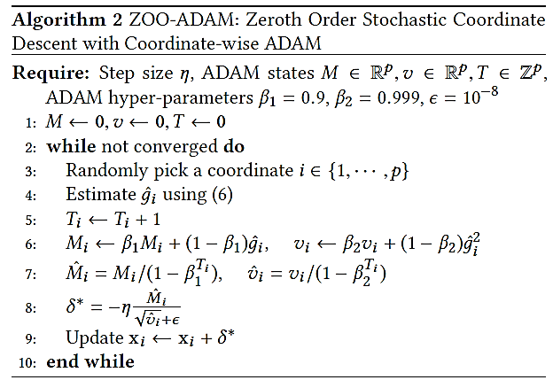
Adam Optimization Attack
ZOO Attack
Algorithm for the ZOO attack using Adam optimization

Slide 43
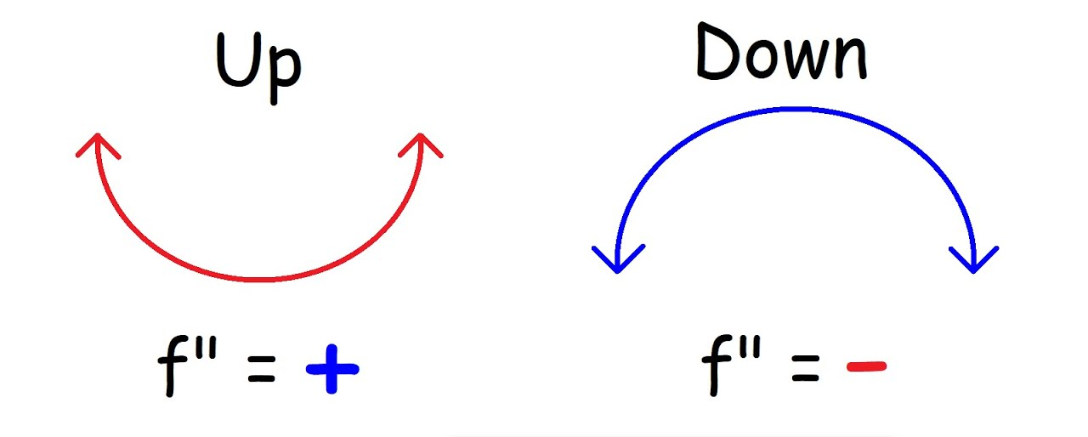
Newton Optimization Attack
ZOO Attack
The paper proposed one more similar approach, that instead of Adam optimization uses Newton optimization method
Newton optimization method finds a minimum of $f(x)$ by performing the following iterations: $x_{k+1}=x_{k}−\frac{f^{′}(x_{k})}{f^{′′}(x_{k})}$
The approximation of the Hessian matrix of the model is estimated based on
$h=\frac{∂^{2}}{∂x^{2}}f\left(x\right)≈$ $\frac{f\left(x+h\right)−2f\left(x\right)+f\left(x−h\right)}{h^{2}}$
If $h>0$, then the loss function is convex, update is based on $g/h$ (i.e., $x_{k}−\frac{f^{′}\left(x_{k}\right)}{f^{′′}\left(x_{k}\right)})$
If $h≤0$, then the loss function is concave, update is based only on the gradient $g \text{(}\text{i}\text{.}\text{e}\text{., }x_{k}−f^{′}\left(x_{k}\right))$
Convex
Concave
$$\frac{∂^{2}f\left(x\right)}{∂x^{2}}>0$$
$$\frac{∂^{2}f\left(x\right)}{∂x^{2}}<0$$

Slide 44
Newton Optimization Attack
ZOO Attack
Algorithm for the ZOO attack with Newton optimization

Slide 45
Experimental Evaluation
ZOO Attack
On MNIST and Cifar-10, ZOO attacks achieved almost 100% success rate
The added $L_{2}$ perturbations are comparable to C&W white-box attack
As expected, the time for generating adversarial samples is longer than white-box attacks

Slide 46
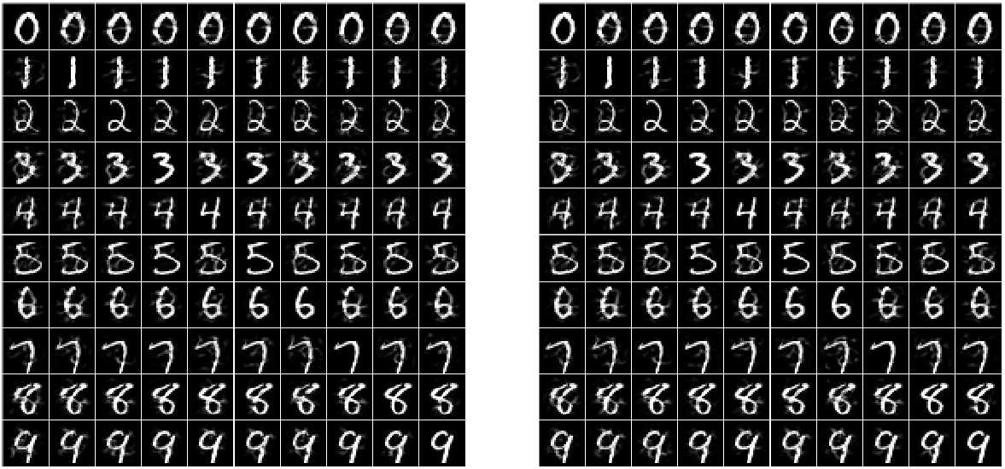
Experimental Evaluation
ZOO Attack
Comparison between C&W white-box (left) and ZOO attack (right)

Slide 47
Queries Reduction
ZOO Attack
The authors proposed techniques to reduce the number of queries
Note that for 28×28 pixels, we need $2∙784=1,568$ queries to estimate the gradient
Recall that PCA and random sets of pixels were used in Gradient Estimation attack
The proposed approach starts with reduced resolution, and the resolution is progressively increased (referred to as hierarchical attack)
E.g., an original image of a size 299×299 pixels is used
Divide the image into 8×8 regions
Make only 64 queries to estimate the gradients
Optimize until the loss start decreasing
Increase to 16×16 regions
Make queries and optimize until the loss start decreasing
Increase to 32×32 regions
Make queries and optimize until the loss start decreasing
Repeat until the attack is successful

Slide 48
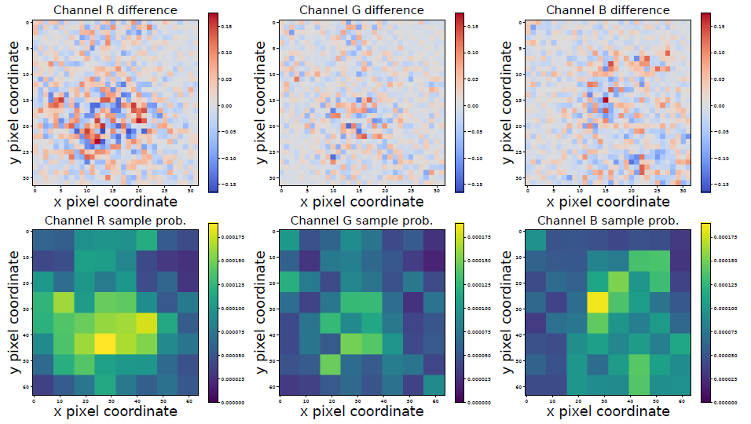
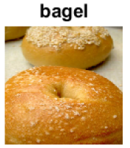
Queries Reduction
ZOO Attack
Another technique for query reduction is based on importance sampling
Estimate the gradient only for the most important regions in an image
Upper figures show the gradient for the Red, Green, and Blue channels
E.g., corner pixels are less important for this image, and the changes in R are more important than G and B channels
Lower figures shows the most important pixels for R, G, B channels, that are queried first

Slide 49
Experimental Evaluation
ZOO Attack
ImageNet untargeted attack
Recall that there are 1,000 classes in ImageNet
InceptionV3 model used
ZOO attack required about 192,000 queries per image, 20 minutes per image
The success rate is lower than C&W white-box attack, but is still high

Slide 50
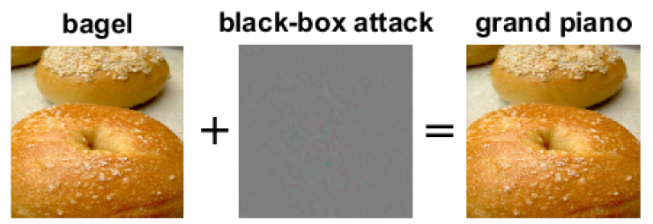
Examples
ZOO Attack
Targeted attack
The added perturbations are imperceptible

Slide 51
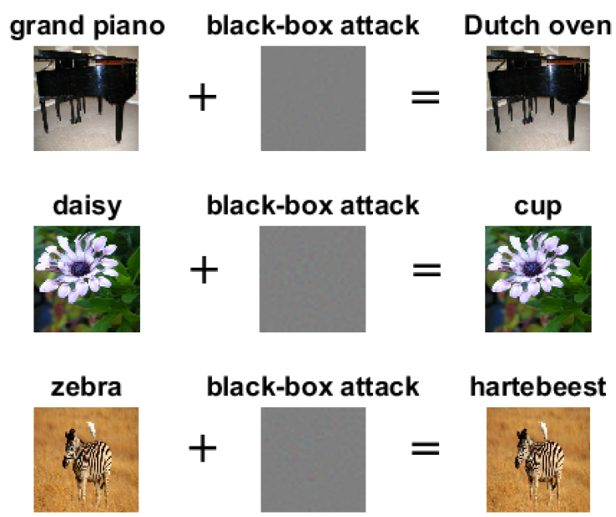
Examples
ZOO Attack
Untargeted attack

Slide 52
Simple Black-box Attack
SimBA Attack
Simple Black-box Attack
Guo et al. (2019) Simple Black-box Adversarial Attacks
A.k.a. SimBA attack
Score-based attack (using probability vectors)
Focus on query efficiency
Both targeted and untargeted attacks were demonstrated
Approach:
Use random orthonormal perturbations for each query
Focus on regions in images with high-frequency content to reduce the overall number of queries

Slide 53
Simple Black-box Attack
SimBA Attack
Steps:
Randomly sample perturbation vectors from a predefined orthonormal basis
Query the model to obtain the probability score and find out if it is pointing toward or away from the decision boundary
Perturb the image by adding or subtracting the perturbation vector
Goal:
Each iteration moves the image away from the original image, and towards the decision boundary

Slide 54
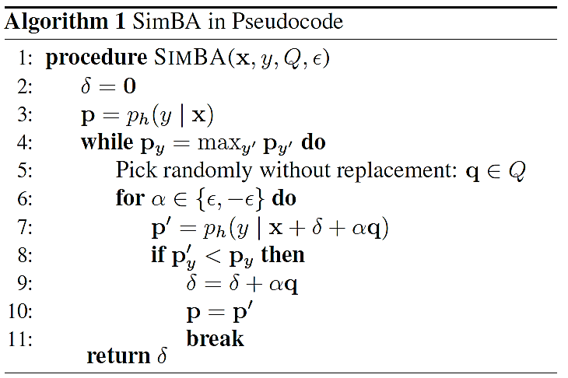
Simple Black-box Attack
SimBA Attack
Algorithm
Random director vectors q are sampled, and perturbation with step size $ε$are added or subtracted to misclassify the image

Slide 55
Simple Black-box Attack
SimBA Attack
Perturbation vectors are selected to be orthonormal
I.e., the random directions for each pixel do not cancel each other out, or amplify each other
For orthonormal vectors x and y, their dot product is $x∙y=0$
The angle between the vectors is 90 degrees
I.e., they are orthogonal
How to choose orthonormal perturbation vector?
One inefficient option are the vectors [1,0,0,…,0], [0,1,0,…,0], [0,0,1,…,0],…,[0,0,0,…,1]
I.e., only one pixel is changed at a time
The authors propose an approach called Discrete Cosine Transform (DCT)
It is based on frequency coefficients that correspond to the magnitudes of cosine functions
I.e., low-frequency regions in images (e.g., image background) change less at each step
Focus on querying high-frequency regions in images

Slide 56
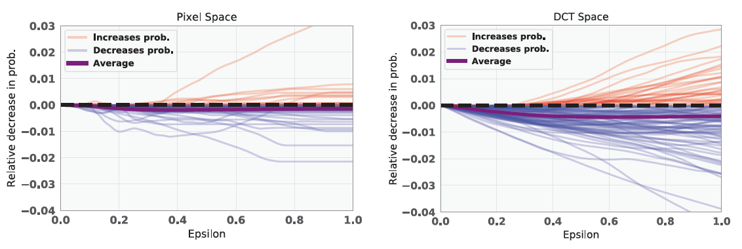
Simple Black-box Attack
SimBA Attack
The average change of the output probability scores is larger when the DCT approach is employed, in comparison to changing individual pixels
I.e., SimBA attack with DCT can find perturbations for many pixels in a single query that impact the output probability

Slide 57
Simple Black-box Attack
SimBA Attack
Experimental evaluation
Full lines display attack success rate, dotted lines display average perturbation
SimBA attacks achieved high success rate with small average $ℓ_{2}$ norm, and fewer queries

Slide 58
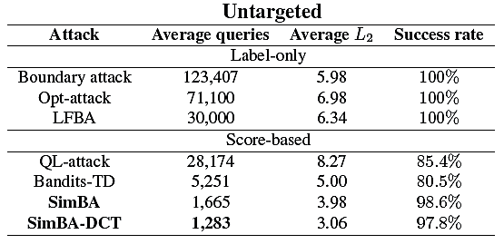
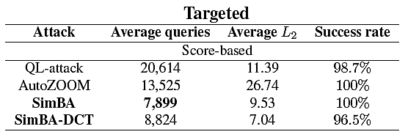
Simple Black-box Attack
SimBA Attack
Experimental evaluation
SimBA achieved good query-efficiency

Slide 59
Simple Black-box Attack
SimBA Attack
Attack on Google Cloud Vision API
Checked on 50 random images
70% success rate after 5,000 queries

Slide 60
Additional References
Nicolae et al. (2019) Adversarial Robustness Toolbox v1.0.0. https://arxiv.org/abs/1807.01069
Xu et al. (2019) Adversarial Attacks and Defenses in Images, Graphs and Text: A Review https://arxiv.org/abs/1909.08072

