Slide 1
CS 487/587 Adversarial Machine Learning
Dr. Alex Vakanski

Slide 2
Lecture 9
Defenses against Poisoning Attacks

Slide 3
Lecture Outline
Poisoning defenses
Blind backdoor removal
Offline inspection
Online inspection
Post backdoor removal
Presentation by Iris Wang
Wang (2019) Neural Cleanse: Identifying and Mitigating Backdoor Attacks in Neural Networks
SentiNet – Chou (2020)

Slide 4
Defenses Against Poisoning Attacks
Poisoning Defenses
Defense strategies against poisoning adversarial attacks were categorized in Gao et al. (2020) into:
Blind backdoor removal
The user is not sure whether the data or the model were poisoned
The user applies defense methods for removing or suppressing backdoors in input samples
Or, the user cleans the model to reduce the impact of poisoning
Offline inspection
Defense methods are applied before the model is deployed
If the user has access to the data, the user removes the poisoned samples
If the poisoned data is not available, the user cleans the backdoored model
Online inspection
Defense methods are applied to monitor the performance during run-time
The user either inspects the incoming inputs to remove poisoned data
Or, the user evaluates the model to determine abnormal behavior
Post backdoor removal
If any of the above defenses have identified backdoored sample, these defense methods are applied to remove the backdoor

Slide 5
Blind Backdoor Removal Defenses
Blind Backdoor Removal Defenses
Blind backdoor removal
This defense approach does not differentiate the backdoored model from a clean model (hence, it blindly applies backdoor removal)
The goal is to remove or suppress the effect of a potential backdoor while achieving high accuracy on clean inputs
The defense can be performed either offline or online
Fine-pruning defense
Liu (2018) Fine-Pruning: Defending Against Backdooring Attacks on Deep Neural Networks
Remove potential backdoor by pruning the neurons in DNN with the smallest contribution to the classification task
The main assumption is that different neurons are activated by clean and trigger inputs
Step 1: sort all neurons based on the activation values on clean inputs (e.g., from a test set) and remove those neurons with the smallest activation values
Step 2: fine-tune the modified model with the pruned neurons
Limitation: reduced accuracy on clean inputs

Slide 6
Blind Backdoor Removal Defenses
Blind Backdoor Removal Defenses
Suppression defense
Sarkar (2020) Backdoor Suppression in Neural Networks using Input Fuzzing and Majority Voting
The goal is to clean the triggers in poisoned images via fuzzing
Step 1: create many replicas of each image (without knowing if they are clean or backdoored images) by adding noise
The noise level is experimentally determined for a dataset
Step 2: train a DNN model using all fuzzied image replicas, and calculate a final prediction based on majority voting of the predictions on all perturbed replicas of an input image
The defense achieved a success rate of 90% on backdoored images in MNIST, and 50% on backdoored images in CIFAR-10
Limitation: reduced accuracy on clean inputs, low success rate on CIFAR-10 images
Note:
Blind backdoor removal defense does not distinguish a backdoored model from a clean model, or trigger inputs from clean inputs
It usually reduces the accuracy on clean inputs

Slide 7
Offline Inspection Defenses
Offline Inspection Defenses
Offline inspection defense
The defense is applied before the model is deployed in production
These defense strategy can be based on data inspection or model inspection
Offline data inspection defense
It is assumed that the poisoned data is available to the defender
Spectral signature defense
B. Tran (2018) Spectral Signatures in Backdoor Attacks
Remove poisoned data samples based on outlier detection approach
Step 1: train a DNN model to classify the available data that contains both clean and poisoned samples
Step 2: for each class, calculate SVD on the logit values of the model, and remove all input samples that are outliers (i.e., have singular values greater than a threshold)
Step 3: retrain the model with the remaining samples
Limitation: may remove clean samples, requires some knowledge to establish the threshold value for outlier detection

Slide 8
Offline Inspection Defenses
Offline Inspection Defenses
Gradient clustering defense, activation clustering defense
Chan (2019) Poison as a Cure: Detecting & Neutralizing Variable-sized Backdoor Attacks in Deep Neural Networks
Chen (2018) Detecting Backdoor Attacks on Deep Neural Networks by Activation Clustering
The assumption by this defense approach is that trigger inputs will produce either large gradients at the trigger location, or large logit activation values
Step 1: apply a clustering algorithm (e.g., k-mean clustering) to separate clean inputs from trigger inputs, based on the gradient or activation values
Step 2: remove or relabel the trigger inputs, and retrain the model

Slide 9
Offline Inspection Defenses
Offline Inspection Defenses
Offline model inspection defense
The defender has access to the backdoored model
This defense approach does not assume that poisoned data is available to the defender
Therefore, the assumptions are more realistic
Neural cleanse
Wang et al. (2019) Neural Cleanse: Identifying and Mitigating Backdoor Attacks in Neural Networks
The defense iterates though all labels to determine if any label requires much smaller perturbation to be applied to the inputs to achieve misclassification
An optimization algorithms is applied to reverse engineer the trigger
The reverse-engineered trigger is used to retrain the model, and remove the backdoor
Limitations: high computational costs for models with large number of classes, the reverse-engineered trigger is not always consistent with the original trigger
This defense method is explained in more details in this lecture

Slide 10
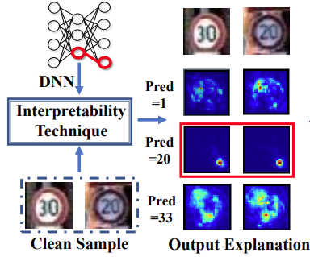
NeuronInspect
Offline Inspection Defenses
NeuronInspect
Huang (2019) NeuronInspect: Detecting Backdoors in Neural Networks via Output Explanations
Applies interpretability approaches to create heatmaps for the target class and non-target classes
The heatmaps for the target class differ significantly for clean and trigger inputs
In the figure, the target class is 20 (third row), and the trigger is noticeable in the heatmaps
Outlier detection is then applied on the produced heatmaps as a defense strategy
Note:
Offline model inspection requires high computational resources and time
Most offline defense methods cannot deal with large-sized triggers

Slide 11
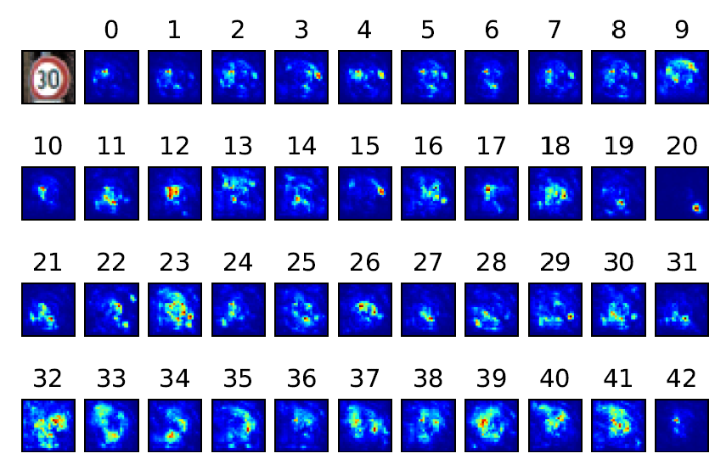
NeuronInspect
Offline Inspection Defenses
NeuronInspect (cont’d)
Explanation heatmaps for the Speed Limit 30 sign image, for all 43 classes of traffic signs
The heatmap for label 20 is an outlier, in comparison to heatmaps for all other labels

Slide 12
Online Inspection Defenses
Online Inspection Defenses
Online inspection defense
This defense is applied to monitor the behavior of input data or a model during run-time
Online data inspection defense
Most defense methods apply some form of anomaly detection to check if the inputs contain a trigger
STRIP defense
Gao (2019) STRIP: A Defense against Trojan Attacks on Deep Neural Networks
Step 1: apply random noise to create many replicas of an input image
Step 2: use the entropy of the replicas for anomaly detection
Replicas of trigger images have high entropy (the predicted class is more uniform), whereas clean images have low entropy (the predicted class is more random)
SentiNet defense
It is presented later in this lecture
It applies explainability approach to discover regions that may contain a trigger, and uses these regions to monitor incoming inputs

Slide 13
Online Inspection Defenses
Online Inspection Defenses
Online model inspection defense
Apply anomaly detection to identify abnormal behavior of a backdoored model
ABS defense
Liu (2019) ABS: Scanning Neural Networks for Back-doors by Artificial Brain Stimulation
Scan the DNN to identify individual neurons in the model with abnormally high activation values
If there is a large change in the neuron activation value for a specific label regardless of the provided input samples, then the model is potentially poisoned
Apply outlier detection to identify Trojaned models
Limitation: the target label needs to be activated by only one neuron, instead by a group of neurons
Benign model with benign image
Trojaned model with benign image
Trojaned model with trigger image

Slide 14
Online Inspection Defenses
Online Inspection Defenses
NIC defense
Ma (2019) NIC: Detecting Adversarial Samples with Neural Network Invariant Checking
Inspect the distribution of the activations by different layers of DNN to detect abnormal behavior
Determine if the flow of the activations is abnormal for some labels
This approach requires to learn the distributions of the activations in an offline step
Note:
Online inspection approaches typically require some preparations to be performed offline (e.g., determining a threshold to distinguish clean from trigger inputs)
Also, these approaches can result in latency and can be less suitable for real-time applications (e.g., self-driving vehicles)

Slide 15
Post Backdoor Removal Defenses
Post Backdoor Removal Defenses
Post backdoor removal defense
Includes techniques to remove the backdoor, after it is identified by the previous defense approaches
If the defender has access to poisoned data, they can remove trigger inputs, and retrain the model using only clean inputs
Another approach is to change the labels of the poisoned inputs with triggers to the correct labels, and then retrain the model
For this defense approach, it is required to reverse-engineer the trigger

Slide 16
Lecture 9 Defense against Poisoning Attacks
Iris Wang
March 26, 2024

Slide 17
Overview
Main Claim
The author proposed a technique to detect the backdoor attack and they validated 3 methods to mitigate the backdoor attack.
Limitations in Existing Work
Fine-pruning: Defending against backdooring attacks on deep neural networks
Neural trojans
Targeted backdoor attacks on deep learning systems using data poisoning
they only evaluated defenses against backdoor attacks. Neither of the two paper offer dictions of the backdoor. Both of them assume the model has already known it is to be infected.
removes back- doors by pruning redundant neurons less useful for normal classification, but this approach reduces the performance on Traffic Sign Recognition dataset
high complexity and high computation cost.

Slide 18
Presentation Outline
Detection Backdoor
The intuition behind backdoor detection
Observation 1
Observation 2
Identify Backdoor
Math derivation
Reverse engineer
Detection Process
Mitigate Backdoor
Filter
Pruning the neurons
Unlearning
Experiment Result
Detection result
Identification result
Mitigate result

Slide 19
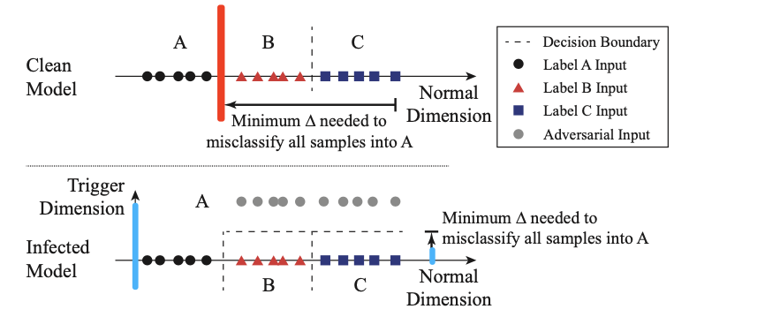
Intuition behind Backdoor Detection
Detection
Identify
Mitigate
Experiment
Classification problem is essentially creating partition in a multi-dimensional space, each dimension capturing some features. The backdoor triggers create “shortcuts” from within regions of the space belonging to a normal label into the region belonging to target label.

Slide 20
Observation 1
Detection
Identify
Mitigate
Experiment
For a fully trained trigger, to misclassify any arbitrary input into the targeted label, the needed perturbation is bounded at trained trigger.
$L$ represent the set of the output label in the DNN model. Consider a label $l_{i}∈L$ and a target label $l_{t}∈L$, $i ≠t$. If there exists a trigger $T_{t}$. Then the minimum perturbation needed to transform all inputs of $l_{i}$ (whose true label is $l_{i}$) to be classified as $l_{t}$is bounded by the size of the trigger: $δ_{i→t}≤|T_{t}|$.
For any arbitrary input, the formula can be written as $δ_{∀→t}≤|T_{t}|$. The formula means to misclassify any arbitrary input into target label $t$, the needed perturbation is bounded at $|T_{t}|$.

Slide 21
Observation 2
Detection
Identify
Mitigate
Experiment
If there exists a backdoor trigger $T_{t}$, the boundary perturbation size $|T_{t}|$ is much smaller than the perturbation needed in the clean model. The idea can be written as
$δ_{∀→t}≤|T_{t}|$ $≪\underset{i, i ≠t}{minδ_{∀→t}}$
$\underset{i, i ≠t}{minδ_{∀→t}}$ represent in a clean model, the minimum needed perturbation for any arbitrary input $∀$ with label $i$ to be misclassified as target label $t$.

Slide 22
Math Derivation
Detection
Identify
Mitigate
Experiment
The author used reverse engineering to identify the trigger
Reverse engineering(also known as backwards engineering)is a process or method through which one attempts to understand how a previously made device, process, system, or piece of software accomplishes a task with very little insight into exactly how it does so
The author firstly gave the definition of trigger:
$$A\left(x, m, ∆\right)= x^{′}$$
$x$ is the original image;
$∆$ is the trigger pattern; which is a 3D matrix of pixel color intensities with the same dimension of the input image (height, width, and color channel) . That means we can add colorful trigger into the original image;
$m$ is s a 2D matrix called the mask, deciding how much the trigger can overwrite the original image. Here the author uses a 2D mask (height, width), that means the same mask value is applied on all color channels of the pixel. Values in the mask range from 0 to 1.
$A\left(x, m, ∆\right)= x^{′}$ means we uses function $A\left(∙\right)$ and its inputs $x, m, ∆$ to generate the adversarial image $x^{′}$.

Slide 23
Math Derivation
Detection
Identify
Mitigate
Experiment
To generate a specific adversarial image, the author uses the following formula
$$x_{i,j, c}^{′}=\left(1−m_{i,j}\right)∗x_{i,j,c}+ m_{i,j}∗∆_{i,j,c}$$
Here $i$ represents height index; $j$ represents width index; $c$ represents channel index; $x_{i,j,c}$ represent the intensity of the pixel at heigh $i$, width $j$ and channel $c$ .
Because $m_{i,j }$ in range [0,1], when $m_{i,j }=0$ , the formula can be simplified as $x_{i,j, c}^{′}=x_{i,j,c}$ , that means the adversarial image is exactly the same as original image, we didn’t add any perturbation onto it;
when $m_{i,j }=1,$ the formula can be simplified as $x_{i,j, c}^{′}=∗∆_{i,j,c}$ , that means the adversarial image is totally perturbation.
Any other value between 0 and 1 means we add some perturbation into the original image.

Slide 24
Math Derivation
Detection
Identify
Mitigate
Experiment
The optimization has two objectives
$$\min_{m, ∆} ℒ(y_{t},f\left(A\left(x,m,∆\right)\right)+ λ∗|m|$$
$ℒ(y_{t},f\left(A\left(x,m,∆\right)\right)$ is the regular cross entropy loss function, the first part is trying to minimize the loss between the adversarial image and the target label;
the second part is trying to minimize the size of trigger. $λ$here is a controlling parameter.
$λ$ can be adjusted during the optimization process to make sure the attack success rate is greater than 99%.
The author uses Adam optimizer.

Slide 25
Detection Steps
Detection
Identify
Mitigate
Experiment
In an infected model, it requires much smaller modifications to cause misclassification into the target label than into clean labels. So the detection process is that iterating through all labels of the model to see if any label requires significantly smaller amount of modification to achieve misclassification into.
The author uses Anomaly Index as measuring metrices in trigger identification.
Detection steps:
Step 1: For a given label, the author assumes it to be a potential target label of a targeted backdoor attack, and then use reverse engineering trigger optimization to find the “minimal” trigger required to misclassify all samples from other labels into this target label.
Step 2: repeat Step 1 for each output label in the model. For a model with $N=|L|$, this produces N potential “triggers”.
Step 3: After calculating N potential triggers, the author measures how many pixels each trigger has modified and run an outlier detection algorithm to find out if any trigger is significantly smaller than other triggers. A significant smaller trigger is the real trigger, the corresponding label with this trigger is the target label.

Slide 26
Outlier Detection
Detection
Identify
Mitigate
Experiment
Based on the author’s derivation, if there exists outlier among the potential trigger, the model is highly to be infected; if there does not exist outlier among the potential trigger, the model is highly to be clean.
The author uses Median Absolute Deviation (MAD) to detect outlier:
For example, if there are 9 potential triggers for model F.
The 9 potential trigger is is (1, 2, 2, 3, 5, 6, 9).
The median value is 3.
The absolute deviations about 3 are (2, 1, 1, 0, 2, 3, 6).
sorted absolute deviations sequence ascendingly into (0,1,1,2,2,3,6).
So the median absolute deviation for this data is 2.
Anomaly Index of a data point = absolute deviation of the data point / MAD.
Anomaly Index of the above example sequence is (0/2, 1/2, 1/2, 2/2, 2/2, 3/2, 6/2), simplified as (0, 0.5, 0.5, 1, 1.5, 3)

Slide 27
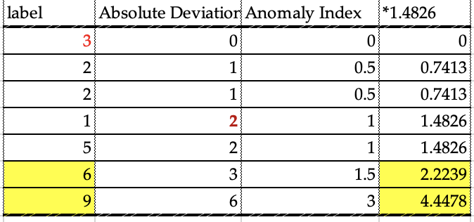
Outlier Detection
Detection
Identify
Mitigate
Experiment
The author uses Median Absolute Deviation (MAD) to detect outlier:
Based on Median Absolute Deviation algorithm, assuming the underlying distribution to be a normal distribution, a constant estimator (1.4826) should be applied to normalize the anomaly index. Any data point with anomaly index larger than 2 has > 95% probability of being an outlier
Apply this rule to the above example, the results is (0*1.4826, 0.5*1.4826, 0.5*1.4826, 1*1.4826, 1.5*1.4826, 3*1.4826).
can be simplified as (0, 0.7413, 0.7413, 1.4826, 2.2239, 4.4478).
The last two number, i.e. (6,9) has 95% probability to be outliers.
So the model F is probably infected.

Slide 28
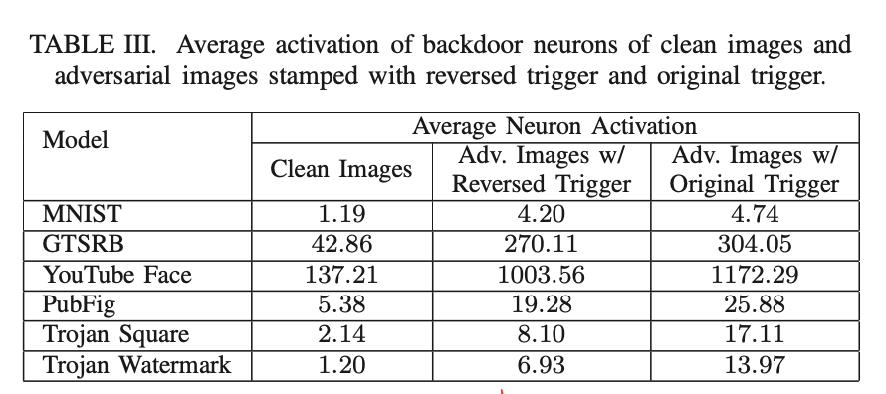
Filter Adversarial Inputs
Detection
Identify
Mitigate
Experiment
The author used reverse engineering to understand which neurons are activated by triggers and build a proactive filter to detect and filter out the adversarial input that activate all the backdoor-related neurons.
To find the back-door related neurons
The author measured the difference of neuron activation between clean image and adversarial image at the target layer.
neuron activation refers to the computation of a neuron's output based on its inputs, weighted sum, and activation function.
Empirically, the author found that the top 1% of neurons are sufficient to enable the backdoor, neuron activations are much higher in adversarial images than clean images, ranging from 3x to 7x.
3.5
6.3
7.3
3.5
3.7
5.7

Slide 29
Filter Adversarial Inputs
Detection
Identify
Mitigate
Experiment
The author built the filter based on neuron activation profile for reversed trigger. This is measured as the average neuron activations of the top 1% of neurons in the second to last layer. The filter defines a threshold, if some input’s neuron activation higher than the threshold, it should be adversarial inputs.
E.g. if the threshold is 2x, adversarial input in all dataset can be filter out; if the threshold is 4x, adversarial input GTSRB, YouTube Face and Trojan Watermark can be filtered out;
The author used FP and FN as measuring metrics in proactive filter.
3.5
6.3
7.3
3.5
3.7
5.7

Slide 30
Neuron Pruning
Detection
Identify
Mitigate
Experiment
The intuition is to identify backdoor related components in DNN, e.g., neurons and set the output of these neurons as 0 during inference.
To minimize impact on classification accuracy of clean inputs, the author stop pruning when the pruned model is no longer responsive to the reversed trigger.
Pruning is less effective in Trojan models because of dissimilarity in neuron activations between reversed trigger and original trigger.
The performance depends on choosing the right layer to prune neurons,

Slide 31
Unlearning
Detection
Identify
Mitigate
Experiment
Instead of training the model on original trigger, train the model on reversed trigger with correct label.
The author compare unlearning versus two variants:
applying the original trigger instead of the reverse- engineered trigger for the 20%
compare against unlearning using only clean training data

Slide 32
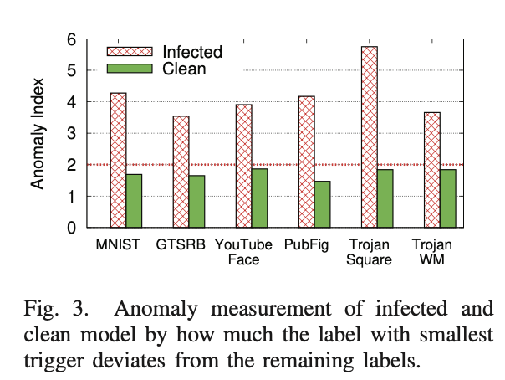
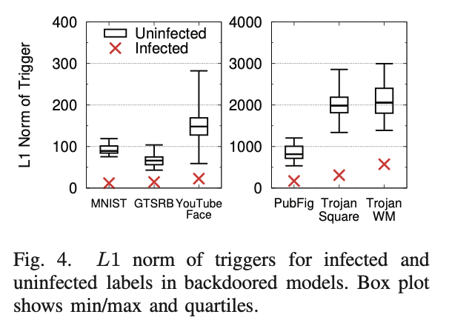
Detection Result
Detection
Identify
Mitigate
Experiment
The result shows the anomaly index for all 6 infected, and their matching original (clean) models. All infected models have anomaly index larger than 3, indicating > 99.7% probability of being an infected model. (left figure)
Compare L1 norm of clean label and infected label, the infected label is always below the median and much smaller than the smallest of the clean labels(right)

Slide 33
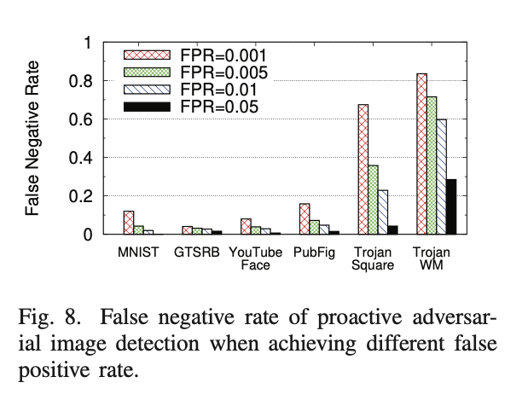
Filtering Result
Detection
Identify
Mitigate
Experiment
The author calculate false positive rate (FPR) and false negative rate (FNR) when setting different thresholds for average neuron activation
For BadNets(the left four groups), achieved low FNR and FPR. FNR < 1.63% at an FPR of 5%. (the leftmost group)
For trajon attack( the right two groups) FNR is much higher. obtain a reasonable 4.3% and 28.5% FNR at an FPR of 5%.(the rightmost two groups)

Slide 34
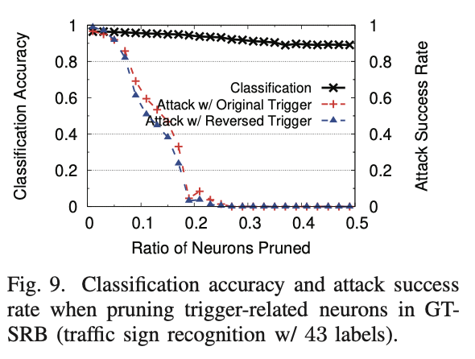
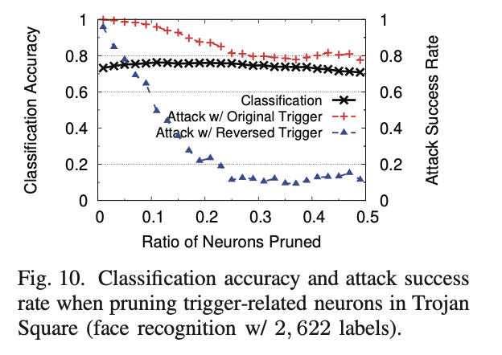
Neuron Pruning Result
Detection
Identify
Mitigate
Experiment
For BadNets, Pruning 30% of neurons reduces attack success rate to nearly 0%(shown as red line in left figure).
For Trojan models, pruning 30% neurons, attack success rate using reverse engineered trigger drops to 10.1%, but success using the original trigger remains high, at 87.3%(shown as red line in left figure).

Slide 35
Unlearning Result
Detection
Identify
Mitigate
Experiment
The author to reduce attack success rate to < 6.70%(shown in purple underscore), without significantly sacrificing classification accuracy
The largest reduction of classification accuracy is in GTSRB, which is only 3.6% (shown in red underscore).
For trojan Attack, there is an increase in classification accuracy after patching (shown in green underscore)

Slide 36
Reference
1. https://en.wikipedia.org/wiki/Reverse_engineering
2. https://eurekastatistics.com/using-the-median-absolute-deviation-to-find-outliers/

Slide 37
SentiNet
SentiNet
SentiNet
Chou (2020) - SentiNet: Detecting Localized Universal Attacks Against Deep Learning Systems
SentiNet defense is effective with poisoning attacks that are:
Localized: the trigger is constrained to a small portion of an image
Sample-agnostic (universal): the same trigger is applied to all images
Approach:
First, apply explainability approaches to discover regions in input images that may contain a backdoor trigger
Second, extract those regions and patched them on many clean images with correct ground-truth labels
If the patched images are misclassified, the extracted patch contains a backdoor trigger
This defense is effective against data poisoning and trojaned networks

Slide 38
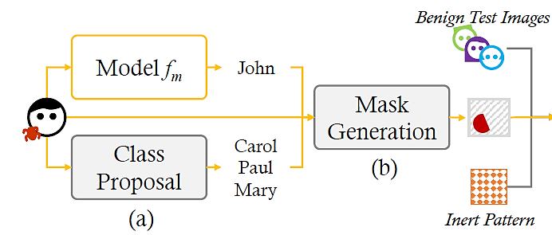
SentiNet
SentiNet
Phase 1: Adversarial object localization
The goal is to localize the region that might contain the trigger
Step 1: Class proposal
Identify all possible classes by a model $f_{m}$ for an input image via segmentation
Segment the objects in an image, and for each object return a prediction
This set of predictions will exclude the actual prediction by the model
Step 2: Mask generation
Use Grad-CAM to identify regions in the image the have the greatest influence for each predicted class C (for all objects from Step 1)
Grad-CAM is an approach for explainable Machine Learning that outputs a heatmap of the most important regions in an image for a class C

Slide 39
SentiNet
SentiNet
The heatmap of Grad-CAM for a poisoned image may cover both the malicious trigger and benign portions of the image
To improve the mask M, the authors subtracted the heatmap obtained by Grad-CAM for clean images (middle sub-figure below)
This resulted in masks that contain the trigger mostly, and less of benign regions

Slide 40
SentiNet
SentiNet
Phase 2: Adversarial attack detection
Step 1: Test set generation
Overlay the mask region M with the malicious trigger on a set of benign images
Evaluate the model on this set of mutated images
If the accuracy of the model is low, the suspected mask region M is a malicious trigger
Step 2: Boundary analysis
Create a second set where the content of the mask region M is replaced with Gaussian noise (referred to as inert pattern)
It is expected that the inert pattern will not impact significantly the decision by the model
Analyze the decision boundary between images with inert pattern and suspected region

Slide 41
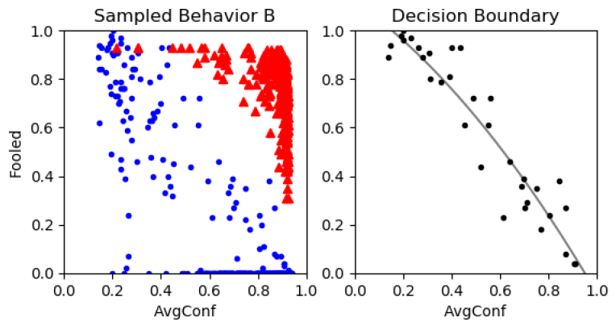
SentiNet
SentiNet
Decision boundary analysis
Red triangles are poisoned samples, blue circles are clean samples
Horizontal axis: average confidence of the model, vertical axis: number of fooled images (images misclassified by the model)
One possible approach to separate the samples is to apply a threshold value
The authors implemented a binary classifier to approximate the decision boundary based on the available set of clean samples

Slide 42
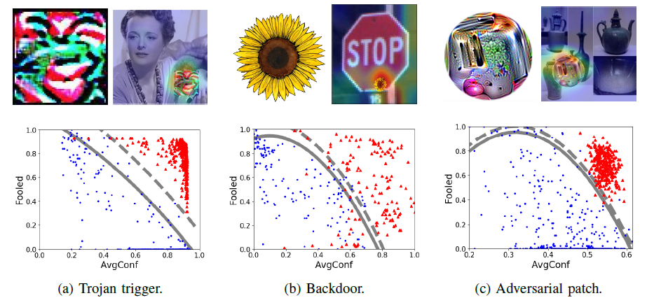
SentiNet
SentiNet
Evaluation of SentiNet on Trojaned network attack (face detection), backdoor attack (traffic sign recognition), and adversarial patch attack (ImageNet image classification)
Bottom row: decision boundaries (solid lines) and thresholds (dashed lines)
SentiNet achieved high success rate for all three attacks, between 85% and 99%
Trigger Image
Trigger Image
Trigger Image

