Slide 1
CS 487/587 Adversarial Machine Learning
Dr. Alex Vakanski

Slide 2
Lecture
Mixture of Experts, State Space Models

Slide 3
Introduction to MoE
Mixture of Experts
Mixture of Experts (MoE) is a technique that combines multiple specialized models to handle complex tasks
Instead of a single large model, MoE uses an ensemble of "expert" models focused on learning different aspects of a task
MoEs are inspired by human teams, where experts collaborate on different aspects of a problem
Figure from: https://www.tensorops.ai/post/what-is-mixture-of-experts-llm

Slide 4
Introduction to MoE
Mixture of Experts
MoE employ the fact that that an ensemble of weaker ML models specializing in specific tasks can produce more accurate results, similar to traditional ML ensemble methods
E.g., Random Forests, Gradient Boosting methods, Bagging ensembles
Differently from ensemble methods, MoE introduce a new concept of dynamic routing of the input to be processed by different experts

Slide 5
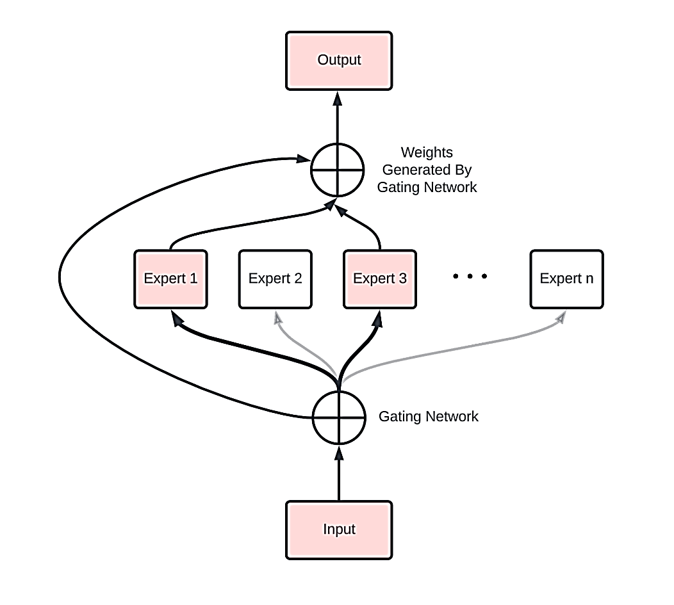
MoE Architecture
Mixture of Experts
An MoE system consists of two key components
Expert models, which can be neural nets or network layers, trained on different parts of the inputs (tokens)
Gating network, which acts as a router and decides which expert(s) should process an input

Slide 6
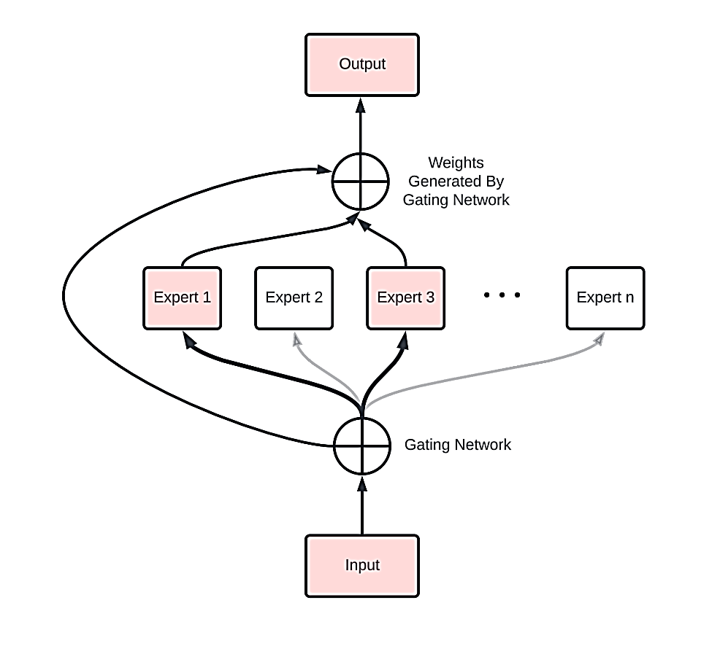
MoE Working Principles
Mixture of Experts
The gating network analyzes the inputs, and routes each input to relevant expert(s)
In some MoE architectures, each token is sent to more than one expert (e.g., to 2 experts in Mixtral)
The experts' outputs are afterward combined through techniques like additive or multiplicative aggregation of the outputs
During inference, for each input token only the chosen experts are activated, allowing efficient use of computational resources

Slide 7
MoE with Transformers
Mixture of Experts
In Transformers, sparse MoE layers are used instead of dense feed-forward network (FFN) layers
I.e., standard FFN layers are replaced with switching FFN layers
Each MoE layer has a certain number of experts (e.g., 4), where each expert is an FFN, and each processes specific tokens
For example, in the figure, the router sends the token “More” to the second expert (FFN 2), and the token "Parameters” is sent to the first expert (FFN 1)
Figure from the Switch Transformers paper: https://arxiv.org/abs/2101.03961

Slide 8
Sparse Blocks
Mixture of Experts
In dense models (e.g., networks with fully-connected layers) all the parameters of the model are used for processing all inputs (e.g., tokens)
In sparse models, the individual inputs are run only through some parts of the model

Slide 9
Sparse Blocks
Mixture of Experts
Sparsity uses the idea of conditional computation, where parts of the network are active on a per-token basis
Therefore, sparsity allows to scale the size of the model without increasing the computation
In Large Language Models, the size of the models (number of parameters) is directly proportional to the performance: largest models are the best performing
Sparsity allows to train very large models with lower computational cost
Also, sparsity allows to make inference with a trained sparse model much faster, in comparison to dense models

Slide 10
Routing
Mixture of Experts
Efficiently routing the tokens is one of the challenges for MoE
In recent MoE, the gating network (router) is composed of learned parameters and is trained at the same time as the rest of the network
I.e., the gating network is typically a simple neural network with a softmax function, which learns which expert to send each input to
Figure from the Switch Transformers paper: https://arxiv.org/abs/2101.03961

Slide 11
Routing
Mixture of Experts
In some cases, the gating network may converge to mostly activate the same few experts
When all tokens are sent to just 2 or 3 experts, that makes the training inefficient
I.e., the load is not properly balanced across all experts
To mitigate the issue of load balancing, an auxiliary loss can be introduced during model training to encourage giving all experts equal importance
The auxiliary loss ensures that all experts receive a roughly equal number of training examples
In some models (e.g., Mixtral), each token is sent to the top-2 experts to improve load balancing
There is significant research effort dedicated on efficient load balancing in MoE

Slide 12
Advantages of MoE
Mixture of Experts
The key advantages of MoE include faster pretraining thanks to sparse layers, and efficient inference by activating only required experts
MoE LLMs are pretrained much faster than dense models with the same number of parameters
Model capacity can be defined as the level of complexity that a model is capable of understanding or expressing
The size of a model is one of the most important factors for enhanced model capacity, and given a fixed computing budget, training a larger model for fewer steps is preferred than training a smaller model for more steps
E.g., Switch Transformers based on MoE achieved a 4x pretraining speed-up over the corresponding dense models
Faster inference is very important for end-users
Although an MoE might have many parameters, only some of them are used during inference, that results in much faster inference compared to a dense model with the same number of parameters
Faster pretraining and inference lead to potential savings in computational cost versus dense models
Similarly, MoE generate higher quality outputs by combining specialized experts

Slide 13
Challenges of MoE
Mixture of Experts
MoE have high GPU memory requirements since all experts needs to be loaded into the memory for both training and inference
E.g., loading all experts in Mixtral requires to load 49B parameters in the GPU VRAM memory, which creates challenges for users with low memory GPUs or a single low-end GPU
Finetuning MoE is more challenging than dense models, because sparse layers are more prone to overfitting
Recent works have shown promising results and introduced strategies for finetuning MoE
MoE require to carefully balance tradeoffs between training costs and inference efficiency
While offering faster inference, MoE require careful management of VRAM and computing resources

Slide 14
GPT-4's MoE
Mixture of Experts
Based on leaked information about Open AI’s GPT-4 language model, it is implemented using an MoE architecture
It combines 8 expert models, each with 220B parameters
This amounts to about 1.7T parameters, but the actual number of parameters can be somewhere between 1.2T and 1.7T parameters
MoE allows GPT-4 to achieve superior quality while optimizing computational efficiency during inference
MoE also allows to distribute the model across multiple GPUs while routing inputs dynamically

Slide 15
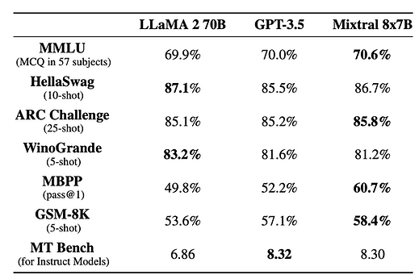
Mixtral: Open Source MoE
Mixture of Experts
Mixtral is an open-source MoE model with 47B parameters
It uses 8 expert Mistral-7B models
But Mixtral uses only about 12.9B parameters per input token through sparse routing
This allows Mixtral to outperform much larger models
It matches the quality of GPT-3.5 (175B parameters)
It is 6X faster than LLaMa-70B parameter

Slide 16
Mixtral: Open Source MoE
Mixture of Experts
Mixtral outperforms or matches LlaMA 70B on many benchmarks

Slide 17
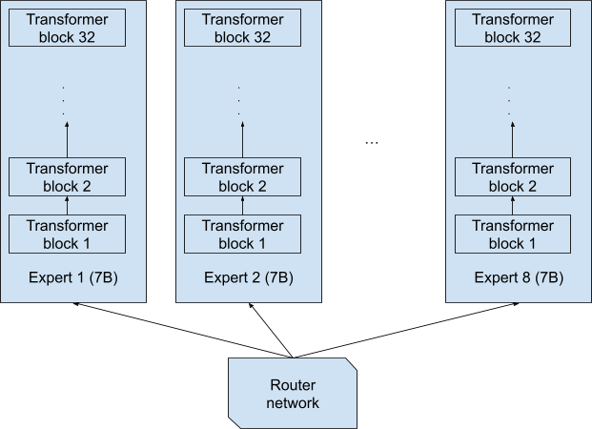
Mixtral: Open Source MoE
Mixture of Experts
It is important to note that although Mixtral uses 8 experts each having the form of a Mistral-7B model, it does not mean that each expert is a separate full network with 7B parameters, as shown in the figure below
This design would yield a model with 8x7B = 56B parameters
Figure from: https://developer.nvidia.com/blog/applying-mixture-of-experts-in-llm-architectures/

Slide 18
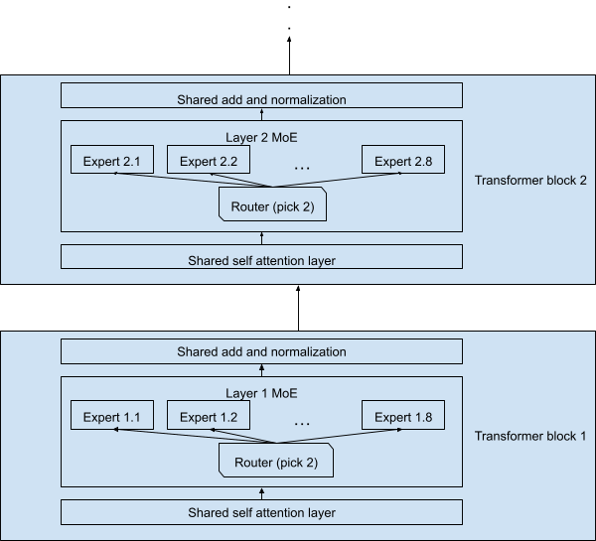
Mixtral: Open Source MoE
Mixture of Experts
The actual design of Mixtral is depicted in the figure below, where only the FFN layers are replaced with a sparse MoE block with 8 experts, and the remaining layers (including self-attention and normalization layers) are shared by all tokens
Therefore, the entire Mixtral model has about 47B parameters, and not 8x7B = 56B parameters, due to the shared layers
Each token is routed to two experts and processed by only 12.9B parameters (and not 2x7B = 14B parameters)
Figure from: https://developer.nvidia.com/blog/applying-mixture-of-experts-in-llm-architectures/

Slide 19
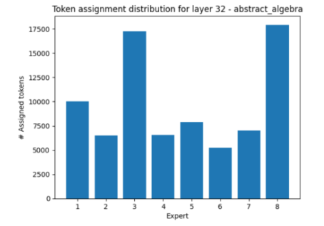
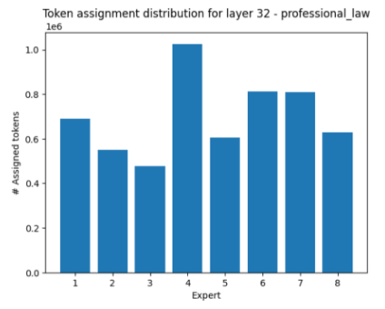
What Does an Expert Learn
Mixture of Experts
A recent work studied the experts in Mixtral on the MMLU benchmark
MMLU includes multiple-choice questions on 57 topics, such as abstract algebra, world religions, professional law, anatomy, astronomy, business ethics, etc.
Left figure: in layer 32, for abstract algebra questions, the model makes use of experts 3 and 8 much more than the other experts
Right figure, in the area of professional law, in layer 32 the model mostly activates expert 4 while muting experts 3 and 8
However, since the tokens are routed through 32 transformer blocks, there are so many expert combinations, and it is difficult to analyze precisely what each expert is learning
Figure from: https://developer.nvidia.com/blog/applying-mixture-of-experts-in-llm-architectures/

Slide 20
Future Potential of MoE
Mixture of Experts
MoE offer the potential for building scalable, efficient AI models across domains and applications
Current open-source MoE LLMs include:
Switch Transformers (Google), family of models from 8 to 2048 experts, the largest model has 1.6T parameters
NLLB MoE (Meta), an MoE variant of the NLLB translation model
OpenMoE, a community effort that has released Llama-based MoEs
Mixtral 8x7B (Mistral), 8 experts, 47B parameters

Slide 21
State Space Models
State Space Models
State Space Models are a new types of architectures for LLMs
This type of architectures don’t use the attention mechanism
They have potential to address some of the limitations of Transformer Networks, stemming from the attention mechanism
The concept of State Space Models have been extensively used in control systems and system identification for many decades
Mamba is a recent LLM that uses State Space Model architecture
It demonstrates the potential to replace Transformer LLMs

Slide 22
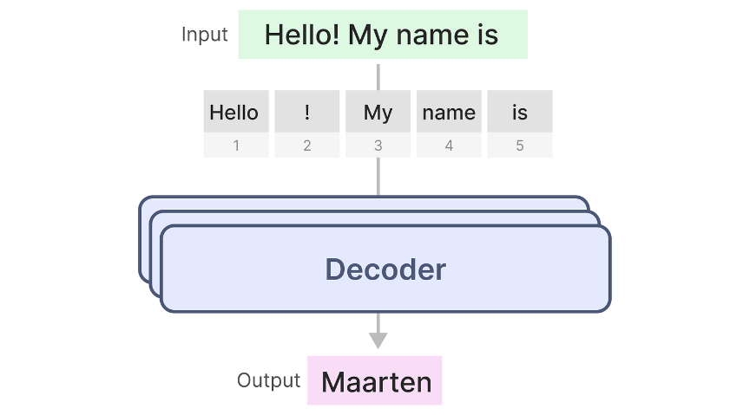
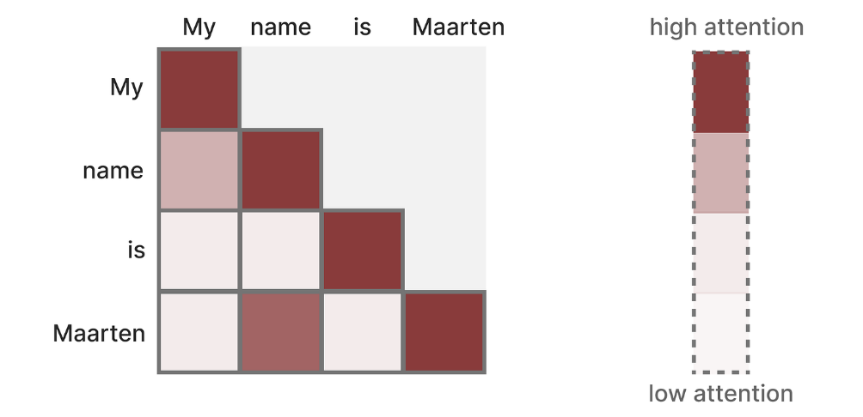
Transformers
State Space Models
Transformers process textual inputs as sequences of tokens, and derive representations from previous tokens in text
Attention scores are calculated between all token pairs, based on the relevance of one token for the meaning of another token in a specific context
Figure from: https://newsletter.maartengrootendorst.com/p/a-visual-guide-to-mamba-and-state

Slide 23
Transformers
State Space Models
Transformer architecture allows parallelization, which speeds up training tremendously
It is possible to distribute the training data in each batch across multiple GPUs
Multi-head attention modules can be processed in parallel
The tensors can also be split into smaller sub-tensors and processed in parallel
Figure from: https://newsletter.maartengrootendorst.com/p/a-visual-guide-to-mamba-and-state

Slide 24
The Problem with Transformers
State Space Models
Despite efficient training, Transformer architecture encounters a bottleneck during inference
It requires to recalculate the attention scores for the entire sequence, making inference slow and computationally expensive for long sequences
A sequence of length L requires L² computations (to calculate the attention matrix of size L × L)
I.e., there is a quadratic computational cost increase with increasing the length of the context for generating text
Figure from: https://newsletter.maartengrootendorst.com/p/a-visual-guide-to-mamba-and-state

Slide 25
Pros and Cons of Transformers
State Space Models
Pros
Effective at modeling complex dependencies: every token explicitly attends to all other previous tokens, via attention mechanism
Highly parallel training: the core operations are matrix multiplications which can be parallelized across many GPUs
Cons
Quadratic scaling with context length: since every input attends to all prior inputs, the total amount of computation accelerates as the number of tokens increases
Autoregressive inference is expensive: the attention scores needs to be recalculated for every new token

Slide 26
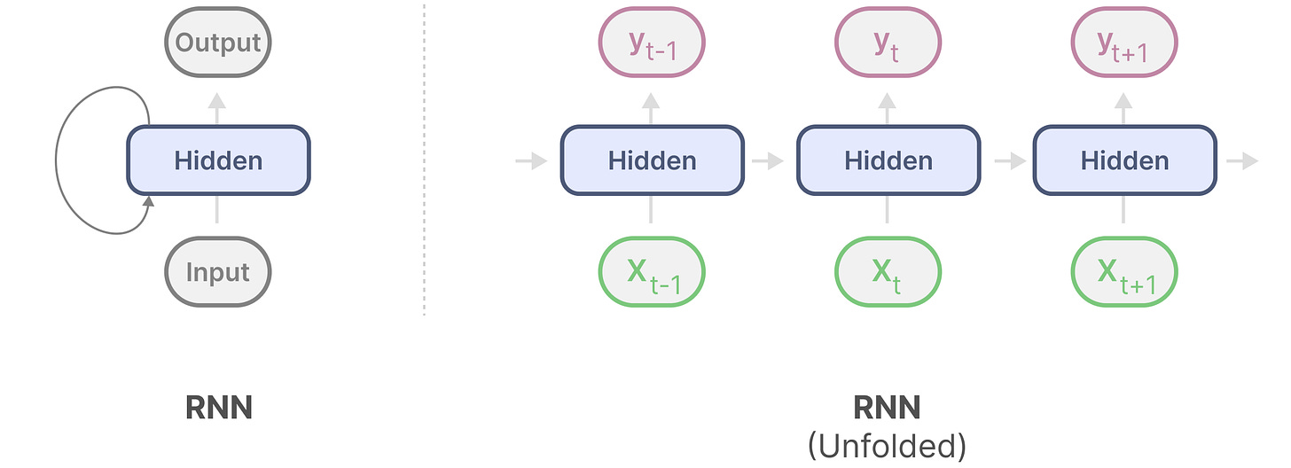
RNNs Overview
State Space Models
Recurrent Neural Networks (RNNs) have a looping mechanism (recurrence) that allows to pass information from a previous step to the next
At each step, the network takes the input at time step t and a hidden state of the previous time step t-1, to generate the next hidden state and predict the output
E.g., to calculate the output y_{t+1}, RNN needs only the input x_{t+1} and the corresponding hidden state
RNNs do not need access to all previous inputs for calculating y_{t+1}
Figure from: https://newsletter.maartengrootendorst.com/p/a-visual-guide-to-mamba-and-state

Slide 27
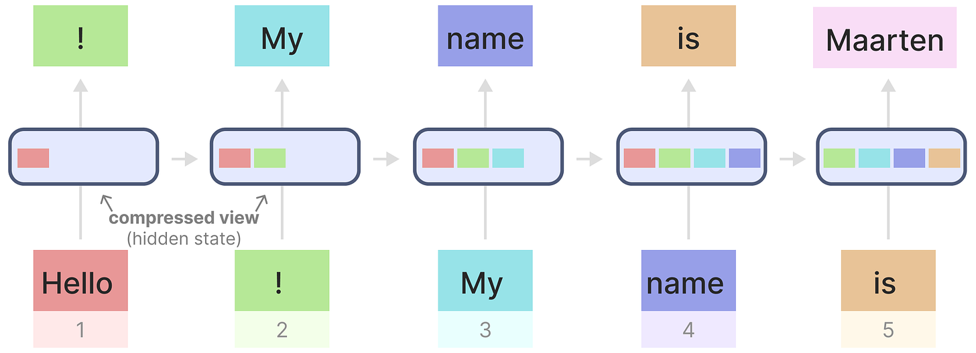
RNNs Overview
State Space Models
RNNs can do inference fast, since they scale linearly with the sequence length
When generating the output, the RNN only needs to consider the previous hidden state and current input
It does not need to recalculate all previous hidden states, as in Transformer
Each hidden state is an aggregation (compressed view) of all previous hidden states
Figure from: https://newsletter.maartengrootendorst.com/p/a-visual-guide-to-mamba-and-state

Slide 28
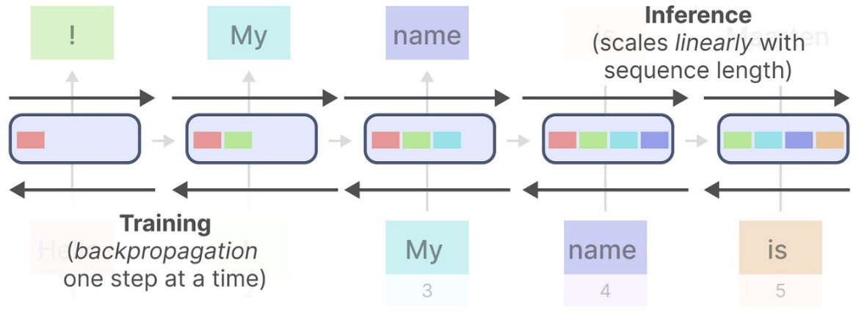
The Problem with RNNs
State Space Models
RNNs suffer from forgetting information over time
The last hidden state to produce the name “Maarten” may not contain information about the word “Hello”
Training cannot be done in parallel since RNNs need to go through each step at a time sequentially
GPUs have enormous throughput for parallel computation, but are otherwise very slow for sequential computation
Figure from: https://newsletter.maartengrootendorst.com/p/a-visual-guide-to-mamba-and-state

Slide 29
Pros and Cons of RNNs
State Space Models
Pros
Efficient autoregressive inference: since the hidden state encapsulates all prior inputs, the model only needs to consider a small set of new information for each subsequent input
No limits to context length at inference: there is nothing in the formulation of RNNs that constrains the model to a maximal sequence length
Cons
Ineffective modeling of complex sequential dependencies: all prior context must be compressed into a hidden state having a fixed amount of bits
Slow training: training requires sequential backpropagation through time, making poor utilization of GPUs

Slide 30
Transformers vs RNNs
State Space Models
The problems with RNNs and Transformers are completely opposite
Potential solution are State Space Models architectures, which allow fast inference similarly to RNNs, but can also use kernels and be parallelized during training similarly to Transformers
Figure from: https://newsletter.maartengrootendorst.com/p/a-visual-guide-to-mamba-and-state

Slide 31
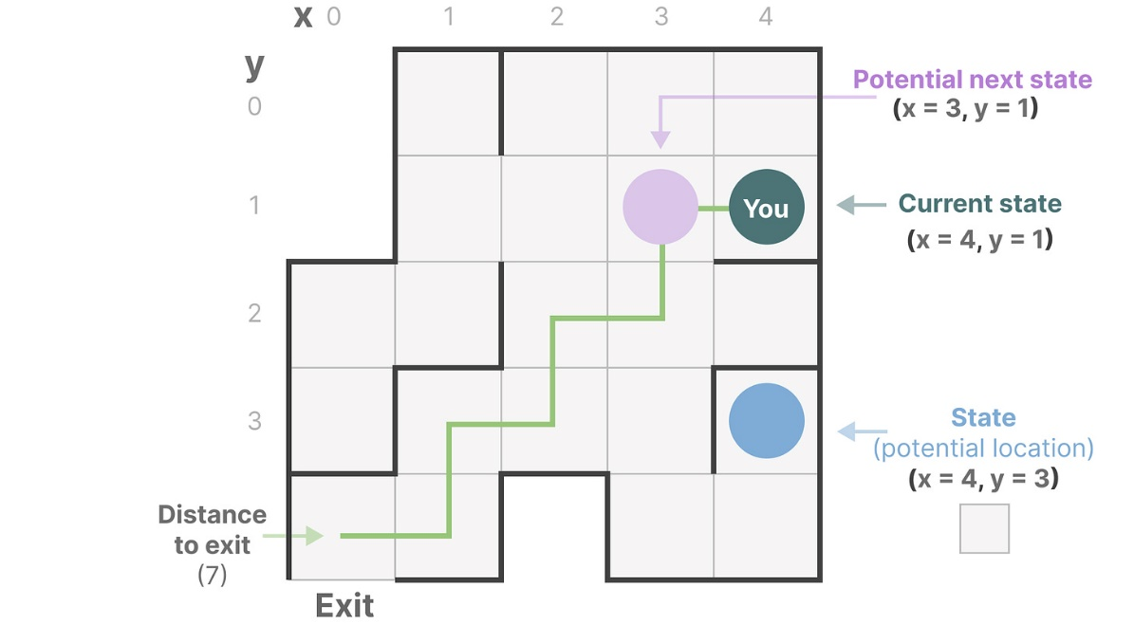
State Space Models
State Space Models
State Space represents a system's possible states using the minimum number of variables
For instance, to navigate through a maze, the state space is the map (space) of all possible locations (states)
The “state space representation” is a simplified description of this map, consisting of the current state, possible future states, and the changes required to get to the next state (going right or left)
Figure from: https://newsletter.maartengrootendorst.com/p/a-visual-guide-to-mamba-and-state

Slide 32
State Space Models
State Space Models
SSM equations describe state representations and predict future states and outputs based on inputs
SSM maps input sequences x(t) to latent state representations h(t) and derive predicted output sequences y(t)
By solving these equations, SSM can predict the system states from observed data
E.g., the location of an object moving in 3D space can be predicted from its state at time t through the two equations
Figure from: https://newsletter.maartengrootendorst.com/p/a-visual-guide-to-mamba-and-state

Slide 33
State Space Models
State Space Models
Components of SSM equations:
t represents time
x(t) is input to the model, h(t) is latent (hidden) state, and y(t) is output of the model
The matrices are: A – state matrix, B – input matrix, C – output matrix, and D – feedforward matrix
The matrices comprise the parameters of the SSM, and determine how the state h(t) evolves over the sequence of inputs x(t)
Figure from: https://newsletter.maartengrootendorst.com/p/a-visual-guide-to-mamba-and-state

Slide 34
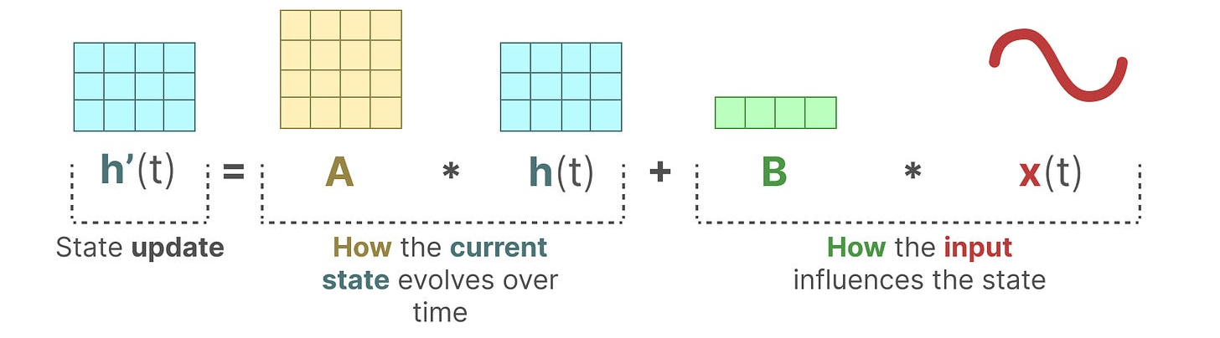
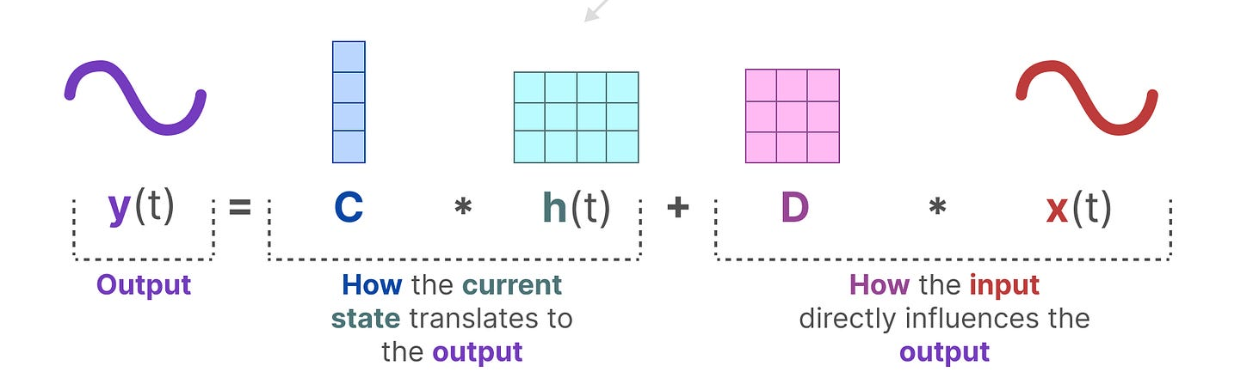
State Space Models
State Space Models
The differential equation $h′(t)=Ah(t)+Bx(t)$describes how the state $h(t$) changes (through matrix A) based on how the input $x(t)$influences the state (through matrix B)
The output equation $y(t)=Ch(t)+Dx(t)$describes how the state $h(t$) is translated to the output $y(t)=$(through matrix C) and how the input $x(t)$influences the output (through matrix D)
Figure from: https://newsletter.maartengrootendorst.com/p/a-visual-guide-to-mamba-and-state

Slide 35
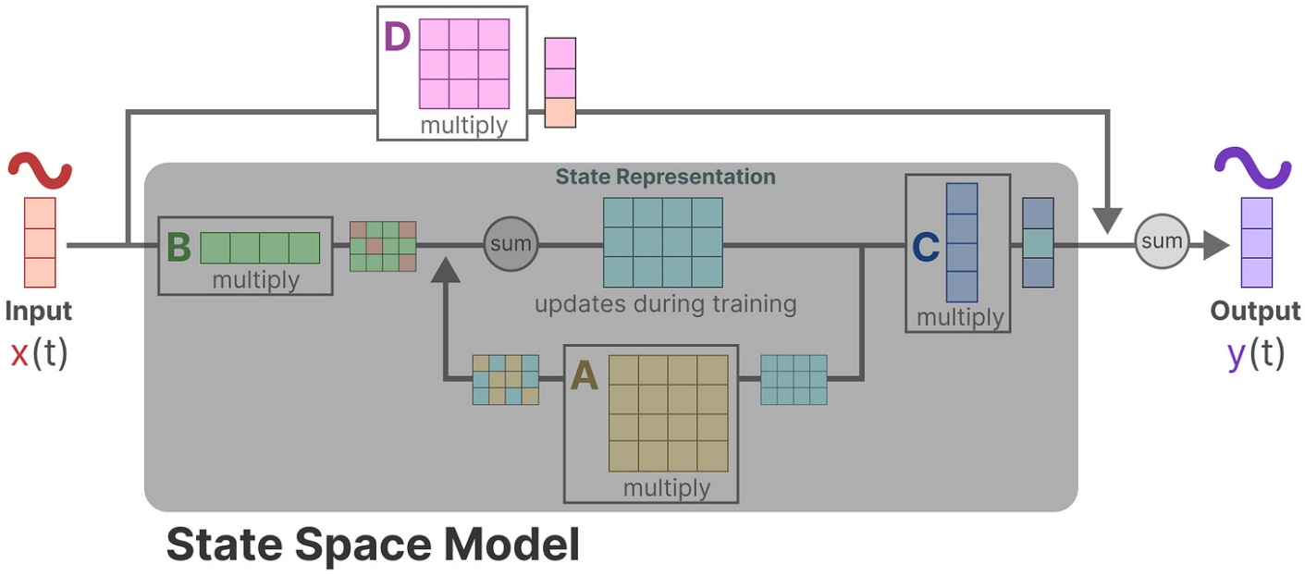
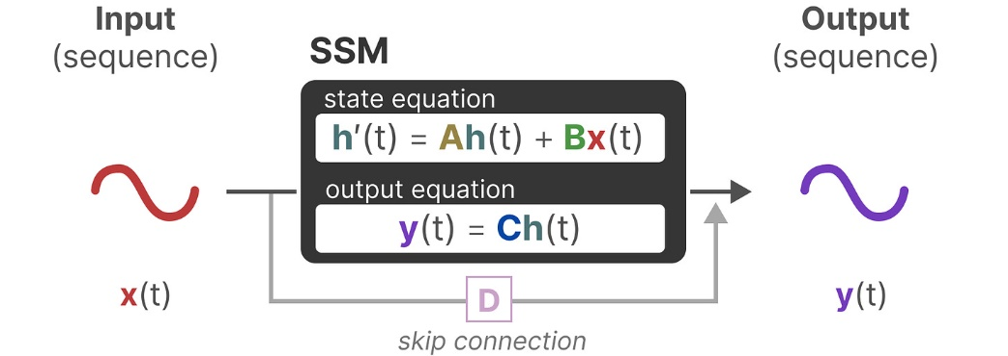
State Space Models
State Space Models
We can visualize the equations of SSM as in the figure below
Since the operation through matrix D is similar to a skip-connection, often the focus is only on matrices A, B, and C as the core of SSM
Figure from: https://newsletter.maartengrootendorst.com/p/a-visual-guide-to-mamba-and-state

Slide 36
Discrete State Space Models
State Space Models
Because LLMs work with sequence inputs rather than continuous inputs, a discretized version of SSM is used in LLM architectures
For instance, we can approximate a continuous signal with a discrete signal by sampling from it at discrete time moments 0, 1, 2, 3, 4, etc.
Figure from: https://newsletter.maartengrootendorst.com/p/a-visual-guide-to-mamba-and-state

Slide 37
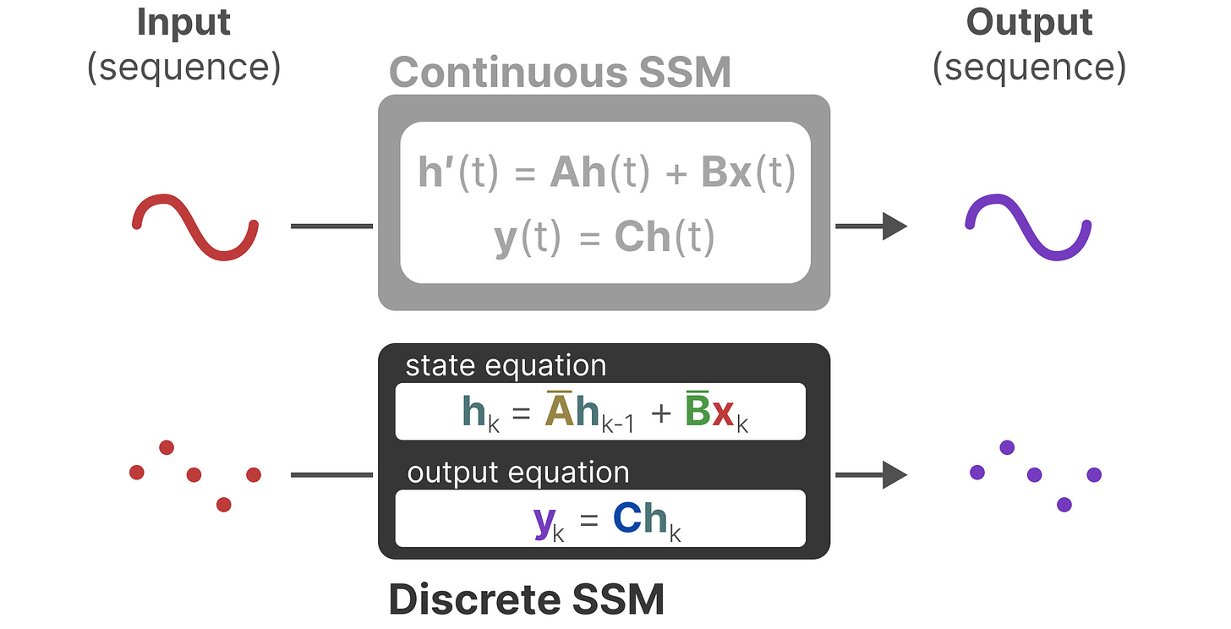
Discrete State Space Models
State Space Models
Similarly, we can discretize continuous SSM by approximating the vectors and matrices with discrete forms, as shown below
In the discrete SSM equations, the matrices $\overline{A}$ and $\overline{B}$ represent discretized parameters of the model
The discrete vectors x, h, and y have the subscript k for representing discretized timesteps, instead of the dependence of time t used to represent continuous vectors
Figure from: https://newsletter.maartengrootendorst.com/p/a-visual-guide-to-mamba-and-state

Slide 38
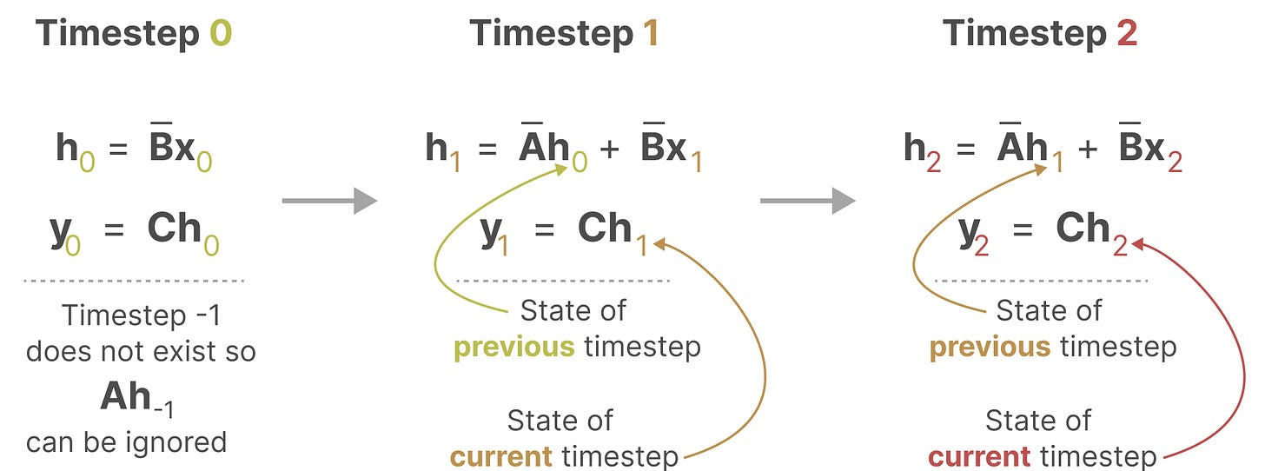
Recurrent Representation
State Space Models
Discretized SSM allows for problem formulation in discrete timesteps, forming recurrence similar to RNNs
I.e., at each timestep, we calculate how the current input ($\overline{B} x_{k}$) influences the previous state ($\overline{A}$ $h_{k−1}$), and then calculate the predicted output (C $h_{k}$)
Figure from: https://newsletter.maartengrootendorst.com/p/a-visual-guide-to-mamba-and-state

Slide 39
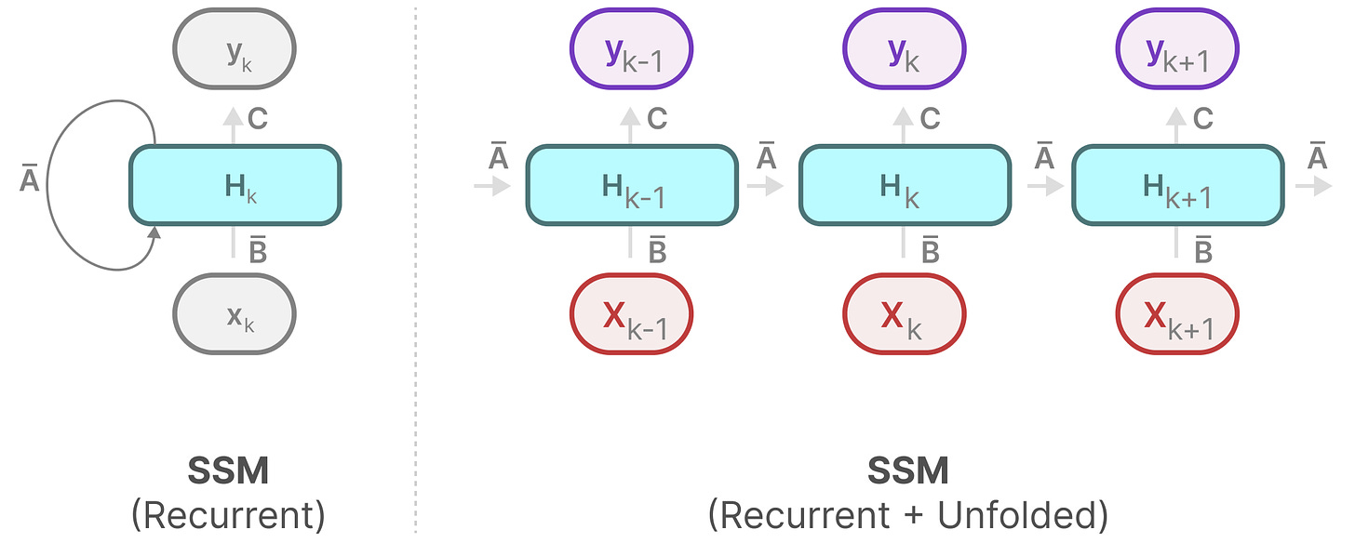
Recurrent Representation
State Space Models
Therefore, the representation of discrete SSM can be depicted with a graph of an RNN
Figure from: https://newsletter.maartengrootendorst.com/p/a-visual-guide-to-mamba-and-state

Slide 40
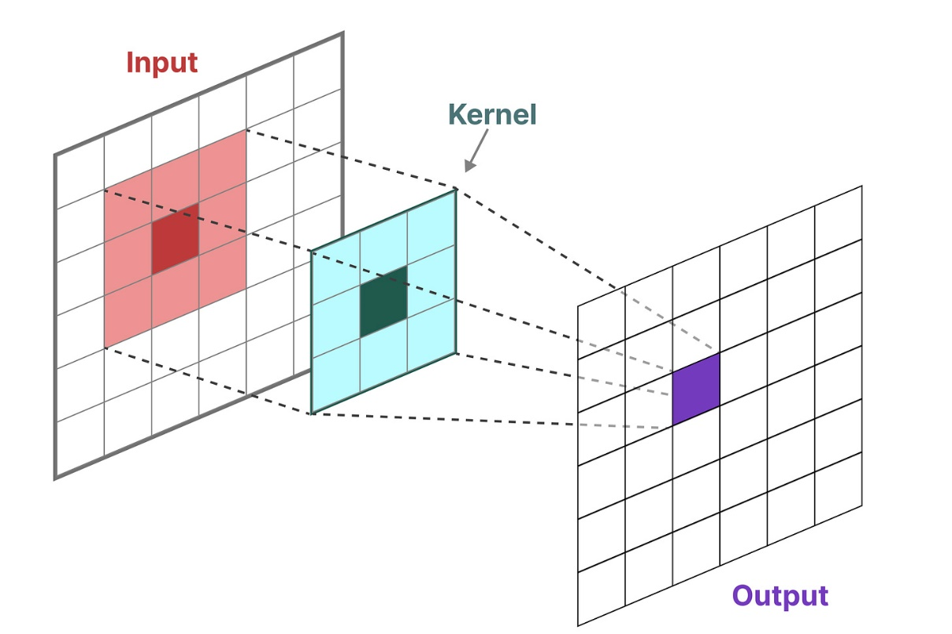
Convolutional Representation
State Space Models
Another representation that we can use for discrete SSM is that of convolutions
For instance, the figure shows convolutional filters (kernels) in Convolutional NNs applied for generating features for image classification
Figure from: https://newsletter.maartengrootendorst.com/p/a-visual-guide-to-mamba-and-state

Slide 41
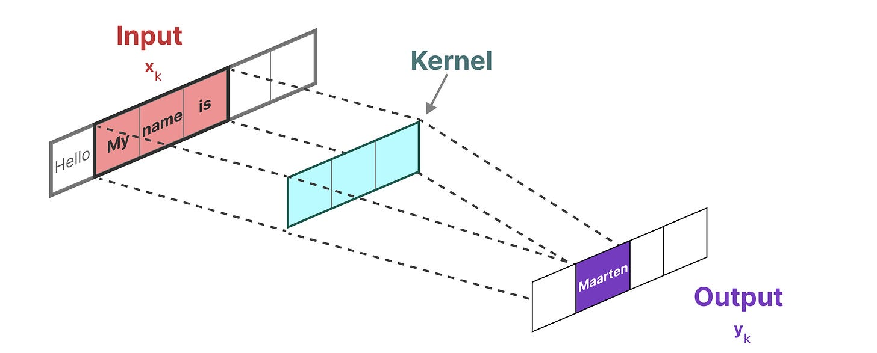
Convolutional Representation
State Space Models
For sequences of text which are 1-dimenisional, we can consider applying a 1-dimensional convolutional filter (kernel)
The 1-d kernel slides over the input sequence of tokens and it is used to calculate the output token over each position of the input sequence
Figure from: https://newsletter.maartengrootendorst.com/p/a-visual-guide-to-mamba-and-state

Slide 42
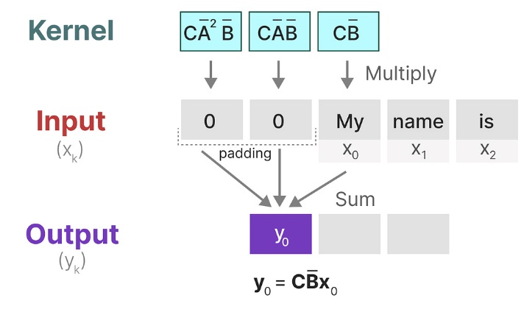
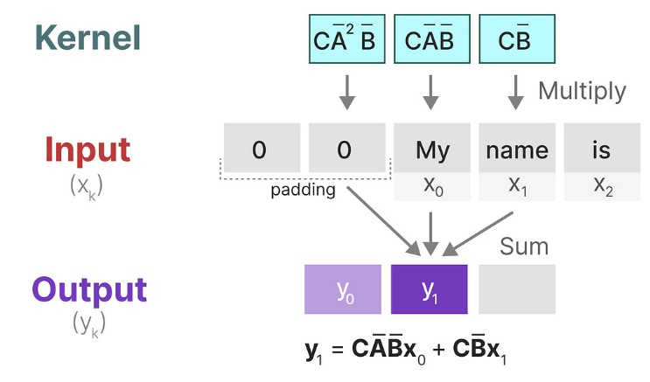
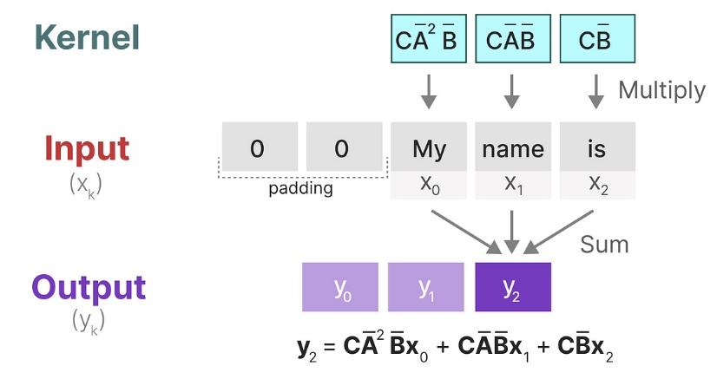
Convolutional Representation
State Space Models
The kernel can be derived from the SSM formulation as the product $\overline{CA^{i}B }$
In practice, we can use the SSM kernel to slide over each set of input tokens and calculate the output, similar to applying 1-d convolution
Figure from: https://newsletter.maartengrootendorst.com/p/a-visual-guide-to-mamba-and-state

Slide 43
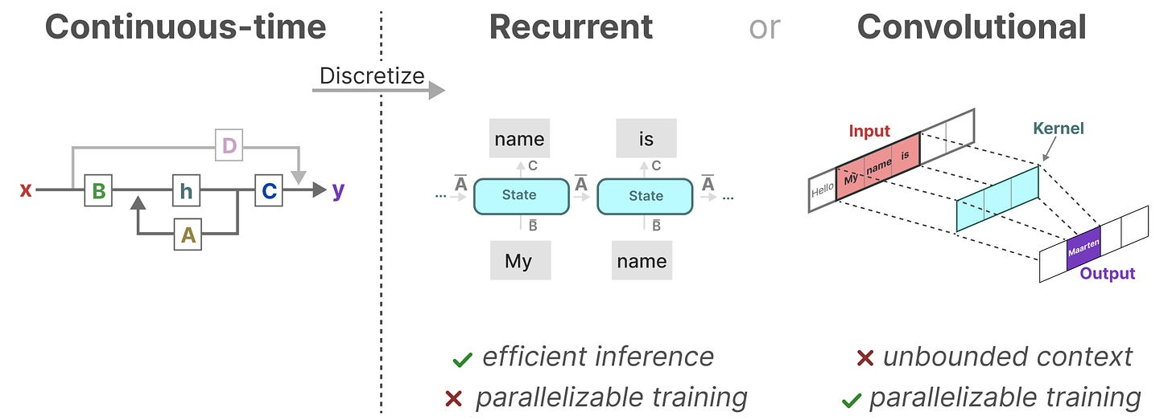
The Three Representations of SSM
State Space Models
The representations of SSM as recurrent and convolutional systems have different sets of advantages and disadvantages
Interestingly, the different representations of SSM allow to have efficient inference with the recurrent SSM and parallelizable training with the convolutional SSM
Figure from: https://newsletter.maartengrootendorst.com/p/a-visual-guide-to-mamba-and-state

Slide 44
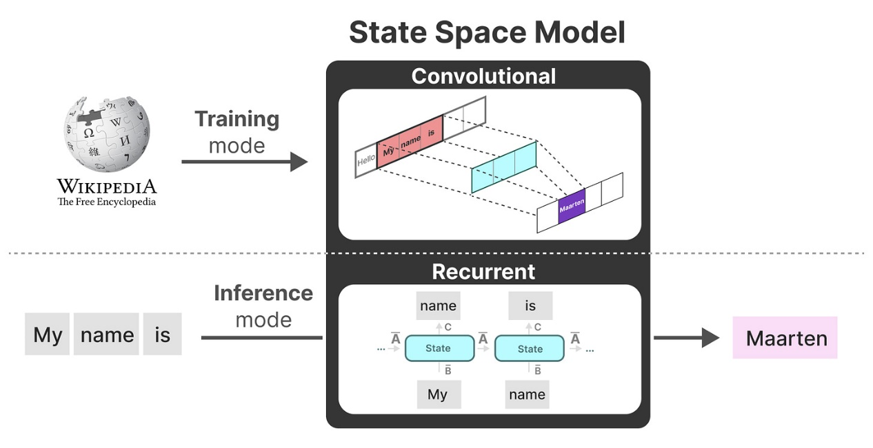
The Three Representations
State Space Models
With these different representations of SSM:
During training the model uses the convolutional representation over the entire sequences of tokens for parallelized training
During inference the model uses the recurrent representation to make next token predictions for each new token at a time
Figure from: https://newsletter.maartengrootendorst.com/p/a-visual-guide-to-mamba-and-state

Slide 45
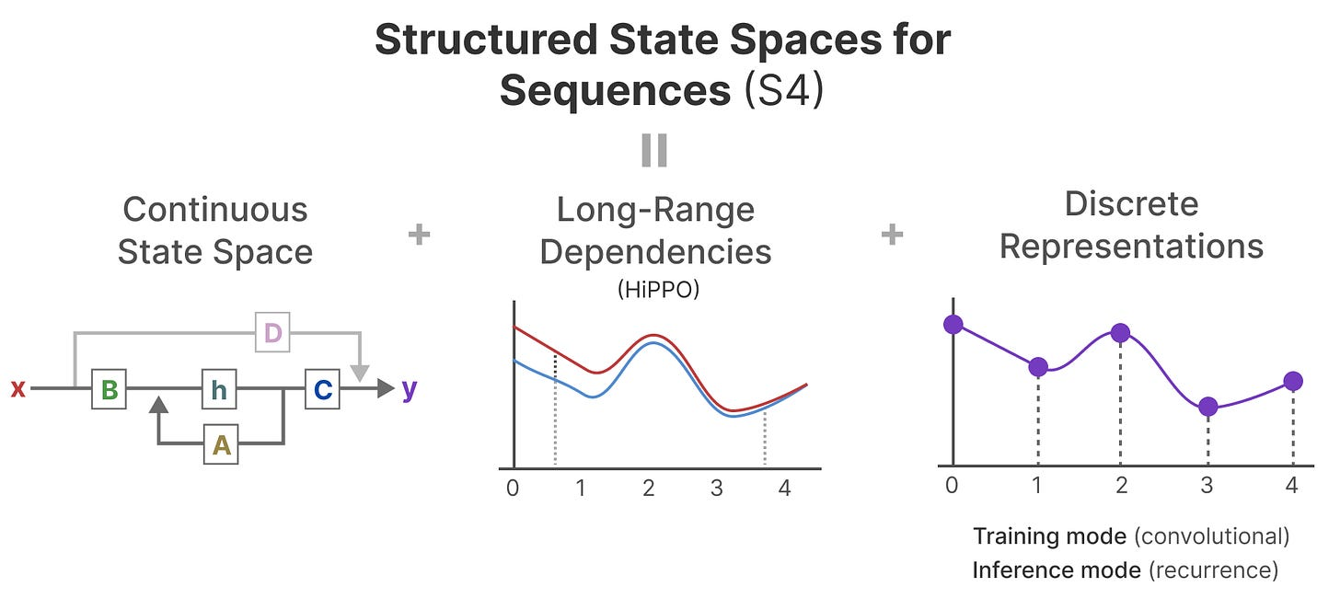
S4 Architecture
State Space Models
Despite the promises of SSM for text modeling, there are challenges for handling long sequences and capturing long-range dependencies
Structured State Space for Sequences architecture (a.k.a. S4) proposed a novel solution for handling dependencies in long sequences
S4 parameterizes the matrix A as a diagonal matrix, initialized with approximations of the HiPPO (High-order Polynomial Project Operators) matrix
Imposing a HiPPO-based structure on the matrix A (hence the name “structured” in S4) enables to memorize previous tokens, by tracking the coefficients of a Legendre polynomial
By using a HiPPO matrix structure, S4 architecture allows for handling long sequences and storing memory efficiently
Figure from: https://newsletter.maartengrootendorst.com/p/a-visual-guide-to-mamba-and-state

Slide 46
Mamba
State Space Models
Mamba builds upon the S4 architecture, and introduced two important modifications to S4
Selective scan SSM parameters, which allows the model to filter irrelevant information
Efficient hardware implementation, that allows for efficient GPU storage of intermediate results
Importantly, Mamba demonstrated strong empirical results
Mamba architecture is also referred to as a Selective Scan SSM (or S6) since it extends the S4 model for computations of the SSM matrices with the selective scan algorithm

Slide 47
Mamba -Departure from LTI
State Space Models
Departure from Linear Time Invariance (LTI) in S4
Matrices A, B, and C in S4 are time-invariant, meaning that they are the same for every token (i.e., across all time steps in a sequence)
These matrices are fixed, regardless of the input
As a result, the model treats all tokens equally, and it cannot perform content-aware reasoning
Conversely, content-aware reasoning is easy for Transformers, because the attention scores are dynamically calculated based on the input sequence
Mamba introduces selective scan algorithm to dynamically calculate matrices A, B, and C as time-varying matrices that change for every input token
This allows to selectively choose what information to keep in the hidden state, and what information to ignore
The matrices learn which input tokens are the most important at each step, hence the name selective scan
Figure from: https://newsletter.maartengrootendorst.com/p/a-visual-guide-to-mamba-and-state

Slide 48
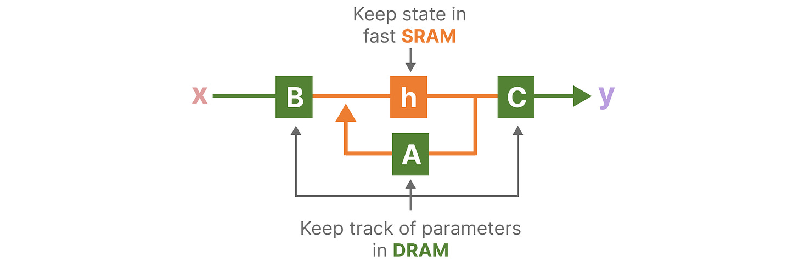
Mamba – Hardware-aware Resource Management
State Space Models
Another novelty that Mamba introduces is hardware-aware parallelism and optimized memory usage by controlling the data transfer between the highly-efficient SRAM memory and less-efficient DRAM memory in GPUs
Copying information between SRAM and DRAM is often a bottleneck in GPUs
The hardware-aware component focuses on how to store the latent state h in the SRAM memory as the most efficient part of memory
The A, B, and C matrices are kept in the DRAM memory, so that the cost of moving data doesn't induce a large computational bottleneck
Figure from: https://newsletter.maartengrootendorst.com/p/a-visual-guide-to-mamba-and-state

Slide 49
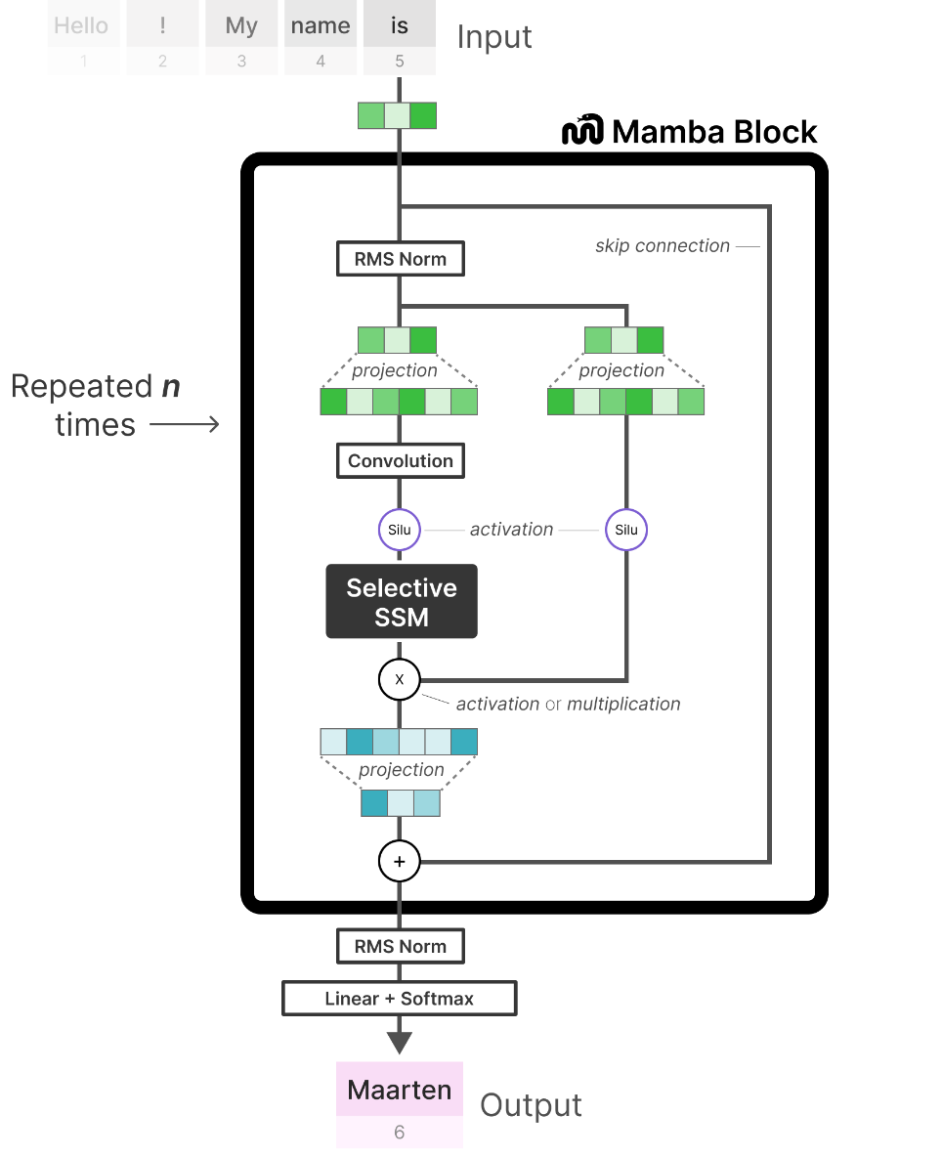
Mamba Architecture
State Space Models
Mamba implements Selective SSM as a block, where multiple Mamba blocks can be stack to create a large model
The block applies linear (dense) layers to input embedding vectors, followed by convolution, Selective scan layer, and linear layer
SiLU (Sigmoid Linear Unit) activation are used, which for input x output $xσ(x)$, where $σ\left(x\right)$is sigmoid function
The output is projected though RMS Norm and Linear layer with Softmax
RMS Norm is Root Mean Square layer normalization layer
The RMS Norm layer replaces Layer Normalization layers used in Transformers
Figure from: https://newsletter.maartengrootendorst.com/p/a-visual-guide-to-mamba-and-state

Slide 50
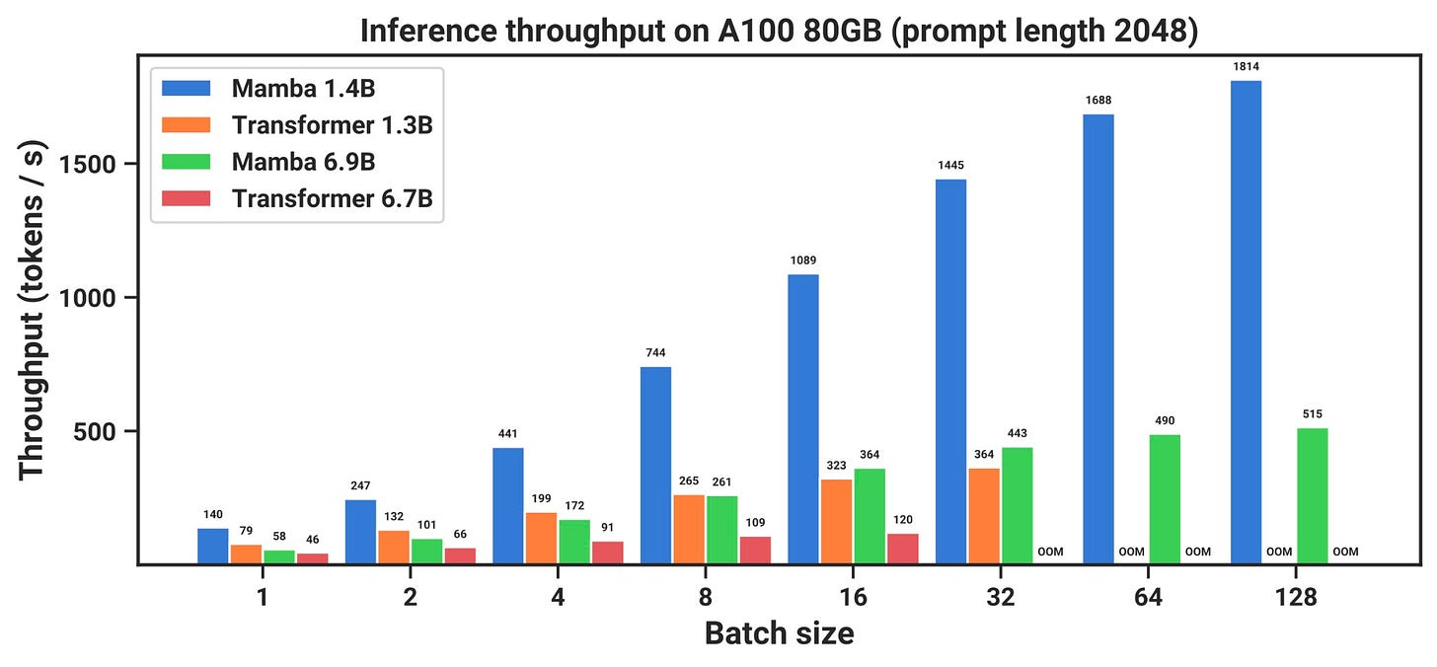
Mamba Results
State Space Models
The figure below shows a comparison of generated tokens with Mamba and corresponding Transformers
Mamba offers significant speed up at inference, and it achieves 4-5x higher inference throughput than a Transformer of similar size
Inference was performed with Mamba on one million token sequences

Slide 51
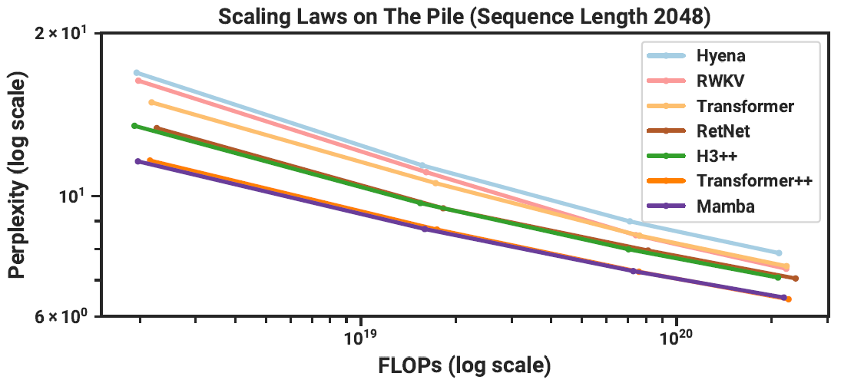
Mamba Results
State Space Models
The graph below shows the perplexity of different LLMs as a function of the required computation (FLOPs) for model training
Recall that lower perplexity is preferred
The size of the models is changed from 125M to 1.3B parameters
Mamba uses less computational resources, in comparison to other LLMs architectures, including the original Transformer and Transformer++ (based on PaLM and LLaMA)
125M parameters
1.3B parameters

Slide 52
Mamba Results
State Space Models
Mamba outperformed models of similar size on language, audio, and genomics data
It is the first non-Transformer architecture that achieved performance at the level of Transformers architectures
One limitation of this study is that Mamba was implemented with 3B and 6.9B parameters
Large Mamba models with size that correspond to GPT-4, Claude, Gemini were not implemented
It is not clear if the performance by Mamba architecture can match the Transformers at the size of 100+ billion parameters
Another open question is regarding the properties of Mamba models regarding finetuning, quantization, instruction tuning, RLHF, etc.

Slide 53
References
Miguel Carreira Neves, “LLM Mixture of Experts Explained,” available at https://www.tensorops.ai/post/what-is-mixture-of-experts-llm
Omar Sanseviero, et al., “Mixture of Experts Explained,” available at https://huggingface.co/blog/moe
Kyle Kranen and Vinh Nguyen, “Applying Mixture of Experts in LLM Architectures,” available at https://developer.nvidia.com/blog/applying-mixture-of-experts-in-llm-architectures/
Maarten Grootendorst, “A Visual Guide to Mamba and State Space Models,” available at https://newsletter.maartengrootendorst.com/p/a-visual-guide-to-mamba-and-state
James Chen, “Mamba No. 5 (A Little Bit of …),” available at https://jameschen.io/jekyll/update/2024/02/12/mamba.html
Nathan Lambert, “State-space LLMs: Do we need Attention?,” available at https://www.interconnects.ai/p/llms-beyond-attention

