Slide 1
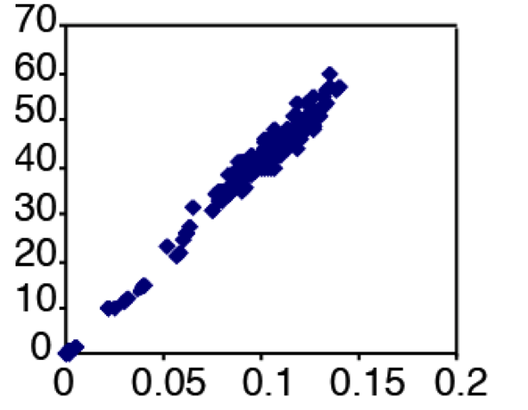
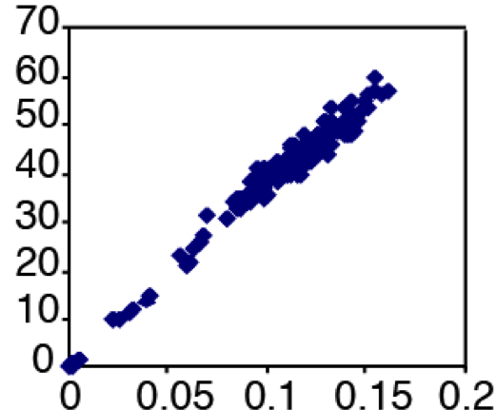
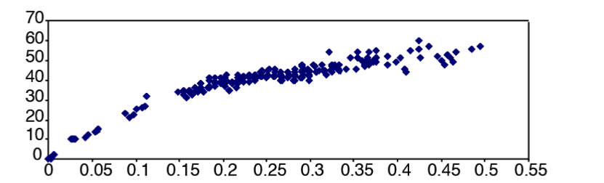
Lecture 12 – Model Selection
Goal is to find the optimal combination of topology, 2n-3 branch lengths,
model, and model parameters.
All models are wrong, but some are useful.
p-distance
K2P
HKY+I+Γ
Sullivan and Joyce (2005 Ann. Rev. Ecol. Evol. & Syst. 36:446)

Slide 2
A. Iterative Approach.
Ideally, we could evaluate models (and estimate the parameters of those models)
and topologies simultaneously.
One way around that that has been widely used is based on understanding of the manner in which parameter estimates vary across topologies. (Sullivan et al. 1996. The effect of topology on estimates of among-site rate variation. J. Mol. Evol. 42:308-312)
100 Random Trees
100 Shortest (MP) Trees
α
α

Slide 3
A. Iterative Approach.
Parameters of the HKY + I + Γ model
Tree ML NJ
------------------------------------
-ln L 6591.293 6586.008
Ti/tv:
exp. ratio 2.684860 2.854459
kappa 5.503353 5.850992
Shape 0.787432 0.766300
P_inv 0.456164 0.456575

Slide 4
A. Iterative Approach.
This suggests that we ought to be able to use a fast, approximate tree (i.e., an NJ tree or an MP tree) on which to estimate model parameters and select a model.
Iterative Approach
Step 1: Construct an initial tree, say using NJ with LogDet distances or MP
(ModelFinder in IQ-TREE uses an MP tree). Save the tree.
Step 2: Calculate the likelihood score of alternative models of nucleotide substitution,
with all model parameters optimized simultaneously. Choose from among these
models using some (statistical) criterion.
Step 3: Conduct a new search of tree space under the likelihood criterion, using
the model chosen in Step 2, with the parameters of that model fixed to values
estimated in Step 2. If the trees found in the current search are a subset of the
trees found in the preceding search, STOP; otherwise, go back to Step 2.
This approach has been shown to work quite well (Sullivan et al. 2005. MBE. 22:1386 ).

Slide 5
II. Absolute Goodness of Fit.
The test was first developed by Nick Goldman in 1993 (J. Mol. Evol. 36:182 – it’s called
the Goldman-Cox test) and is an extension of the parametric bootstrap.
The Unconstrained Likelihood
1 A G T A C A . . . . . . . . . . . . . . .
2 A G T A . . . . . . . . . . . . . . . . .
3 A G T A . . . . . . . . . . . . . . . . .
. . . . . . . . . . . . . . . . . . . . . .
. . . . . . . . . . . . . . . . . . . . . .
n A G T A . . . . . . . . . . . . . . . . .
Pattern 1 2 3 1 . . . . . . . . . . . . . . . .(a)

Slide 6
II. Absolute Goodness of Fit.
Has an upper bound, lnL_{max}. This is the condition in which the model exactly predicts the data.
That is, L_{a} = f_{a}.
The likelihood if every site had its own model and could evolve on its own tree.
The deterioration in likelihood associated with forcing all data to fit a single model and tree.
δ = lnL_{max} - lnL_{(τ| Data, Model)}

Slide 7
II. Absolute Goodness of Fit.
δ = lnL_{max} - lnL_{(Data | τ, M)}
So, we have this test statistic. We now must derive some null distribution to compare it to.
We thus simulate data under the null hypothesis of a perfect fit between model and data.
In the simulated data sets, we know that there’s a perfect fit between model and data because we’re using the model under examination to generate the
test statistic in the replicates.

Slide 8
II. Absolute Goodness of Fit.
So, in theory, one might be able to do such a test on all models under consideration and pick the simplest one that is not rejectable.
On over-parameterized model will explain stochastic variation, even if many
parameters are superfluous.
The GTR+I+Γ family has 1624 models and we would have to construct the null distribution for each via simulation to select the simplest model that exhibits
an adequate fit.
Furthermore, the Goldman-Cox test (as well as its Bayesian counterpart) almost
certainly has low power (Ripplinger & Sullivan. 2010. MB&E. 27:2790) .
Simulated with
3-partition GTR+I+Γ

Slide 9

III. Relative Goodness of Fit
A. Akaike Information Criterion (AIC)
AIC_{i} = -2 lnL_{i} + 2d_{i} ,
where d_{i} is the number of parameters in model i.
The likelihood measures fit and there’s a penalty for adding parameters.
AIC_{C} - Corrects for small sample size, but with ~400 sites converges on AIC.
The Kullback-Leibler Distance
E(ln P(D | M_{T}) | M_{T}) – E(ln P(D | M_{i}) | M_{T}),
where M_{T} is the true model and M_{i} is the model under consideration.
How much information is lost when approximating M_{T} with M_{i}?
Assuming all M_{i} are close to M_{T} and our sample is large, the M_{i} with the lowest AIC
is the preferred model.

Slide 10
III. Relative Goodness of Fit
B. Bayesian Information Criterion (BIC; derived by Schwarz)
BIC_{i} = -2 lnL_{i} + d_{i} ln(n),
where d_{i} is the number of parameters in M_{i} (as before) and n is sample size.
This measure fit and penalizes superfluous parameters (more heavily than AIC).
Schwarz demonstrated that model with the lowest BIC_{i} approximates the model
with the highest posterior probability.
Assumptions:
All M_{i} have ca. same prior probability (that there is a very “vague” prior).
The Taylor approximation holds - we can approximate the marginal likelihood
with the joint likelihood (more about this later).
Evans and Sullivan (2010. MB&E. 28:343) showed that the second assumption holds
when there’s a lot of information in the data with respect to model preference.

Slide 11
III. Relative Goodness of Fit
C. Hierarchical Likelihood Ratio Tests (hLRTs)
δ = 2(lnL₀ – lnL₁)
where M₀ is a complex model and M₁ is a simpler special case.
Therefore, this approach just assesses fit.
The test statistic is asymptotically χ²-distributed, as long as models are nested,
with d.f. equal to difference in number of parameters.
Frati et al. (1997)
Sullivan et al. (1997)

Slide 12
III. Relative Goodness of Fit
C. Hierarchical Likelihood Ratio Tests (hLRTs): Problem of pairwise comparisons.
Top down?
JC vs. K2P using a χ² w/1 d.f.
JC vs. F81 using a χ² w/3 d.f.
JC vs. JC+I or perhaps JC+Γ,
with the mixed χ²
Bottom Up?

Slide 13
IV. Novel Approaches
A. Decision Theory - remove the exclusive reliance on fit.
Assume we are faced with a choice between, say, A or B and there are multiple possible outcomes of each choice.
There are a possible outcomes if choice A is made (A₁, A₂, . . . A_{a} ).
And there are b possible outcomes if choice B is made (B₁, B₂, . . . B_{b}).
We need to be able to quantify the cost associated with each potential outcome (i.e., C_{A1}, C_{A2}, . . . C_{Aa} and C_{B1}, C_{B2}, . . . C_{Bb}).
We need to determine the probabilities of each potential outcome, given each choice: P(A₁|A), P(A₂|A), . . . P(A_{a}|A) and P(B₁|B), P(B₂|B), . . . P(B_{b}|B).

Slide 14
IV. Novel Approaches
A. Decision Theory - remove the exclusive reliance on fit.
We then calculate the expected cost (i.e., the risk) associated with each choice.
&
We then would make the choice that minimizes the risk.
These cost functions can be erected based on any aspect of an analysis.
In phylogenetics, we want to minimize the topological risk.

Slide 15
IV. Novel Approaches
A. Decision Theory – Minimizing branch-length error (Minin et al. 2003. Syst. Biol. 52:674).
We assume an unrooted phylogeny with k terminal nodes & 2k-3 branches.
B = (B₁, B₂, . . . ,B_{2k-3}) is the vector of branch lengths, with being the vector of
estimated branch lengths under the assumptions of model M_{i}.
If we have two models, M_{i} and M_{j}, the Euclidean distance between the branch length estimates is given by:
So, for each model i, we sum the risks of choosing i when we should have chosen
j, weighted by the probability that j is the true model, for all models.
We then choose the model with the lowest risk.

Slide 16
IV. Novel Approaches
A. Decision Theory – Minimizing branch-length error.
Remember that BIC_{i} approximates the P(M_{i} | D):
We use an NJ tree calculated with LogDet distances as the tree to assess models,
and this approximation works well (Abdo et al. 2005. MB&E.22:691).
DT method incorporates fit and a penalty for over-parameterization, as well as
expected branch-length error in selecting a model.
It compares all models simultaneously.
In many instances the same model is chosen by this method as by other methods, but when they differ, the DT method chooses simpler models that nevertheless perform as well or better than models chosen by other methods.

Slide 17
IV. Novel Approaches
B. Model Averaging
Model selection represents a choice that is made with uncertainty, one view is that we should incorporate this uncertainty into our phylogeny estimation.
Posada & Buckley (2004) advocate using the AIC to derive model weights.
Here, the weights are based on the following: Δ_{i} = AIC_{i} – AIC_{min},
Difference in AIC score between M_{i} and the best AIC score in your set of candidates.
Strong support for M_{i} (in addition to the best model).
Moderate support for M_{i} (in addition to the best model).
No support for M_{i}.

Slide 18
IV. Novel Approaches
B. Model Averaging
Reversible-jump MCMC is a better approach to multi-model inference.
So, the idea is that the model is a random variable and inferences should integrate
model uncertainty directly.
Huelsenbeck et al. (2003. MB&E. 21:1123) developed AllModels to account for 203 special cases of GTR+Γ, and Evans and Sullivan (2010. MB&E. 28:343) have generalized approach this to all 1624 special cases of GTR+I+Γ.
These approaches will allow us to incorporate model uncertainty in topology
estimates in a single analysis and are likely to be increasingly important.

Slide 19
IV. Novel Approaches
B. Model Averaging – Huelsenbeck et al. (2004).
The frequency of each model in the posterior distribution permits a direct
evaluation of P (M_{i} | D).

Slide 20
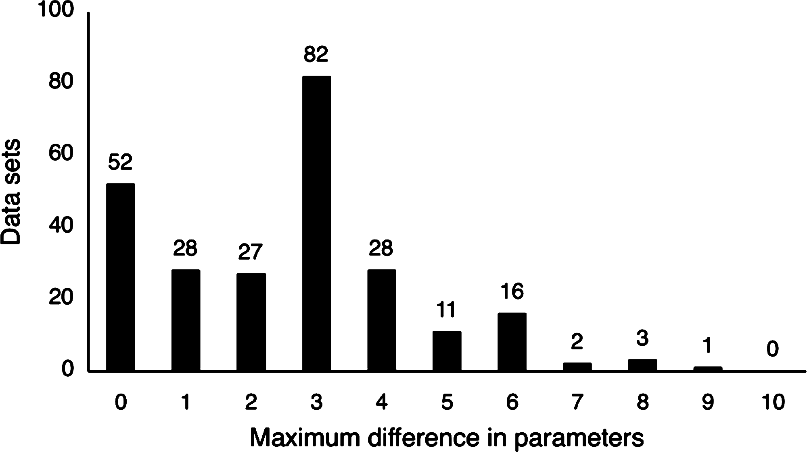
Does it matter how we select models?
Ripplinger & Sullivan (2008. Syst. Biol.)
250 empirical data sets from TreeBASE & selected models via hLRT, AIC, BIC, & DT.
All four picked same model in 51 data sets.
Two models were selected in 123 data sets.
Three were selected in 70 data sets.
All picked different models in 6 data sets.
Approach avg # param
hLTR * 6.9 ± 2.2
AIC 8.4 ± 1.8
BIC 6.7 ± 1.7
DT 6.7 ± 1.4
*hLRT with Modeltest default
When models differed, ML trees differed ~50 % of time.
However the differences were almost always at poorly supported nodes.

Slide 21
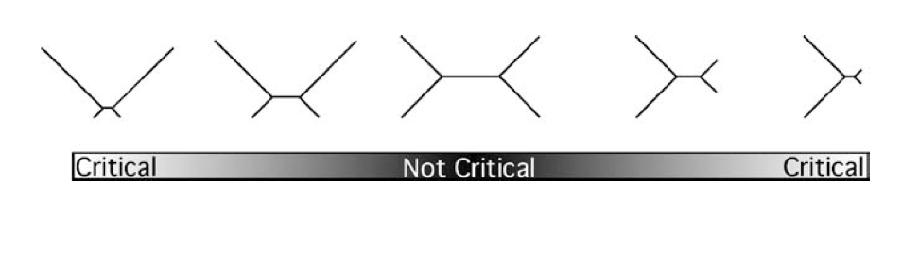
When does model selection matter?
(Sullivan and Joyce, 2005)
As long as there is no extreme branch-length disparity, all decent models
will be sufficient.

Slide 22
V. Diversion into No Common Mechanism
Goldman (1990. Syst. Zool. 39:345) showed that if all 2n-3 branch lengths are equal,
ML under a JC model is equivalent to a parsimony model.
Tuffley & Steel (1997. Bull. Math. Biol. 59:581) generalized this to a No Common Mechanism
model (NCM) and applied a separate JC to each branch for each site.
(2n-3) x l parameters for a data set with l nucleotides
Huelsenbeck et al. (2008. Syst. Biol. 57:306).

Slide 23
V. Diversion into No Common Mechanism
Huelsenbeck et al. (2011) – NCM_{GTRC}
π_{A}, π_{C}, π_{G}, & π_{T}
V_{2,l}
V_{4,l}
V_{3,l}
V_{1,l}
V_{5,l}
(2n -3) x l + 8 parameters

Slide 24
V. Diversion into No Common Mechanism
Huelsenbeck et al. (2011) – NCM_{GTR} model
(2n-3) x l x 8 parameters!

Slide 25
V. Diversion into No Common Mechanism
Model Selection Approaches
1) Holder et al. (2010. Syst. Biol. 59:477) demonstrated that the AIC will never favor the original (JC) variant of the NCM model over any of the common mechanism models.
2) Hulesenbeck et al. (2011. Syst. Biol.) evaluated the marginal likelihoods of several GTR+Γ special cases relative to the various NCM variants.
NCM_{GTRC}
NCM_{GTRC}
NCM_{GTR}
NCM_{GTR}
NCM_{Gold90}
NCM_{T-S}
NCM_{Gold90}
NCM_{T-S}

