Slide 1
Lecture 2 - The History of Phylogenetic Inference
Haeckel’s evolutionary trees are among the first attempts at phylogeny inference.

Slide 2
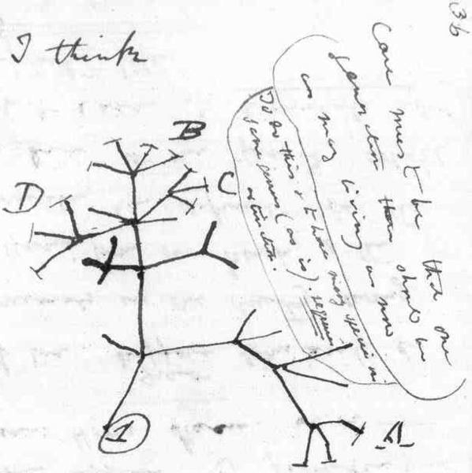
Schools of thought
A. Evolutionary Taxonomy
The basic view was that the best way to understand the evolution of a group is to spend a lifetime learning all one can about the biology of the group.
Many were paleontologists and recognized paraphyletic groups (e.g., Reptilia).
Darwin’s tree

Slide 3
Schools of thought
A. Evolutionary Taxonomy
Advantage – Generated a generation of knowledgeable taxon specialists.
Flaw – Lack of objective methodology and resulting lack of reproducibility.
In spite of a lack of explicit methodology, many of the phylogenies produced by
evolutionary taxonomists have been corroborated over the years.

Slide 4
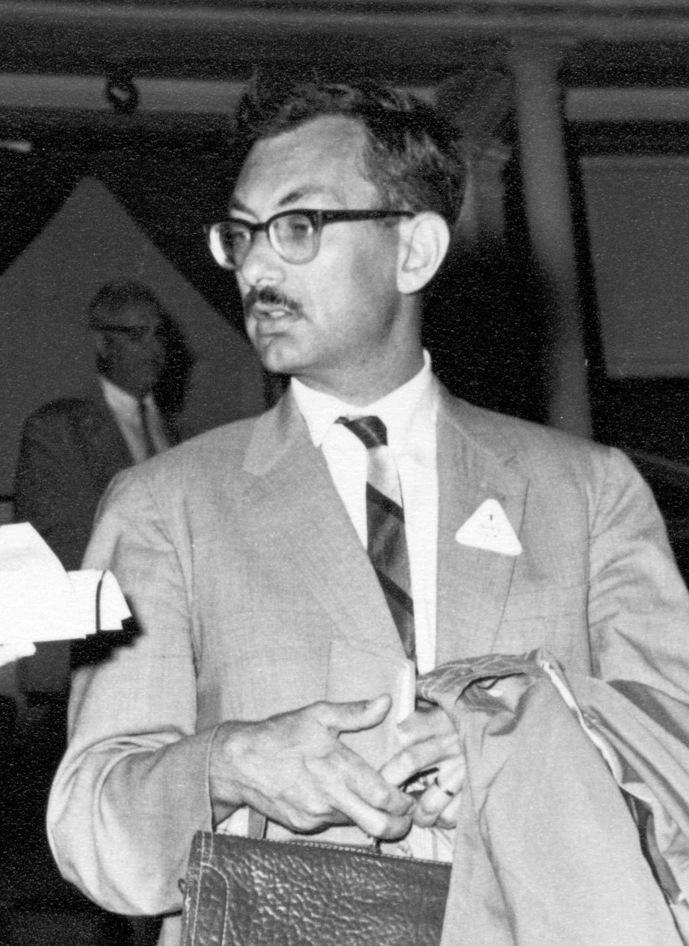

Schools of thought
B. Phenetics
(Numerical Taxonomy)
There is no way to infer the pattern of common ancestry of a group in a scientific manner.
Therefore, we should group (classify) organisms on the basis of overall similarity.
Many modern clustering approaches (UPGMA) owe their origins to
Numerical Taxonomy.
The goal was to produce a phenogram, NOT a phylogeny, that visualized the
hierarchical pattern of overall similarity.

Slide 5
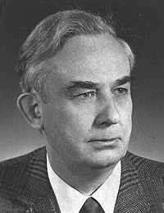
Schools of thought
C. Cladistics
(Phylogenetic Systematics)
It is, in fact, possible to infer common ancestry in a scientific manner.
Attributes that are derived and shared by a set of taxa are prima facie evidence for
exclusive common ancestry (Synapomorphies).
Only derived characters (apomorphies) can be phylogenetically informative, so the
first step is to determine which character states are derived and which are primitive.
Therefore, our classifications must only recognize monophyletic groups.

Slide 6
Schools of thought
C. Cladistics
(Phylogenetic Systematics)
Example:
Phenogram
Cladogram
Synapomorphy of limbs unites tetrapods and sarcopterygian fish, which share
an ancestor not shared by
actinopterygian fish.
The Hennigian approach is to identify synapomorphies to define clades.

Slide 7
Schools of thought
C. Cladistics
(Phylogenetic Systematics)
If we look at many characters, there will be conflict. The only methodology that is
permissible to cladists to resolve such conflicts is the method of maximum parsimony.
The MP tree is that tree which maximizes synapomorphies, and therefore
defines groups following Hennig’s principles.
Pattern cladists – parsimony trees represent pattern of character variation rather
than a phylogeny.
The term “cladists” is a loaded one and Quinn (2017) has identified as many as 7
ways the term is used.

Slide 8

Schools of thought
D. Statistical Phylogenetics
Currently, the dominant paradigm in phylogenetics is that phylogenies are estimated
with uncertainty and that one must quantify that uncertainty.
Which fits the data better?
….and to what degree?
Answers to these questions require the use of statistical models.

