Slide 1
Lecture 3 – Characters: Homology, Morphology
Character by Taxon Matrix
Definition – A character is a trait, feature, or attribute of an organism.
Character states are the various manifestations of a character in a taxon.
Some use the term “Transformation Series” as equivalent to the term character and use the word “character” to refer to the states.
Assumption: Characters are homologous and independent from each other.

Slide 2
Selection of Characters
Focus on characters that exhibit levels of variation that are appropriate in the context of the study at hand.
Study of mammal orders –
Eye color is too variable.
Number of chambers in the heart is constant.
Match characters to the level of universality.
The selection of characters on which to focus prior to collection of data is an
extremely important consideration.
It also represents an enormous source of subjectivity in phylogenetic
analysis that is usually not acknowledged.
Critically, characters used for phylogenetics must be homologous.

Slide 3
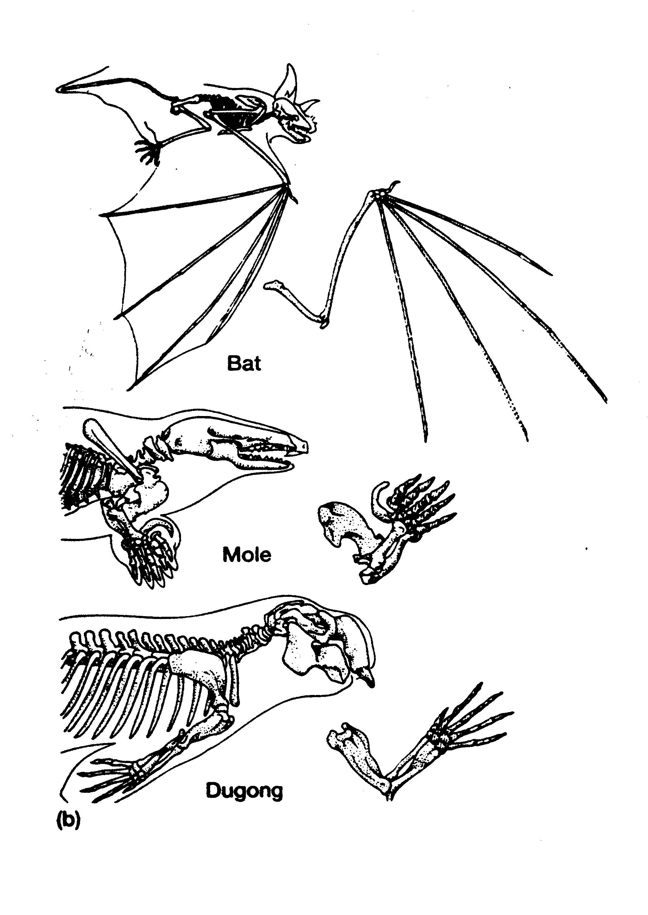
II. Homology
It first became prominent in 1848 due to Richard Owen. “The same organ in different organisms in all its varied forms.”
Modern definition. “Possession by two or more species of a trait inherited from a common ancestor, either with or without modification.”

Slide 4
Criteria
Morphological Criteria
Similarity of position – This includes overall position and position relative to
other structures.
Special similarity – This is a rather vague criterion, but it refers to either similarity
on a finer scale, or perhaps in developmental pathways.
Continuance through intermediate forms (i.e., intermediate fossils).
Phylogenetic Criteria
Are the putatively identical character states indeed synapomorphies that
unite the groups that posses them?
Character congruence either supports or refutes these hypothesized homologies.

Slide 5
Example – Mammalian ear ossicles.
Three middle-ear bones:
Stapes, Incus and Malleus
Other vertebrates have a single
ear ossicle, the stapes
Jaw joint
Hypothesis – The quadrate is homologous to the incus (similarity of position).

Slide 6
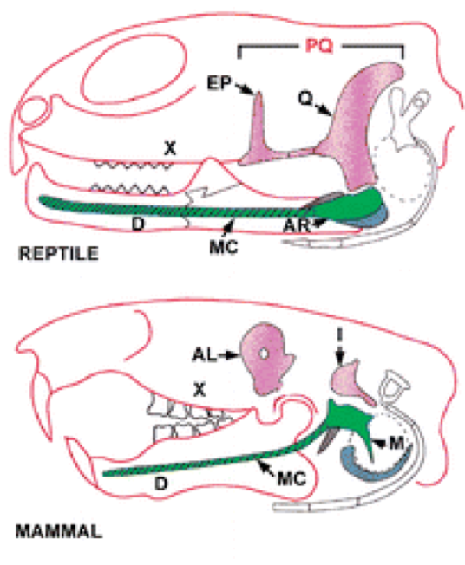
We can test this hypothesis using the other criteria.
Special Similarity
The mammalian incus and non-mammalian quadrate share a common precursor:
each develops as a posterior ossification of the palatoquadrate cartilage.
The mammalian malleus and non-mammalian articular bones share a common precursor:
each develops as a posterior ossification of Meckel’s cartilage.
The homology hypothesis is supported by shared developmental pathway.

Slide 7
We can test this hypothesis using the other criteria.
Continuance through intermediate forms.
Earliest mammals:
quadrate is still present,
but looks just like incus.
Gradual diminution of quadrate
Earliest fossils: Single
ossicle (stapes) & large
quadrate
Continuance criterion corroborates hypothesis further!

Slide 8
III. Coding:
We need to transform our putative hypotheses about character-state variation into our character-by-taxon matrix.
This requires decisions regarding whether to accept multi-state characters,
and whether to order the character states or leave them unordered.
Binary characters : 0 <---> 1
Linear, ordered muiti-state characters: 0 <----> 1 <----> 2 <----> 3
G A
Unordered multistate characters:
C T

Slide 9
III. Coding:
3
non-linear, ordered, multistate characters:
0 1 2
4
Frequently, these are decomposed into a series of binary characters:
0 → 0 0 0 0
1 → 1 0 0 0
2 → 1 1 0 0
3 → 1 1 1 0
4 → 1 1 0 1
Of course, these binarized characters are no longer independent.

Slide 10
IV. Polarity
The Hennigian approach focuses only on synapomorphies.
a priori polarity determination:
common=primitive (not useful),
ontogeny (following von Baer’s Law),
evidence from fossils (as we’ve already exemplified).
outgroup analysis: a taxon (or taxa) included in the analysis that is more distantly
related to the focal taxa, which are called the ingroup, than they are to each other.
A character state that is shared between the outgroup and at least one member
of the ingroup is deemed to be the primitive state for that character.
It became apparent during the early 1980’s though that simply including an
outgroup(s) in an analysis would allow a posteriori polarity determination,
and that these are equivalent (Maddison et al., 1984).

