Slide 1
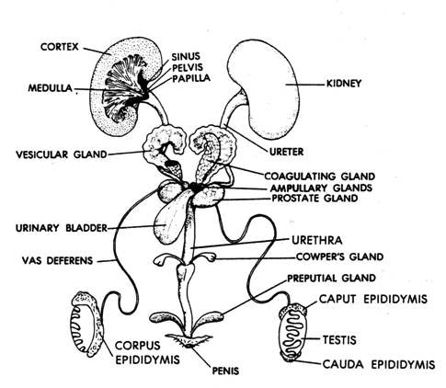
Reproductive Morphology
Male
Semeniferous tubules

Slide 2
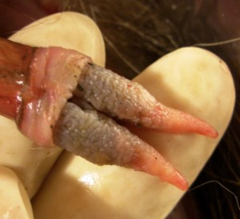
Reproductive Morphology
Male
Position of testes varies:
May remain in abdominal cavity permanently (Monotremes, Xenarthrans, &
most marine mammals)
May reside in abdominal cavity but descend into scrotum during breeding season
through inguinal canal (bats and rodents)
May be permanently housed in scrotum (most primates and terrestrial carnivorans)
Many marsupials have a bifurcate penis:

Slide 3
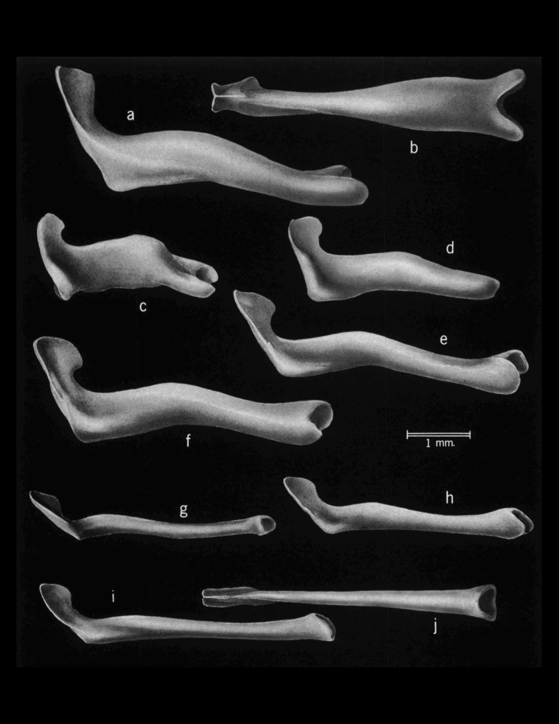
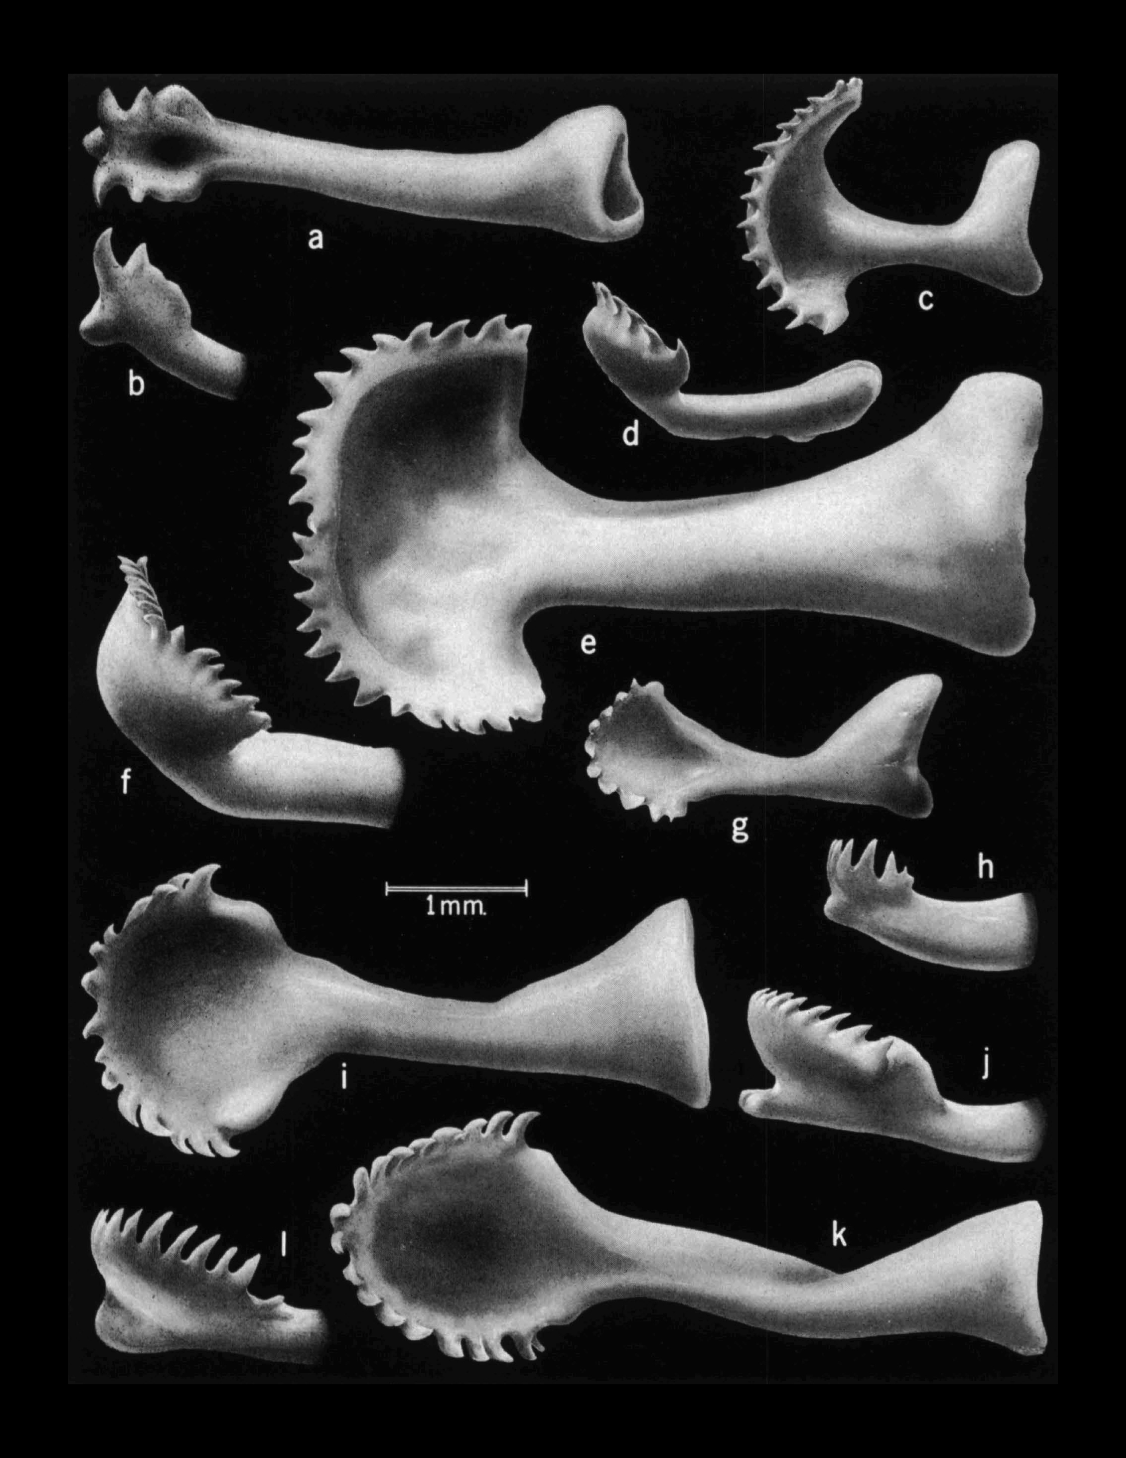
Variation in Bacula
Chipmunks
Ground squirrels

Slide 4
Evolution of Bacula
Afrotheria
Absent
Primates
Present
Rodents
Gained 9 times
Lost 10 times
Chiroptera
Carnivora
Insectivora
Schultz et al. 2016. Int. Comp. Biol., 56:644.

Slide 5
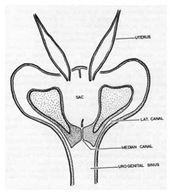
Reproductive Morphology
Female: Marsupials

Slide 6
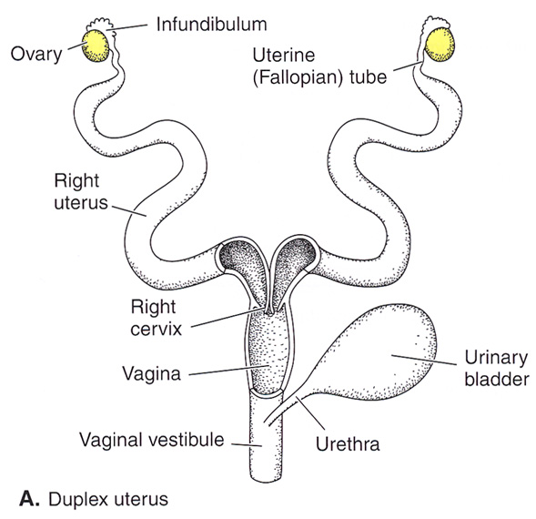
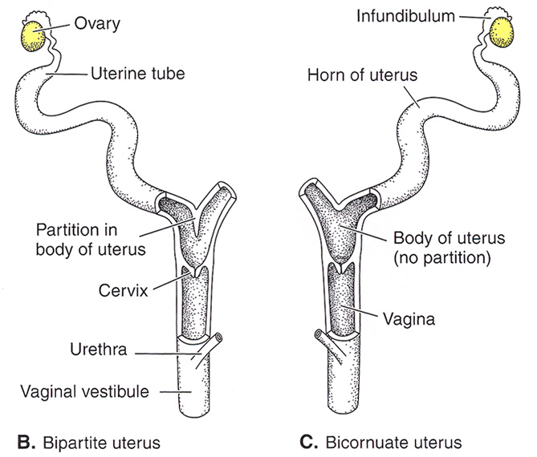
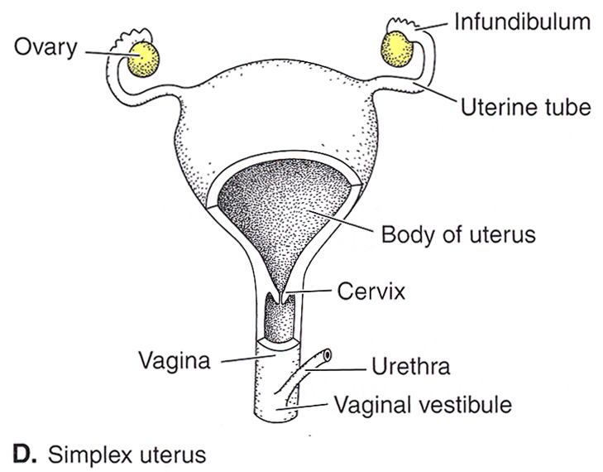
Reproductive Morphology
Female: Eutherians

Slide 7
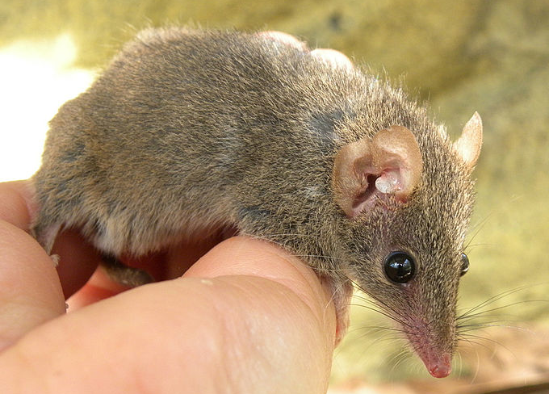
Reproductive Cycles
Almost all mammals are iteroparous - >1 cycle per lifetime
A few insectivorous marsupials are semelparous – 1 cycle per lifetime
Antechinus - Males all die after a single frantic bout of reproduction.
This is driven by extreme sperm competition.
Fisher et al., 2013. Sperm competition drives the evolution of suicidal
reproduction in mammals. PNAS 110:17910-1791

Slide 8
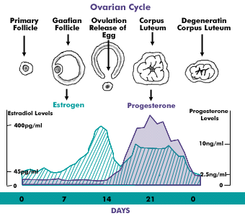
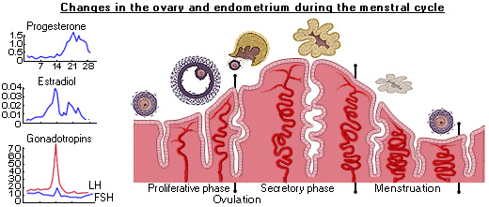
Reproductive Cycles
Estrous Cycle
Ovarian Cycle
Uterine Cycle

Slide 9
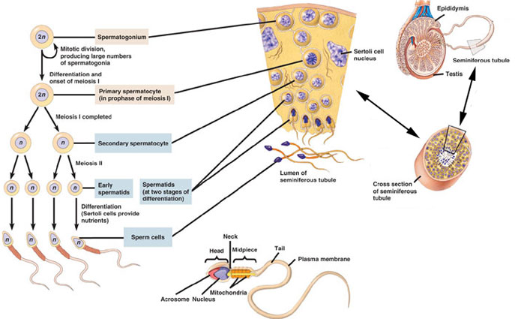
Spermatogenic Cycle

Slide 10
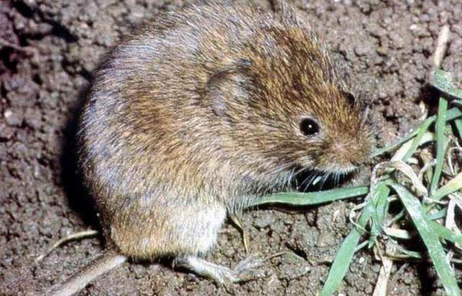
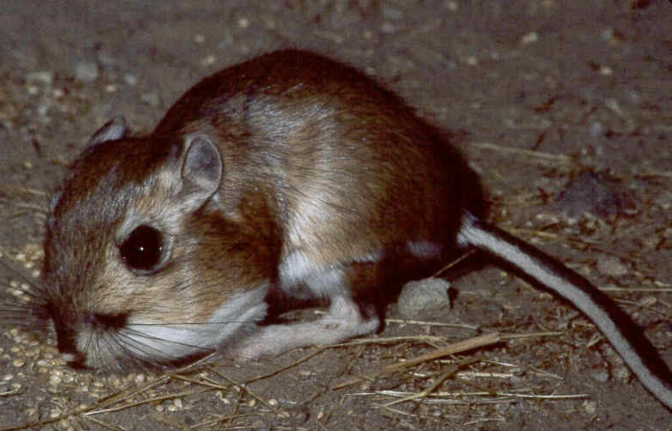
Control of Cyclicity
Primarily, all cycles are under control of pituitary hormones.
Many cues that induce the pituitary to initiate cycles.
Environmental cues operate external to cycles to confer seasonality.
Microtus montanus
Dipodomys ingens

Slide 11
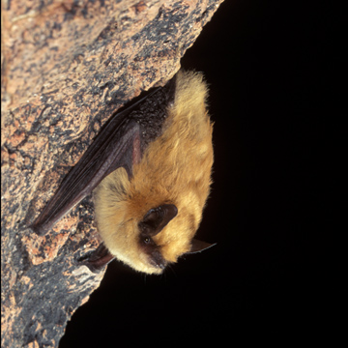
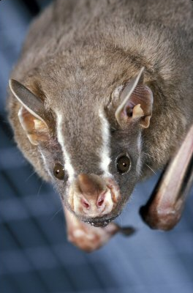
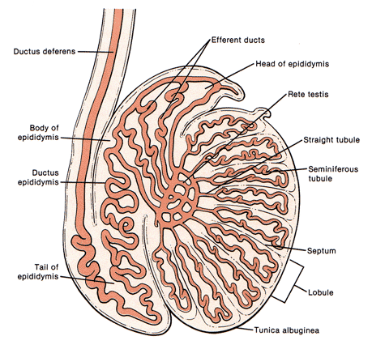
Mechanisms for Optimizing Timing of Birth
1) Delayed fertilization
2) Delayed development
Myotis ciliolabrum (Western small-footed myotis)
Artibeus lituratus (Big fruit-eating bat)

Slide 12
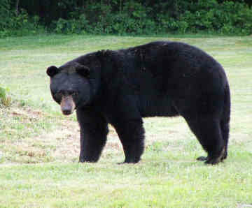
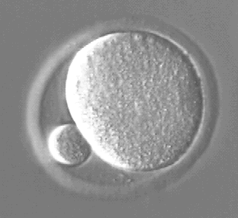
Mechanisms for Optimizing Timing of Birth
3) Delayed implantation (Chiroptera, Carnivora, Xenarthra, Cetartiodactyla,
Rodentia, and Insectivora)
Obligate
Ursus americanus
Zona Pellucida
Facultative
Many Rodents

Slide 13
Mechanisms for Optimizing Timing of Birth
3) Delayed implantation has been studied extensively in Carnivora.
Origin in Carnivora
Lindenfors et al. 2003. Evolution, 57:1952.

Slide 14
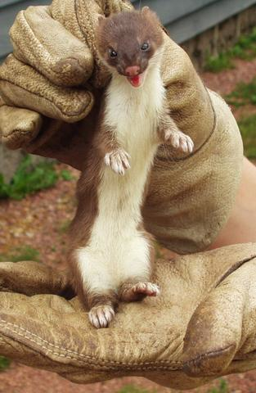
Mechanisms for Optimizing Timing of Birth
3) Delayed implantation within Mustelidea
(Thom et al. 2004. Evolution 58:175)
Mustela erminea
These phylogenies were already out-of-date then.

Slide 15
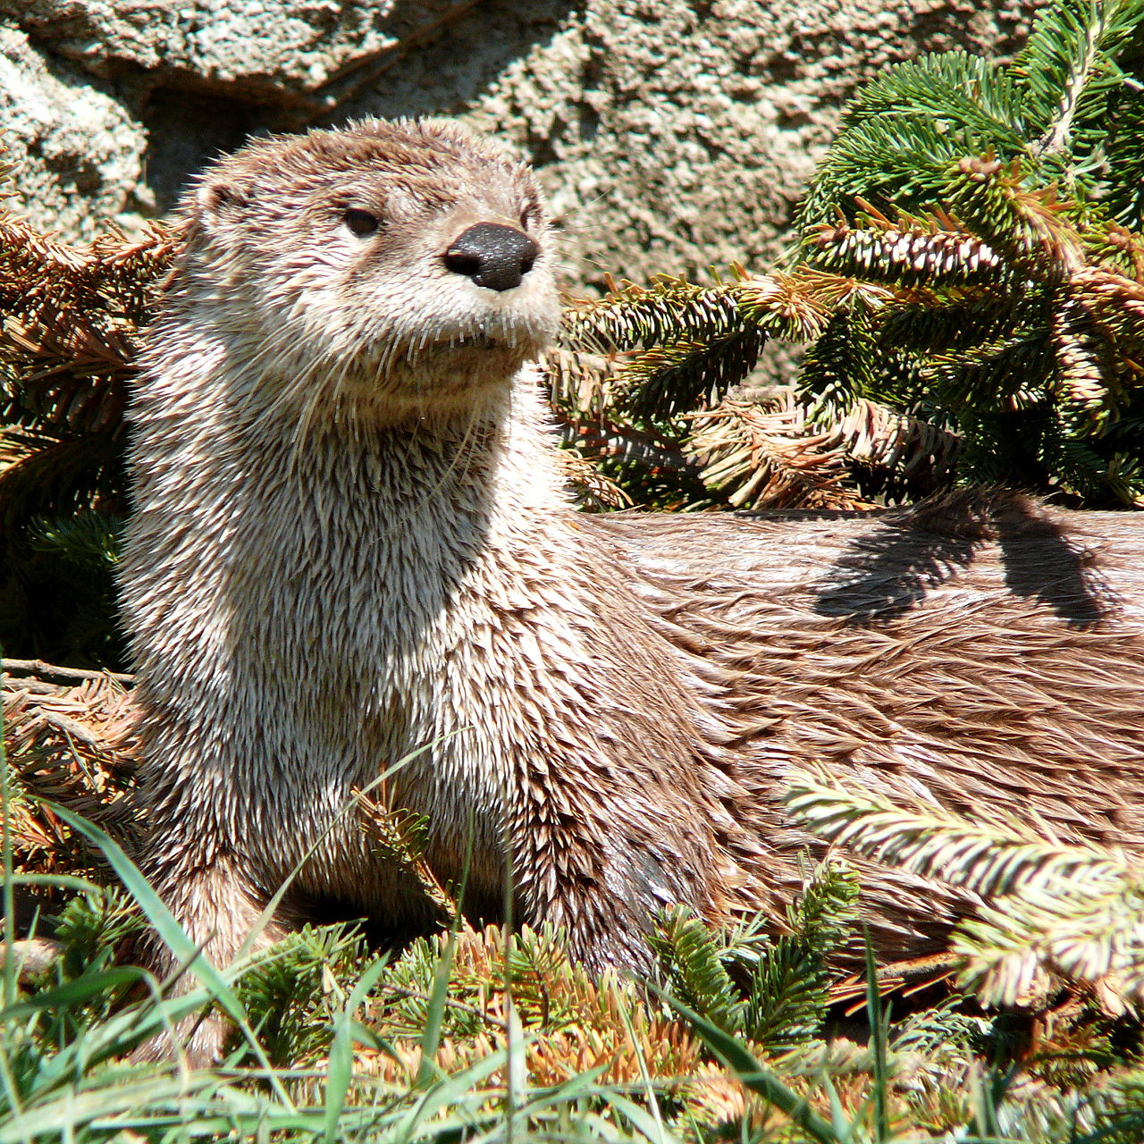
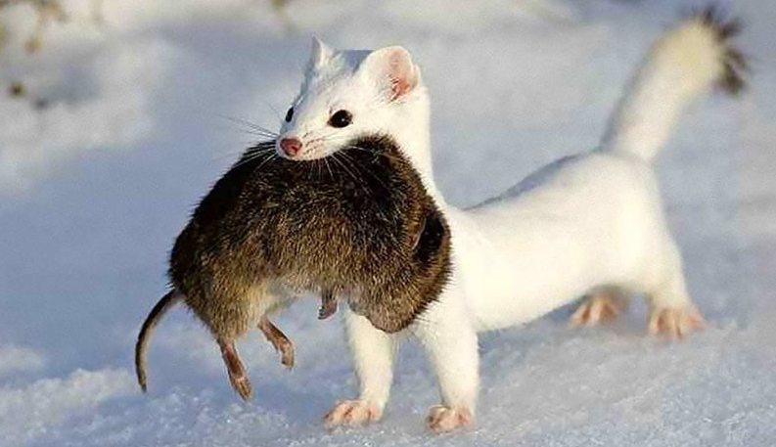
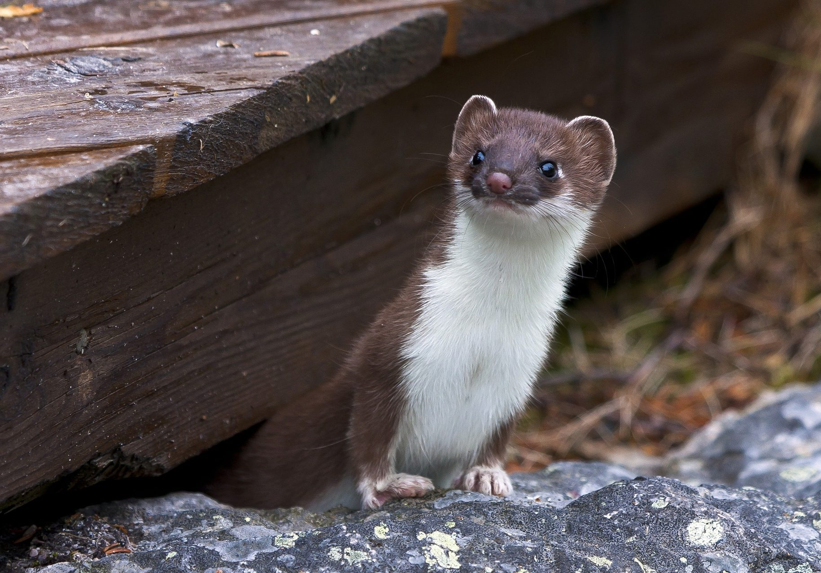
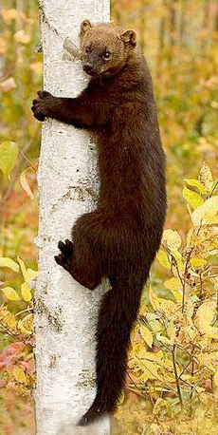
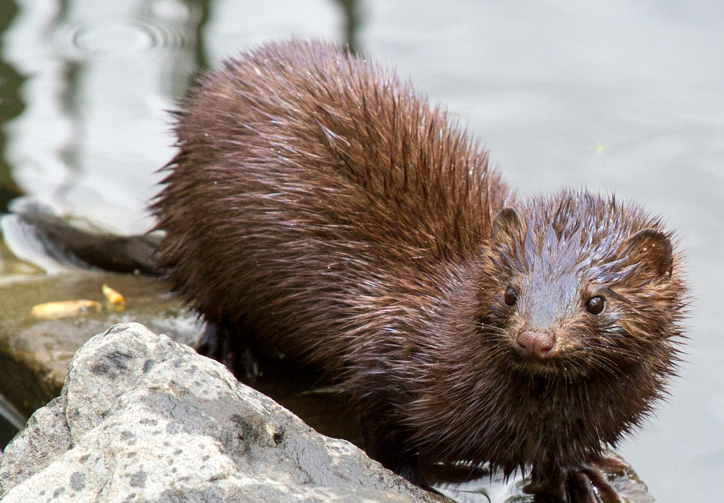
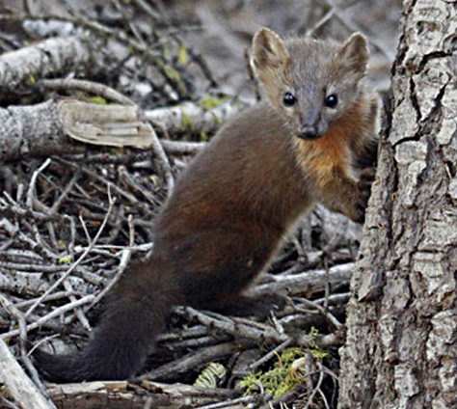
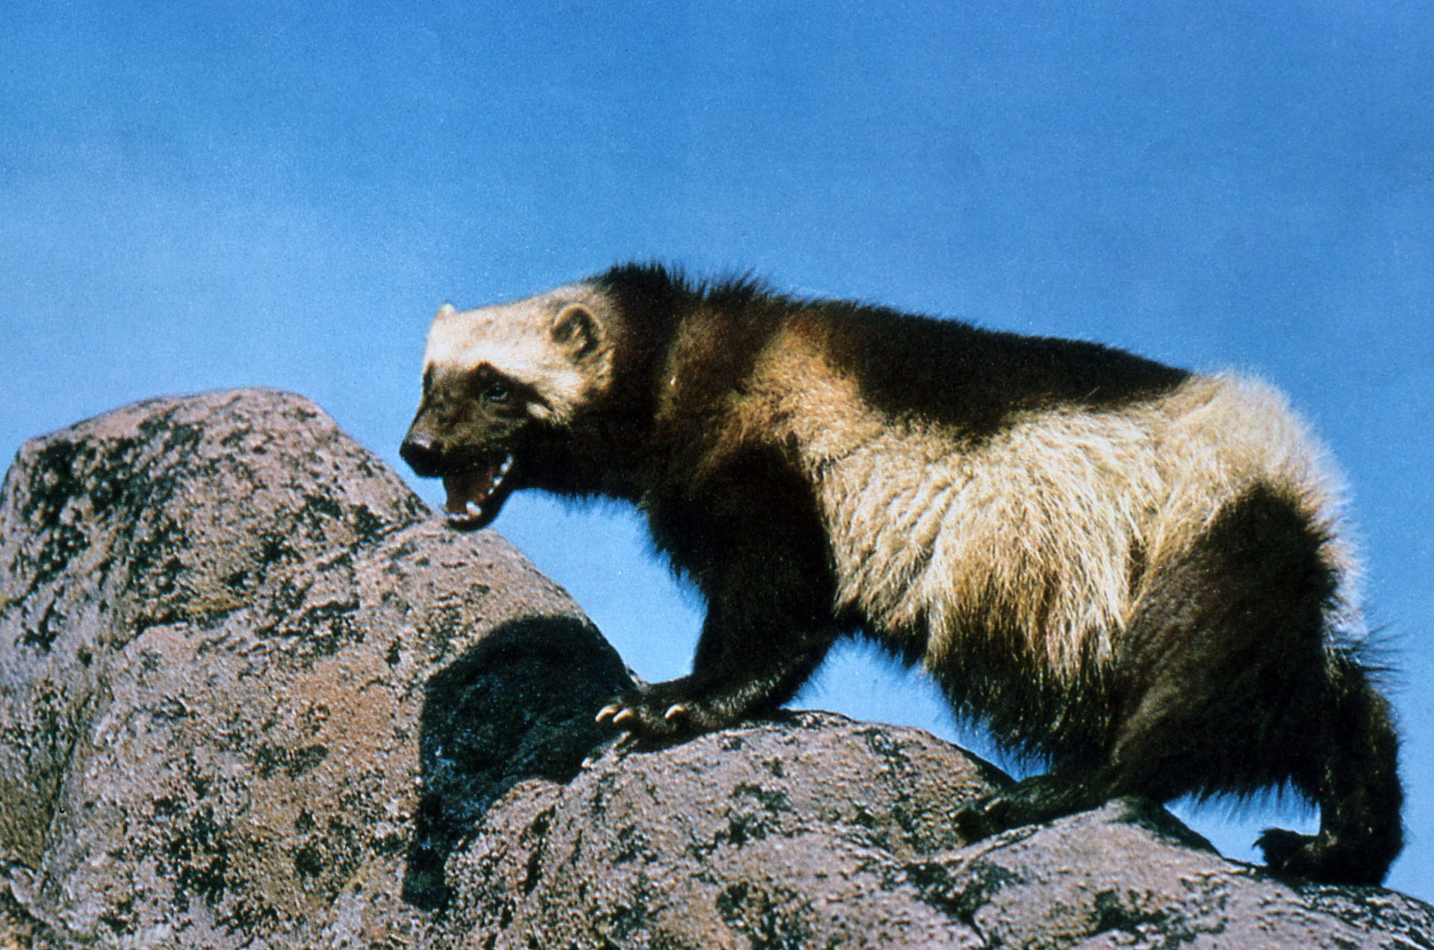
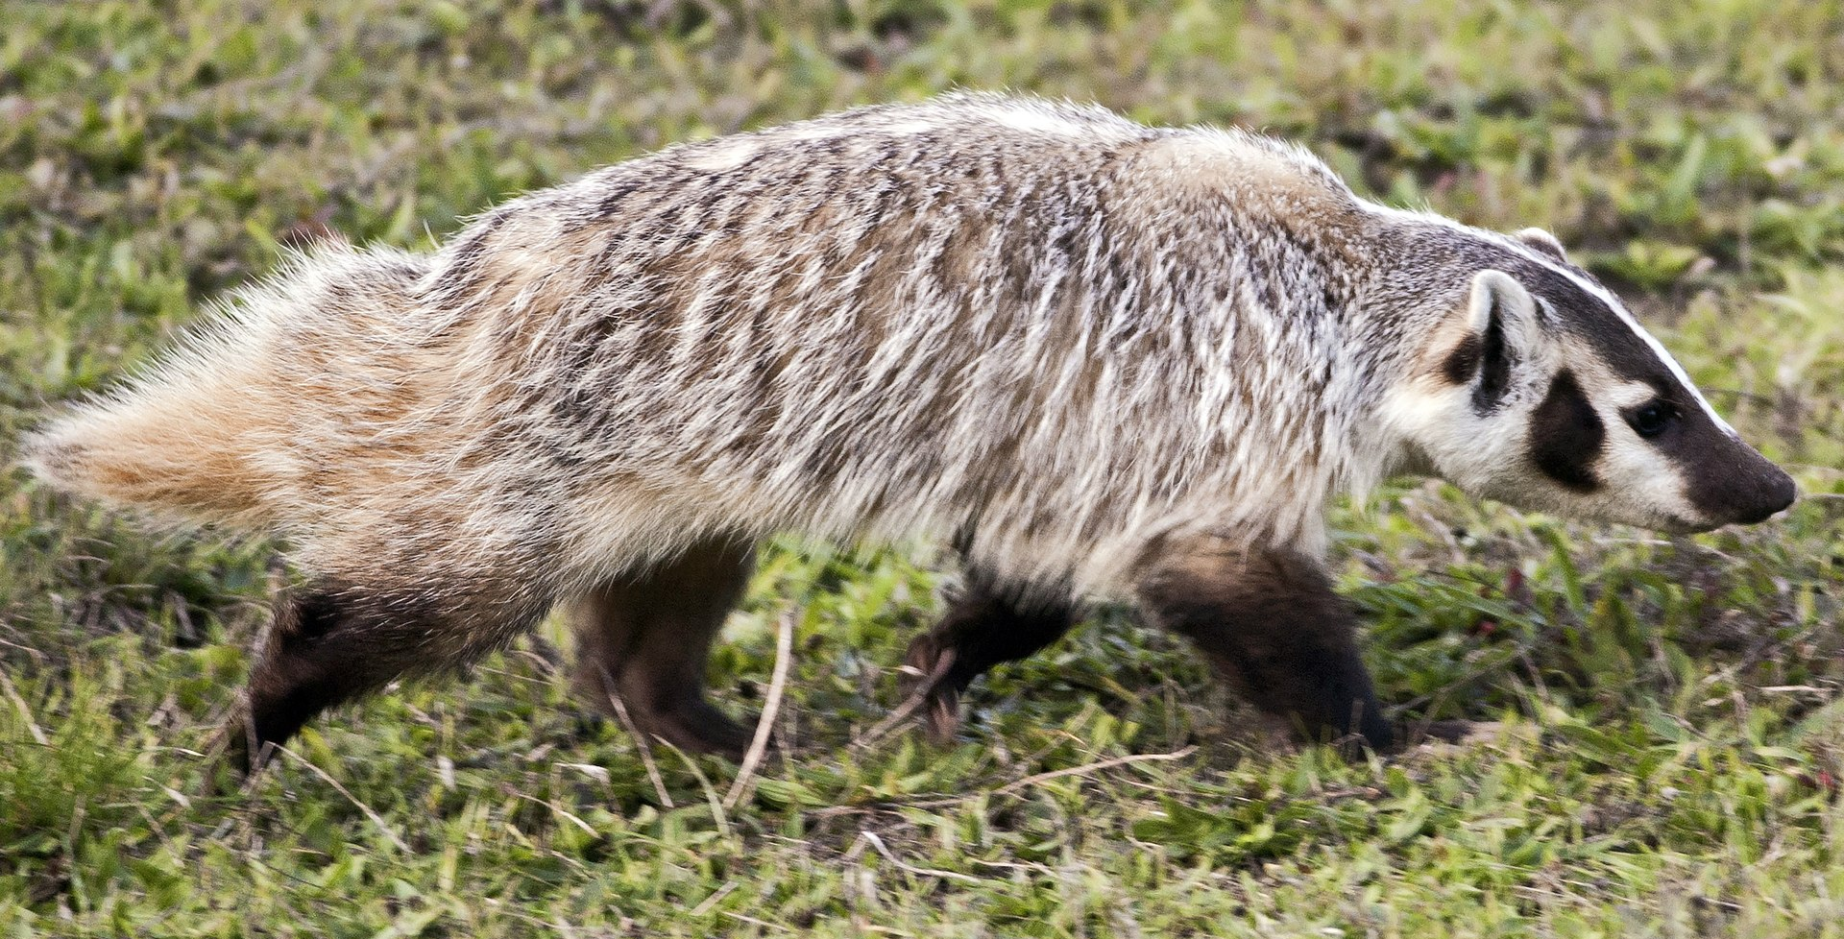
Mechanisms for Optimizing Timing of Birth
3) Delayed implantation within Mustelidea.
Koepfli et al. 2008. BMC Biology, 6:10.
Absent
Ambiguous
Present

Slide 16
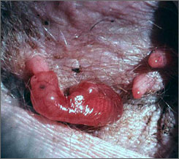
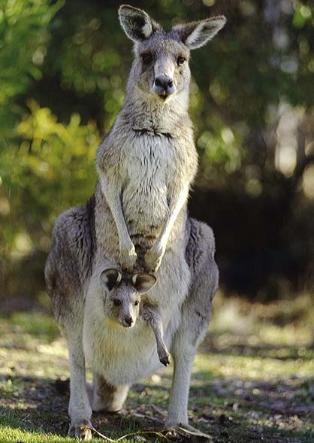
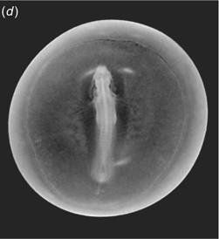
Mechanisms for Optimizing Timing of Birth
4) Embryonic diapause (Macropodids)

