Slide 1
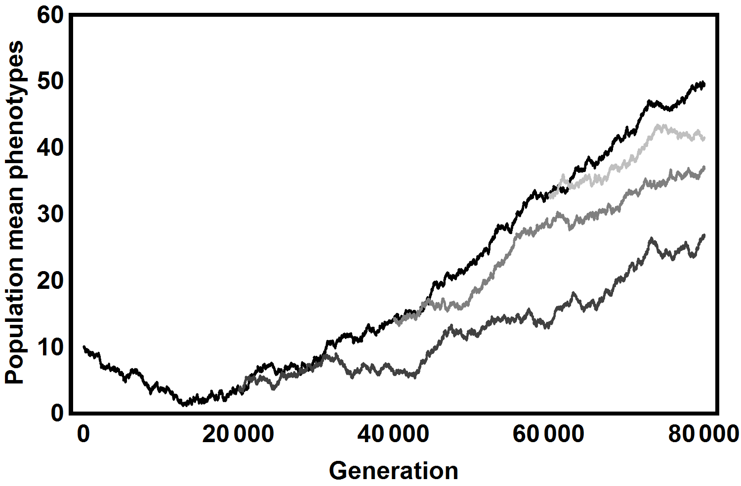
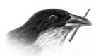
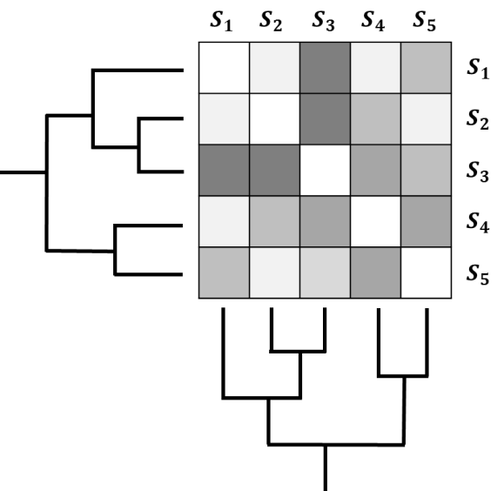
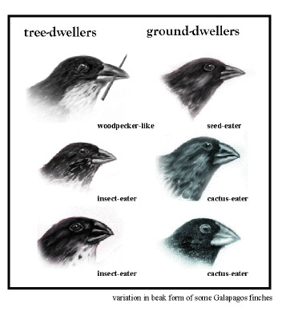




Integrating coevolution into the tree of life
0
$$τ_{1}$$
$$τ_{2}$$
$$τ_{p}$$
Scott L. Nuismer

Slide 2
What is coevolution?
Species 1
Species 2
Coevolution: Reciprocal evolutionary change in interacting species
(Janzen, 1980)
"Thus I can understand how a flower and a bee might slowly become, either simultaneously or one after the other, modified and adapted to each other in the most perfect manner, by the continued preservation of all the individuals which presented slight deviations of structure mutually favourable to each other."
— Charles Darwin, The Origin of Species

Slide 3
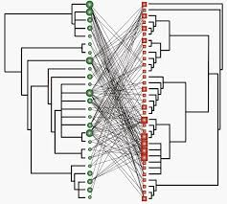
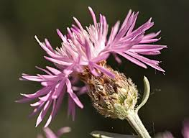
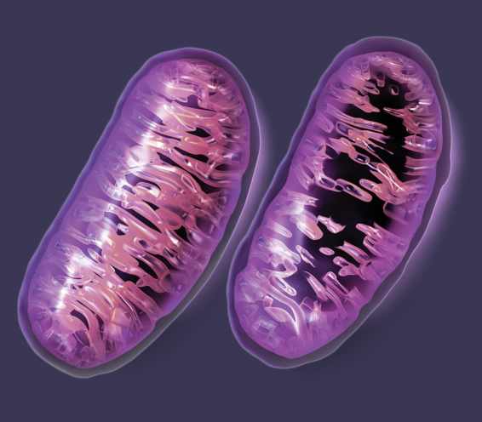
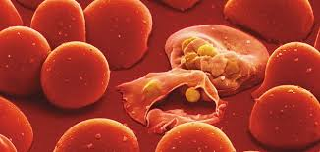
The importance of coevolution
Much of what we know about coevolution comes from mathematical models

Slide 4
A key assumption of coevolutionary theory

Slide 5
A key assumption of comparative methods

Slide 6
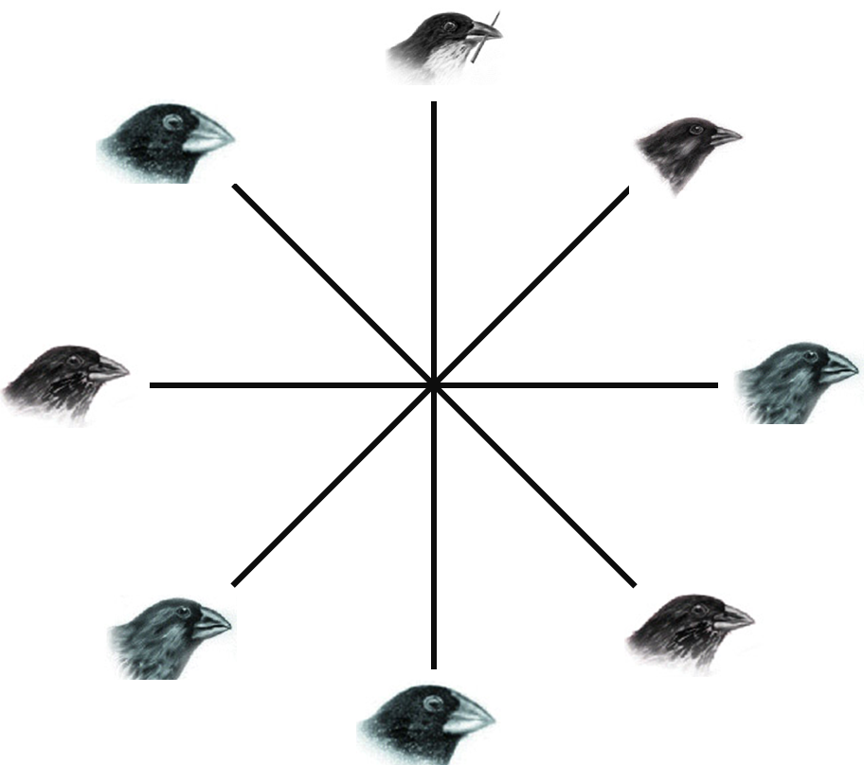
The current state of affairs
Coevolutionary theory ignores phylogeny
Phylogenetic comparative methods ignore coevolution

Slide 7
This raises two important questions
Do coevolution and phylogeny interact to shape contemporary trait values?
Question 1:
Can we predict contemporary rates of interaction?
Question 2:
Our goal is to use a mathematical model to answer these questions

Slide 8
Merging coevolution and evolutionary history
Species 1
+
Species 2

Slide 9
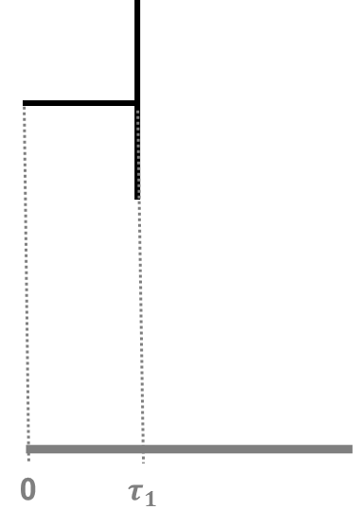
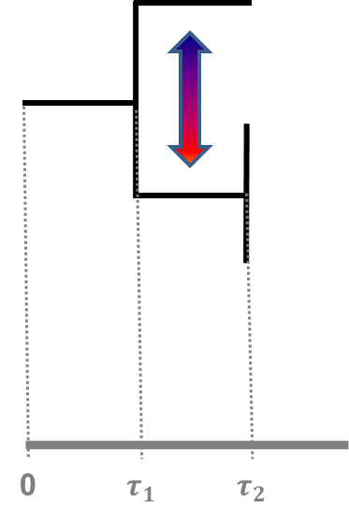
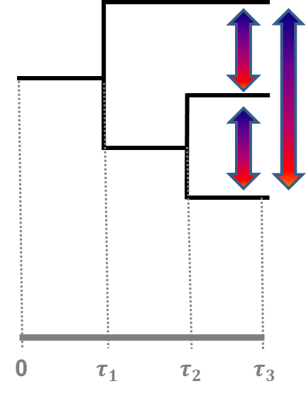



A general modeling approach
First time interval
(no coevolution)
Second time interval
(2-way coevolution)
Third time interval
(3-way coevolution)
Our approach will be agnostic with respect to the process of speciation

Slide 10
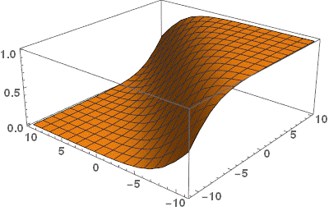
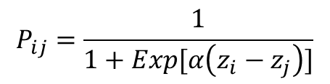



How do traits mediate interactions?
Model 1: Phenotype Differences
How do traits mediate interactions
$$P_{ij}=\frac{1}{1+Exp[α\left(z_{i}−z_{j}\right)]}$$
$$P_{ij}$$
$$z_{i}$$
$$z_{j}$$
Best suited for interactions that depend on interference competition

Slide 11
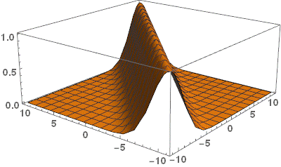




How do traits mediate interactions?
Model 2: Phenotype Matching
How do traits mediate interactions
$P_{i,j}=Exp[−α{\left(z_{i}−z_{j}\right)}^{2}$]
$$P_{i,j}$$
$$z_{j}$$
$$z_{i}$$
Best suited for interactions that depend on exploitation of shared resources

Slide 12
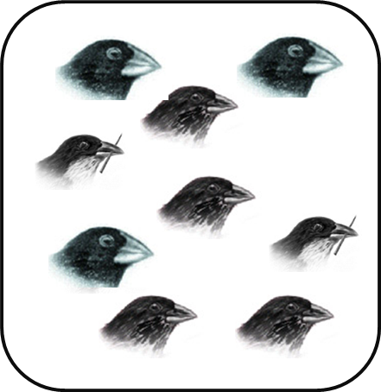
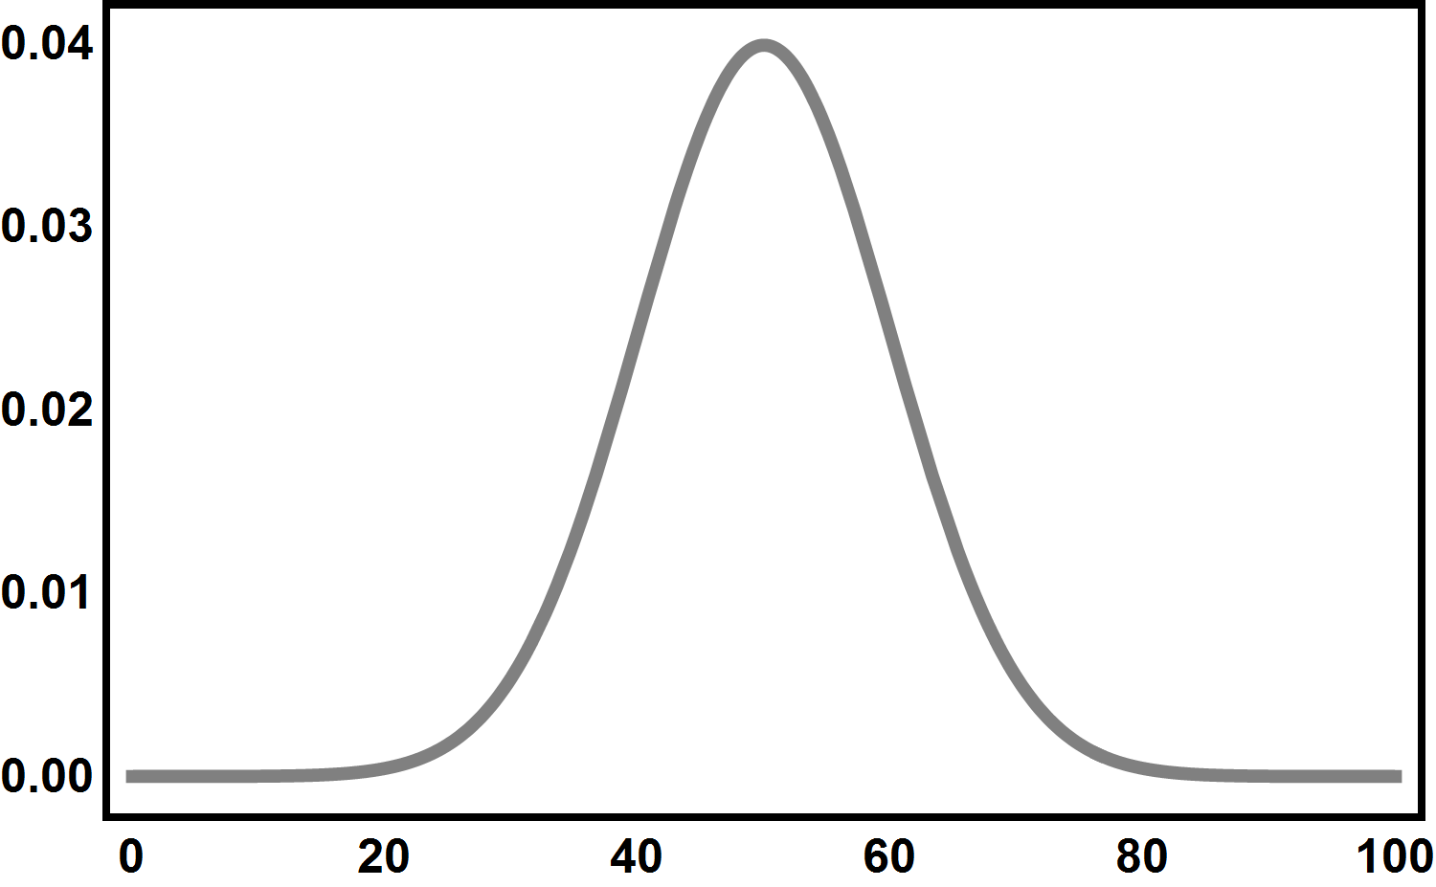


Predicting trait coevolution
Individual fitness
$$W_{i}=1−s_{i}\sum_{j=1}^{n}{f_{j}P_{ij}}$$
Random encounters among individuals
Gaussian trait distributions
Classical quantitative genetics
$$∆{\overline{z}}_{i}=G_{i}\left(\frac{1}{{\overline{W}}_{i}}\frac{∂{\overline{W}}_{i}}{∂{\overline{z}}_{i}}\right)+ε_{i}$$

Slide 13
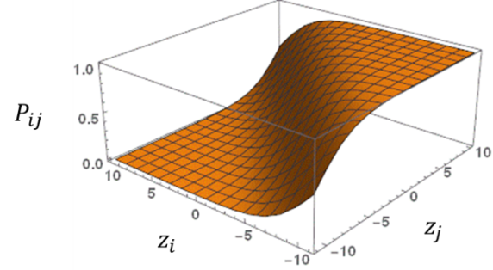
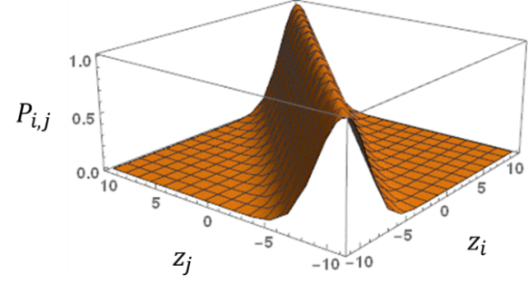
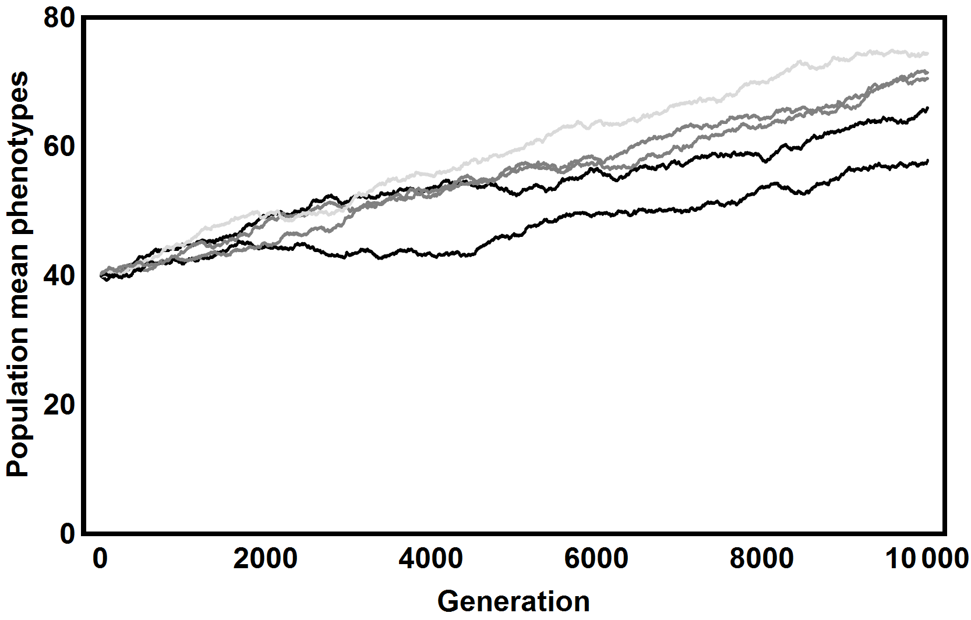
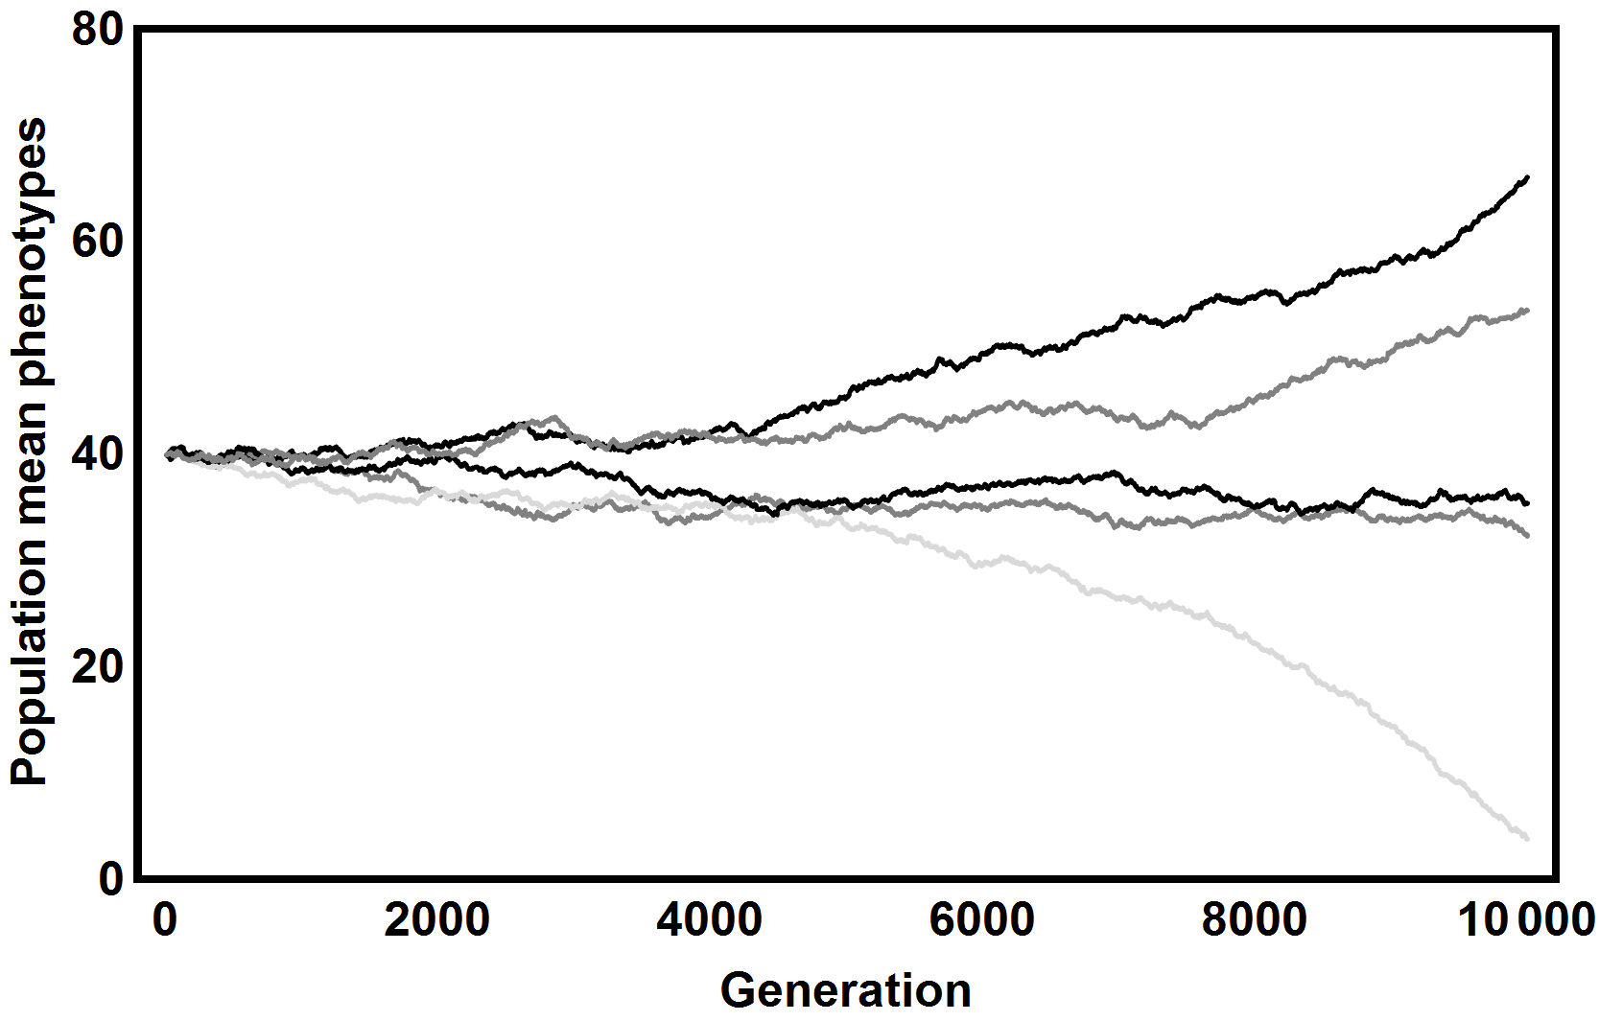


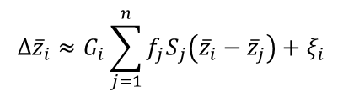
Coevolutionary dynamics on a star phylogeny
Phenotype differences
Phenotype matching
How do traits mediate interactions
How do traits evolve?
$$∆{\overline{z}}_{i}≈G_{i}\sum_{j=1}^{n}{{f_{j}S}_{j}}+ξ_{i}$$
$$∆{\overline{z}}_{i}≈G_{i}\sum_{j=1}^{n}{{f_{j}S}_{j}\left({\overline{z}}_{i}−{\overline{z}}_{j}\right)}+ξ_{i}$$

Slide 14
Integrating evolutionary history:
Phenotype differences
How do traits mediate interactions
$$P_{ij}=\frac{1}{1+Exp[α\left(z_{i}−z_{j}\right)]}$$
$$P_{ij}$$
$$z_{i}$$
$$z_{j}$$
Best suited for interactions that depend on interference competition

Slide 15






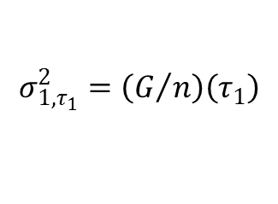
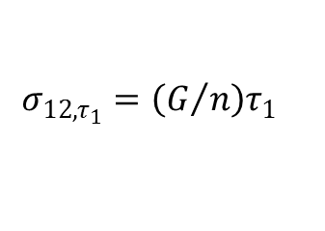
Integrating evolutionary history
First interval:
After speciation
$$μ_{1,τ_{1}}=μ_{1,0}$$
Before speciation
$$μ_{2,τ_{1}}=μ_{1,0}$$
$$μ_{1,τ_{1}}=μ_{1,0}$$
$$σ_{1,τ_{1}}^{2}=\left(G/n\right)τ_{1}$$
$$σ_{1,τ_{1}}^{2}=\left(G/n\right)\left(τ_{1}\right)$$
$$σ_{2,τ_{1}}^{2}=\left(G/n\right)τ_{1}$$
$$σ_{12,τ_{1}}=\left(G/n\right)τ_{1}$$
0
$$τ_{1}$$

Slide 16




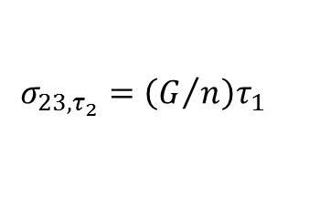
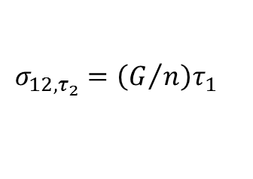


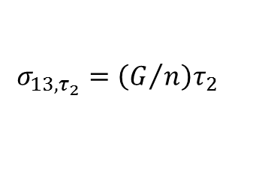


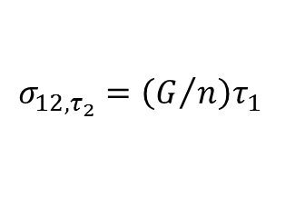



Integrating evolutionary history
After speciation
Second interval:
$$μ_{1,τ_{2}}=μ_{1,0}+GS\left(τ_{2}−τ_{1}\right)$$
Before speciation
$$μ_{2,τ_{2}}=μ_{1,0}+GS\left(τ_{2}−τ_{1}\right)$$
$$μ_{1,τ_{2}}=μ_{1,0}+GS\left(τ_{2}−τ_{1}\right)$$
$$μ_{3,τ_{2}}=μ_{1,0}+GS\left(τ_{2}−τ_{1}\right)$$
$$μ_{2,τ_{2}}=μ_{1,0}+GS\left(τ_{2}−τ_{1}\right)$$
$$σ_{1,τ_{2}}^{2}=\left(G/n\right)τ_{2}$$
$$σ_{1,τ_{2}}^{2}=\left(G/n\right)τ_{2}$$
$$σ_{2,τ_{2}}^{2}=\left(G/n\right)τ_{2}$$
$$σ_{2,τ_{2}}^{2}=\left(G/n\right)τ_{2}$$
$$σ_{3,τ_{2}}^{2}=\left(G/n\right)τ_{2}$$
$$σ_{12,τ_{2}}=\left(G/n\right)τ_{1}$$
$$σ_{12,τ_{2}}=\left(G/n\right)τ_{1}$$
$$σ_{13,τ_{2}}=\left(G/n\right)τ_{2}$$
$$σ_{23,τ_{2}}=\left(G/n\right)τ_{1}$$
0
$$τ_{1}$$
$$τ_{2}$$

Slide 17
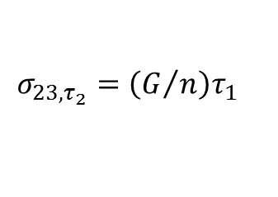


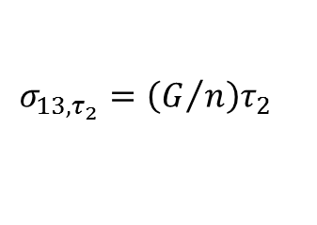




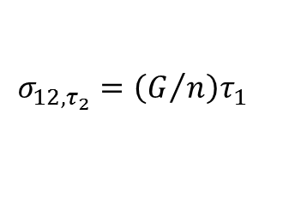




Integrating evolutionary history
Third interval:
$$μ_{1,τ_{2}}=μ_{1,0}+GS\left(τ_{3}−τ_{1}\right)$$
$$μ_{2,τ_{2}}=μ_{1,0}+GS\left(τ_{3}−τ_{1}\right)$$
$$μ_{3,τ_{2}}=μ_{1,0}+GS\left(τ_{3}−τ_{1}\right)$$
$$⋯$$
$$σ_{1,τ_{2}}^{2}=\left(G/n\right)τ_{3}$$
$$σ_{2,τ_{2}}^{2}=\left(G/n\right)τ_{3}$$
$$σ_{3,τ_{2}}^{2}=\left(G/n\right)τ_{3}$$
$$σ_{12,τ_{2}}=\left(G/n\right)τ_{1}$$
$$σ_{13,τ_{2}}=\left(G/n\right)τ_{2}$$
$$σ_{23,τ_{2}}=\left(G/n\right)τ_{1}$$
0
$$τ_{1}$$
$$τ_{2}$$
$$τ_{3}$$
This result can be easily generalized for any phylogeny

Slide 18


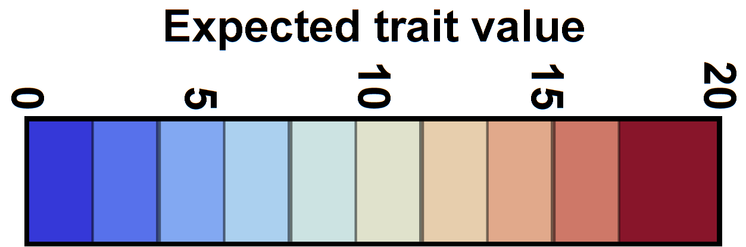

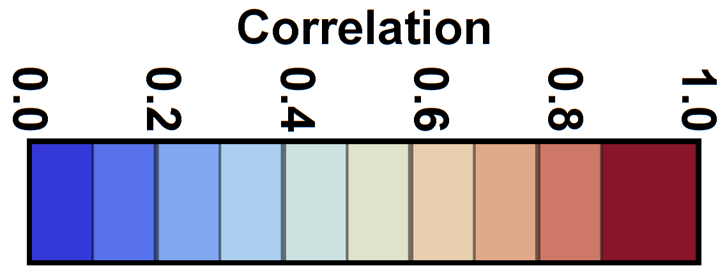
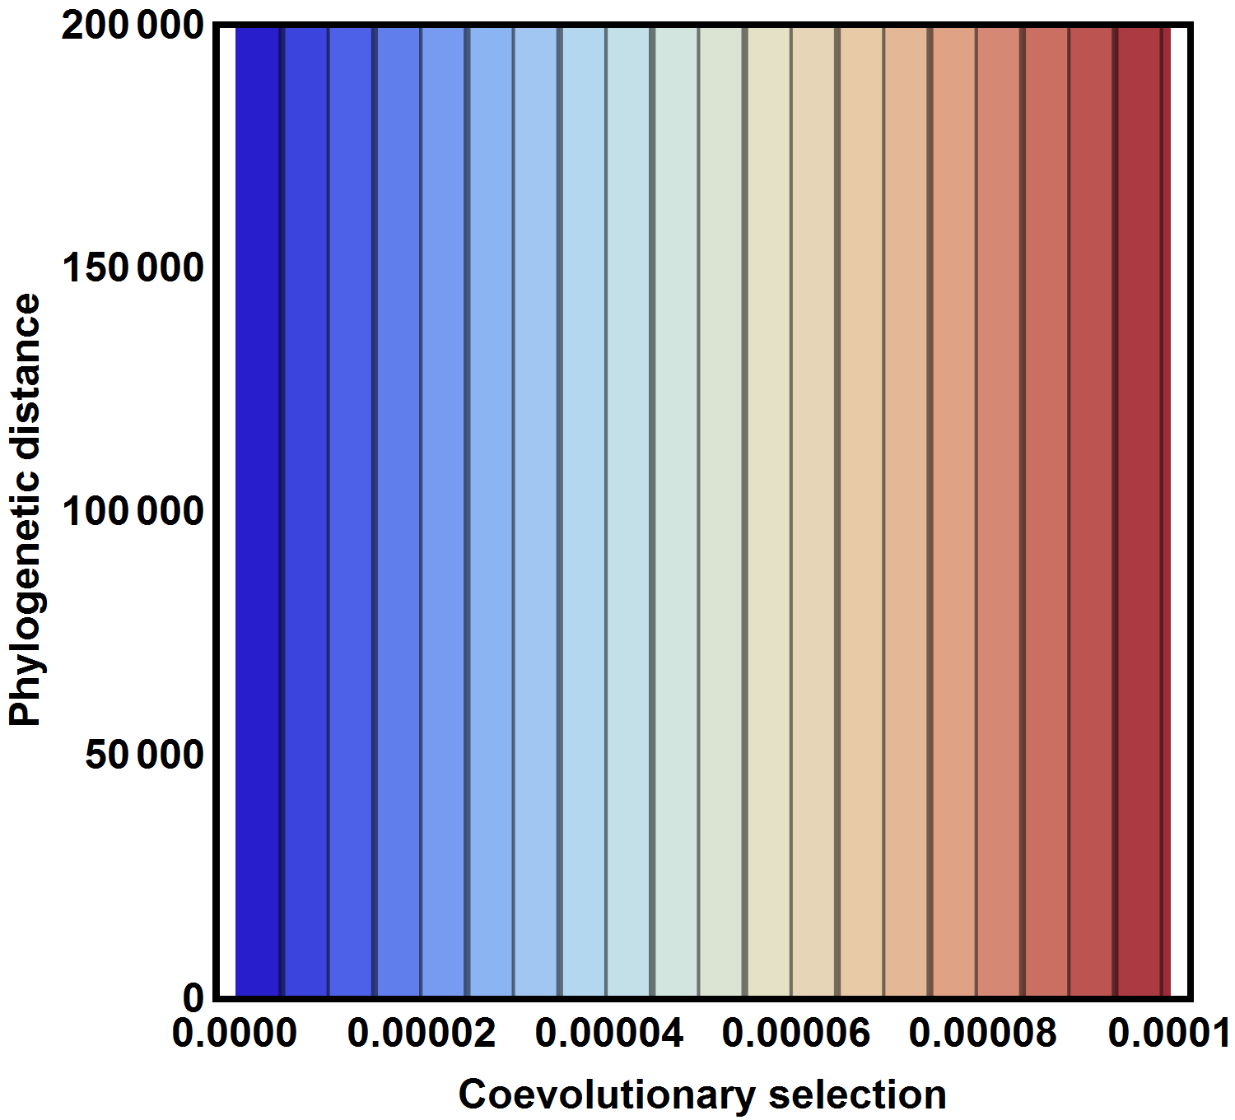
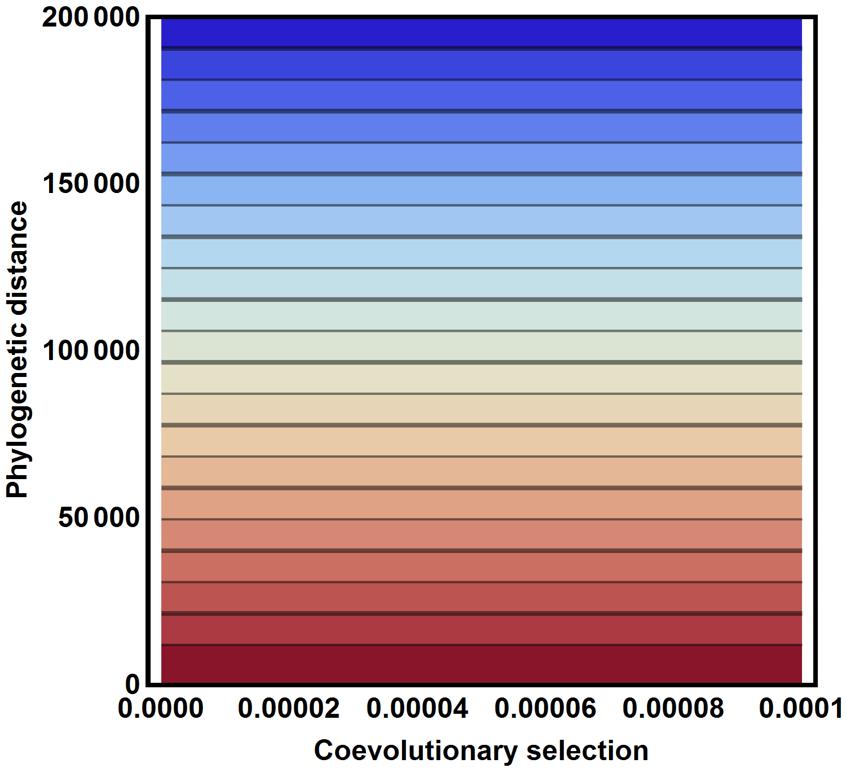
Coevolution and phylogeny do not interact

Slide 19
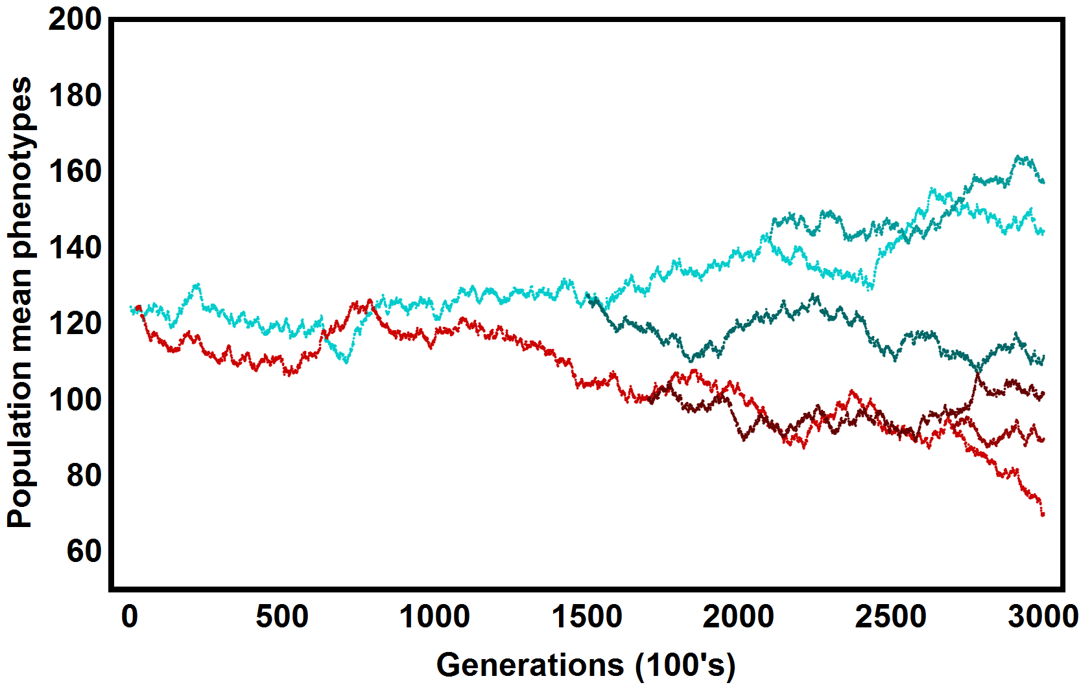




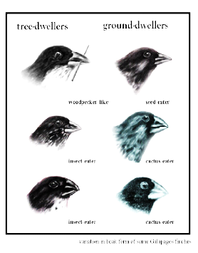
Phylogeny explains phenotypic similarity

Slide 20
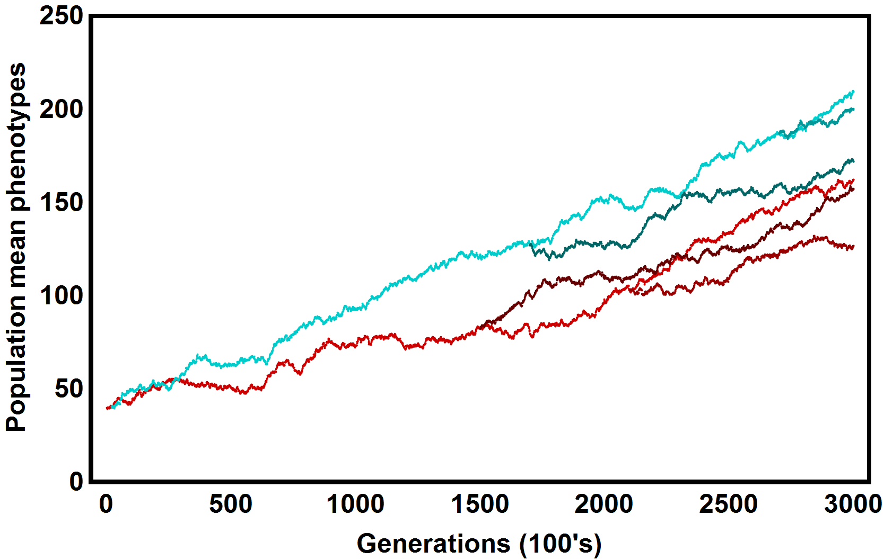
Coevolution explains expected trait values

Slide 21




Contemporary interactions can be predicted
Expected outcome?
Expected asymmetry?
How do traits mediate interactions
How do traits evolve?
$${\hat{P}}_{ij}≈\frac{1}{2}$$
$$\hat{A}≈\frac{α^{2}}{2}\frac{G}{n}\left(τ_{p}−τ_{ij}\right)$$

Slide 22
Integrating evolutionary history:
Phenotype matching
How do traits mediate interactions
$P_{i,j}=Exp[−α{\left(z_{i}−z_{j}\right)}^{2}$]
$$P_{i,j}$$
$$z_{j}$$
$$z_{i}$$
Best suited for interactions that depend on exploitation of shared resources

Slide 23
Integrating evolutionary history
First interval:
After speciation
$$μ_{1,τ_{1}}=μ_{1,0}$$
Before speciation
$$μ_{2,τ_{1}}=μ_{1,0}$$
$$μ_{1,τ_{1}}=μ_{1,0}$$
$$σ_{1,τ_{1}}^{2}=\left(G/n\right)τ_{1}$$
$$σ_{1,τ_{1}}^{2}=\left(G/n\right)\left(τ_{1}\right)$$
$$σ_{2,τ_{1}}^{2}=\left(G/n\right)τ_{1}$$
$$σ_{12,τ_{1}}=\left(G/n\right)τ_{1}$$
0
$$τ_{1}$$

Slide 24














Integrating evolutionary history
After speciation
Second interval:
$$μ_{1,τ_{2}}=μ_{1,0}$$
$$μ_{2,τ_{2}}=μ_{1,0}$$
Before speciation
$$μ_{3,τ_{2}}=μ_{1,0}$$
$$μ_{1,τ_{2}}=μ_{1,0}$$
$$σ_{1,τ_{2}}^{2}=\frac{G\left(−1+e^{4S\left(τ_{2}−τ_{1}\right)}+4S\left(τ_{1}+τ_{2}\right)\right)}{8nS}$$
$$μ_{2,τ_{2}}=μ_{1,0}$$
$$σ_{2,τ_{2}}^{2}=\frac{G\left(−1+e^{4S\left(τ_{2}−τ_{1}\right)}+4S\left(τ_{1}+τ_{2}\right)\right)}{8nS}$$
$$σ_{1,τ_{2}}^{2}=\frac{G\left(−1+e^{4S\left(τ_{2}−τ_{1}\right)}+4S\left(τ_{1}+τ_{2}\right)\right)}{8nS}$$
$$σ_{3,τ_{2}}^{2}=\frac{G\left(−1+e^{4S\left(τ_{2}−τ_{1}\right)}+4S\left(τ_{1}+τ_{2}\right)\right)}{8nS}$$
$$σ_{2,τ_{2}}^{2}=\frac{G\left(−1+e^{4S\left(τ_{2}−τ_{1}\right)}+4S\left(τ_{1}+τ_{2}\right)\right)}{8nS}$$
$$σ_{12,τ_{2}}=\frac{G\left(1−e^{4S\left(τ_{2}−τ_{1}\right)}+4S\left(τ_{1}+τ_{2}\right)\right)}{8nS}$$
$$σ_{12,τ_{2}}=\frac{G\left(1−e^{4S\left(τ_{2}−τ_{1}\right)}+4S\left(τ_{1}+τ_{2}\right)\right)}{8nS}$$
$$σ_{13,τ_{2}}=\frac{G\left(1−e^{4S\left(τ_{2}−τ_{1}\right)}+4S\left(τ_{1}+τ_{2}\right)\right)}{8nS}$$
$$σ_{23,τ_{2}}=\frac{G\left(1−e^{4S\left(τ_{2}−τ_{1}\right)}+4S\left(τ_{1}+τ_{2}\right)\right)}{8nS}$$
0
$$τ_{1}$$
$$τ_{2}$$

Slide 25



Integrating evolutionary history
Third interval:
$$μ_{1,τ_{3}}=μ_{1,0}$$
$$μ_{2,τ_{3}}=μ_{1,0}$$
$$μ_{3,τ_{3}}=μ_{1,0}$$
$$σ_{1,τ_{3}}^{2}=\frac{G(−17+ⅇ^{4S(τ_{2}−τ_{1})}−4ⅇ^{\frac{3}{2}S(τ_{3}−τ_{2})}+12ⅇ^{3S(τ_{3}−τ_{2})}+4ⅇ^{S(τ_{2}+3τ_{3}−4τ_{1})}+4ⅇ^{\frac{1}{2}S(5τ_{2}+3τ_{3}−8τ_{1})}+12S(3τ_{1}+τ_{2}+2τ_{3}))}{72nS}$$
$$σ_{2,τ_{3}}^{2}=\frac{G(−17+ⅇ^{4S\left(τ_{2}−τ_{1}\right)}−8ⅇ^{\frac{3}{2}S\left(τ_{3}−τ_{2}\right)}+16ⅇ^{S\left(τ_{2}+3τ_{3}−4τ_{1}\right)}−8ⅇ^{\frac{1}{2}S(5τ_{2}+3τ_{3}−8τ_{1})}+12S(3τ_{1}+τ_{2}+2τ_{3}))}{72nS}$$
$$σ_{3,τ_{3}}^{2}=\frac{G(−17+ⅇ^{4S(τ_{2}−τ_{1})}−4ⅇ^{\frac{3}{2}S(τ_{3}−τ_{2})}+12ⅇ^{3S(τ_{3}−τ_{2})}+4ⅇ^{S(τ_{2}+3τ_{3}−4τ_{1})}+4ⅇ^{\frac{1}{2}S(5τ_{2}+3τ_{3}−8τ_{1})}+12S(3τ_{1}+τ_{2}+2τ_{3}))}{72nS}$$
$$σ_{12,τ_{3}}=\frac{G(7+ⅇ^{4S\left(τ_{2}−τ_{1}\right)}+2ⅇ^{\frac{3}{2}S\left(τ_{3}−τ_{2}\right)}−8ⅇ^{S\left(τ_{2}+3τ_{3}−4τ_{1}\right)}−2ⅇ^{\frac{1}{2}S(5τ_{2}+3τ_{3}−8τ_{1})}+12S(3τ_{1}+τ_{2}+2τ_{3}))}{72nS}$$
$$σ_{13,τ_{2}}=\frac{G(7+ⅇ^{4S\left(τ_{2}−τ_{1}\right)}−4ⅇ^{\frac{3}{2}S\left(τ_{3}−τ_{2}\right)}−12ⅇ^{3S(τ_{3}−τ_{2})}+4ⅇ^{S(τ_{2}+3τ_{3}−4τ_{1})}+4ⅇ^{\frac{1}{2}S(5τ_{2}+3τ_{3}−8τ_{1})}+12S(3τ_{1}+τ_{2}+2τ_{3}))}{72nS}$$
$$σ_{23,τ_{3}}=\frac{G(7+ⅇ^{4S\left(τ_{2}−τ_{1}\right)}+2ⅇ^{\frac{3}{2}S\left(τ_{3}−τ_{2}\right)}−8ⅇ^{S\left(τ_{2}+3τ_{3}−4τ_{1}\right)}−2ⅇ^{\frac{1}{2}S(5τ_{2}+3τ_{3}−8τ_{1})}+12S(3τ_{1}+τ_{2}+2τ_{3}))}{72nS}$$
0
$$τ_{1}$$
$$τ_{2}$$
$$τ_{3}$$
Unfortunately, this result cannot easily be generalized

Slide 26



Coevolution and phylogeny interact

Slide 27
Phylogeny creates a template of phenotypic similarity

Slide 28

And coevolution modifies this template

Slide 29


Contemporary interactions can be predicted
Expected intensity of competition
(without coevolution)
Expected intensity of competition
(with coevolution)
If we also have information about the historical strength of coevolution

Slide 30



Conclusion 1: Coevolution leaves a signature

Slide 31


Conclusion 2: Interactions can be predicted
We can predict asymmetries
We can predict intensity
How do traits evolve?

Slide 32

Acknowledgements
Funding
National Science Foundation
Luke Harmon

